Slide 1

Group 6 : Snake.py
MIS 6382.503
Data Visualization with Python Job Application at Apple, Boeing & Siemens
Presented By:
Kevin Wo(KXV230027)
Lalit Kolhe(LKK230001)
Manjot Singh(MXS230004)
Punya Anand(PIA230000)

Slide 2
Contents
Data Information
Data Cleaning
Pie Chart
Histogram
Bar Chart
Scatter Plot
Line Chart
Box Plot
Heat Map
Visualizations

Slide 3
Data Information
Job Applications for companies :- 1. Apple
2. Siemens
3. Boeing
For year 2022

Slide 4
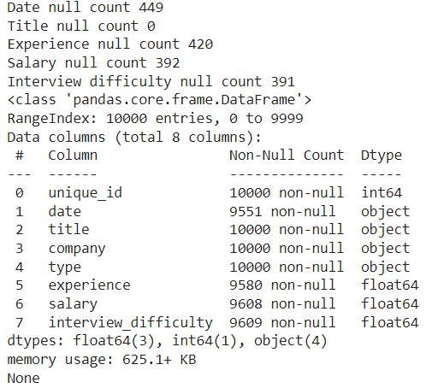
Data Cleansing
Replaced missing Experience values with the median experience
Replaced missing Salary and Interview Difficulty values with the respective means.
Converted Date into Date Time Format
While the data pertains to job applications and were successfully hired and become employees of their respective companies.

Slide 5
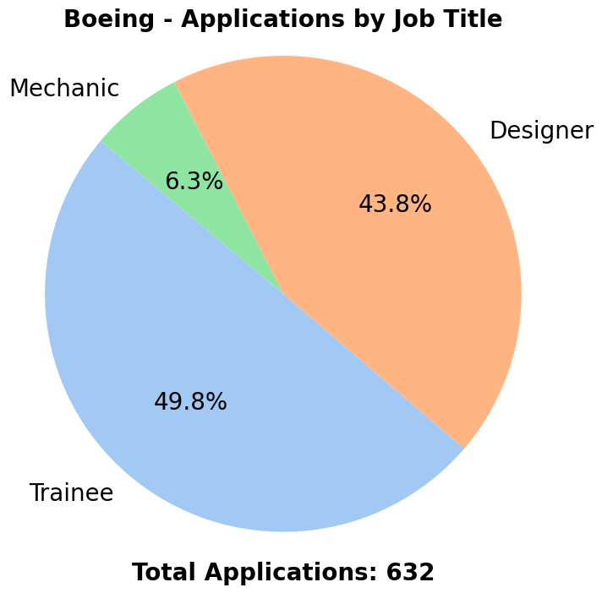
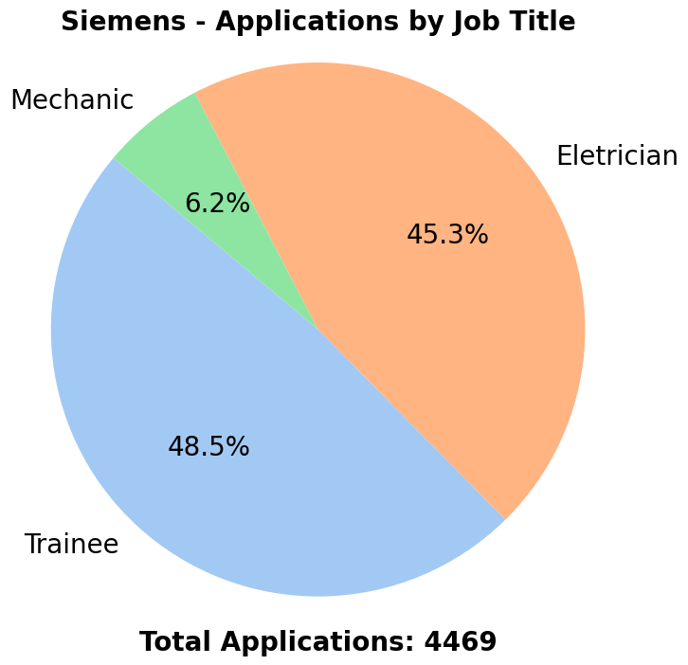
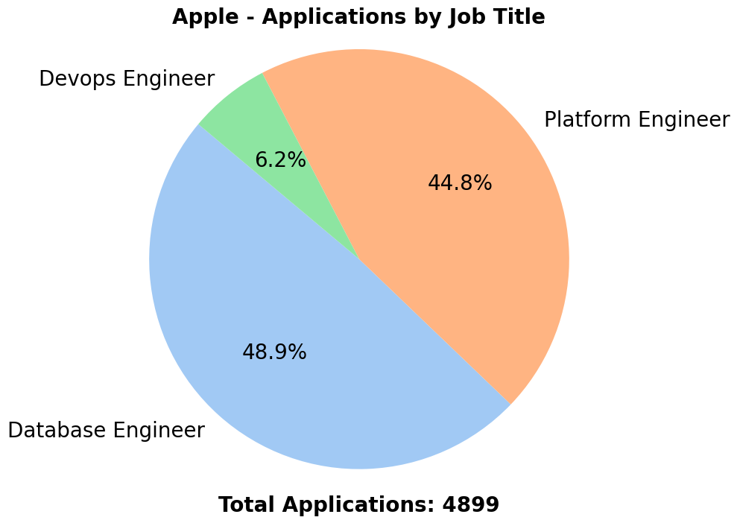
PIE CHART
Notably, the proportion of Mechanics in Boeing and Siemens aligns with that of DevOps professionals in Apple.
The numbers of trainees in Boeing and Siemens closely match those of database engineers in Apple.
The percentages of designers in Boeing and electricians in Siemens correspond to the figures for platform engineers in Apple.

Slide 6
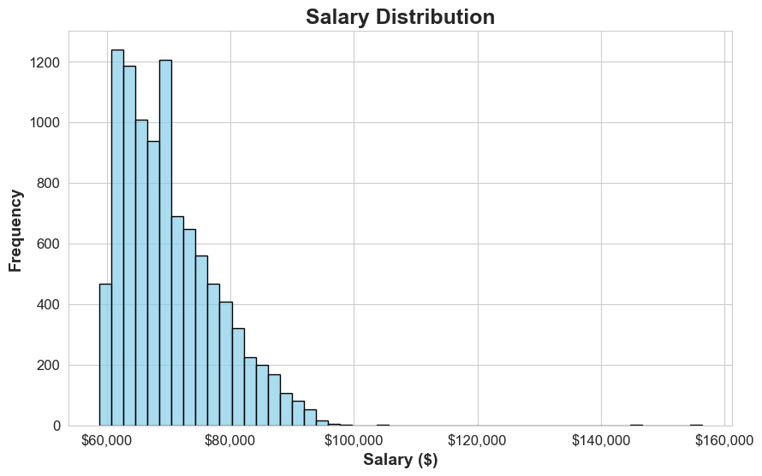
HISTOGRAM
In the Salary Distribution, it's evident that most salaries fall within the range of 58,000 to 70,000 for all three companies.

Slide 7
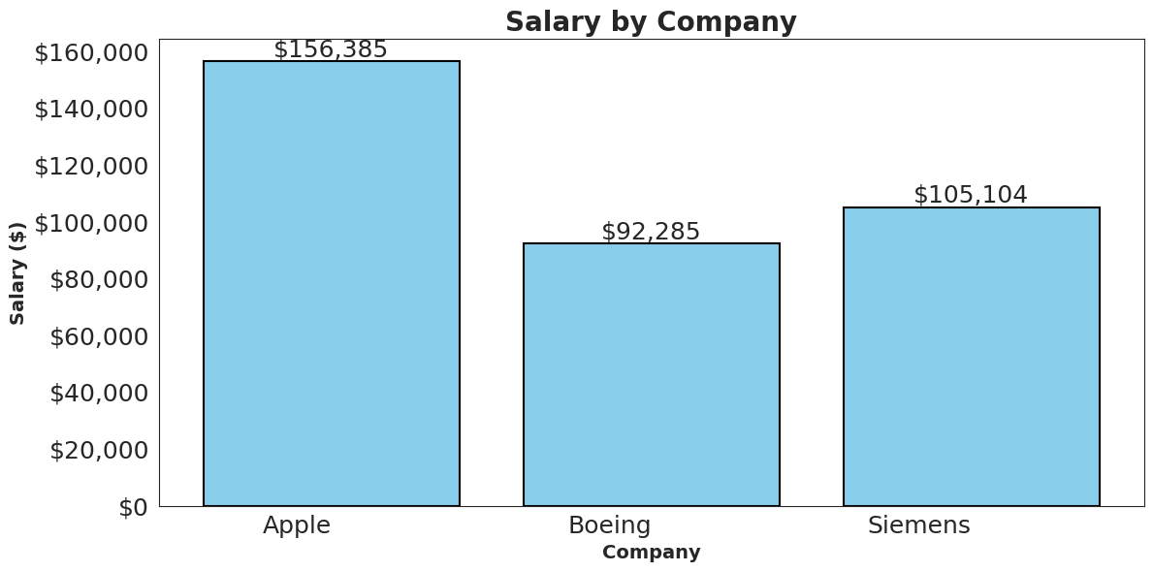
BAR CHART
According to the graph, Apple has the highest monthly salary at around $156,385. Boeing and Siemens have a significantly lower monthly salary, somewhere around $92,285 to $105,104.

Slide 8
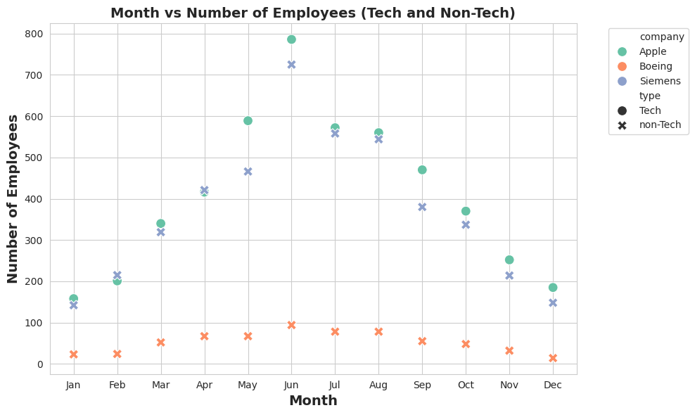
SCATTER PLOT
From this scatter plot, it is apparent that all of the Job Applications are from the tech background for Apple, while Siemens and Boeing are primarily in the non-tech job application domain. Most of the job applications can be in the month of June i.e. 800. Job Application tends to exponentially increase until mid of the year and then decrease.

Slide 9
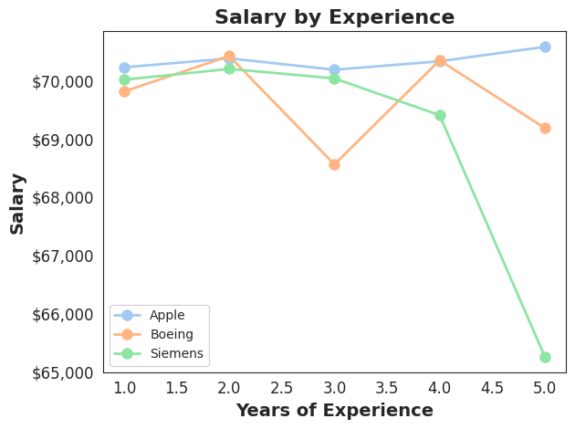
LINE CHART
Multivariate line plot shows salary trends by experience. Apple offers top packages for all levels of experience. Siemens consistently offers lower salaries, especially after 3 years. Initial salaries are similar ($70,000), but others increase with experience, unlike Siemens, which drops at 5 years to around $65,000.

Slide 10
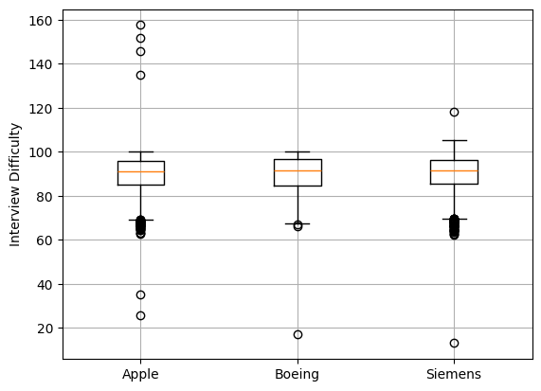

BOX PLOT
The difficulty of interviewing at Apple is perceived to be the highest among the three companies. The box representing Apple's interview difficulty extends higher on the y-axis than the other two companies.
The difficulty of interviewing at Boeing and Siemens is perceived to be similar. The boxes for these two companies are roughly the same height and their medians (the line in the middle of the box) are at a similar position

Slide 11
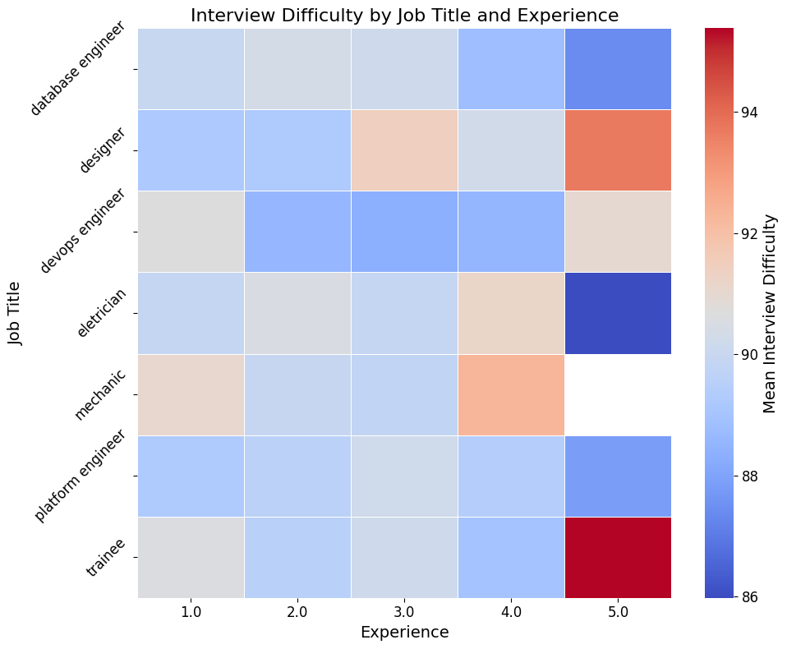
HEAT MAP
The difficulty increases as experience, especially for trainees and designers.
The interview difficulty for electricians is reducing drastically with the rise in experience.

Slide 12
Conclusion
If you're interested in technical roles, consider joining Apple's database engineering team when planning a career switch. For those seeking non-technical opportunities, exploring positions with the designer team at Boeing or the electrician team at Siemens could be a viable option
Given Apple's position with the highest salaries offered, it's logical to conclude that the larger number of applications within Apple is justified.
As experience grows, it's noted that Siemens may not offer commensurate salary increases. In contrast, Apple tends to adjust salaries in accordance with years of experience.
The average salary across all three companies falls within the range of $60,000 to $70,000
Trainees and Designers find it difficult to crack interview with more experience.

Slide 13
Recommendations
If one is considering transitioning to a tech domain at Apple, it is recommended to target the period between May and August for making your move.
For fresh graduates, it is recommended to consider joining Siemens and Boeing initially.
After gaining approximately 3 years of experience, transitioning to a role as a platform or database engineer at Apple is the best career advice based on the given data.
If one is planning to start a carrier with a company and planning to stay in same company for long one should consider joining Boeing.

