Slide 1


Currency Converter
NatWest Currency Converter
Designed By: Lalit Sharma

Slide 2

Agenda
Problem Statement
Objective
Project Flow
Project Objective
Tools & Technologies Used
Conclusion

Slide 3
Problem Statement
Customer should be able to initiate Inter Account transfer between same currencies. Base currency (GBP, USD or EUR) to remaining Exotic currencies (Total count of currencies = 33)

Slide 4
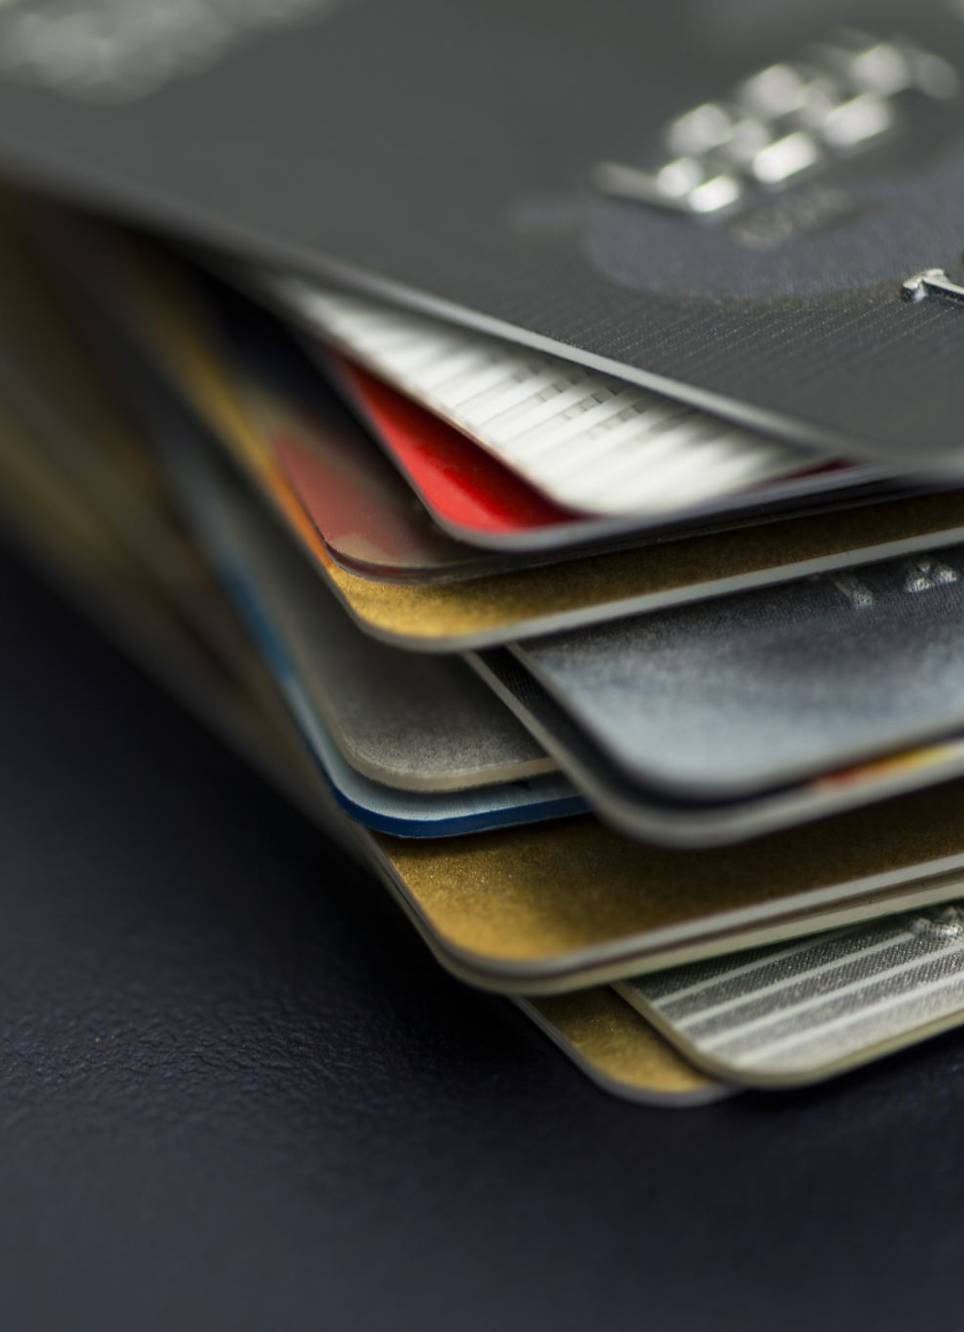
Objectives
Design a platform for currency transfer between and within bank accounts. This provides option to transfer between same and multi-currency based on the customers requirement and provides information about the bank account and the previous transactions in the account.
User Should be able to Sign Up & then Login
Can Add Accounts & Cards
Perform Fund Transfer
Download Statements
View Currency Conversion

Slide 5

Tools and Technologies Used
React
JavaScript
Spring Boot
Microservices Architecture
Bootstrap
Material UI
Material Design Bootstrap
MY SQL Workbench
Mockito
IntelliJ, VS Code

Slide 6
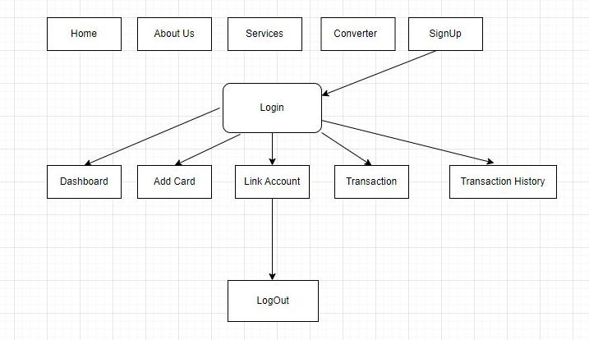
Project Flow

Slide 7

Conclusion
NatWest Currency Transfer helps user to add funds and make payments.
It also helps users to see the Currency Conversion.
Users can also see the transactions history.
Users can add their multiple accounts to make payments.

Slide 8





Thank You

