Slide 1
Comment Service
Lalit Vishwakarma

Slide 2
Agenda
Introduction
Projects
Craft Question - Functional requirements
Nonfunction requirements
Estimations
Data models and ER diagram
APIs
Architecture
Demo
Scaling
Q/A

Slide 3
Introduction
Hometown is Harda, Madhya Pradesh
Education History (2011 to 2017)
Bachelor of Engineering – UIT, RGPV, Bhopal
MTech. – MANIT, Bhopal
Work Experience (2018 to present)
Front-end developer at Synechron Technologies
Back-end developer at Cisco
Full stack developer at Radware

Slide 4
Projects
Vxml-activities
Vxml-activities is a stateless scalable micro-service to handle VXML activities of new Call Flow Builder.
Added IVR features in the product which can handle 10k concurrent calls.
Cyber-controller
Implemented a new driver across microservices to protect millions of users from HTTPS attacks.

Slide 5
Functional Requirements
We should be able to register user.
Users can add/edit/delete posts.
Users can add/edit/delete comments on posts.
Users can reply/edit/delete comment on comments.
Users can likes/dislikes comment or post
Users can see names of users who likes/dislikes comment or post.

Slide 6
Non-functional Requirements
Scalability
CPU – the system should handle requests if one instance’s CPU loaded
Memory – The system should handle the in-memory bottleneck.
Storage – The system should handle requests even if current DB node are full.
Latency – The system should perform well across the world
Security
The system should be secure.
It should provide access to only authenticated users.

Slide 7
Estimate
Total users 100 million.
Active users 10 million.
Read write ration 100:1
Storage
1 million comments every day
1 comment – 8 + 8 + 8 + 8 + 6 + 255 ~ 300 -> 3 comment = 1kb
1 million kb -> 1gb /day ~ 400 gb /year
Instances
100 million read + 1 million write every day
101 million requests every day ~ 101M/86400 per second ~ 1170 request per second
Let’s say single core takes 200 milliseconds for 1 request ~ 5 request per second.
32 core CPU can handle 160 request per second.
1170/160 ~ 8 instances of comment service

Slide 8
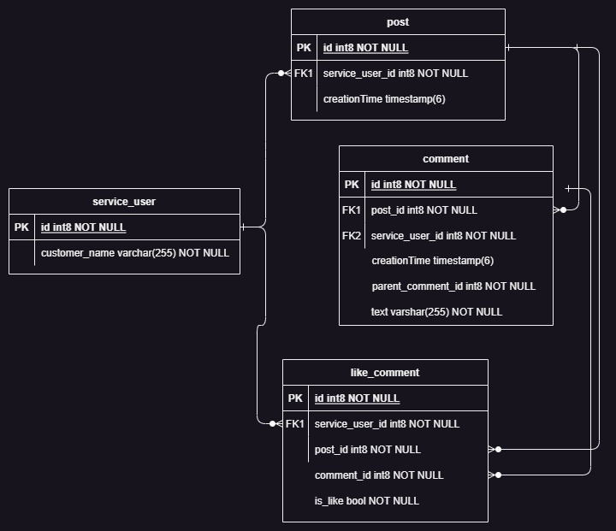
ER Diagram

Slide 9
API’s
/users
/posts
/posts/{postId}
/posts/{postId}/comments
/posts/{postId}/comments/{commentId}
/posts/{postId}/comments/{commentId}/childComments
/posts/{postId}/comments/{commentId}/reply
/posts/{postId}/likes
/posts/{postId}/dislikes
/posts/{postId}/comments/{commentId}/likes
/posts/{postId}/comments/{commentId}/dislikes

Slide 10
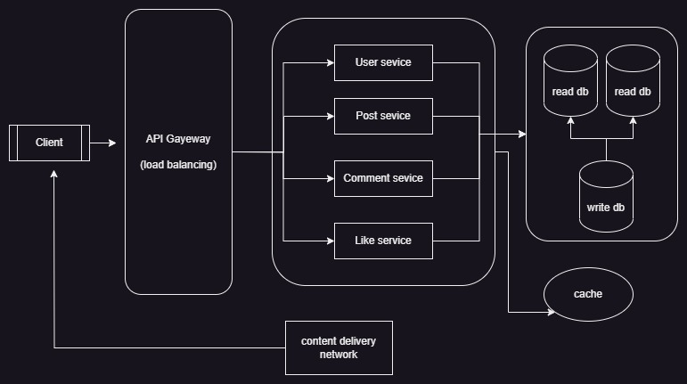
Architecture

Slide 11
Demo
Demo

Slide 12
Scaling and Optimization
Paging
Cache
Gateway and load balancer
Replication/partitioning/sharding
CDN

Slide 13
Questions and Answer

