Slide 1


Assessing and Managing Suicide Risk in Primary Care
Peter M. Gutierrez, Ph.D.
Appleton CBOC
October 19, 2011

Slide 2
Overview
Presentation Overview
Challenges of Assessing Suicide in Primary Care
Advantages and Disadvantages of Using Standardized Suicide Risk Measures
Options in Primary Care for Management of Patients Resistant to Mental Health Referrals

Slide 3
Scope of the Problem
Approximately 35,000 people die by suicide each year in the U.S.
Estimated 45% of those dying by suicide saw their primary care physician within one month of death (McDowell, Lineberry, & Bostwick, 2011)
One VA study found 63% suicide decedents had at least one primary care visit in year prior to death (Denneson et al., 2010)

Slide 4

Why Don’t Primary Care Providers Ask About Suicide?

Slide 5

Too Many Barriers
Time
Expertise
Fear
Overwhelmed
Not a big problem
Other reasons?

Slide 6


Screening vs. Assessment

Slide 7
What’s the Goal?
Screening
Assessment
Snapshot
Quick
Focused
Next steps
Comprehensive
Specialty care
Case conceptualization
Treatment planning

Slide 8

Cost/Benefit of Screening

Slide 9
Who Should be Screened?
At a minimum, anyone being seen for depression or with a history of depression
Those with alcohol abuse problems
Receiving catastrophic medical news
Exhibiting significant changes in mood
McDowell et al., 2011

Slide 10
Other Conditions to Monitor
Comorbid anxiety or agitation
  Particularly PTSD, panic disorder, social anxiety disorder, and generalized anxiety disorder
Significant sleep problems (Ribeiro et al., in press)

Slide 11

Mention of Suicide/Desire for Death
Doesn’t always mean there is a crisis

Slide 12
Know the Warning Signs
Significant anxiety
Psychomotor agitation (e.g., “feeling like want to crawl out of my skin”)
Poor sleep
Concentration problems
Hopelessness
Social isolation
Significant increase in substance use
McDowell et al., 2011

Slide 13
What Information do You Need?
Step-wise approach
  Move from general to specific
Feeling hopeless or thinking about death?
Specific thoughts about suicide?
Family history and own history of self-directed violence
McDowell et al., 2011

Slide 14
What Tools Should I Use?
No standardized measure can predict who will/won’t engage in self-directed violence
Identification of similarity between an individual patient and known groups
Single item indicators very limited utility
Valid and reliable, in particular with good criterion validity

Slide 15
Potential Measures
Heisel and colleagues (2010) reported 15-item Geriatric Depression Scale cut-off of 5 for men and 3 for women accurately identifying ideation
  Designed for primary care patients 65 and older
Patient Health Questionnaire-9 78.9% agreement with SCID-I
  10.2% false positives, 10.8% false negatives (Uebalacker et al., 2011)

Slide 16
Suicidal Behaviors Questionnaire-Revised
Cut-off score of 8 discriminates between adult psychiatric inpatients with/without history of suicide attempt/serious consideration
7 cut-off for non-clinical
Valid, reliable, easy to administer and score
Self-report can be completed prior to appointment
Specifically designed as a suicide screening tool

Slide 17
How Accurate is the SBQ-R?
Adult psychiatric inpatients 95% of those with a history of serious ideation/attempts (positive predictive value)
87% of those without a history of suicidality (negative predictive value).
5% false positives
13% false negatives
Non-clinical undergrads PPV & NPV = 1.00

Slide 18

My Patient is High Risk
Now What do I do?

Slide 19
Managing At-risk Patients
Don’t try to convince your patient that “life isn’t that bad”
Chatting about psychosocial issues isn’t enough
Need a plan ahead of time so know what to do with screening data
Longitudinal monitoring, structured follow-up, appropriate referral to mental health
Vannoy et al., 2011

Slide 20
Safety Planning
Fairly quick and easy to complete in CPRS
Print, discuss, and send home with patient
Consider involving significant others
Keeping safe until can be seen by mental health
Hospitalization does not have to be first option

Slide 21
Treatment of Likely Drivers of Suicide
Collaborative care models may be particularly effective for treating depression (McDowell et al., 2011)
  Education and support for physicians
  Depression care managers
  Monitoring patient outcomes and adherence
  Facilitating communication between patients, primary care, and mental health providers
Treatment of substance use disorders
Consider antidepressants

Slide 22
To Refer or Not to Refer
Do they have a plan?
Have they taken steps to prepare/practice?
Access to lethal means?
Intent to die?

Slide 23
Disposition
Tied to imminence of risk
More frequent primary care contact
Case management
Outpatient mental health
Intensive outpatient treatment
Inpatient hospitalization

Slide 24

But I Don’t Want to Talk to Mental Health
May not be necessary
Empathy and concern enough?
Other supports?

Slide 25
When Can I Stop Worrying?
Once identified as elevated risk need to keep monitoring
Successful treatment of contributing factors
Periodic assessment for increased problems
Watchful waiting stance

Slide 26
Thank You for Your Attention
peter.gutierrez@va.gov

Slide 27
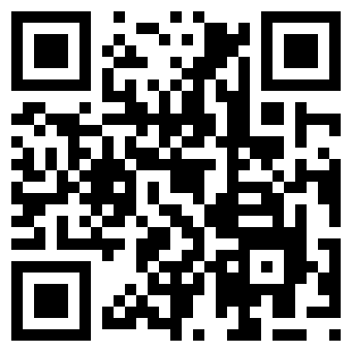
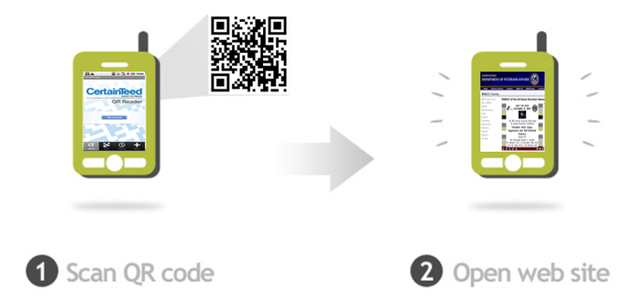
Use Your Smartphone to Visit the VISN 19 MIRECC Website
Requirements:
Smartphone with a camera
QR scanning software (available for free download just look at your phones marketplace)
www.mirecc.va.gov/visn19

