Slide 1

CHICAGO CRIME DATA ANALYSIS
LALITH CHANDRA ATTALURI
BHASHITHA SIDDAREDDY
UDAYA BYREDDY

Slide 2

MOTIVATION
Crime rate had been raising at a constant rate over the past few years due to which there had been chavos among the population in United States
Classifying the crime types occurring in different geographical locations and passing the statistics to police department and to public had been a vital step among the safety

Slide 3
MOTIVATION
Chicago is one of the states where there had been humongous development over past many years along with crime rate had been at the peak level
We have performed Chicago crime data analysis over past 16 years from 2000 - 2017 and classified the crimes so that Police department can take necessary safety measures depending on crime type

Slide 4
Dataset description
The dataset we used is “Chicago Crimes Dataset” that comprises of reported incidents of crime (with the exception of murders where data exists for each victim) that occurred in the City of Chicago from 2001 to 2017.

Slide 5
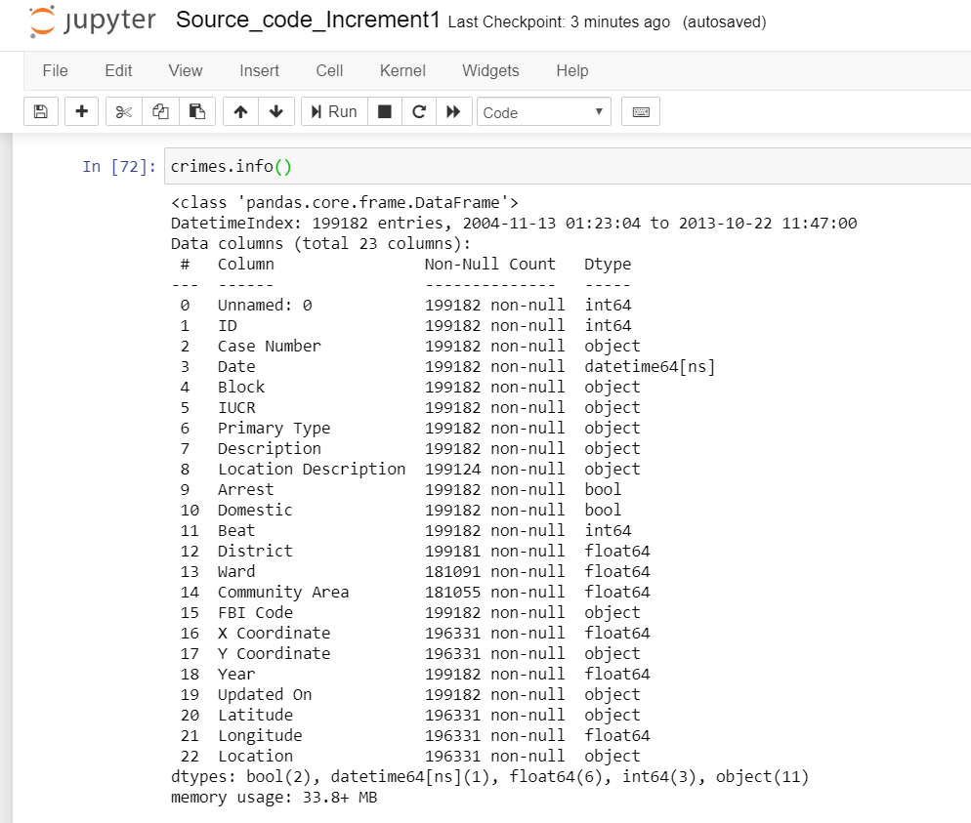
Data Description

Slide 6
Architecture
KNN Model
Data Import
Data Preprocessing
Correlation & Feature Selection
Random Forest Classifier
Ensembled model
Classification report
Data Visualization
MLP Classifier

Slide 7
Solution
The below models had been built on our data
1) KNN Classifier (ML Model)
2) Random Forest Classifier (ML model)
3) MLP Classifier (Neural Networks model)

Slide 8
Solution
Finally an Ensembled model is constructed which combines all the features of above models to bring an intermmediate model
Hence our data is classified based on crime type

Slide 9
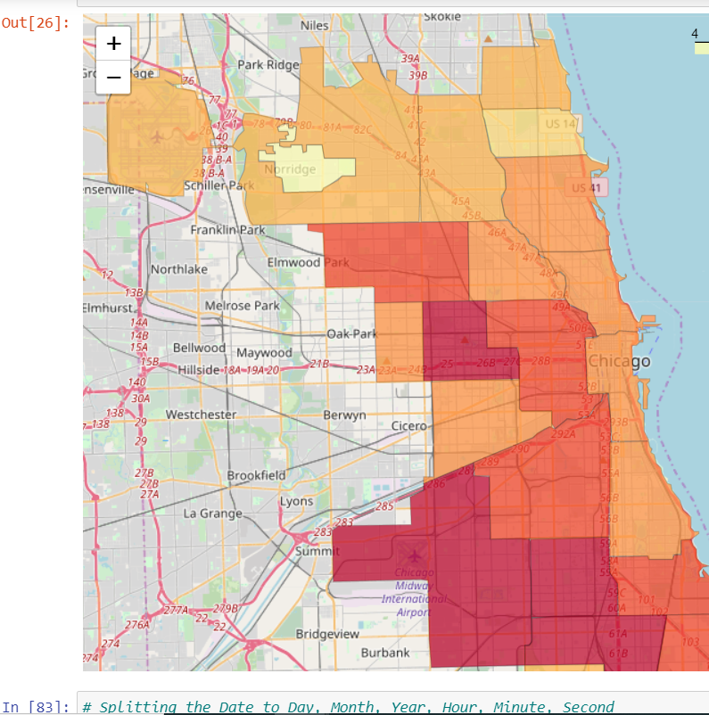
Data Visualisation-1: District Crime Data

Slide 10
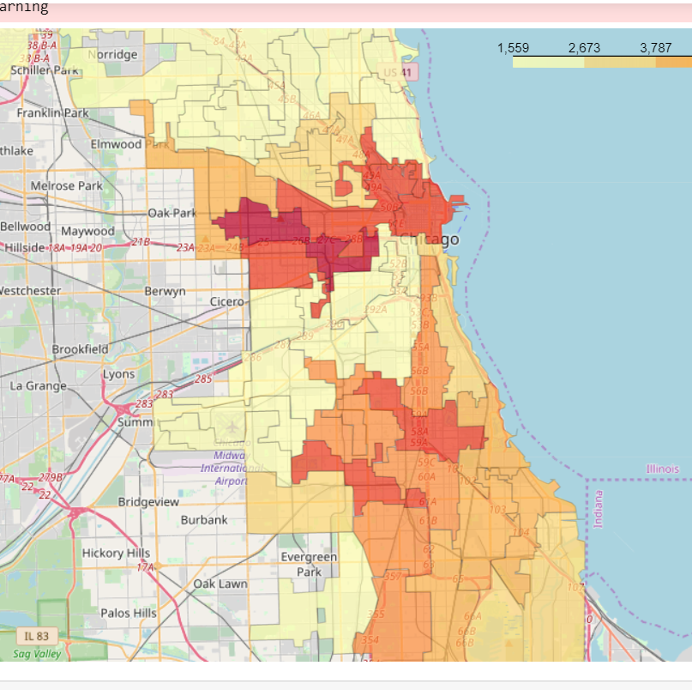
Data Visualisation-2: Wards Crime Data

Slide 11
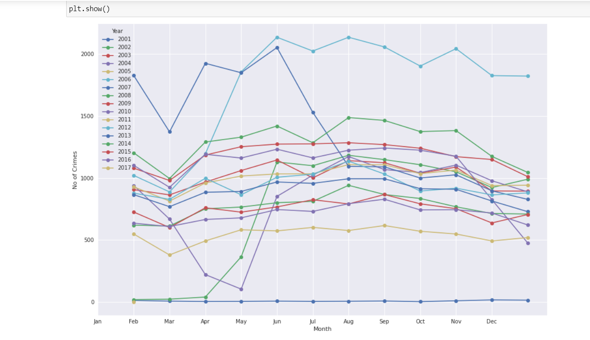
Monthly crimes for different years

Slide 12
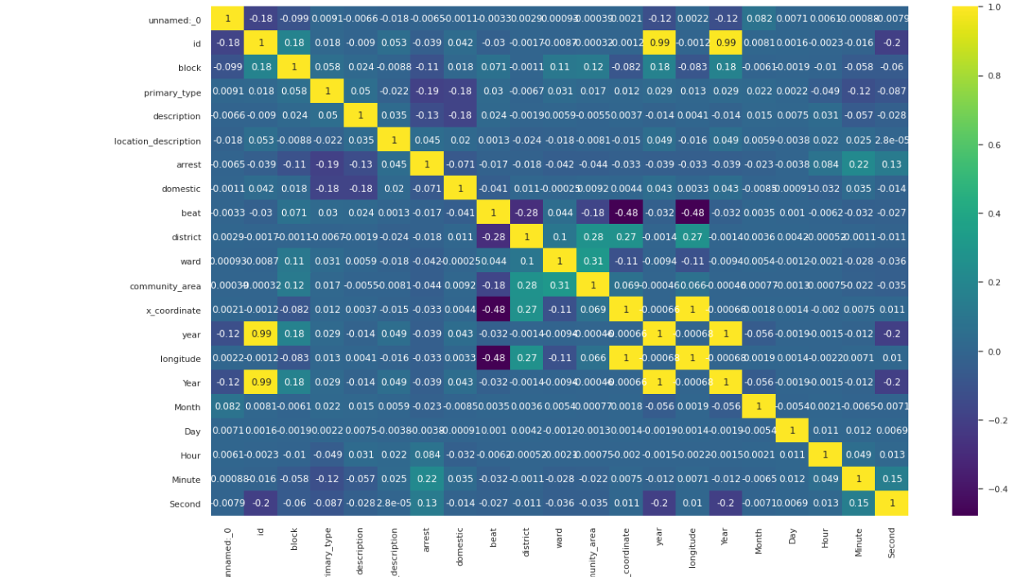
Heat map for correlation

Slide 13
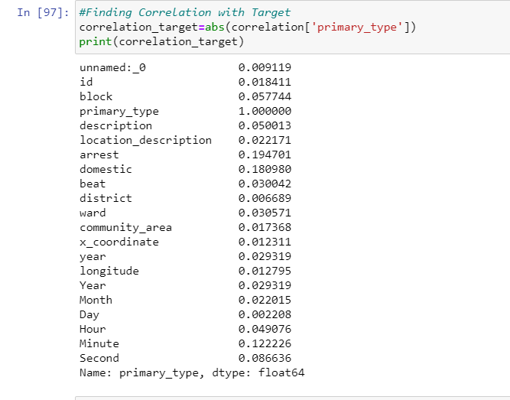
Correlation report

Slide 14
Relevant Features Selection
Depending on correlation score relevant features had been selected whose score is greater than 0.1
Description
Arrest

Slide 15
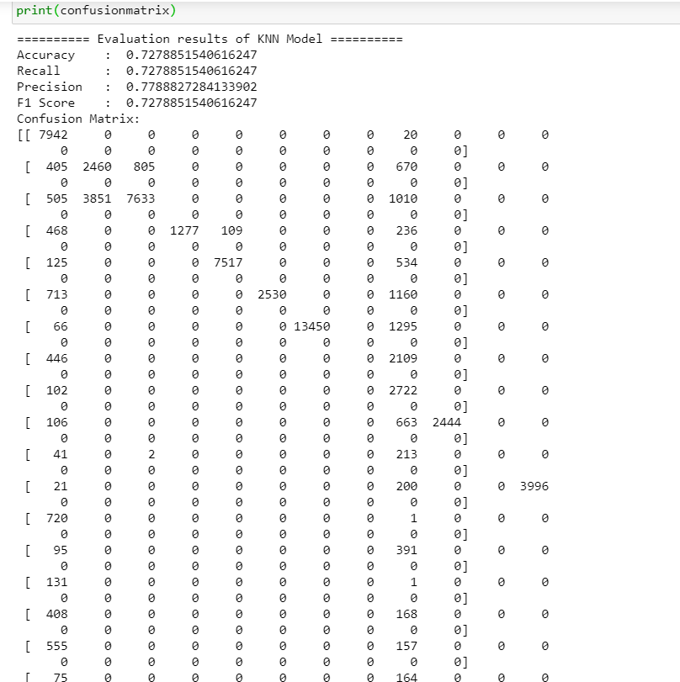
KNN Model
KNN model had been fitted on our data and the evaluation report

Slide 16
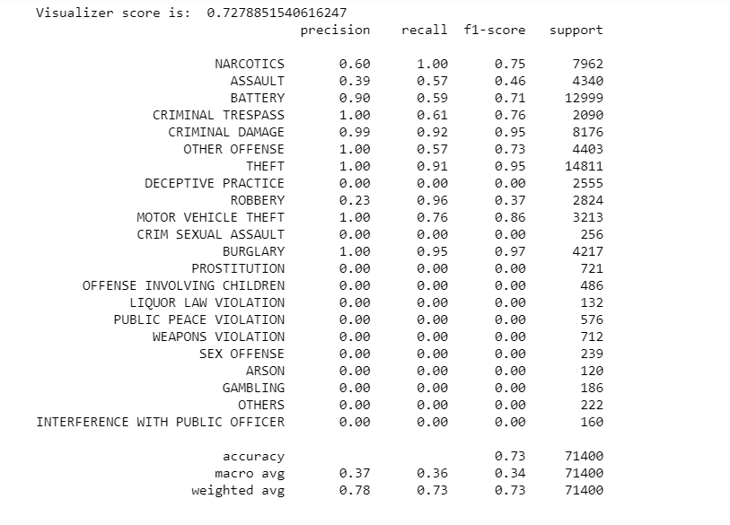
Classification report for KNN

Slide 17
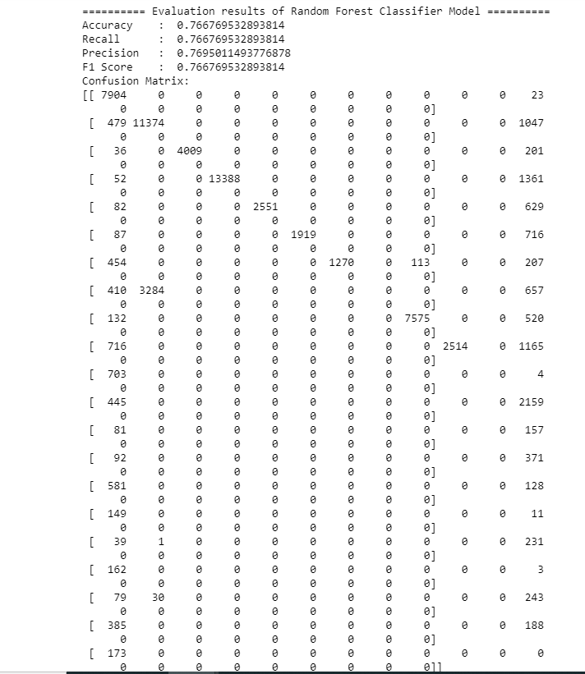
Random Forest Model
Random Forest model had been fitted on our data and the evaluation report

Slide 18
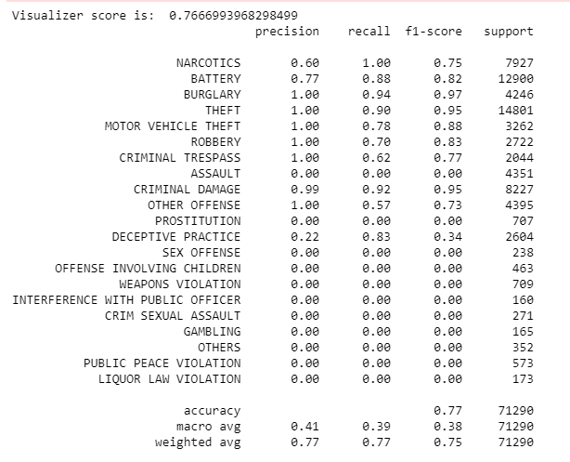
Classification report for Random Forest

Slide 19
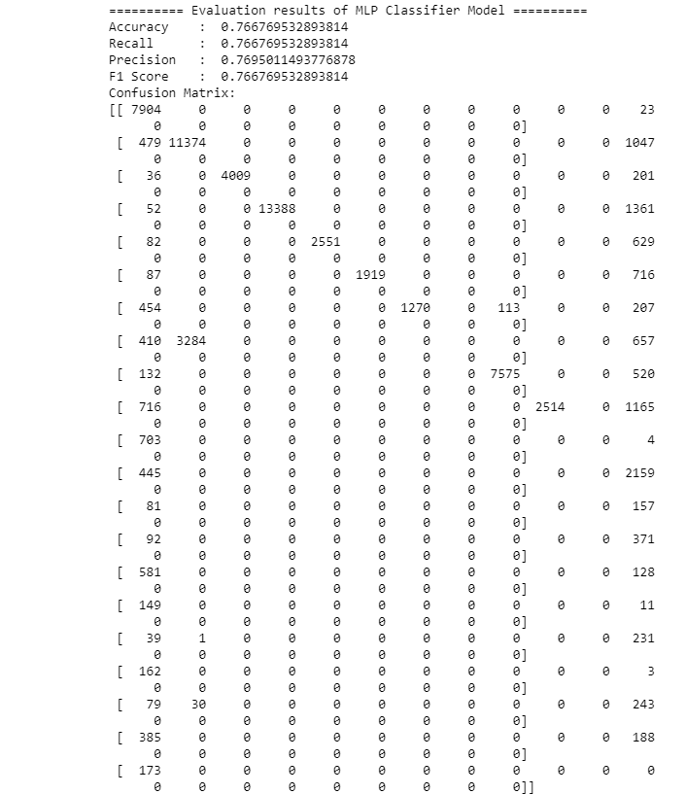
Neural networks model
MLP classifier model had been fitted on our data and the evaluation report

Slide 20
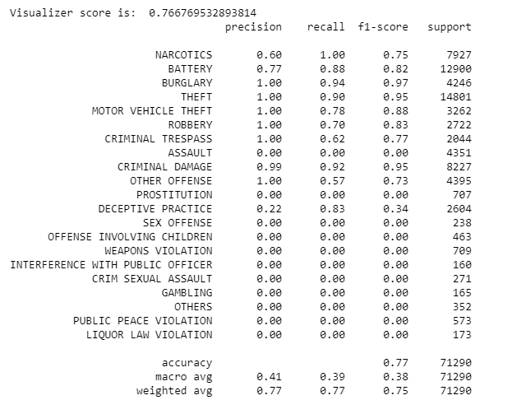
Classification report for MLP classifier

Slide 21
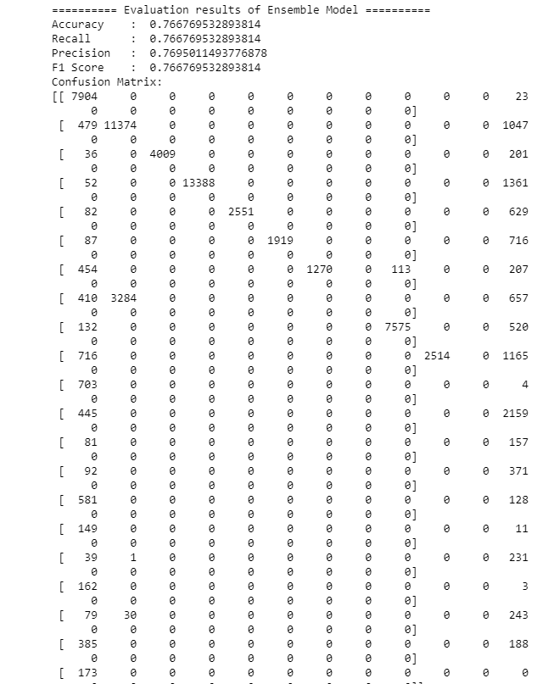
Ensembled model
Ensembled model had been fitted for the previous 3 classifiers for building an intermediate model

Slide 22

Classification report for Voting classifier

Slide 23
Future Scope
Further clustering can be done at district level and ward level

Slide 24

The project has been hosted in https://myfirstapp132.herokuapp.com/

Slide 25

Thank you

