Slide 1
Azure Monitor and Azure Log Analytics

Slide 2
Azure Monitor:
Azure Monitor is a comprehensive monitoring solution that provides real-time insights into the performance and availability of applications and resources hosted on Azure.
Key features: Metrics: Collects and analyzes metrics such as CPU usage, memory utilization, and network traffic to monitor resource health.
Alerts: Enables the creation of alerts based on custom-defined conditions to proactively identify and address potential issues.
Diagnostics: Offers in-depth diagnostics by capturing and analyzing diagnostic logs and providing actionable insights.
Auto scale: Dynamically adjusts resource capacity based on predefined rules to optimize performance and cost.

Slide 3
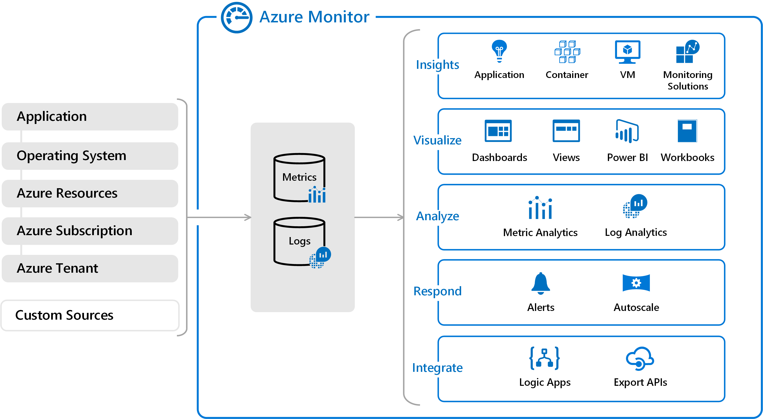

Slide 4
Azure Log Analytics:
Azure Monitor is a comprehensive monitoring solution that provides real-time insights into the performance and availability of applications and resources hosted on Azure.
Key features:
Metrics: Collects and analyzes metrics such as CPU usage, memory utilization, and network traffic to monitor resource health.
Alerts: Enables the creation of alerts based on custom-defined conditions to proactively identify and address potential issues.
Diagnostics: Offers in-depth diagnostics by capturing and analyzing diagnostic logs and providing actionable insights.
Auto scale: Dynamically adjusts resource capacity based on predefined rules to optimize performance and cost.

Slide 5
