Slide 1


Please attribute as SimpleITK Fundamental Concepts (IEEE ISBI 2018)
This work is copyrighted by the Insight Software Consortium
It is distributed under a Creative Commons Attribution 4.0 International License: https://creativecommons.org/licenses/by/4.0/

Slide 2




SimpleITK Fundamental Concepts
¹Hans J. Johnson, ^{2,4}Bradley C. Lowekamp, ^{2,3}Ziv Yaniv
¹The University of Iowa
²National Institutes of Health ³TAJ Technologies Inc.
⁴MSC LLC

Slide 3
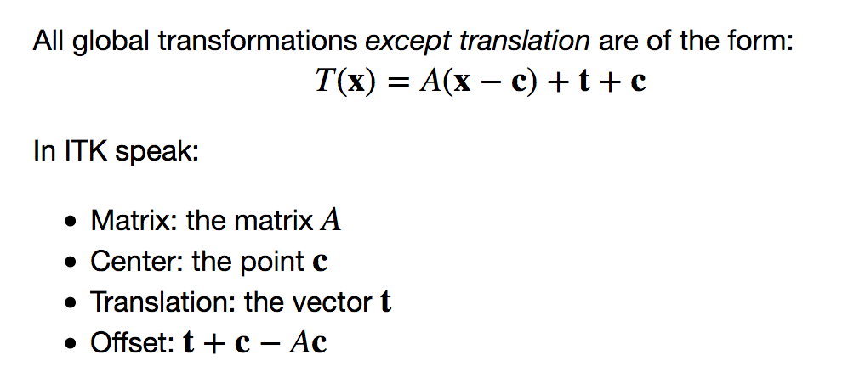
Transforms
All global transformation are of the form*:
*Except translation.

Slide 4
Transforms
Free-Form Deformation:
sparse grid of control points with uniform spacing,
B_{0..3}
cubic B-spline basis functions.
You set:
Spline order (default is cubic)
Number of grid points per axis (mesh size)
Spatial domain manually: origin; physical dimension; direction cosine matrix image based: BSplineTransformInitializerFilter
Transformation is identity outside the user defined domain.

Slide 5
Transforms
Displacement Field:
Dense set of vectors representing the displacement in a given spatial domain.
You set:
Spatial domain and deformation: manually: origin; physical dimension; direction cosine matrix; vector values. image based: vector image which is emptied of its contents.
Transformation is identity outside the user defined domain.

Slide 6
Transforms
Composite transformation:
Represents multiple transformations applied one after the other. T₀(T₁(T₂(…T_{n}(p)...)))
Stack based semantics – first in last applied. composite_transform = sitk.Transform(T₀) composite_transform.AddTransform(T₁)
When used as the optimized transformation in registration (SetInitialTransform), only the parameters of the last transformation, T_{n}, are optimized.

Slide 7
Images
An image is defined by:
Pixel type + spatial dimensionality.
Physical region in space occupied by the image as specified by: origin, spacing, size, and direction cosine matrix.

Slide 8
Images
SimpleITK2Python, SimpleITK2R:
sitk.GetArrayFromImage/as.array – Data copied into numpy/R array (mutable).
sitk.GetArrayViewFromImage – Data view in numpy array (immutable).
Python2SimpleITK, R2SimpleITK:
sitk.GetImageFromArray/as.image – Data copied into SimpleITK image.
Set all of the parameters defining the physical region in space:
new_image.CopyInformation
or
new_image.SetOrigin, new_image.SetSpacing, new_image.SetDirection

Slide 9


Resample: Image + Transform
f
m
Resampling, three elements (assuming arbitrary interpolation method):
Image – the image we resample in coordinate system m.
transformation – T(^{f}p) = ^{m}p maps points from coordinate system f to m.
resampling grid – uniform set of points which will be mapped by the transformation.

Slide 10
Resample: Image + Transform
f
m
Specifying the resampling grid
Use an existing image.
Use origin, size, spacing, and direction cosine.
Unexpected results: errors in resampling grid specification or transformation.

Slide 11
Registration – Coordinate Systems
Three coordinate systems: Fixed, Virtual, Moving.
Three transformations: T_{f}(^{v}p) = ^{f}p
T_{m}(^{v}p) = ^{m}p
T_{opt}(^{m}p) = ^{m}p’
Most often T_{f}=I, the fixed and virtual coordinate systems coincide.

Slide 12
Registration - Framework
Optimizers:
Exhaustive
Nelder-Mead Simplex/Amoeba
Powell
1+1 evolutionary
GradientDescent GradientDescentLineSearch RegularStepGradientDescent
ConjugateGradientLineSearch
L-BFGS-B
Similarity metrics:
MeanSquares Demons Correlation ANTSNeighborhoodCorrelation JointHistogramMutualInformation MattesMutualInformation
Multi-resolution framework.
Masks.
Sampling strategies.

