Slide 1


Please attribute as SimpleITK Historical Overview (IEEE ISBI 2018)
This work is copyrighted by the Insight Software Consortium
It is distributed under a Creative Commons Attribution 4.0 International License: https://creativecommons.org/licenses/by/4.0/

Slide 2




SimpleITK Historical Overview: Standing on the Shoulders of Giants
¹Hans J. Johnson, ^{2,4}Bradley C. Lowekamp, ^{2,3}Ziv Yaniv
¹The University of Iowa
²National Institutes of Health ³TAJ Technologies Inc.
⁴MSC LLC

Slide 3
What is SimpleITK?
A simplified multi-language interface to the National Library of Medicine’s Insight Segmentation and Registration Toolkit (ITK).
Available in:
C++, Python, R, Java, C#, Lua, Ruby, TCL
github.com/SimpleITK/SimpleITK

Slide 4
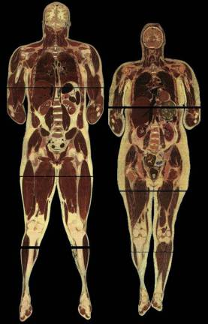
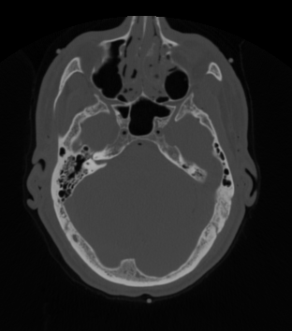
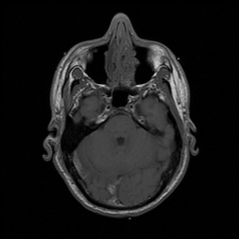
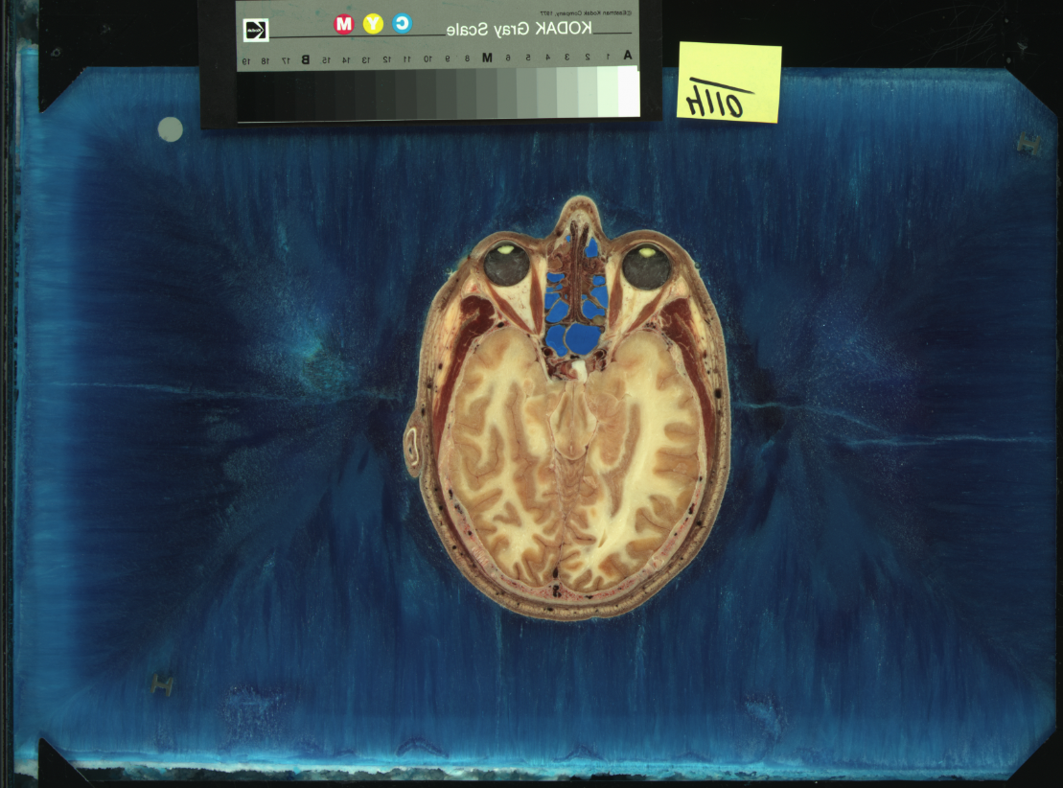
In the Beginning There Was Data
“The Visible Human Male: A Technical Report", V. Spitzer et al., J. Am. Med. Inform. Assoc.,3(2), pp. 118-130, 1996.

Slide 5

Need to Analyze the Data
2002
Insight Segmentation and Registration Toolkit
“Engineering and Algorithm Design for an Image Processing API: A Technical Report on ITK - the Insight Toolkit”, T. S. Yoo et al., Stud. Health Technol. Inform., 85, pp. 586-592, 2002.

Slide 6

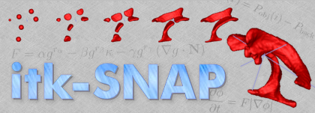
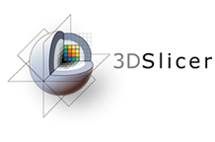




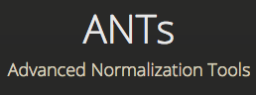




Open Source

Slide 7









Commercial Entities
Based on mailing list – Likely.
But we have no written testimony.

Slide 8
Why SimpleITK
Change in programming expertise:
Shift from C++ to Python and R.
Change in expectations:
No need to compile/build software.
Software should be easy to install.
Language Rank | Spectrum Ranking
1. Python | 100.0
2. C | 99.7
3. Java | 99.5
4. C++ | 97.1
5. C# | 87.7
6. R | 87.7
7. JavaScript | 85.6
8. PHP | 81.2
9. Go | 75.1
10. Swift | 73.7
✓
✓
✓
✓
✓
“The 2017 Top Programming Languages”, IEEE Spectrum, S. Cass.

Slide 9
SimpleITK by the Numbers
18 Minor releases, 1 Major release.
32 Contributors.
8638 Commits.
203,324 lines of code.
Starred on GitHub: main repository 178, notebook repository 109.
More than 100,000 downloads since 1/2013.

Slide 10
User Community

Slide 11
User Community

Slide 12
How to Support
Cite us:
B. C. Lowekamp, D. T. Chen, L. Ibáñez, D. Blezek, "The Design of SimpleITK", Front. Neuroinform., 7:45. https://doi.org/10.3389/fninf.2013.00045, 2013.
Z. Yaniv, B. C. Lowekamp, H. J. Johnson, R. Beare, "SimpleITK Image-Analysis Notebooks: a Collaborative Environment for Education and Reproducible Research", J Digit Imaging., https://doi.org/10.1007/s10278-017-0037-8, 2017.
Star us on GitHub:
Main repository – github.com/SimpleITK/SimpleITK
Notebook repository – github.com/InsightSoftwareConsortium/SimpleITK-Notebooks

Slide 13


