Slide 1


SNAPAMEND
1602-20-737-019
1602-20-737-011
1602-20-737-051

Slide 2
ABSTRACT
OUR PROJECT SNAPAMEND IS ALL ABOUT EDITING PICTURES USING OPENCV AND MATPLOTLIB
WE PROVIDE 5 DIFFERENT EDITING options :
1.SKETCH
2.BLACK AND WHITE
3.BLUR
4.ADD BORDER
5.ADD TEXT
IT HAS AN INTERNAL SAVE OPTION PROVIDED BY MATPLOTLIB
AND LAST OPTION WE PROVIDE IS EXIT

Slide 3
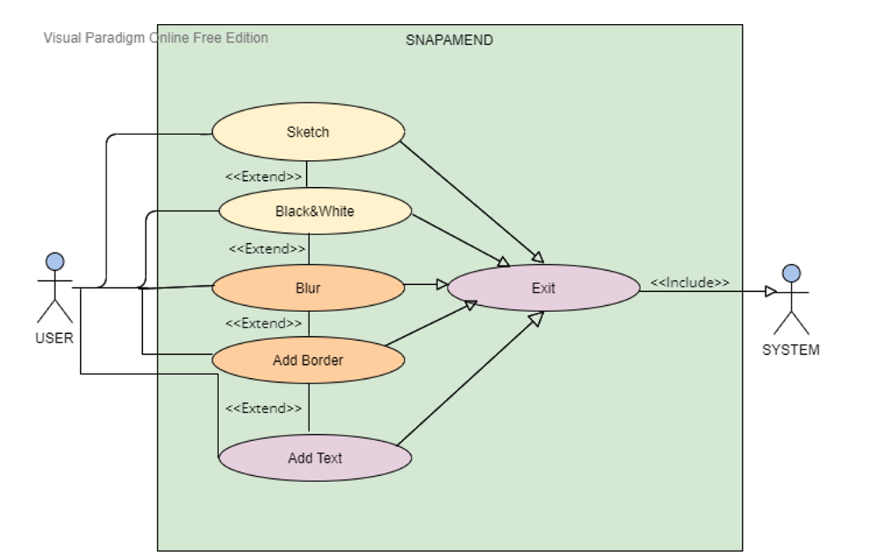
USE CASE DIAGRAM

Slide 4
TECHNOLOGY USED
WE USED OPEN CV FOR EDITING IMAGES
Puttext for ADDING TEXT, COPYBOARDMAKER for Border, BLUR FOR BLURRING IMAGE, etc
FOR reading and DISPLAYING PICTURES WE USED MATPLOTLIB
Imread for reading images and imshow for displaying images
Tkinter is used for building GUI
BUTTOn for adding buttons, Label for adding labels, ASKOPENFILENAME for accessing a file, ENTRY fOr inputting text, ETC

Slide 5
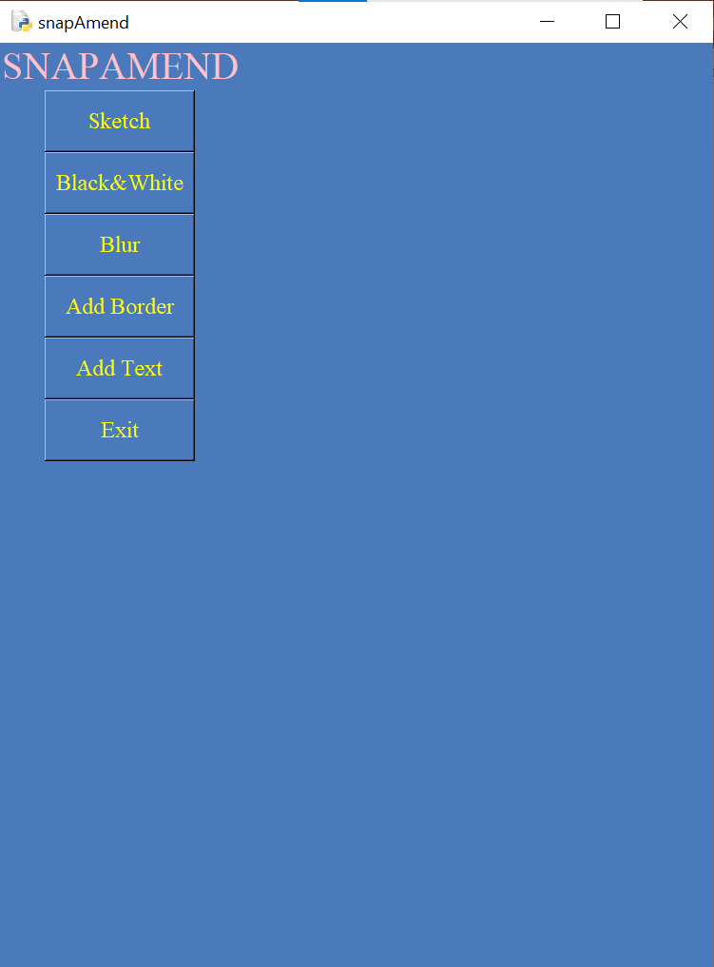
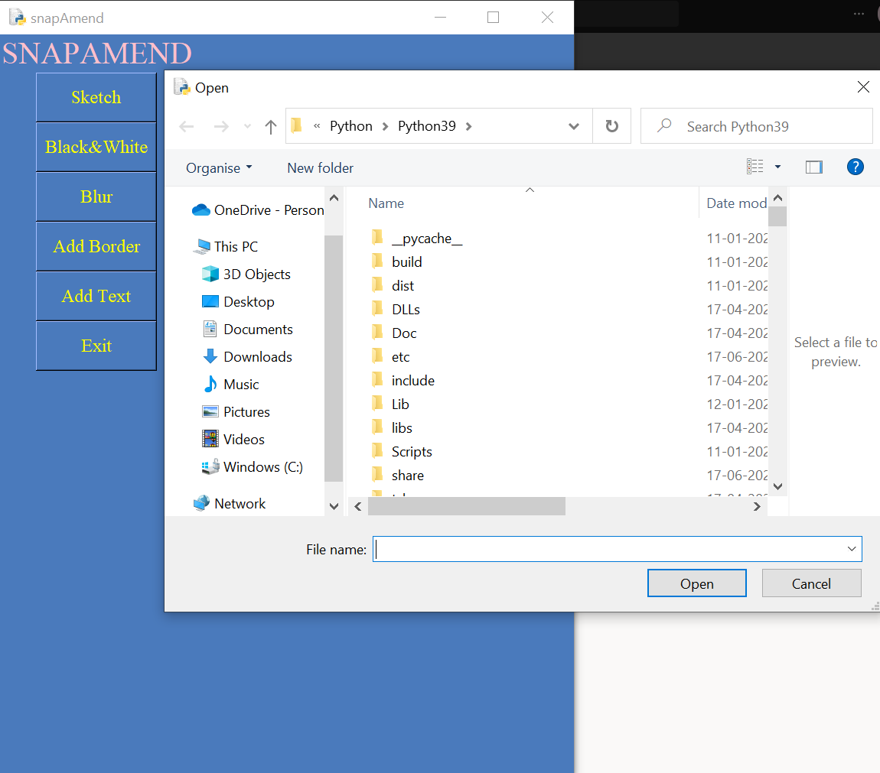
OUTPUTS
SKETCH

Slide 6
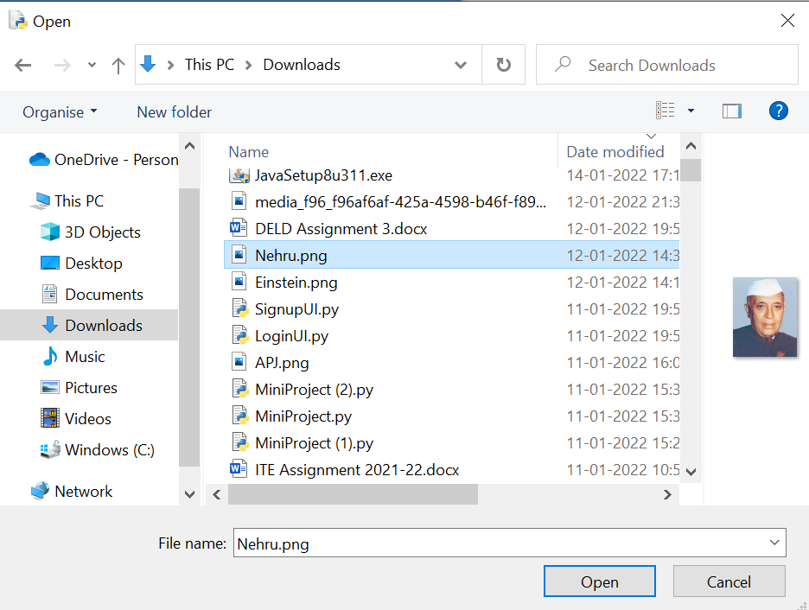
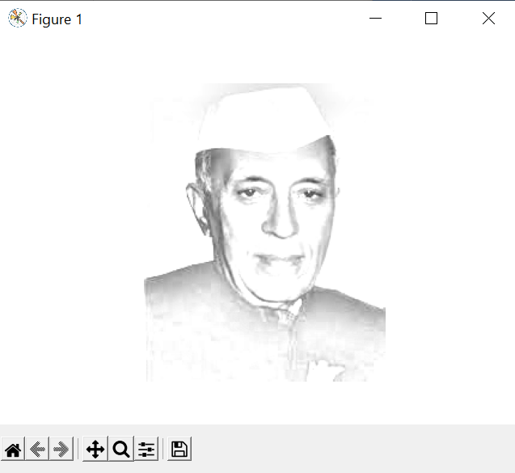

Slide 7
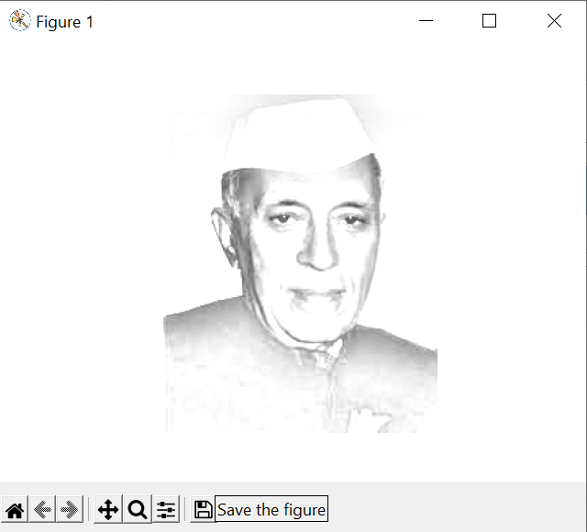
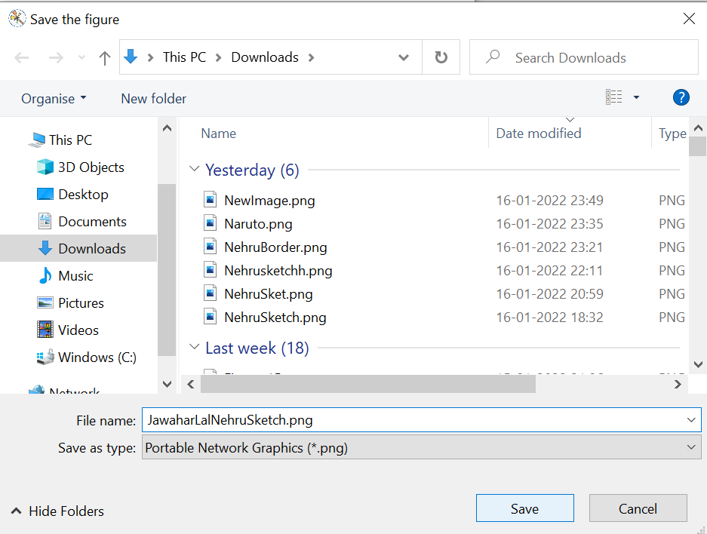
SAVE

Slide 8
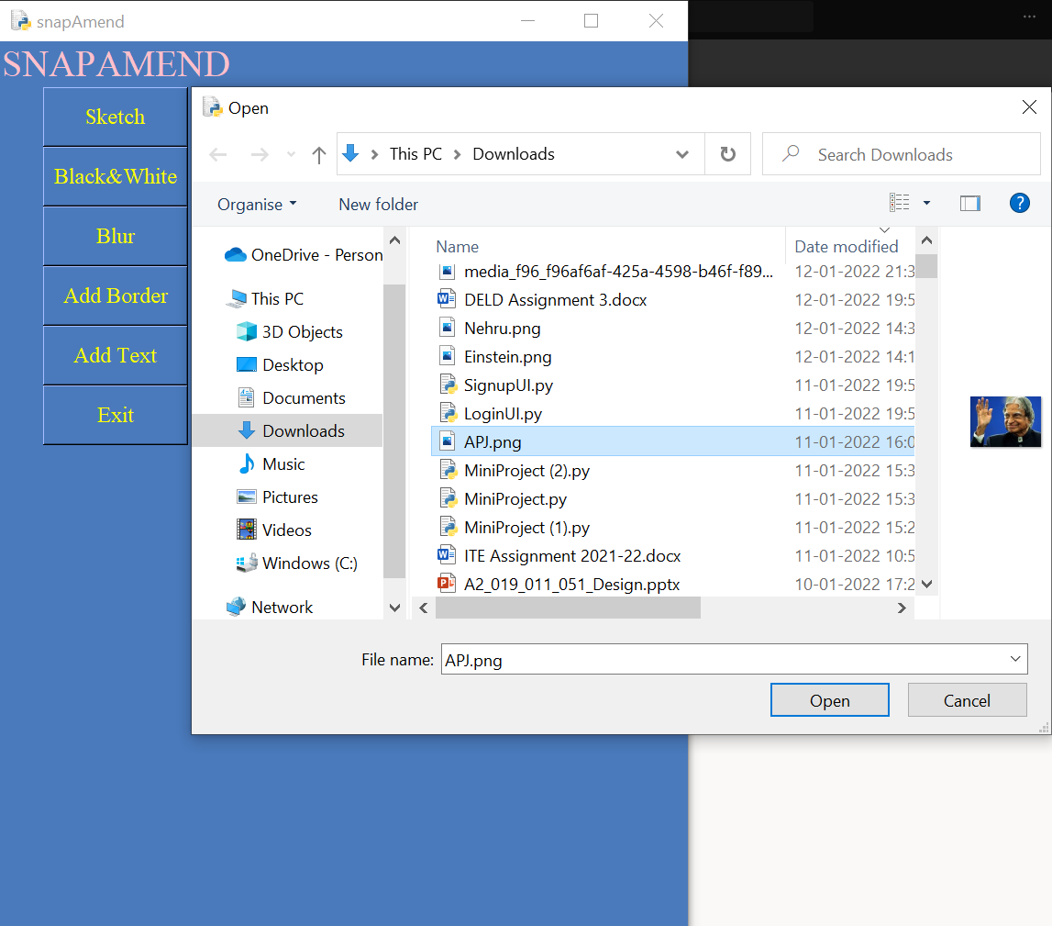
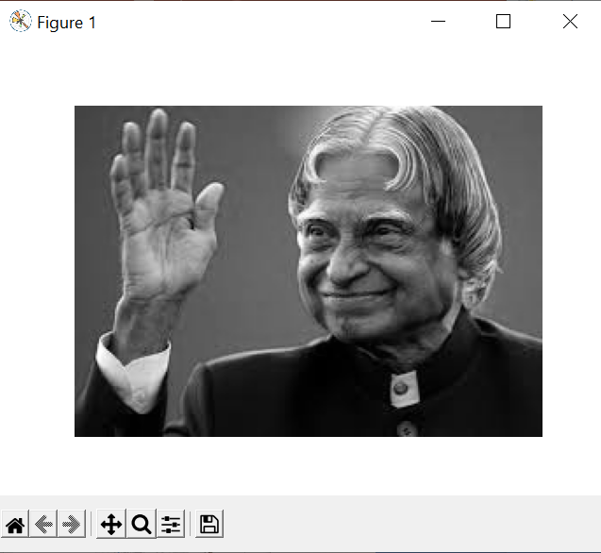
Black&WHITE

Slide 9

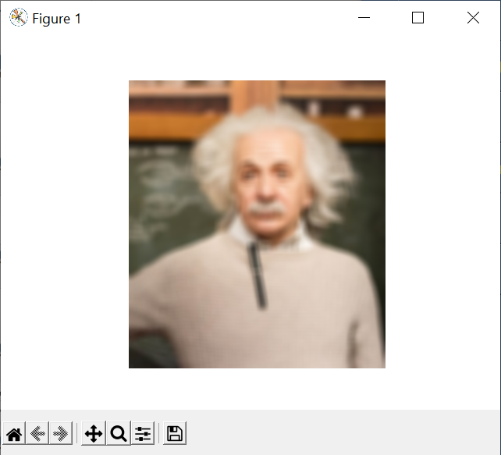
BLUR

Slide 10
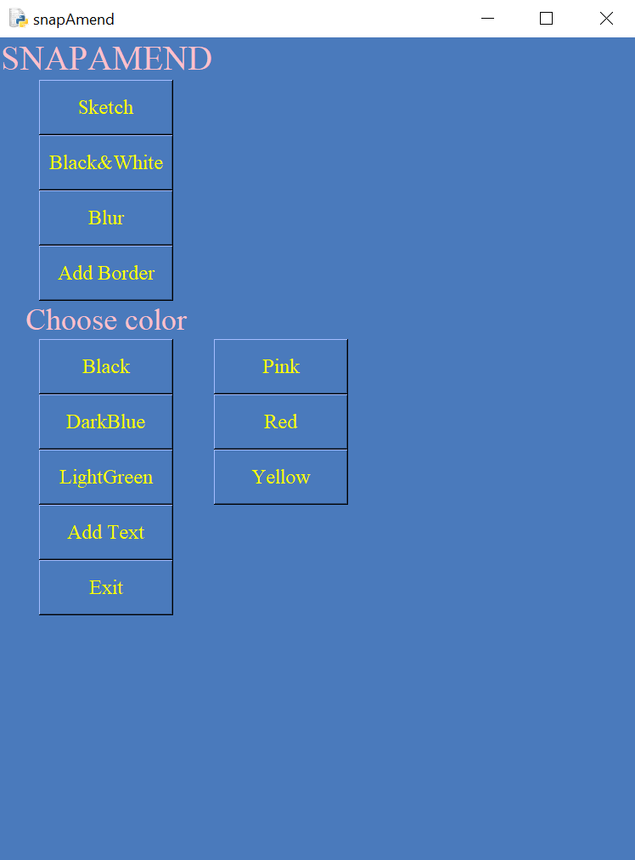
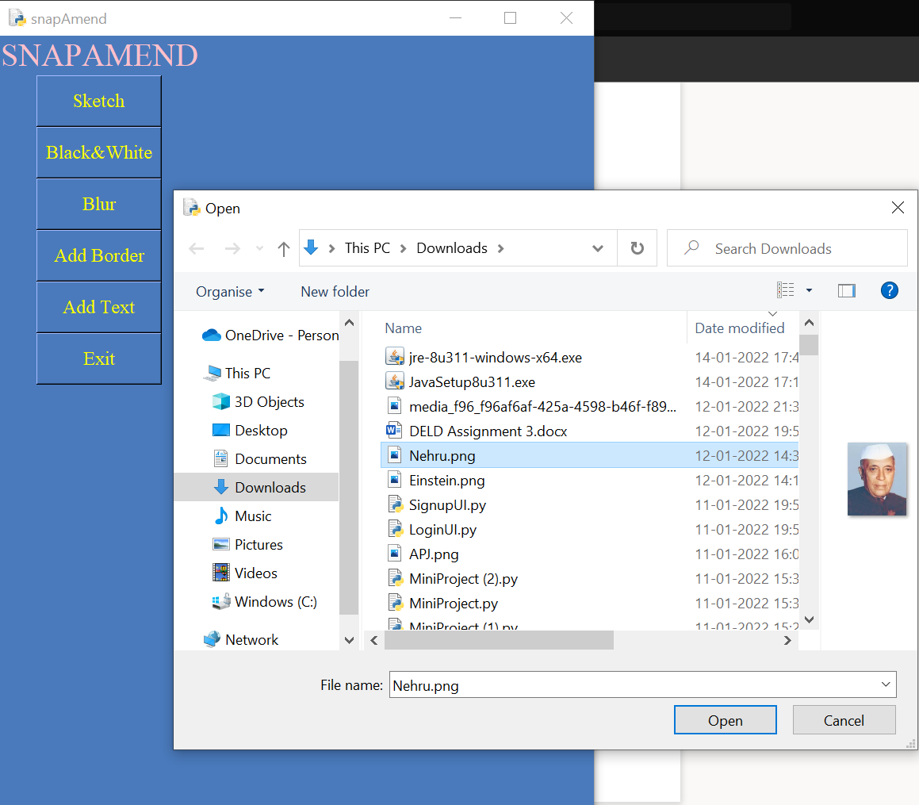
ADD Border

Slide 11
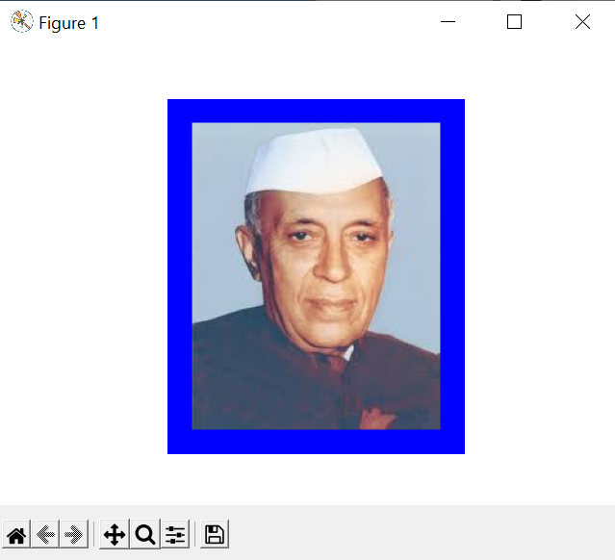
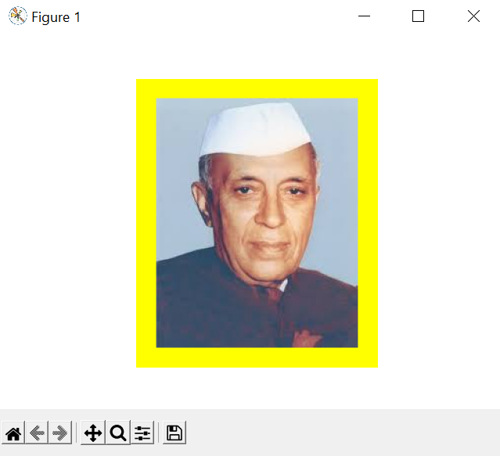
DARK BLUE
YELLOW

Slide 12
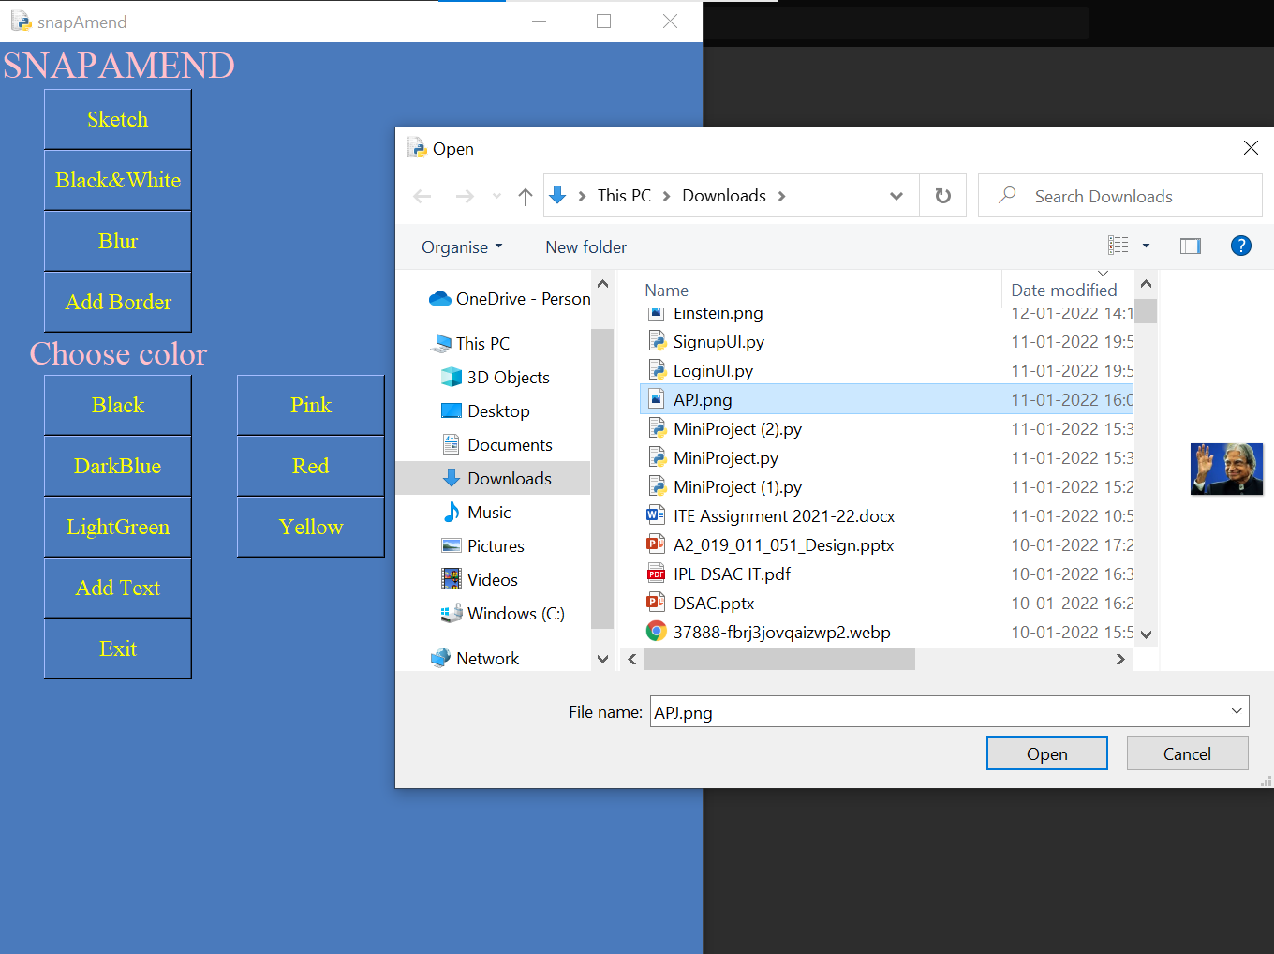
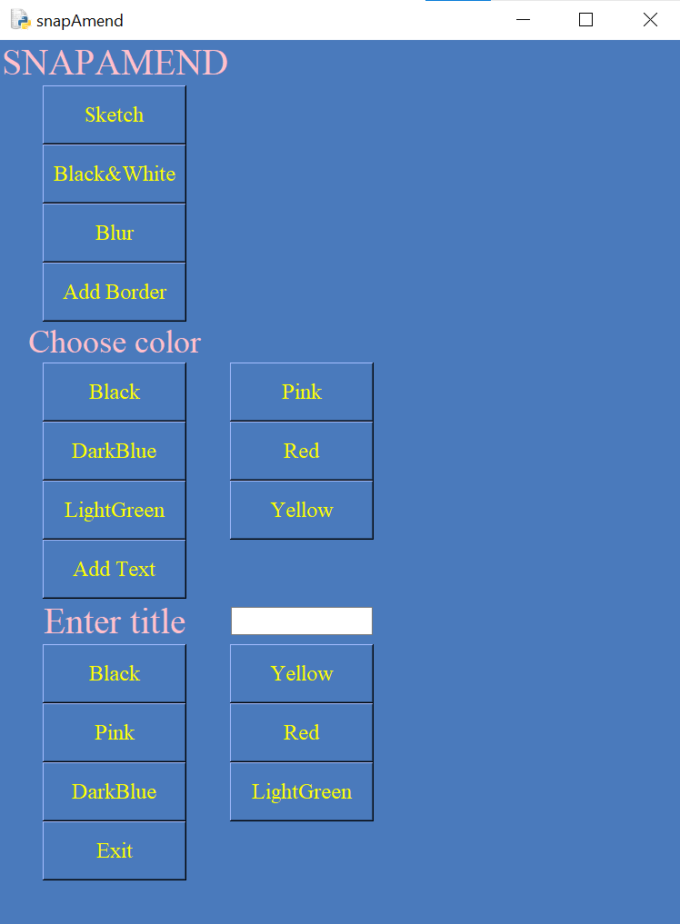
TEXT

Slide 13
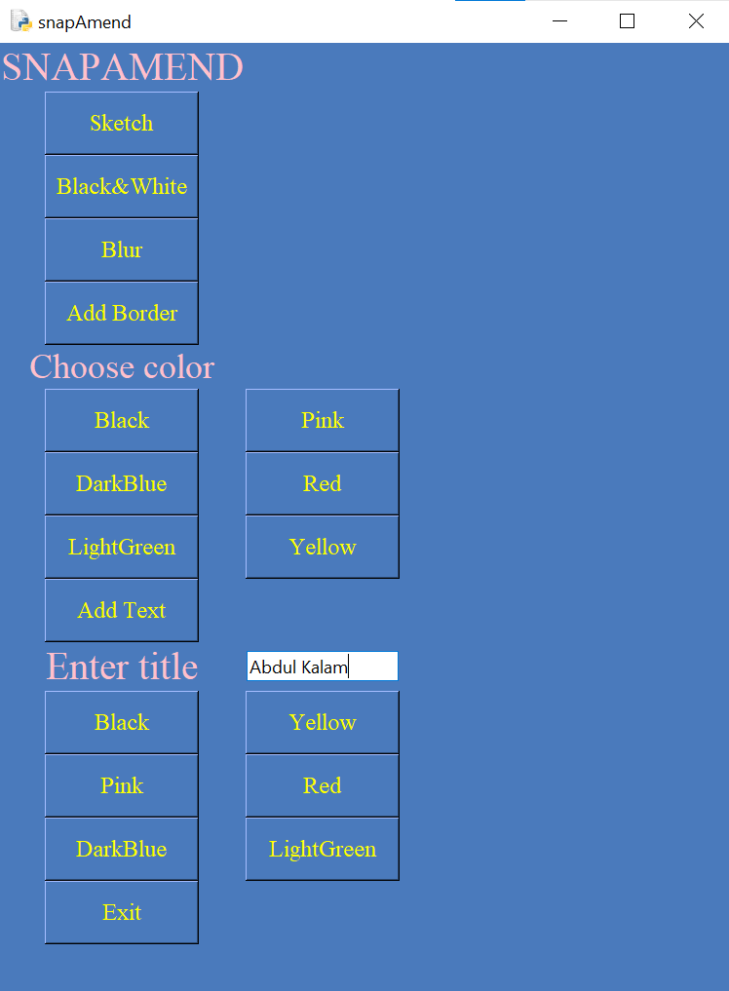
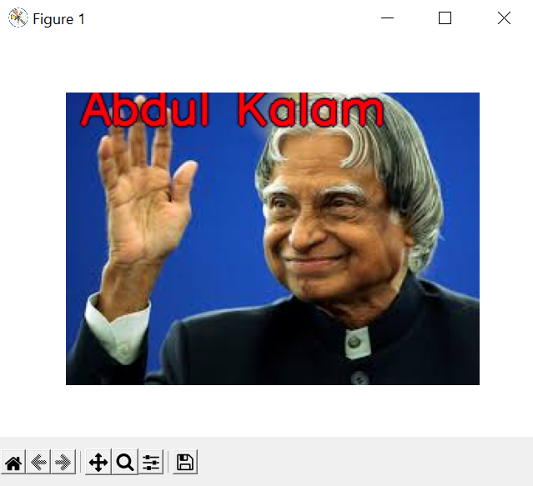
RED COLOURED TEXT

Slide 14
CONCLUSION AND FUTURE SCOPE
FINALLY WE LIKE TO CONCLUDE THAT OUR MINI PROJECt is a good application for those who like editing pictures and adding filters to the pictures
Our project has easy access to any file on pc and can save the edited picture at any location
In future we would like to add more options like cartoonize, background blur and even exchange of pictures

Slide 15

THANK YOU

