Slide 1
Digital Portfolio
STUDENT NAME: LALITHA.N
REGISTER NO AND NMID: 2426J1512 & asbruaz2426j1512
DEPARTMENT: B.SC(INFORMATION TECHNOLOGY)
COLLEGE: COLLEGE/ UNIVERSITY:KPR COLLEGE OF ARTS SCIENCE AND RESEARCH

Slide 2
PROJECT TITLE
Nurse Professional Skills Portfolio

Slide 3


AGENDA
Problem Statement
Project Overview
End Users
Tools and Technologies
Portfolio design and Layout
Features and Functionality
Results and Screenshots
Conclusion
Github Link
3/21/2024 Annual Review

Slide 4

PROBLEM STATEMENT
Nurses play a crucial role in delivering safe, compassionate, and effective patient care. However, traditional resumes and CVs often fail to capture the full spectrum of clinical expertise, hands-on skills, and quality improvement initiatives that nurses contribute to healthcare systems. Recruiters, hospital administrators, and training institutions require a more interactive, structured, and visually engaging way to evaluate a nurse’s professional skills, certifications, experiences, and projects.
The lack of a digital, well-organized portfolio makes it challenging for nurses to:
Present their clinical competencies (e.g., medication administration, wound care, patient monitoring) in a measurable way.
Showcase quality improvement projects, certifications, and continuing education beyond simple job titles.
Demonstrate soft skills such as patient advocacy, mentorship, and communication in a credible format.
Provide potential employers and collaborators with a quick, accessible, and professional online record of their qualifications.
There is a need for a dynamic, responsive, and print-friendly digital portfolio system that enables nurses to effectively highlight their skills, experience, and contributions in both online and offline formats.

Slide 5

PROJECT OVERVIEW
The Nurse Professional Skills Portfolio is a responsive web-based application that allows nurses to showcase their competencies, experiences, and achievements in an interactive format. Built with HTML, CSS, and JavaScript, it works seamlessly on both desktop and mobile devices.
Key features include:
Interactive Skill Bars – Animated progress indicators for clinical competencies.
Experience Timeline – Clear chronological display of professional roles.
Projects & Initiatives – Space to highlight quality improvement and patient safety efforts.
Theme Toggle & PDF Export – Personalization with light/dark modes and one-click PDF download.
Contact Form – Simple interface for collaborations or training requests.
The portfolio serves as both an online interactive resume and a print-friendly document for recruitment, academic, or networking purposes, bridging the gap between traditional CVs and modern digital needs in healthcare.

Slide 6

WHO ARE THE END USERS?
1.Nurses (Primary Users)
Nursing students, staff nurses, and senior nurses who want to showcase their clinical skills, education, certifications, and projects.
They use it as a digital resume for recruitment, promotion, or academic submissions.
2.Healthcare Recruiters & Employers
Hospital HR teams, nursing supervisors, and clinical managers who review nurse portfolios during job applications, promotions, or credentialing.
They benefit from the structured and visual format for quicker evaluation.
3.Academic Institutions & Educators
Nursing schools, faculty, and examiners can use it to assess student competencies, practical training, and quality projects.
Helps in tracking learning journeys and verifying achievements.
4.Professional Networking & Collaboration Partners
Other healthcare professionals, training providers, and quality improvement teams who may explore the portfolio for collaborations, workshops, or audits.
5.Patients & Community (Indirect Users)
While not the primary audience, patients or community health representatives may view simplified parts of the portfolio during patient education initiatives or awareness programs.a

Slide 7

TOOLS AND TECHNIQUES
1. Development Tools:
HTML5 – Structuring portfolio sections (skills, experience, forms).
CSS3 – Styling, responsive design, dark/light themes, print layout.
JavaScript (ES6) – Interactivity, theme toggle, skill bar animations, form handling.
Web Browsers (Chrome/Firefox/Edge) – Testing and debugging.
VS Code / Sublime Text – Code editing.
2. Design & Styling Techniques:
Responsive layouts with CSS Grid/Flexbox.
CSS Variables & Media Queries for theming and mobile adaptation.
Card-Based UI to present sections clearly.
Print-Friendly CSS for PDF export.
3. Interactive Features:
Intersection Observer API – Animate skill bars on scroll.
Local Storage – Save theme preference.
Event Listeners & Form Validation – User interaction handling.
PDF Export using window.print().
4. User Experience Enhancements:
Chips/Tags for certifications and tools.
Timeline View for experience.
Progress Bars & Project Cards for skills and initiatives.

Slide 8
PORTFOLIO DESIGN AND LAYOUT
Two-column grid → Profile, skills, experience (left); certifications, education, tools, contact (right).
Header with logo, nurse name, PDF export, and theme toggle.
Hero section → Avatar, designation, specialties, and skill tags.
Main sections → Summary, skill bars, timeline, projects, and protocols.
Side sections → Certifications, education, tools & technologies, contact form.
Design principles → Minimal, responsive, accessible, and print-friendly.
8

Slide 9
FEATURES AND FUNCTIONALITY
Header & Branding → Logo, title, tagline, with PDF export and theme toggle (saved in local Storage).
Hero Section → Avatar, name, designation, specialties, and chips for certifications/strengths.
Professional Summary → Short overview of clinical background and values.
Core Skills → Animated progress bars for medication, IV therapy, monitoring, wound care, etc.
Experience Timeline → Chronological roles with achievements and measurable outcomes.
Projects & Initiatives → Grid-style cards highlighting quality and safety projects.
Certifications & Education → Credentials, degree, and relevant coursework.
Tools & Tech → Chips for EHRs, monitors, infusion pumps, and devices.
Contact Form → Interactive form with validation and demo message status.
Footer & Extra Features → Auto year update, responsive design, accessibility, dark/light mode, and print-friendly export.

Slide 10
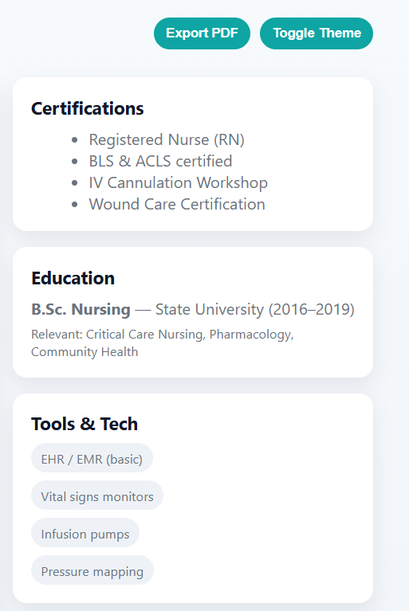
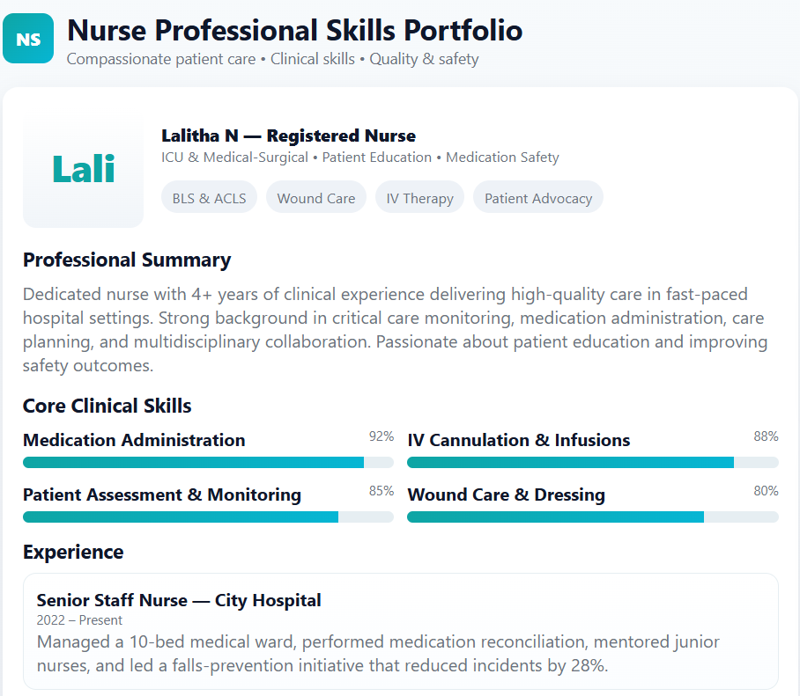

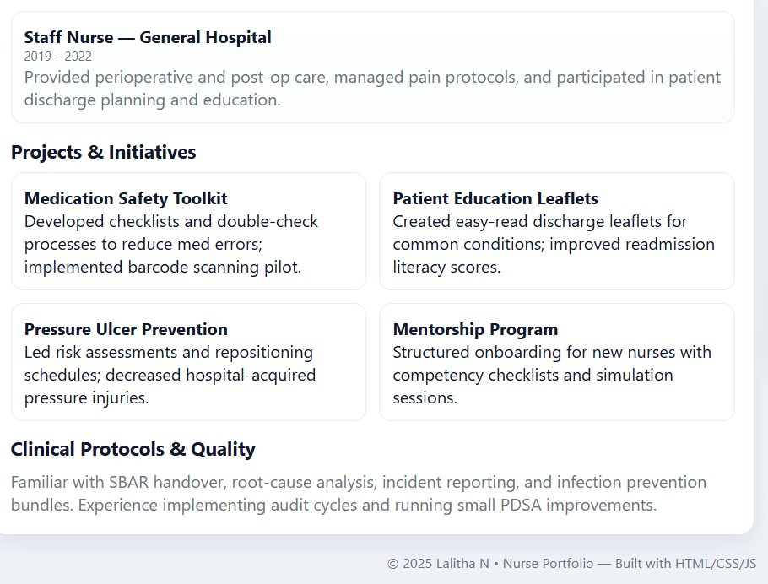
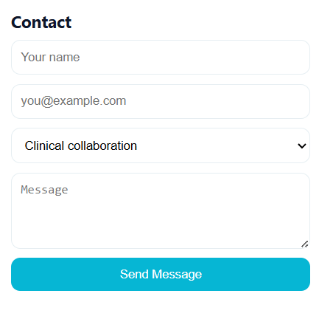
RESULTS AND SCREENSHOTS
3/21/2024 Annual Review
10

Slide 11
CONCLUSION
The Nurse Professional Skills Portfolio provides a modern, structured, and interactive way for nurses to present their qualifications, clinical skills, and professional contributions.
Unlike static resumes, this digital portfolio integrates:
Dynamic visualization of skills through progress bars and animations.
Organized sections for experience, certifications, projects, education, and tools.
Interactive features such as a contact form, theme toggle, and print-friendly PDF export.
Responsive design that works seamlessly across devices and adapts to both light and dark modes.
By combining professionalism with accessibility, the system empowers nurses to showcase their expertise while giving recruiters, institutions, and collaborators a clear, engaging, and quick way to evaluate credentials.
This portfolio bridges the gap between traditional CVs and modern digital expectations, offering a flexible format for both online engagement and offline documentation.
11

Slide 12
GITHUB LINK

