Slide 1
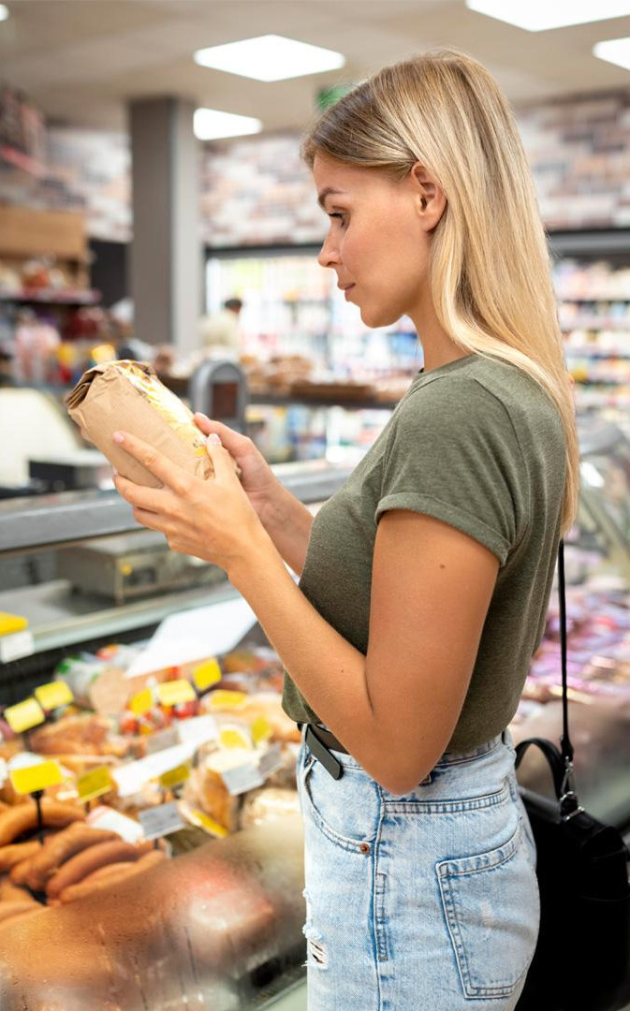
ONLINE GROCERY STORE
Team ID : 06
1002114097- Lalitha Nagasai Nagaraju
1002112714- Jaya Sravani Ganji
10020274432- Agan Peter Pidaparthi

Slide 2
Table of Contents
Introduction
Planning
Design
Implementation
Testing
Maintanence

Slide 3
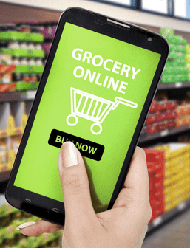
Project Description
The project involves developing a grocery shopping website where users can browse, search for, and purchase groceries online.
The website will include features such as user registration, product catalog browsing, search functionality, shopping cart management, secure payment processing, order tracking, and user reviews. Our aim is to replicate the seamless experience of traditional grocery shopping in an online environment, ensuring customer satisfaction and retention.

Slide 4
REQUIREMENTS
User registration and login systems for both customers and admins
Product catalog with categories, descriptions, images, and pricing.
Search functionality allowing users to find products easily.
Shopping cart feature to add, remove, and modify items before checkout.
Secure payment gateway integration for online transactions.
Order tracking system to monitor the status of placed orders.
User review and rating system for products.
Scalability to handle increasing traffic and product inventory.
Compliance with data protection regulations to ensure customer privacy

Slide 5
2. PLANNING

Slide 6
ESTIMATION METHODS
We have several estimation methods for planning and scheduling tasks:
Time Estimation: The time estimates are broken down into specific activities such as Planning and Requirements Gathering, Design and UI/UX Development, Front-end Development, Back-end Development, Integration and Testing, and Deployment and Maintenance. Each activity has a specified duration in days.
Task Management Tools: The project mentions the use of task management tools like Jira, Monday.com, or Asana. These tools typically incorporate estimation methods such as bottom-up estimation, where individual tasks are estimated, and then aggregated to provide overall project estimates.
Burn Down Chart: The project includes a Burn Down Chart, which is a visual representation of planned versus actual progress over time.
Gantt Chart: The Gantt chart provides a visual representation of the project schedule, showing the timeline for each phase and task.

Slide 7
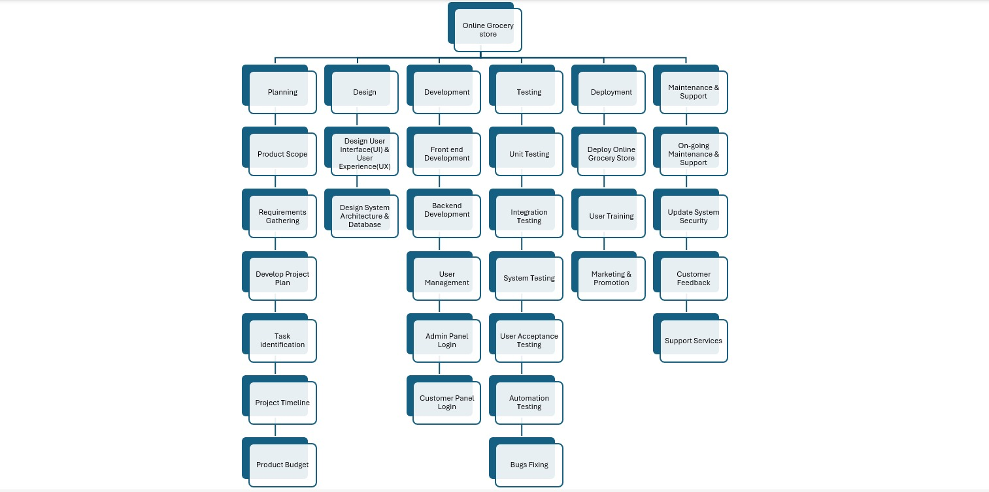
WORKDOWN STRUCTURE

Slide 8
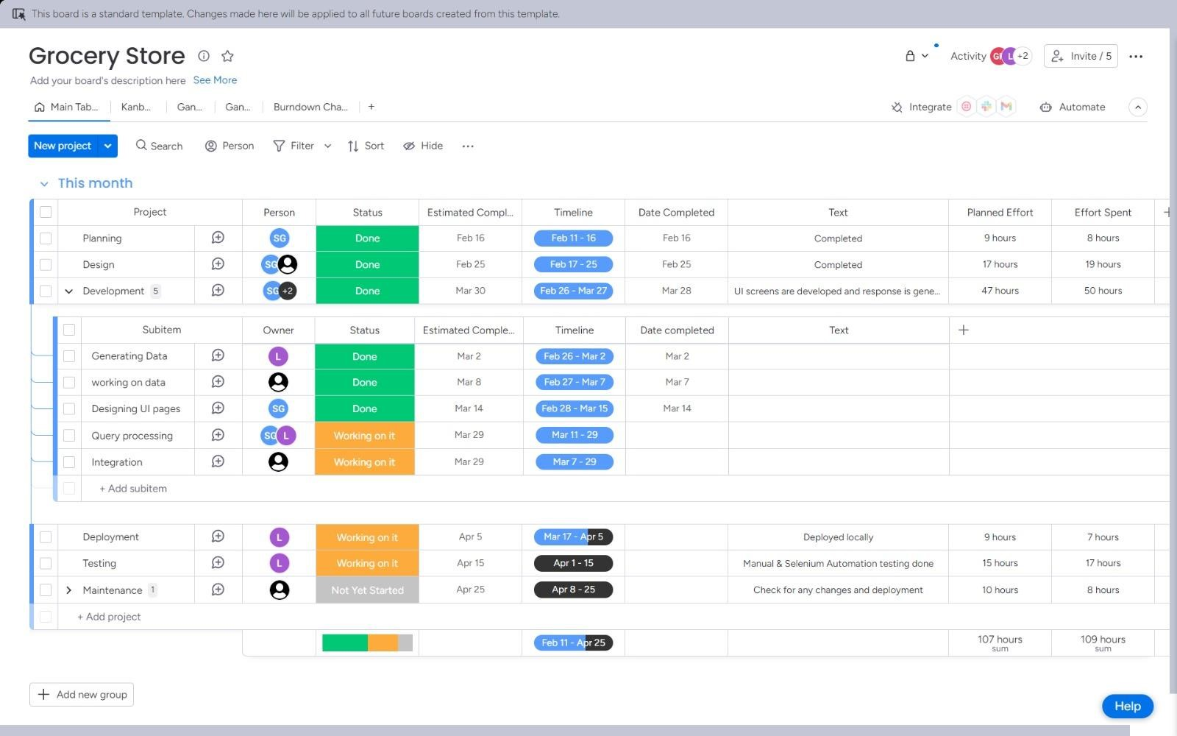
PLANNING
Here we used MONDAY.COM for project planning, team collaboration and for reports and analytics.
Each column contains cards that represent tasks. Each card contains information about the task, such as task name ,people assigned, status ,estimated completion date, date completed, text , planned effort and effort spent .

Slide 9
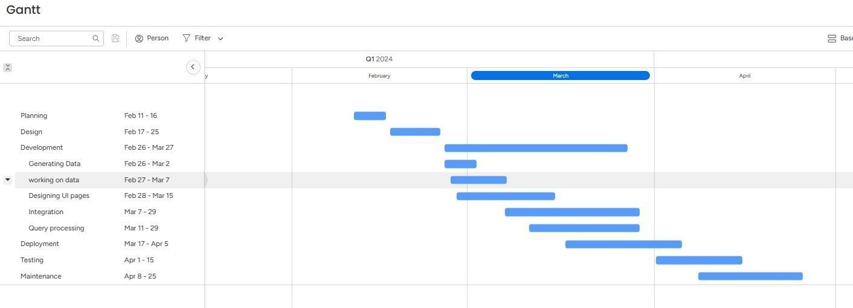
GANTT CHART

Slide 10
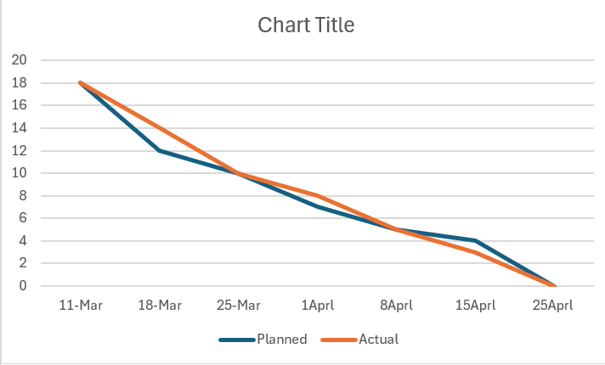
BURNDOWN CHART

Slide 11
RISK IDENTIFICATION AND ASSESMENT
RISK FACTOR | PROBABILITY | RISK PLANNING
Technology Risk: Dependency on third-party APIs | Moderate (25-50%) | Implement graceful degradation strategies
Tool Risk: Compatibility issues with chosen development tools/platforms | Low (10-25%) | Evaluating toolsets, flexibility in technology choices and have migration plan
Requirements Risk: Ambiguous or incomplete project requirements | High (50-75%) | Comprehensive requirement gathering, implementing a robust process.
Estimation Risk: Underestimation of project timeline | Moderate (25-50%) | Regular review and adjust project plans based on progress

Slide 12
3.DESIGN

Slide 13
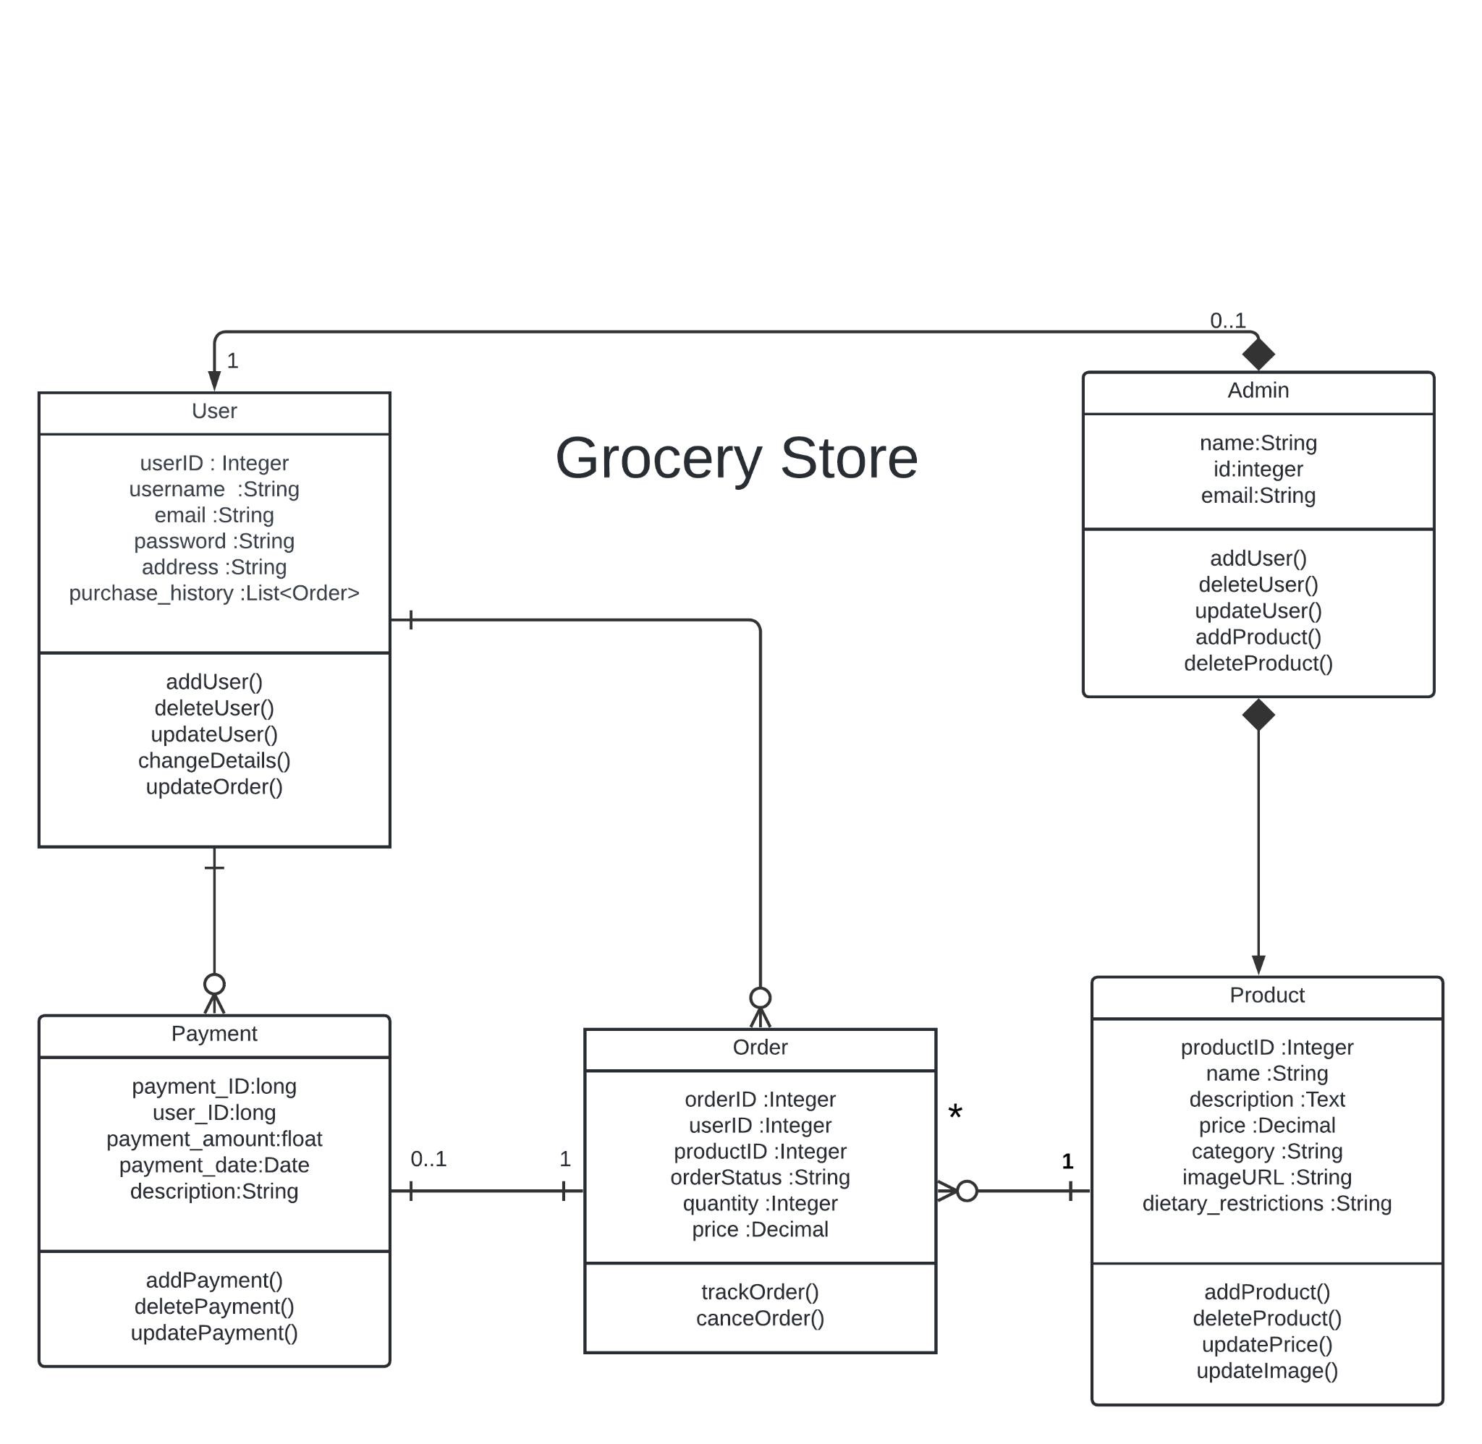
UML DIAGRAM

Slide 14
4.IMPLEMENTATION

Slide 15
HARDWARE REQUIREMENTS
I3 Processor with 4GB RAM
SOFTWARE REQUIREMENTS
HTML
CSS
JS
ReactJS
MYSQL
VS Code
Apache, Php and Xampp

Slide 16
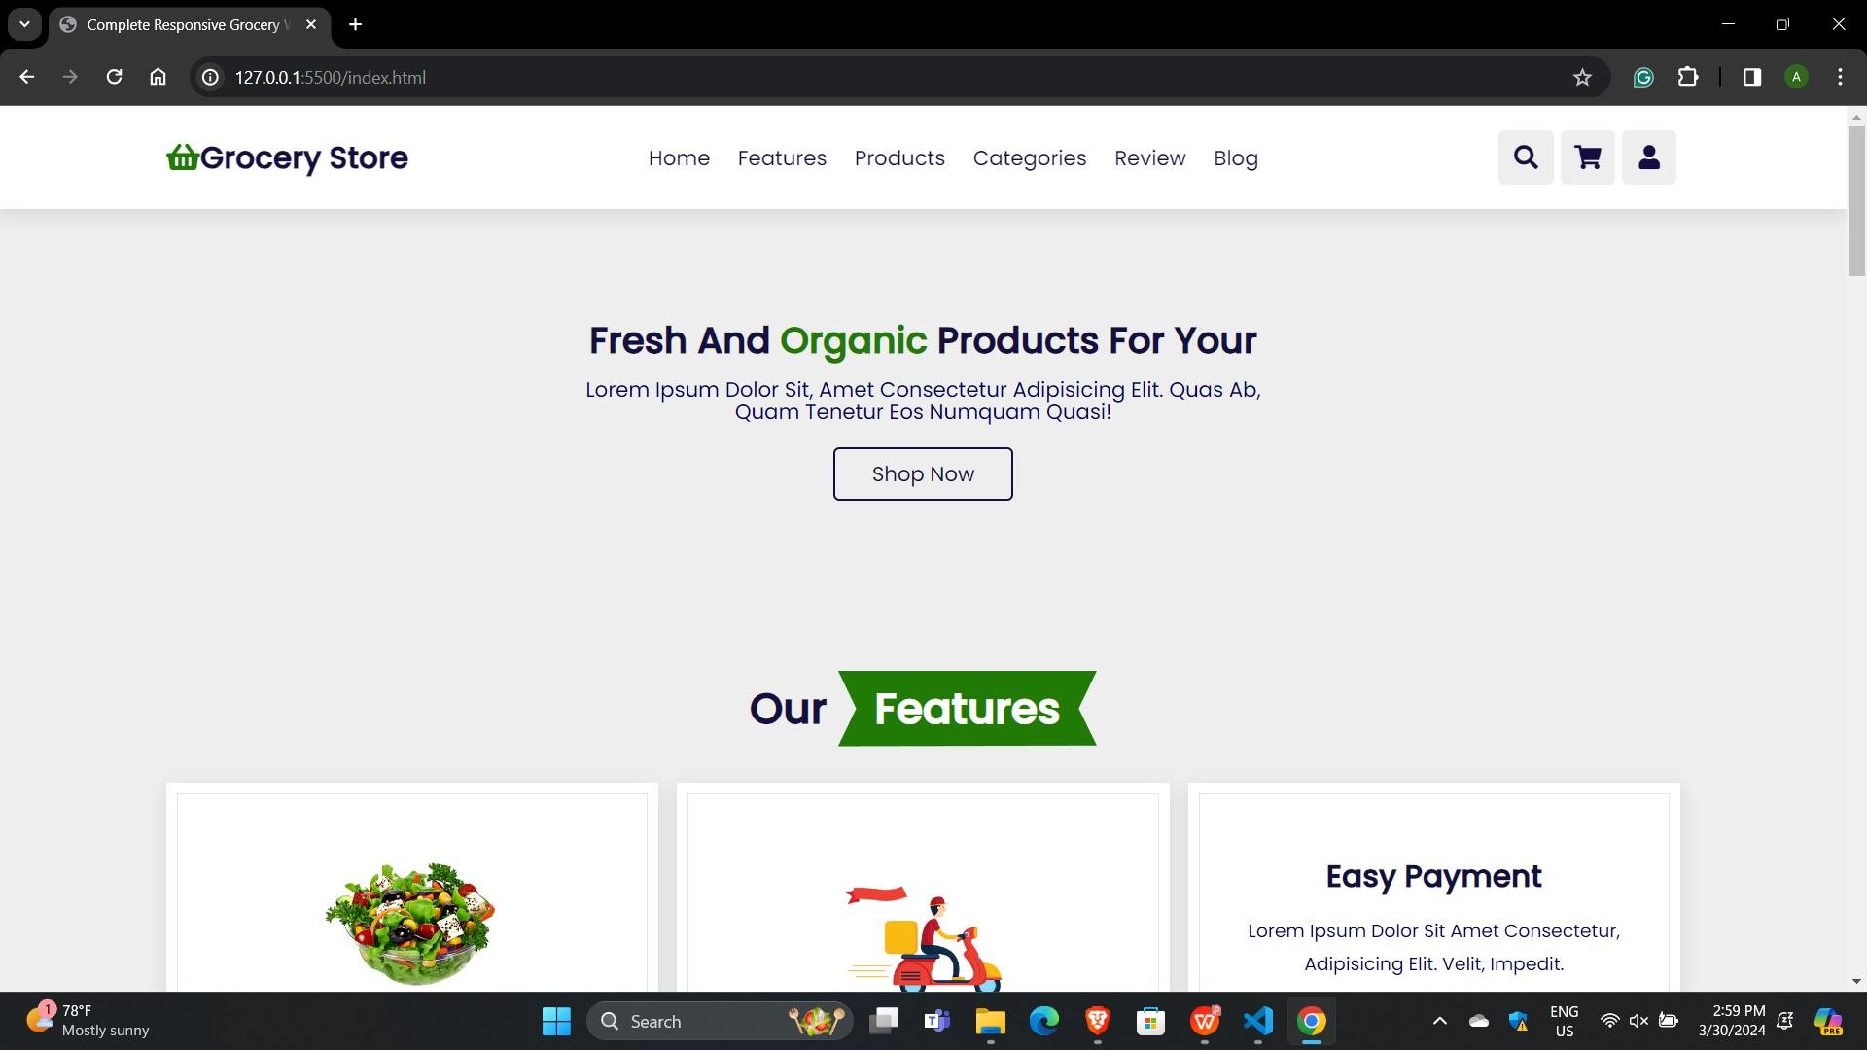
USER INTERFACE

Slide 17
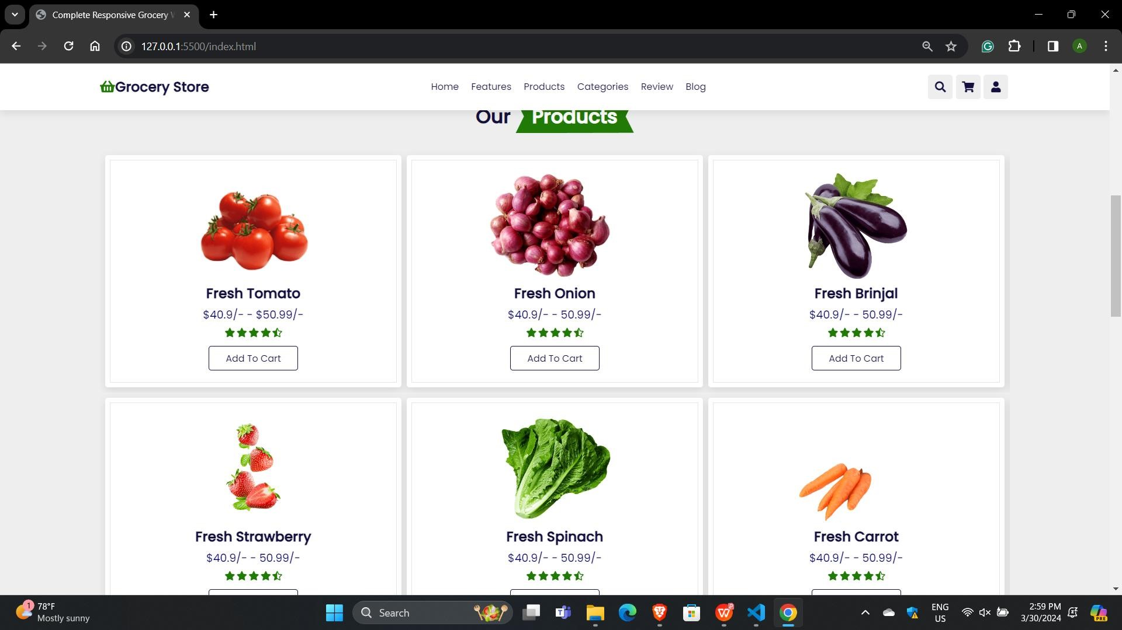
USER INTERFACE

Slide 18
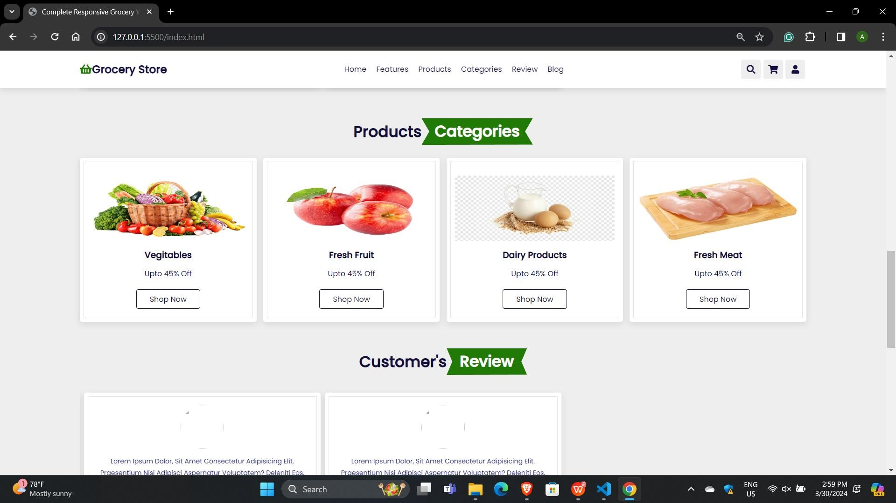
USER INTERFACE

Slide 19
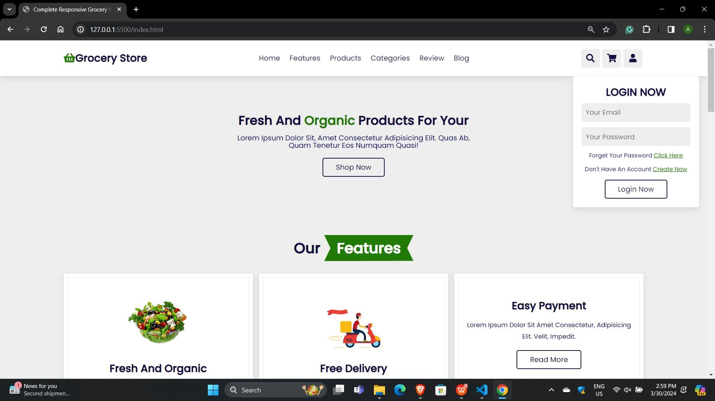
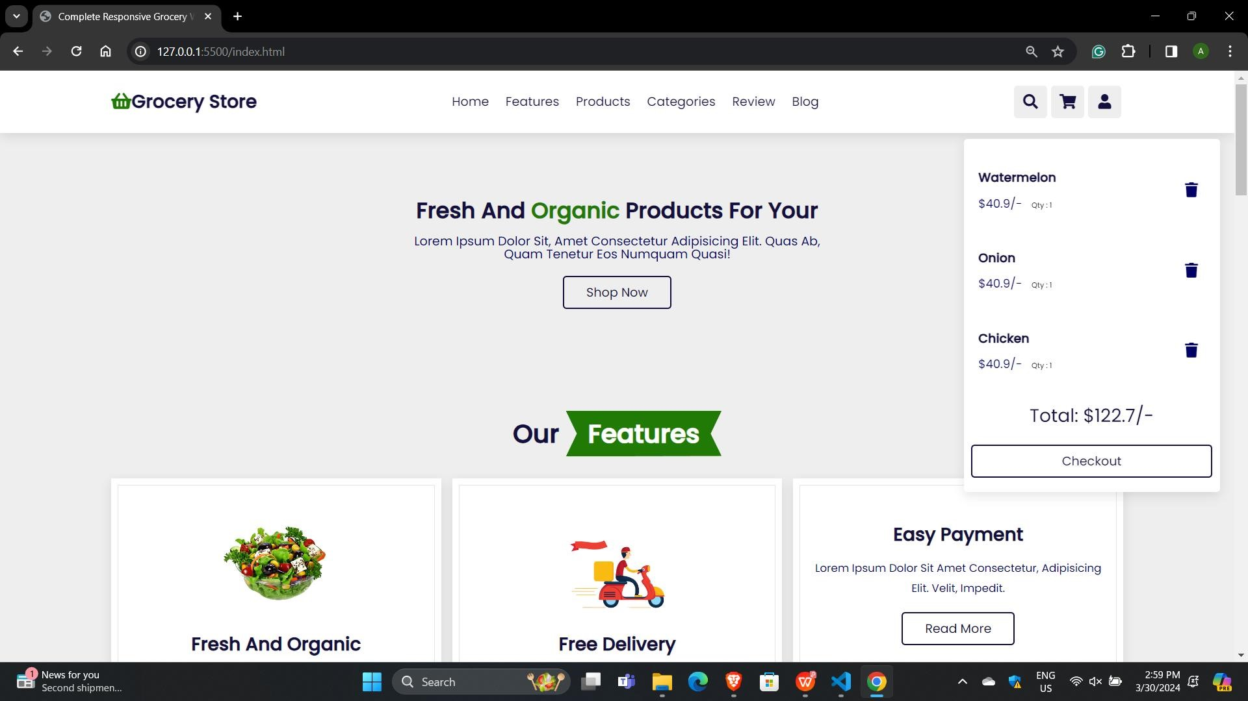
USER INTERFACE

Slide 20
5. TESTING

Slide 21
MANUAL TESTING
UNIT TESTING :
Front-end Unit Testing:
Product Catalog Component: Verified correct display of products fetched from backend. Ensured filtering products by category functions correctly. Tested adding products to the shopping cart functionality.
User Authentication Component:
Validated user login functionality with valid credentials , verified appropriate display of error messages for invalid login attempts and tested user registration process for successful sign up.
Back-end Unit Testing:
RESTful APIs: Verified product information API returns correct data. Ensured payment processing API securely handles transactions and tested order tracking API for accurate status updates.

Slide 22
MANUAL TESTING
INTEGRATION TESTING :
Front-end and Back-end Integration Testing:
Ensured seamless integration between front-end components and back-end APIs.
Verified correct passing of user authentication tokens for secure access.
Tested integration of shopping cart feature with backend for consistent item management.
SYSTEM TESTING :
Simulated complete user journey from registration to placing order to ensure smooth feature integration.
Tested system scalability with high volume of concurrent users browsing and purchasing products.
Performed security testing to identify and mitigate potential vulnerabilities such as SQL injection or cross-site scripting attacks.

Slide 23
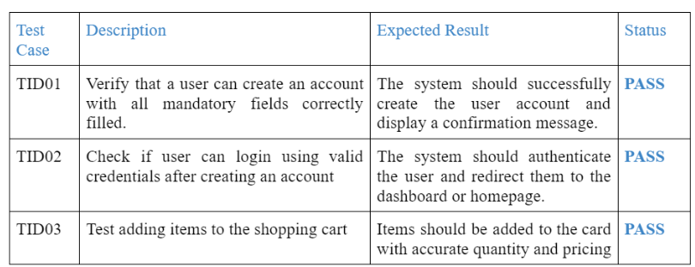
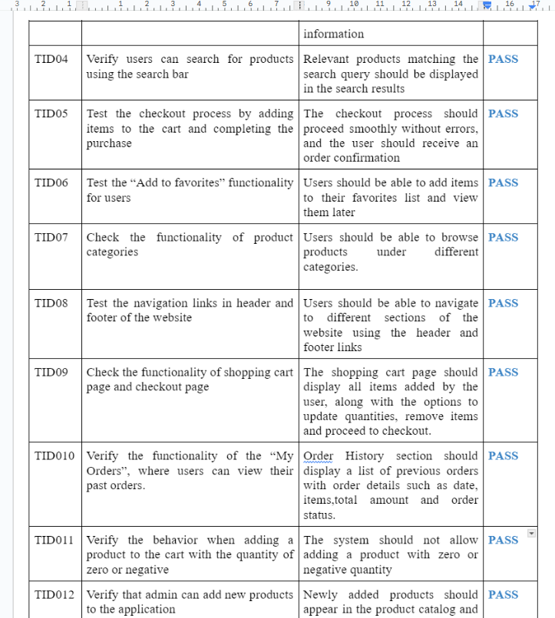
TEST CASES

Slide 24
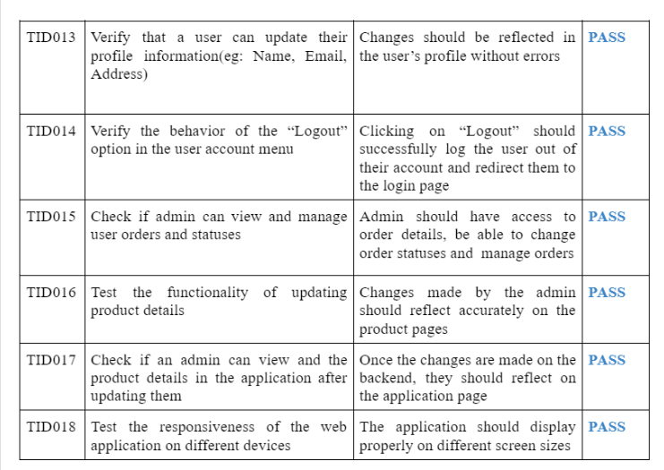

Slide 25
AUTOMATION TESTING
USING SELENIUM :
Our team meticulously identified and documented test cases covering various functionalities of the grocery store website, including user registration, product browsing, search functionality, shopping cart management, secure payment processing, and order tracking.
Based on the identified test cases, our testers created comprehensive test scenarios to simulate user interactions with the website. These scenarios encompassed a wide range of user behaviors and inputs to ensure thorough testing coverage.
Through the implementation of automation testing with Selenium, we achieved a remarkable outcome – all test cases were executed successfully without encountering critical failures or defects. Each automated test scenario was meticulously designed to validate specific functionalities of the grocery store website, and Selenium's robust testing capabilities facilitated thorough verification.

Slide 26
5.MAINTANENCE

Slide 27
MAINTENANCE
Maintenance Phase:
During the maintenance phase, our focus shifts to sustaining and enhancing the E-Commerce Grocery Store platform. Key tasks include:
Bug Fixes: Identifying and resolving software glitches promptly to ensure system stability.
Performance Optimization: Continuously improving platform speed and efficiency.
Security Updates: Keeping the platform secure with regular patches and updates.
Feature Enhancements: Adding new features and refining existing ones based on user feedback.
User Support: Providing ongoing assistance to ensure smooth user experience.

Slide 28
Services
SERVICES WE CAN PROVIDE FOR OUR CUSTOMERS:
User Registration/Login: Securely create accounts, manage profiles, and recover passwords.
Product Catalog: Well-organized groceries with descriptions, images, and pricing.
Search Functionality: Robust search for quick product finding.
Shopping Cart: Easily manage items, view subtotal, and total costs.
Secure Payments: Multiple payment options with reliable gateways.
Reviews/Ratings: Customers can leave feedback to help others.

Slide 29
Future Scope
Quick deliveries: It would be possible to receive our groceries the same day we place our order. Additionally, we might arrange for deliveries at our convenience. The website may even employ cutting-edge technology to schedule time-saving delivery routes.
Local farms, fresh produce: The website may offer additional locally grown, fresh produce from neighboring farms.
Track your groceries: With the use of specialized equipment, you can keep track of the origin of your food and know exactly what you're purchasing.
Click and collect: Choosing items online and then rushing to the store to get them might be common in the future.

Slide 30
References
SAFEWAY GROCERY STORE - https://www.safeway.com/
FRESH DIRECT STORE- https://www.freshdirect.com/
FOR USER INTERFACE - https://dribbble.com/
FOR FRONT END DEVELOPMENT - https://github.com/
FOR BACKEND - https://nodejs.org/en
TASK MANAGEMENT TOOL- https://monday.com/

Slide 31

THANK YOU

