Slide 1
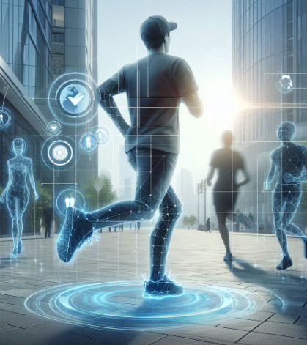
Title: A Human Activity Recognition-Based Safety System
CSC 588 - U17 Pattern Recognition and Machine Learning
By
Lalitha Priya Bijja – 101168225

Slide 2
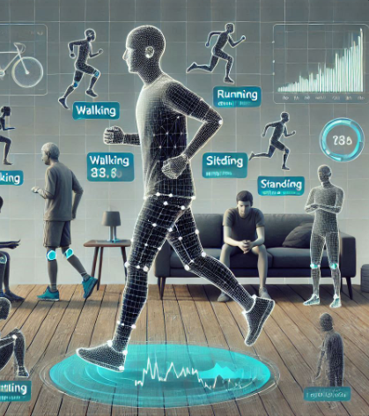
Problem Statement
The task is to classify various human activities, such as walking, running, sitting, and standing, based on time-series sensor data.
Additionally, the system should be able to detect abnormal activities and send automated alerts to designated contacts.

Slide 3

Objectives
Key aspects of the solution include:
Preprocess raw sensor data to make it suitable for model training.
Explore the dataset to understand its structure and patterns.
Build and compare LSTM and RNN models to classify human activities.
Evaluate the performance of the models using metrics such as accuracy and confusion matrices.
Implement an SOS email alert system to notify emergency contacts in case of abnormal activities.
Implementing a detection mechanism for abnormal behavior, triggering a safety protocol when such behaviors are detected.

Slide 4
Dataset
Source: UCI HAR Dataset
Description: This dataset is widely used for human activity recognition tasks. It contains sensor data collected from the accelerometer and gyroscope of a smartphone, worn on the waist by 30 volunteers.
The data captures six types of activities: walking, walking upstairs, walking downstairs, sitting, standing, and lying down.
.

Slide 5
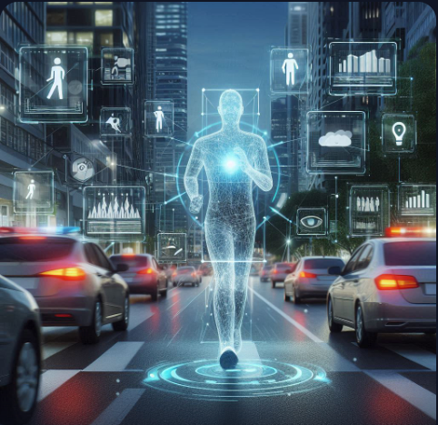
Methodology
 | Steps | Methods/Techniques
1. | Data Preprocessing | Standardization Label Encoding Reshaping for LSTM/RNN Train/test split
2. | Exploratory Data Analysis | Null Values Missing values Outlier Detection Feature Corelation Class Distribution Temporal Analysis
3. | Visualization Techniques | Histogram Bar plot Correlation Heatmap
4. | Machine Learning models | LSTM Model RNN Model
5. | Model Evaluation | Confusion matrix Accuracy Loss Plot

Slide 6
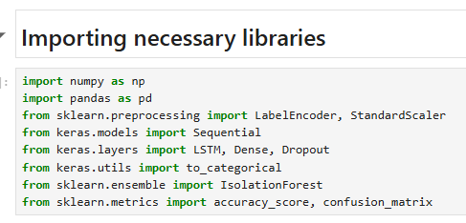
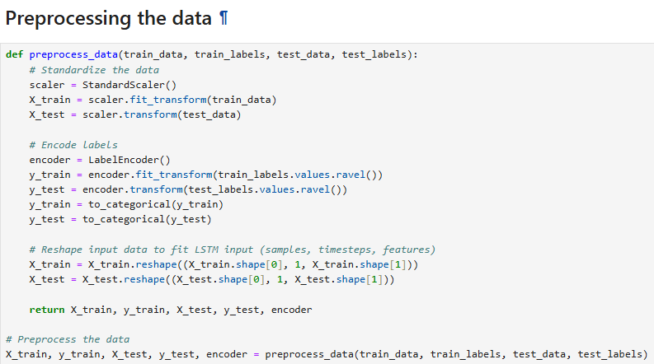
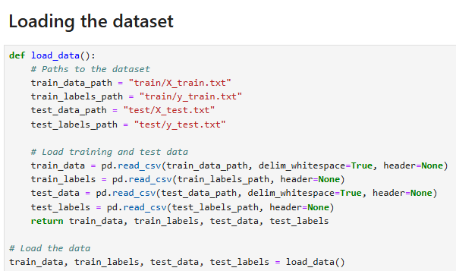
Installing necessary libraries & loading data
Performing Data Preprocessing
Fig: Importing Libraries

Slide 7
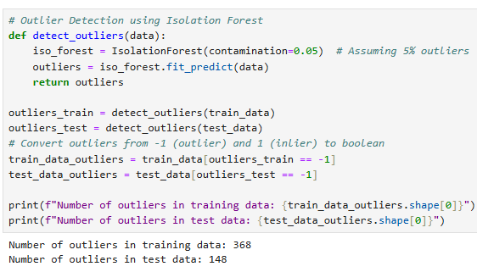
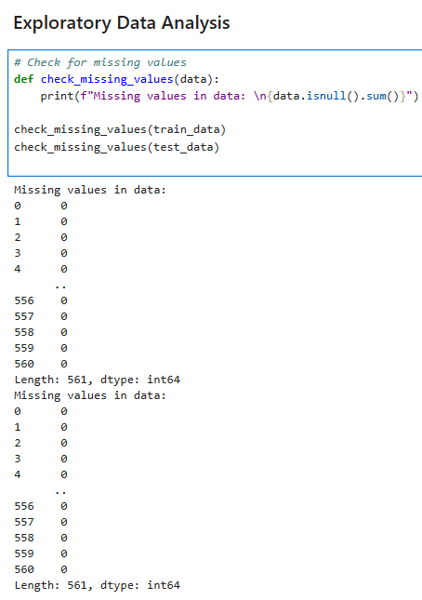
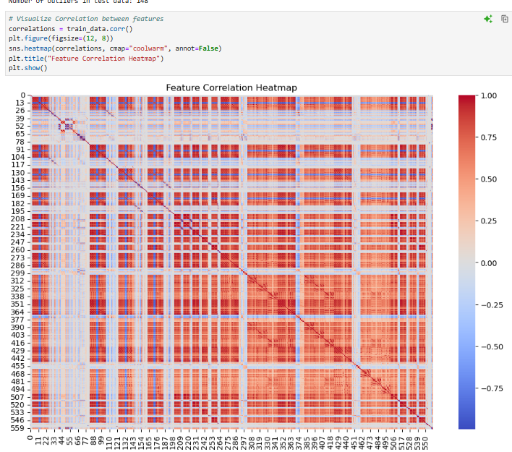
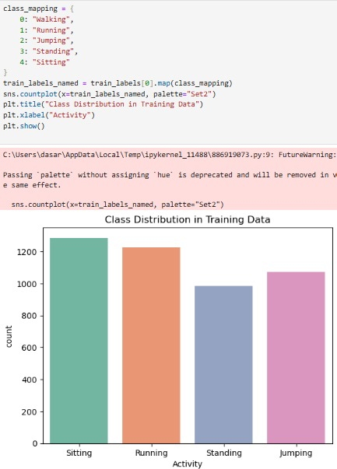
Exploratory Data Analysis
Fig: Outlier Detection
Fig: Correlation Heatmap
Fig: Checking for missing values
Fig: Training data distribution

Slide 8
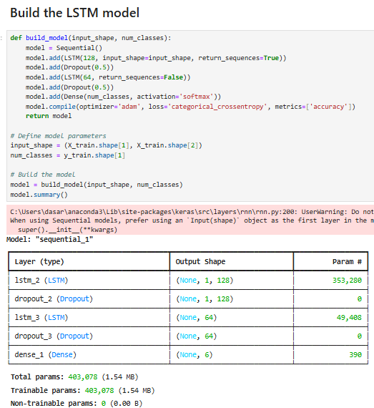
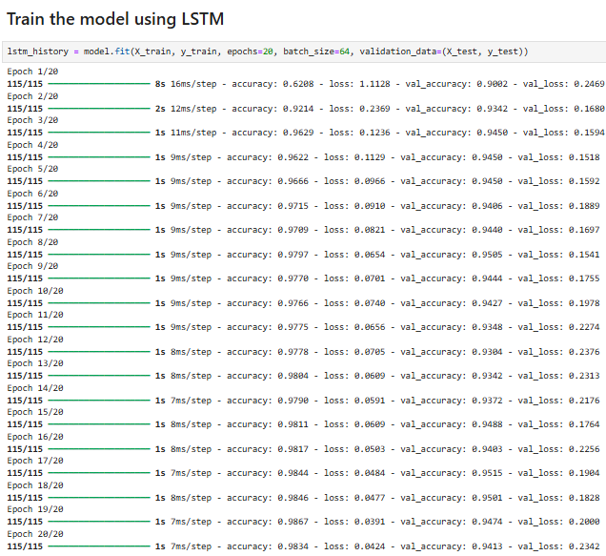
Building Machine Learning Models
Long Short – Term Memory (LSTM) Model
Fig: LSTM Model

Slide 9
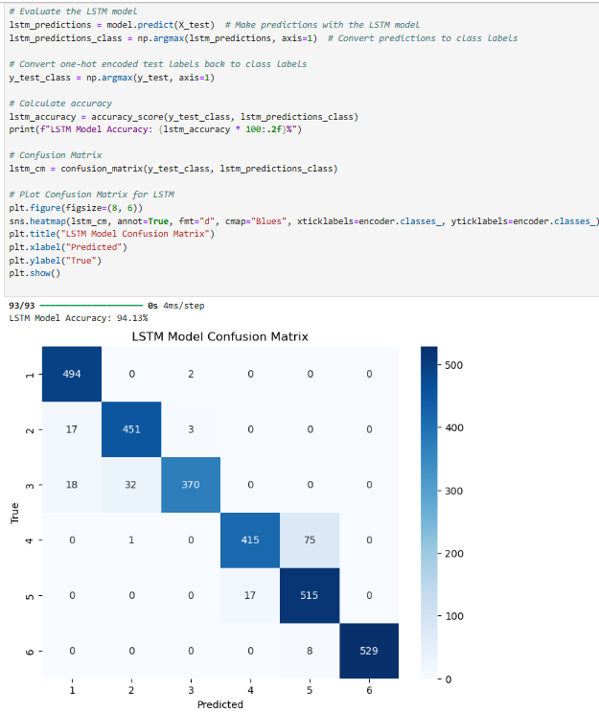
Model Evaluation (LSTM)
High Accuracy classes: correct predictions is for class 6, 529 correct predictions. Moderate Accuracy Classes: Other classes such as class 1 and class 2.
Lower Accuracy Classes: The lowest number of correct predictions is for class 3, with 370 correct predictions.
Misclassification (Non-diagonal): 75 instances of class 4 were misclassified as class 5.

Slide 10
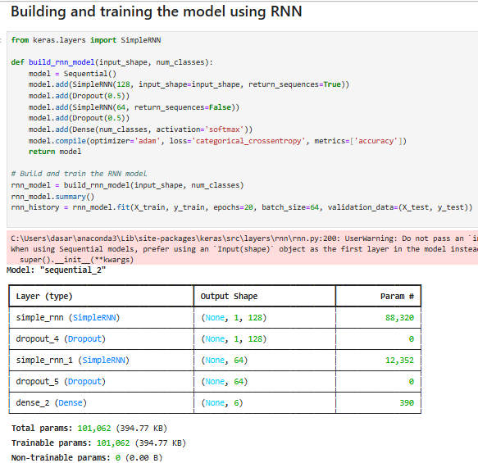
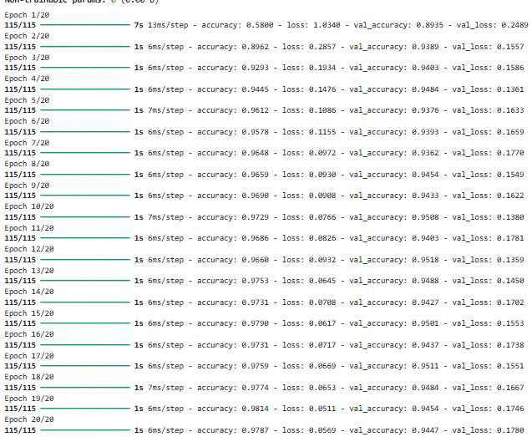
Recurrent Neural Network (RNN) Model

Slide 11
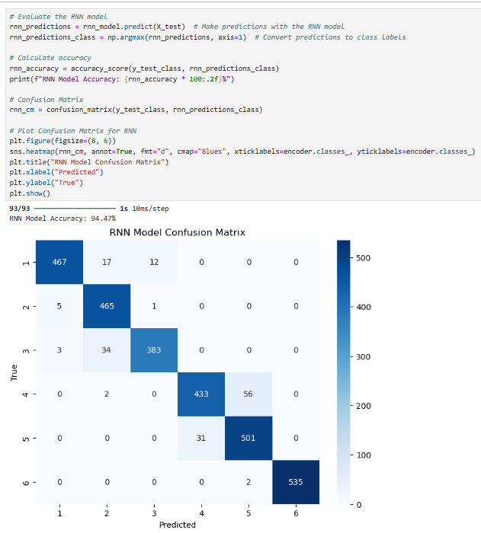
Model Evaluation (RNN)
Accuracy: 94.47%
High Accuracy: The model shows high accuracy across most classes.
Misclassification: class 2 being sometimes confused with class 1 and class 3.

Slide 12
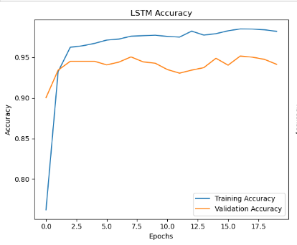
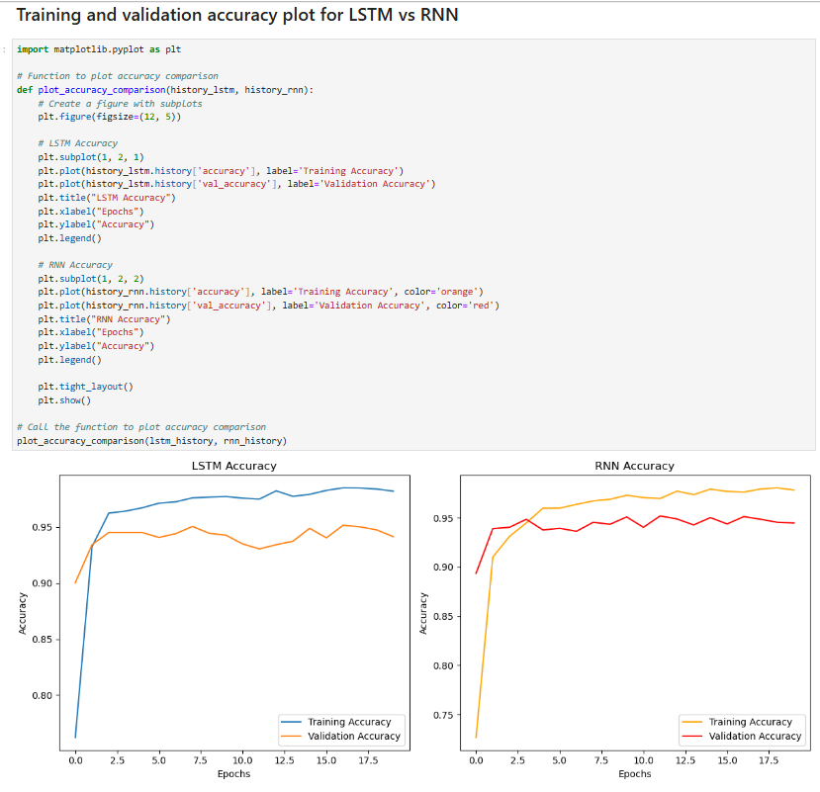
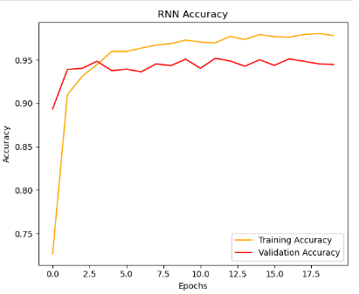
Comparison LSTM Vs RNN
Performance: Both models show high accuracy and low loss metrics, indicating strong performance in classifying human activities.
Overfitting: Both models exhibit signs of overfitting, with training accuracies higher than validation accuracies.

Slide 13
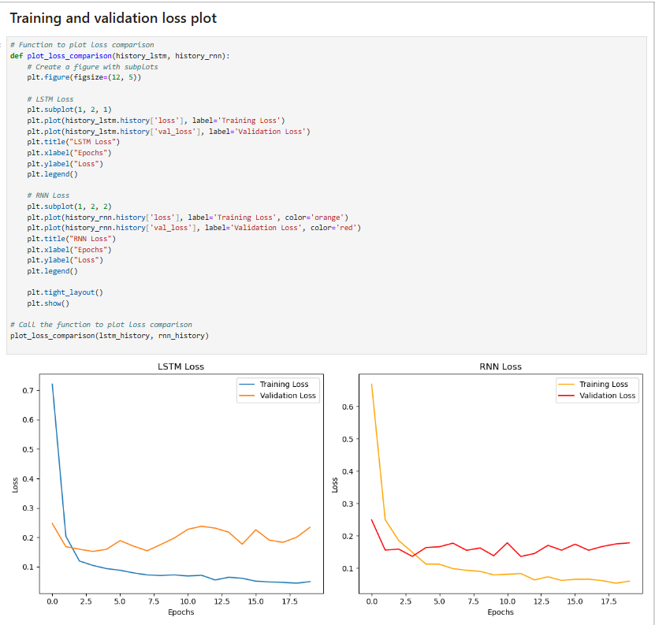
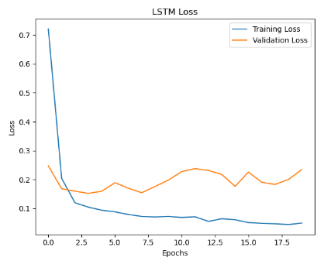
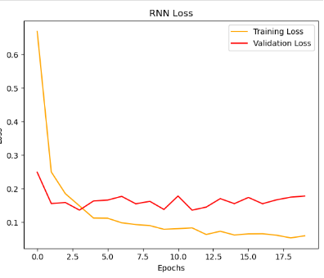
Loss Plot
LSTM model have a slight edge in stability and performance than compared to RNN

Slide 14
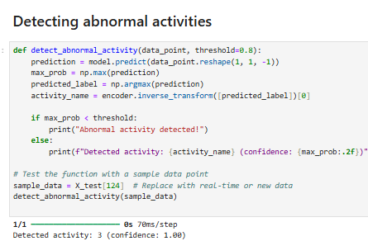
The model is highly confident (100%).

Slide 15
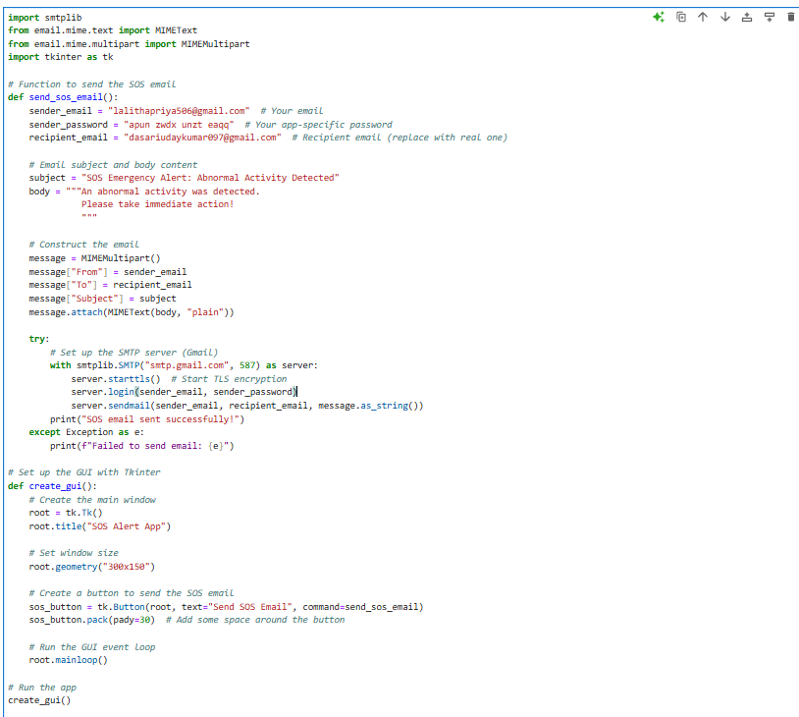
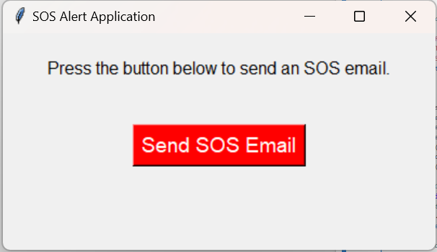
Developing SOS Alert Application

Slide 16

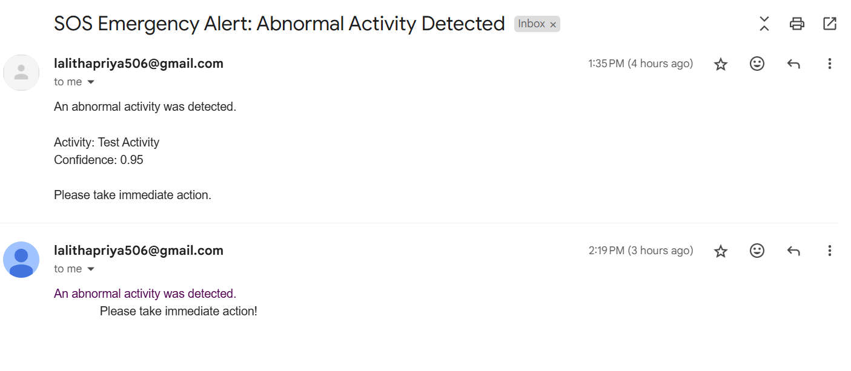
Results

Slide 17
Conclusion
LSTM Performance: The LSTM model demonstrated superior performance in terms of accuracy and robustness.
RNN Performance: The RNN model achieved reasonable accuracy but struggled with certain classes due to its limited capability to retain long-term information.
Class-wise Performance: Some activity classes, such as "Walking Downstairs," showed higher misclassification rates, possibly due to overlapping feature characteristics.
SOS Alert System: The SOS alert system was successfully implemented.

Slide 18
Key Takeaways
The LSTM model demonstrated superior effectiveness over the RNN model for time-series data.
Standardization and one-hot encoding were critical in achieving high accuracy.
Exploratory Data Analysis (EDA) revealed significant patterns and relationships within the dataset.
The SOS alert system illustrated the real-world applicability of the project.
Future Directions
Advanced Architectures: such as Bidirectional LSTMs, Transformers, or hybrid approaches
Real-Time Processing: Extend the system to handle real-time data streams from wearable devices.
Mobile Integration: Develop a mobile application to enable broader accessibility and real-world use.
Class Imbalance Solutions: Address class imbalance using methods like oversampling, undersampling, or class weighting for improved classification of minority classes.

