Slide 1
ASSIGNMENT-1
CYBER SECURITY WITH IBMQRADAR
N.Lalitha Laya Devi
20NR1A0575
BITS VIZAG

Slide 2
INTRODUCTION TO CYBER SECURITY
:-
What is cyber security ?
Cyber security is the practice of protecting computer systems, networks, and data from digital threats like hacking, malware, and unauthorized access
Types of cyber security attacks
Active attack
Passive attack
1)Man in the middle
2) Spoofing
3)Dos attack
4)phishing attack
5)Reply attack
1)Computer surveillance
2)Network surveillance
3)Wire tapping

Slide 3
ESSENTIAL TERMINOLOGY
Malware:- Malware is harmful software designed to damage computers, steal data, or gain unauthorized access to systems.
IP address:-
An IP address is a unique numerical label assigned to devices on a network, enabling communication and identification over the Internet.
Phishing:-
Phishing is a cyber attack where scammers impersonate legitimate entities to trick people into revealing personal or sensitive information, often through deceptive emails or websites.
Firewall :- A firewall is a security barrier that monitors and controls network traffic, preventing unauthorized access and protecting against cyber threats.
Social engineering:- Social engineering is manipulating people to gain unauthorized access or sensitive information.
Ransomware:- Ransomware is a type of malicious software that encrypts files on a victim's device and demands payment for their release.
Antivirus:- Antivirus is software that protects computers from viruses and malware by detecting, blocking, and removing them.

Slide 4
Introduction to network
OSI model
Tcp/Ip
Client server architecture
networks
Port & protocols
Cisco packet tracer
subneting
Windows n/w commands

Slide 5
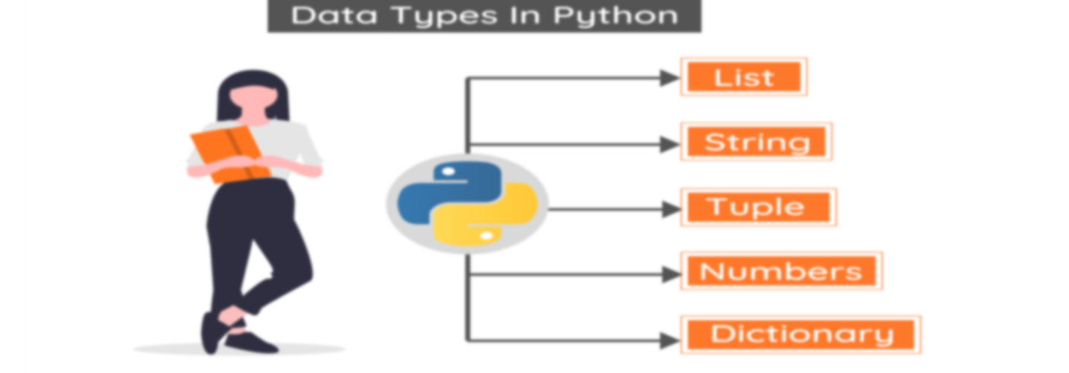
Python for hacking
Introduction:
Python ,a versatile programming language is widely used in the field of cyber security & hacking due to its simplicity ,flexibility & extensive libraries
Setting up python:
Install python from the official website.
Data types:
File handling:
Python offers robust file handling capabilities allowing hackers to read, write & manipulate files

Slide 6
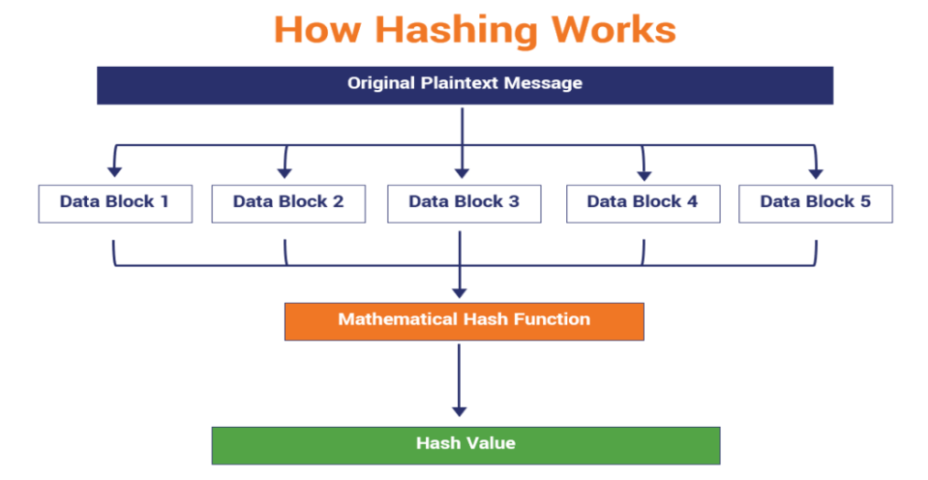
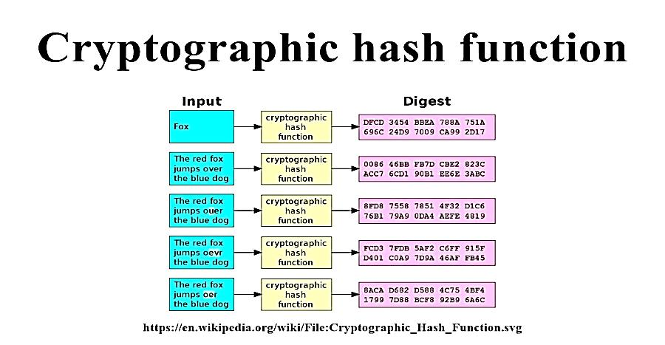
Cryptographic failures
Example:-cryptography for hashing
Agenda
Cryptography for hashing
Text based hashing
Packet analyzers
Cryptoforce
Port scanners
Brute force
Rever shell
Fuzzers

Slide 7
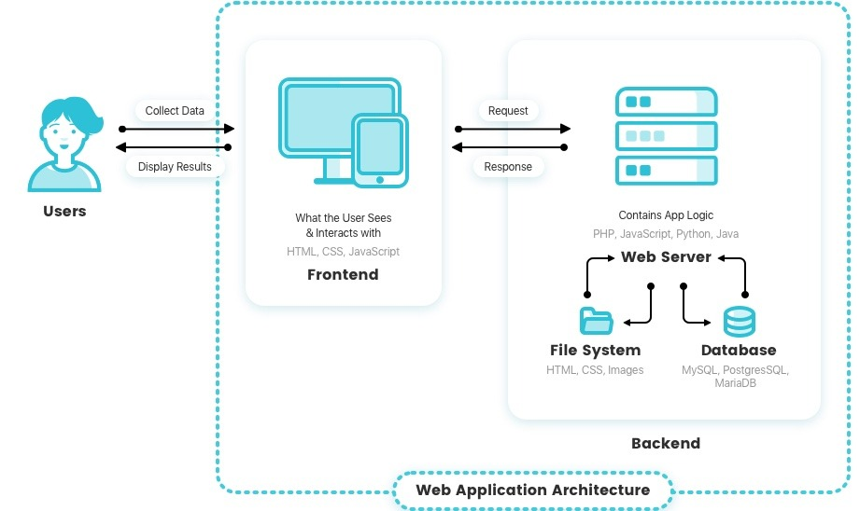
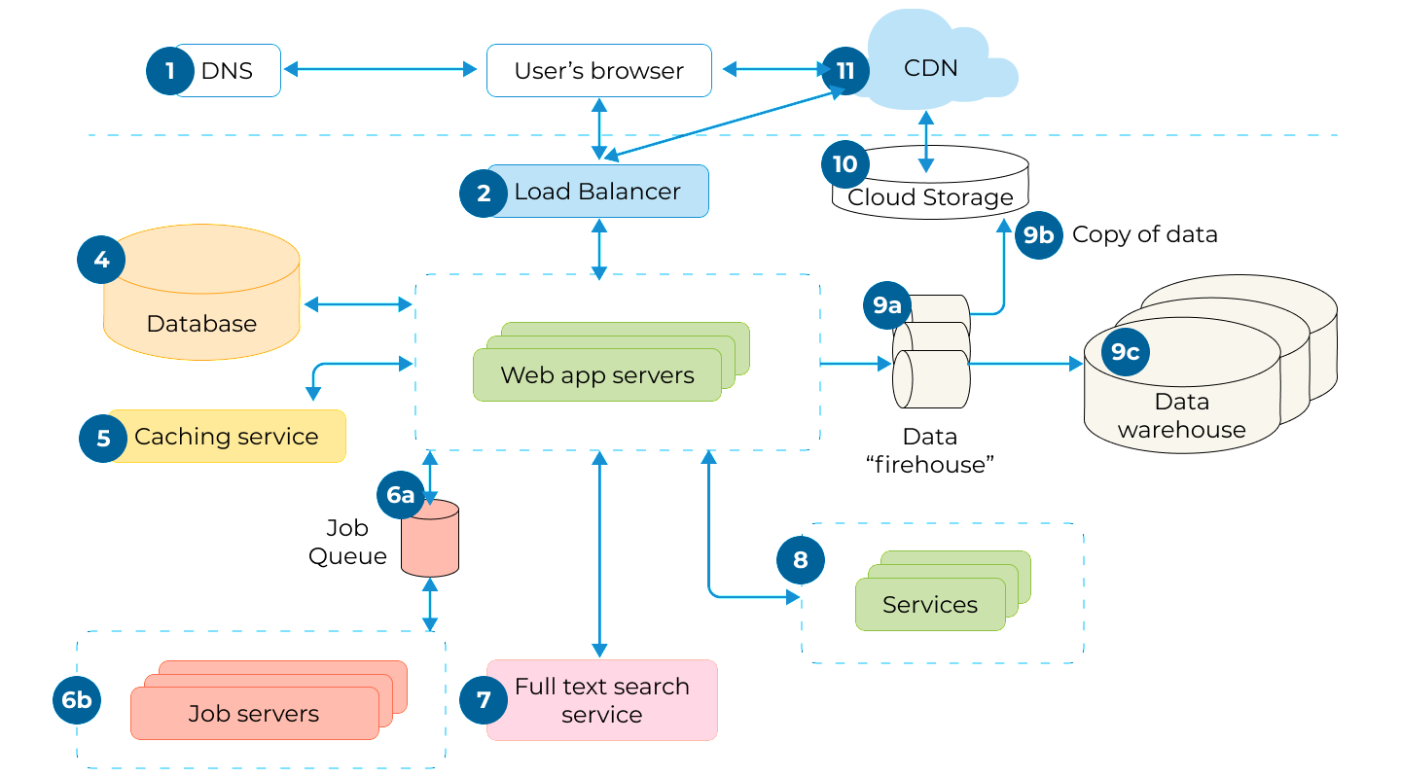
Hacking web applications
What is web application ?
Web application is a computer program that is accessed through a web browser
Over a network ,typically the internet.
How web applications works
Web application architecture

Slide 8
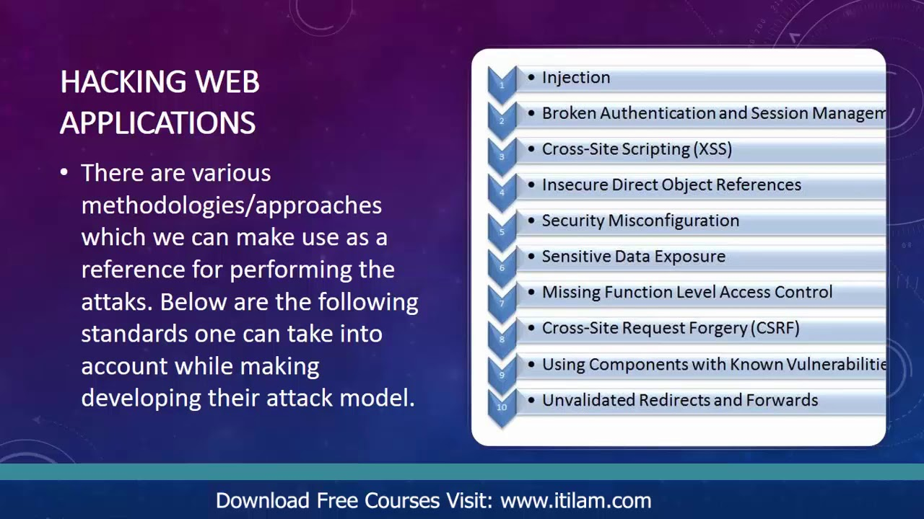
Owasp top 10 applications security risks -2021

Slide 9
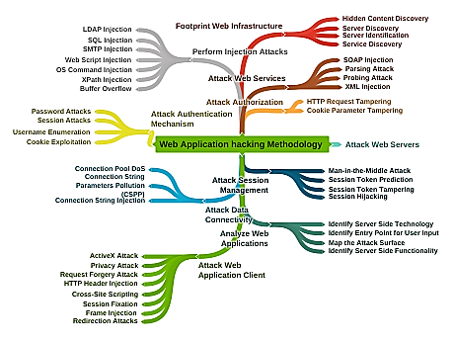
Web applications hacking methodology

Slide 10
webhooks
Webhooks are a way for web applications to communicate with each other in real-time. The basic operation of webhooks involves a sender application (such as an API or service) notifying a receiver application (another service or endpoint) about an event that has occurred.
Here's a brief overview of how webhooks work:
Event Trigger: An event occurs in the sender application, such as a new user signup, a payment received, or a file uploaded.
Notification: The sender application sends an HTTP POST request containing data about the event to a predefined URL, which is the endpoint of the receiver application (webhook endpoint)
.
Receiver Processing: The receiver application receives the HTTP POST request from the sender, processes the data, and takes appropriate actions based on the event received.
Response: Upon receiving the data, the receiver application may send a response to acknowledge receipt of the webhook payload.
Webhooks allow for seamless integration and automation between different web services and applications, enabling them to react to events and trigger actions in real-time without the need for constant polling or manual intervention

