Slide 1
BOOKS BUY MART
Team members:
Sardar Harleen Singh
Kayethoju Rakesh
Danda Sravani Reddy
Athipamula shashikanth

Slide 2





Technologies Used.!
Frontend
Backend

Slide 3
PROJECT SCOPE:
Providing users with books on the subscription basis.
Admin has the access to all the stock available and manipulating the availability of books.
Users can access the mart once they sign up for availing the book

Slide 4
Screenshots

Slide 5
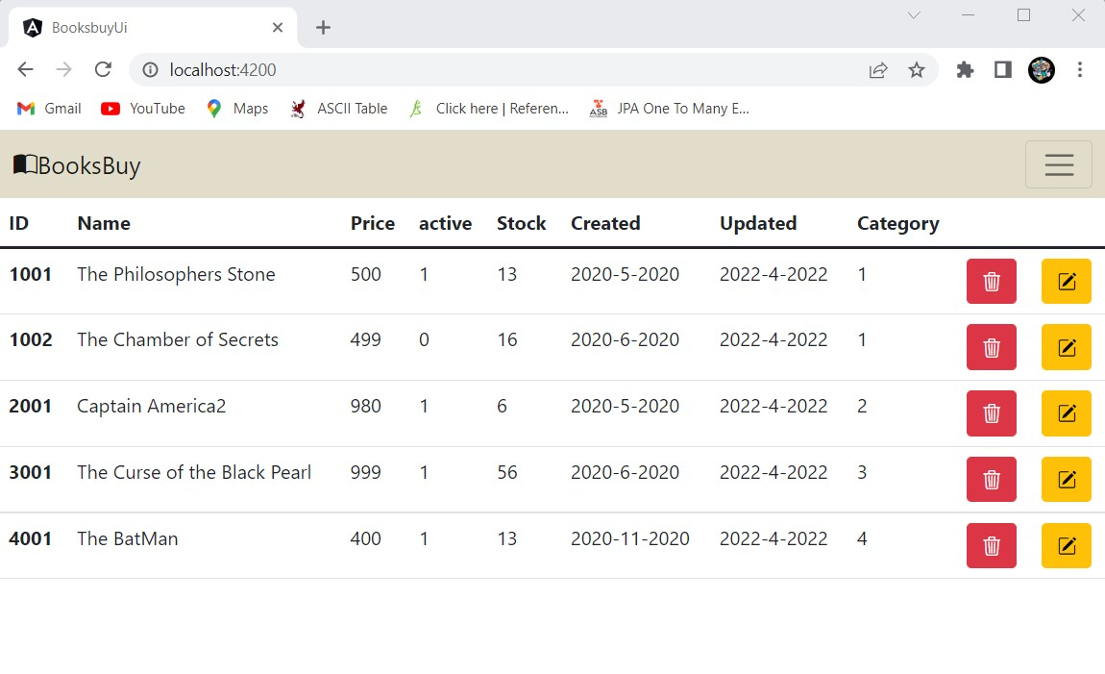

Slide 6
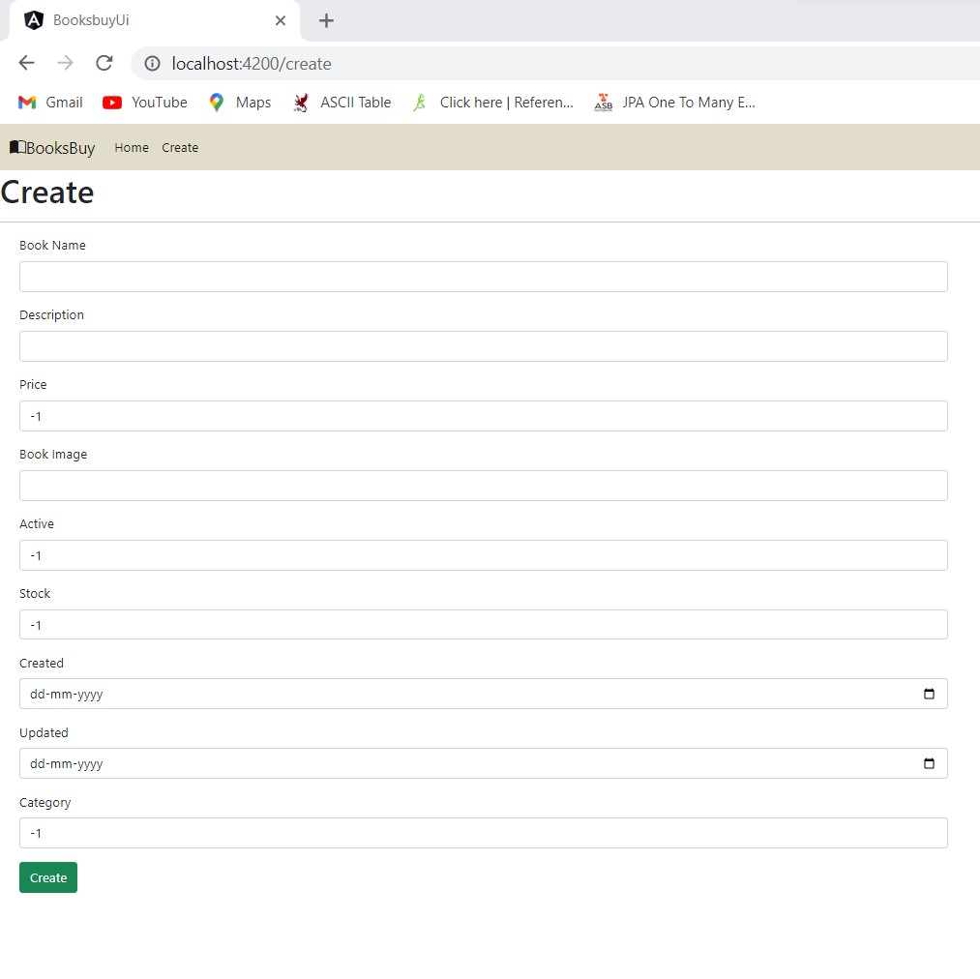

Slide 7
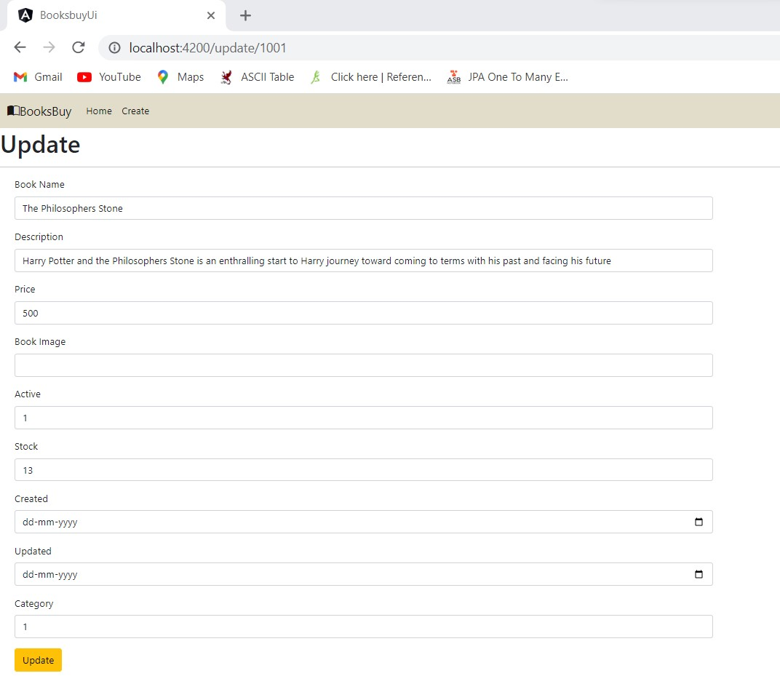

Slide 8
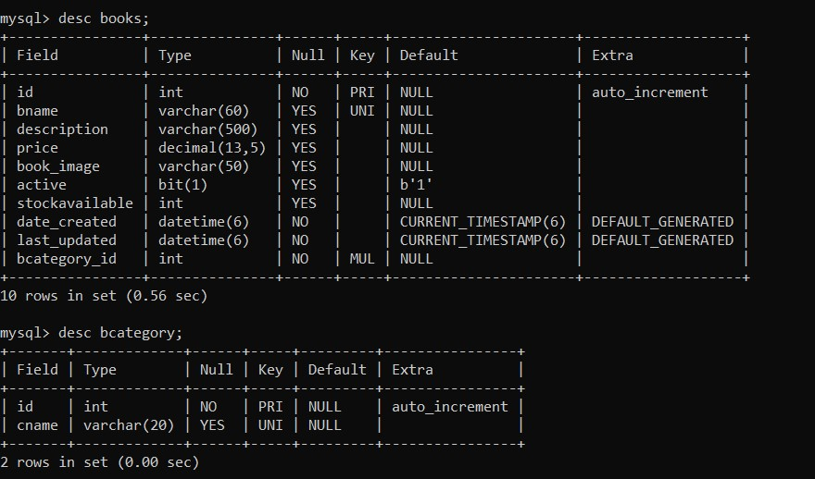

Slide 9
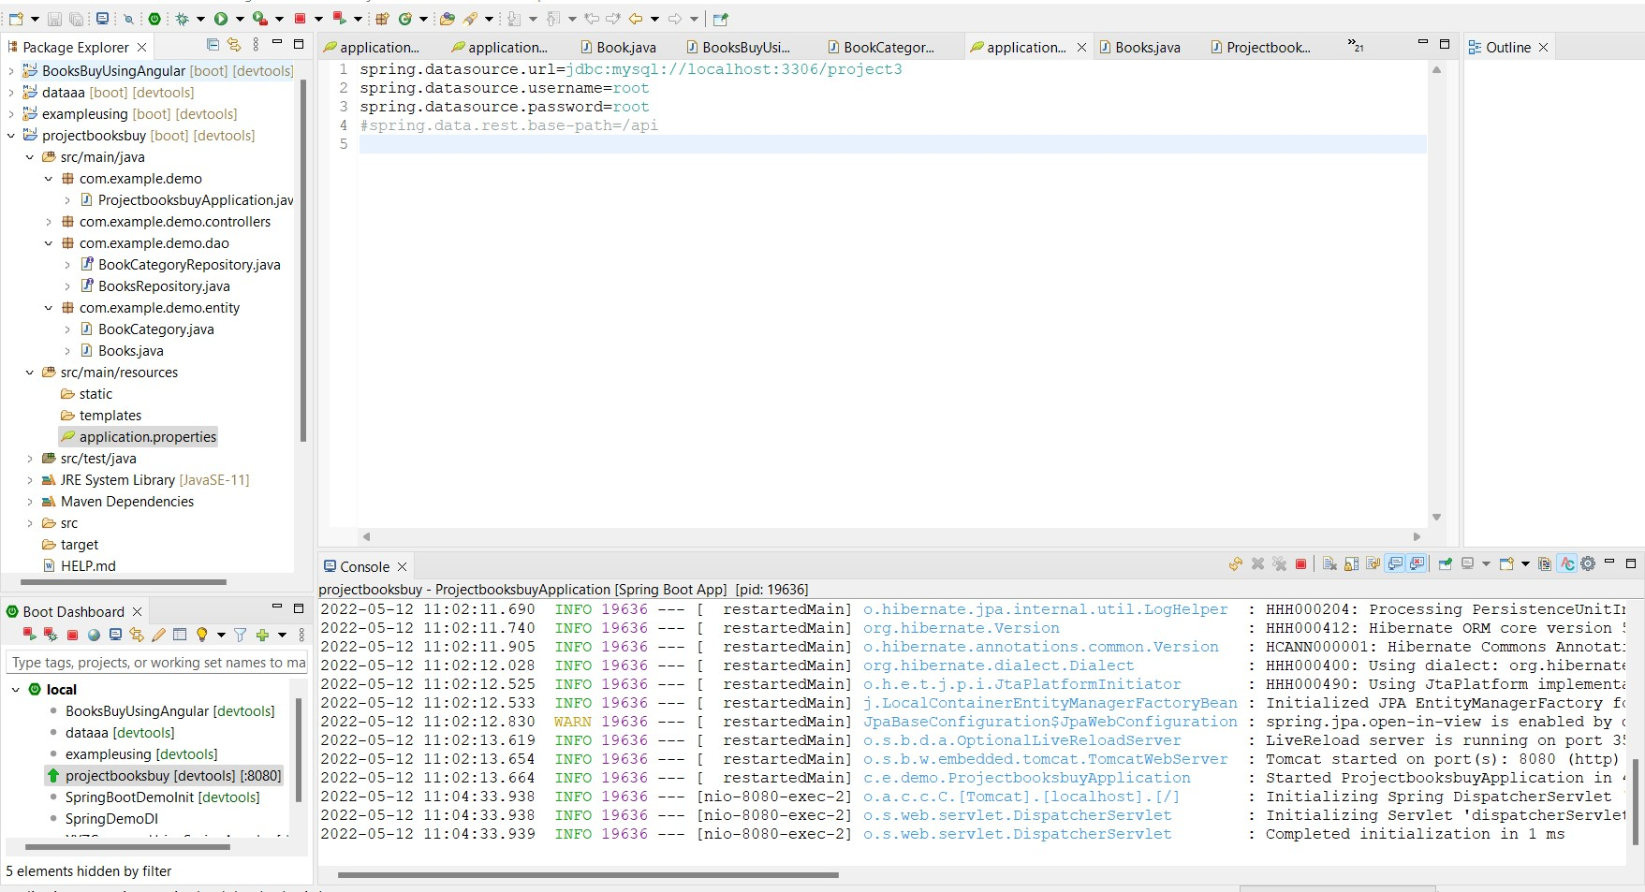

Slide 10
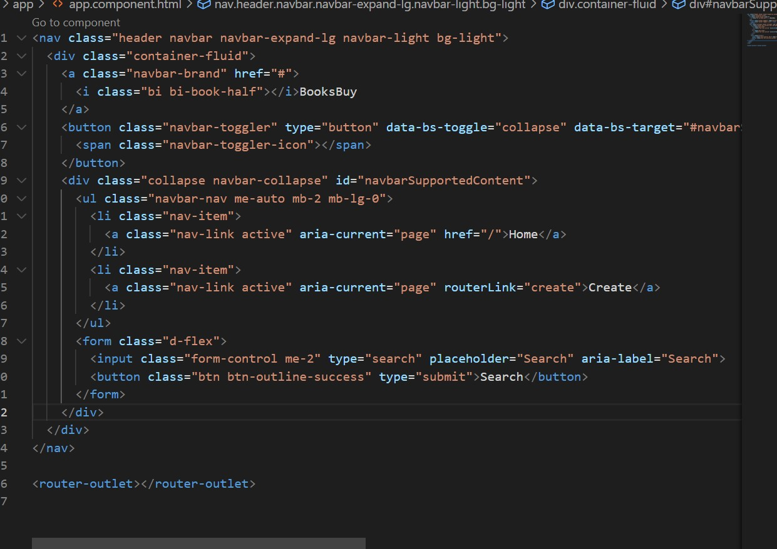

Slide 11
SCOPE OF IMPROVEMENT :
Creating user and admin modules
Adding login, signup, payment gateway pages
Adding images to books
Implementing search module for user to effectively search for particular book
Implementing filters to effective selection of books.!

Slide 12


