Slide 1
COLLEGE MANEGEMENT STSTEM
Project Presented by
Pesingu Lalitha

Slide 2






Technologies Used.!
FrontEnd
Backend

Slide 3
PROJECT SCOPE:
Aim: Providing information about Faculty ,Placements ,Contacts,
Infrastructure , Courses and Student activity club.
Users: Faculty , Students
Functions : Faculty and students can able to “Upload” and “Delete” theire Information.
Requirements : Register by using “username” and “password”.

Slide 4
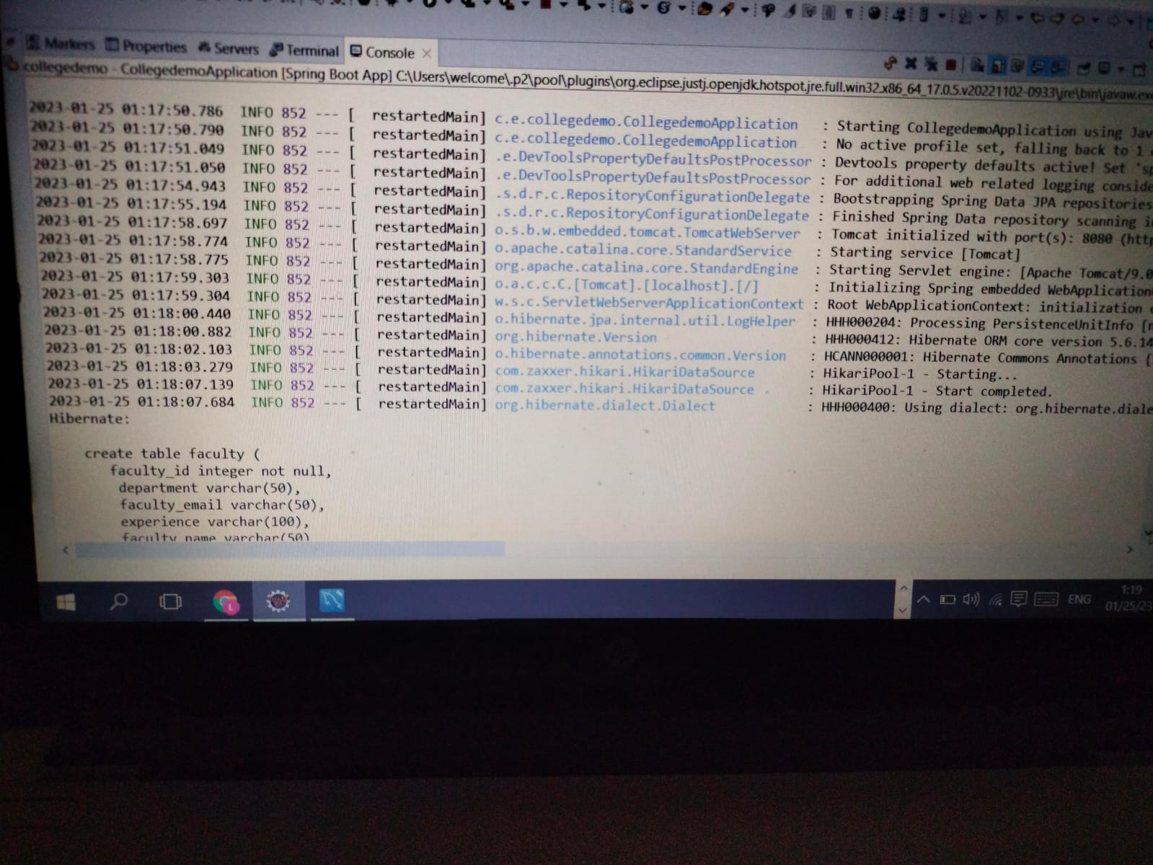
Screenshots: Backend part:

Slide 5
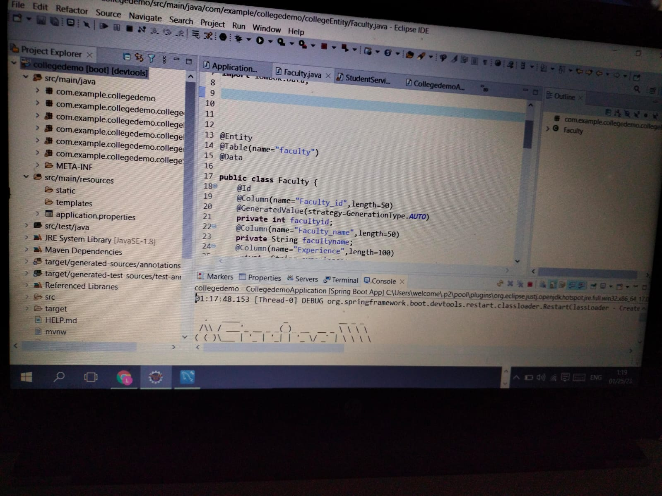

Slide 6
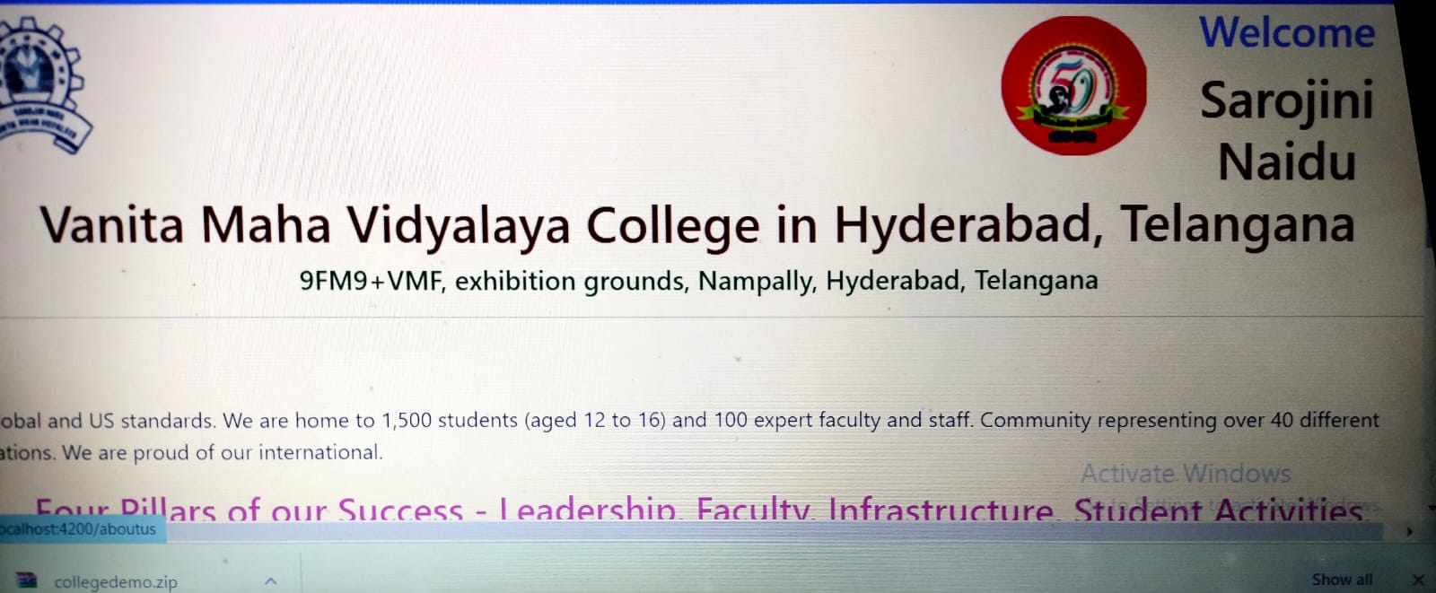
Front end part: Home Page:

Slide 7
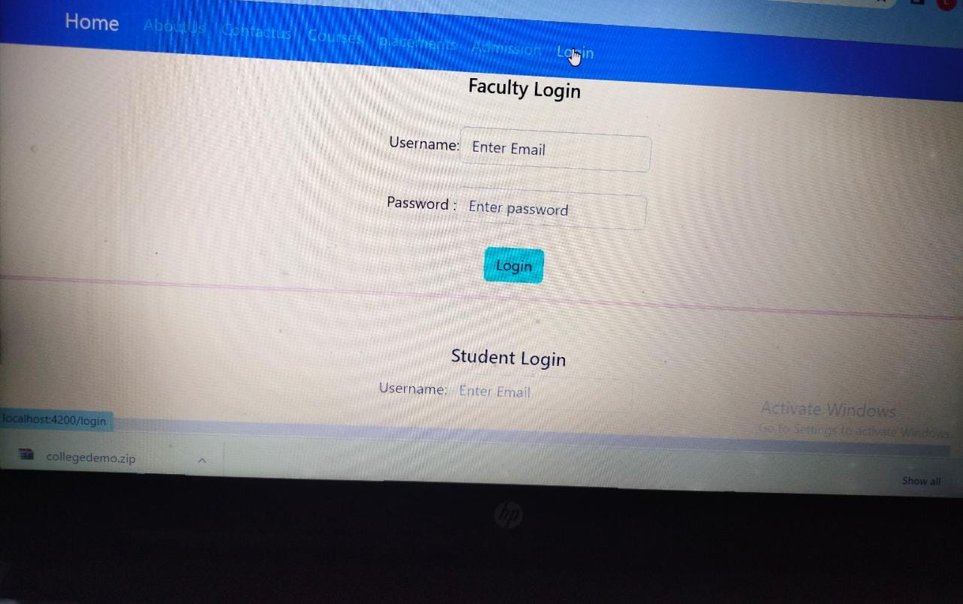
Faculty Login

Slide 8
SCOPE OF IMPROVEMENT :
Creating student and faculty modules
Adding login, course, palacement gateway pages
Adding images to college
Implementing search module for user to effectively search for particular college
Implementing filters to effective selection of college.!

Slide 9


