Slide 1
Cloud File Storage System with Smart Storage Management
Scalable cloud storage with AI-based performance optimization
Team members: [Add names]
Guide: [Add guide name]
Date: [Add date]

Slide 2
Problem statement
People and organisations alike store more every year (photos, documents, projects, records), and most of it is written once and rarely opened again.
Public cloud drives keep this data on the provider's servers, under its terms and pricing: free space is small (Google gives 15 GB shared across its services), more space is a recurring per-GB fee, and access depends on the account staying active.
Many people want an alternative they control: an individual on a spare PC or home server, a student team, a small business, or a college lab, for privacy, cost or policy reasons.
Self-hosting removes the provider's safeguards: one failed disk can lose everything, an open sign-up lets anyone in, rarely used files fill full-cost space, and nobody can see what is happening.
Gap: no small, self-hosted, Drive-like product combines approved accounts, replicated storage nodes, automatic prediction-based archiving and a plain-language admin summary.
This project is that product at small scale; it does not claim to replace Google Drive at global scale.
Notes:
If asked "why not Google Drive?": Drive is right for most people. This is for anyone who wants the files on their own machine or server (privacy, no per-GB subscription, policy, data residency). Self-hosting removes the provider's durability and tiering, so the project adds replication across nodes and prediction-based archiving, plus admin approval and an admin summary. The same system serves an individual and an institution; only the scale and who the admin is change.

Slide 3
Existing systems and the gap
System | What it does well | Gap for this use case
Google Drive / Dropbox | Easy sync and sharing; copies and placement managed by the provider | Files stay on the provider's servers under its terms and pricing; owners cannot keep them on their own machine
Amazon S3 (tiering) | Very durable object storage; moves objects between access tiers automatically | A developer API, not a drive with accounts, folders, approval and viewer; billed per use
HDFS / Ceph / MinIO | Replication across many machines at large scale | Infrastructure to operate and integrate; no end-user drive or admin summary
Nextcloud (self-hosted) | Self-hosted file sync and sharing | Largely leaves replication and tiering to the storage underneath
This project | Self-hosted drive for individuals, teams and institutions: approved accounts, replicated nodes, prediction-based archiving, AI summary | Small scale; nodes on one machine in the demo; setup needs basic technical skill; no file sharing between accounts yet
A design comparison, not a benchmark: this project does not claim to outperform these systems.
Notes:
Be precise: these are design differences, not performance claims. S3 tiering, HDFS replication and Nextcloud are real systems; this project reimplements the ideas at small scale so they can be shown end to end.

Slide 4
Objectives
Provide a self-hosted, Google-Drive-style drive for individuals, teams and institutions with nested folders, upload, drag and drop, and an in-app file viewer.
Allow sign-in with Google only, with every new account approved by an administrator first.
Keep each account's files and folders completely private to that account.
Move rarely used files to compressed storage automatically, so users never notice or manage it.
Predict which files will be needed again, using a model trained on the access history.
Give the administrator a plain-language storage summary and suggestions, generated with Gemini 3.8 Flash.
Spread every file over several storage nodes in replicated chunks, so that node failures lose no data and stop no download.
Keep all metadata in PostgreSQL, with constraints that protect data integrity.

Slide 5
Methodology: approach and technologies
Backend: Spring Boot 3.5 on Java 21, organised by feature (account, file, folder, tiering, insights).
Frontend: React 19 with TypeScript, built with Vite, in a Google-Drive-like layout.
Database: PostgreSQL 16, started with Docker Compose; tests also run on a real PostgreSQL.
Sign-in: Spring Security with Google OAuth2 / OpenID Connect.
AI: Gemini 3.8 Flash, called from the server over its REST API.
File storage: five storage nodes holding replicated chunks of every file, accessed only through a FileStore interface.
Built in steps: core drive, then sign-in and approval, tiering, admin panel, and AI summary.

Slide 6
Methodology: how files are stored
File details (name, size, owner, folder, tier) are saved in PostgreSQL.
The file's contents are stored under a random id (UUID), never under the user's file name, so two files with the same name cannot clash.
Folders are database rows with a parent id, so nesting and moving need no disk changes.
Each storage node has two areas: hot (plain files) and cold (gzip-compressed files).
The rest of the application reads and writes files only through one interface (FileStore), so the storage underneath can change, for example from local folders to separate containers or servers, without changing the rest of the code.
An upload first writes the file's bytes to storage and only then saves its record in the database in one short step, so the database is never held locked during slow disk work; if saving the record fails, the written bytes are removed.

Slide 7
Methodology: distributed storage and replication
Nodes: the system has 5 storage nodes, each run as a separate Docker container. Docker is used to simulate 5 separate machines on one computer: every container has its own process, storage and network address, so stopping one is a genuine node failure, and the same image can later run on real machines.
Chunking: every file is split into small pieces called chunks (256 KiB each). A small manifest records how many chunks the file has.
Replication: every chunk is stored on 3 different nodes, so there are 3 copies. A hash of the chunk id picks which 3, so chunks spread evenly and no node holds a whole file.
Fault tolerance: even if 2 nodes are down at the same moment, every chunk still has at least 1 copy on a working node, so every file can still be read.
Failure detection: the backend checks every node every 3 seconds; a node that does not answer is marked unreachable automatically.
Self-healing: when a node is lost, its missing copies are re-created on working nodes, so each chunk is back to 3 copies. A node that returns is brought up to date.
Limits: if 3 nodes are down at the same moment, a chunk whose 3 copies were exactly on those nodes cannot be read until one returns. All containers run on one machine, so the failure of the whole machine is not covered.

Slide 8
Methodology: open-source comparison
Idea | HDFS | Ceph | Cassandra | This project
Unit of data | Blocks (128 MB default) | Objects in placement groups | Rows by partition key | 256 KiB chunks plus a manifest
Copies | Replication factor 3 by default | Replicated pools, 3 copies by default, or erasure coding | Replication factor, commonly 3 | 3 copies of every chunk
Placement | NameNode chooses DataNodes | CRUSH algorithm | Consistent hashing ring | Rendezvous hashing over nodes
Failure handling | Re-replicates under-replicated blocks | Self-healing and rebalancing | Hinted handoff and repair | Heartbeat detects failures; repair loop re-copies chunks and resyncs returning nodes
Adding capacity | Add DataNodes, rebalance | Add OSDs, data rebalances | Add nodes to the ring | Add a node; only its share moves
The same ideas at small scale: no claim of matching their scale, performance or erasure coding.
Notes:
Defaults quoted from general knowledge of these systems (HDFS block size 128 MB and replication 3; Ceph replicated pools of size 3; Cassandra replication factor commonly 3). Verify against each project's documentation before presenting.

Slide 9
Methodology: sign-in and access control
The user signs in with Google; the server receives an OpenID Connect identity (id, email, name).
A new account starts as "waiting" and cannot use the drive until an admin approves it.
After sign-in the browser holds a session cookie that is HttpOnly and SameSite=Lax.
Requests that change data must carry a CSRF token (XSRF-TOKEN cookie, X-XSRF-TOKEN header).
Role and status are re-read from the database on every request, so a rejection takes effect at once.
Every query is limited to the owner; another user's file or folder returns 404.

Slide 10
Methodology: smart storage management
Every download is logged: file, time, response time, and whether a restore was needed.
The optimizer runs every night at 03:00, and the admin can run it on demand.
It trains a logistic-regression model on the access history and scores every file.
A file with less than a 40% predicted chance of being opened is moved to cold storage and compressed.
Files uploaded within the last day are never archived.
With fewer than 10 training examples, a simple recency rule is used instead of the model.
Opening a cold file restores it to hot storage automatically; the user sees no difference.

Slide 11
Methodology: AI storage summary (admin only)
The admin presses "Summarise" in the Storage operations tab; other users get 403.
The server builds a snapshot of numbers only: file counts, bytes, hot/cold split, downloads, restores, timings.
File names, file contents and user details are never sent to the AI.
The snapshot goes to Gemini 3.8 Flash (generateContent REST call), which is asked to reply in JSON with a summary and suggestions.
The answer is cached for 5 minutes, and nothing is changed automatically.
If no API key is set or the call fails, a built-in summary is written from the same numbers and labelled as such.

Slide 12
Methodology: database design (PostgreSQL)
Four main tables: accounts, folders, files, and access logs.
accounts: Google subject id and email are unique; role (member / administrator) and status (waiting / approved / rejected) are checked values.
folders: owner and parent folder, so folders can nest to any depth.
files: owner, folder, name, size, stored size, tier (hot / cold), hot probability, upload and last-access time.
access logs: one row per download, with response time and a "restored from cold" flag.
Indexes support lookups by owner, folder and file; links between tables are ids checked by the application.

Slide 13
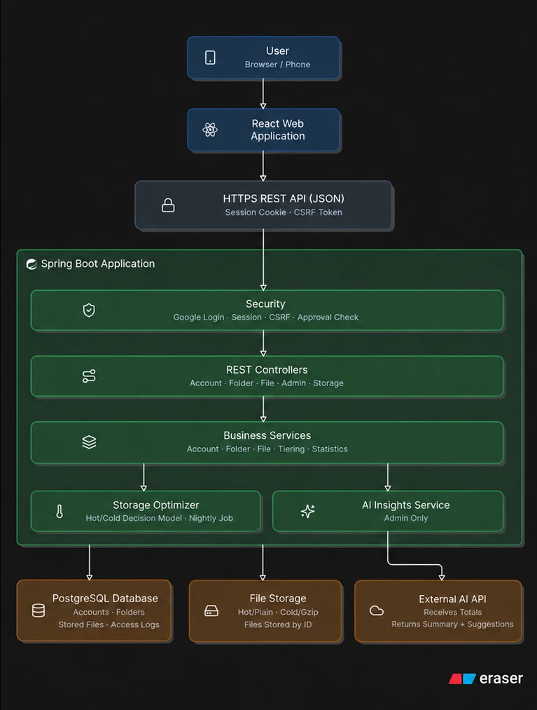
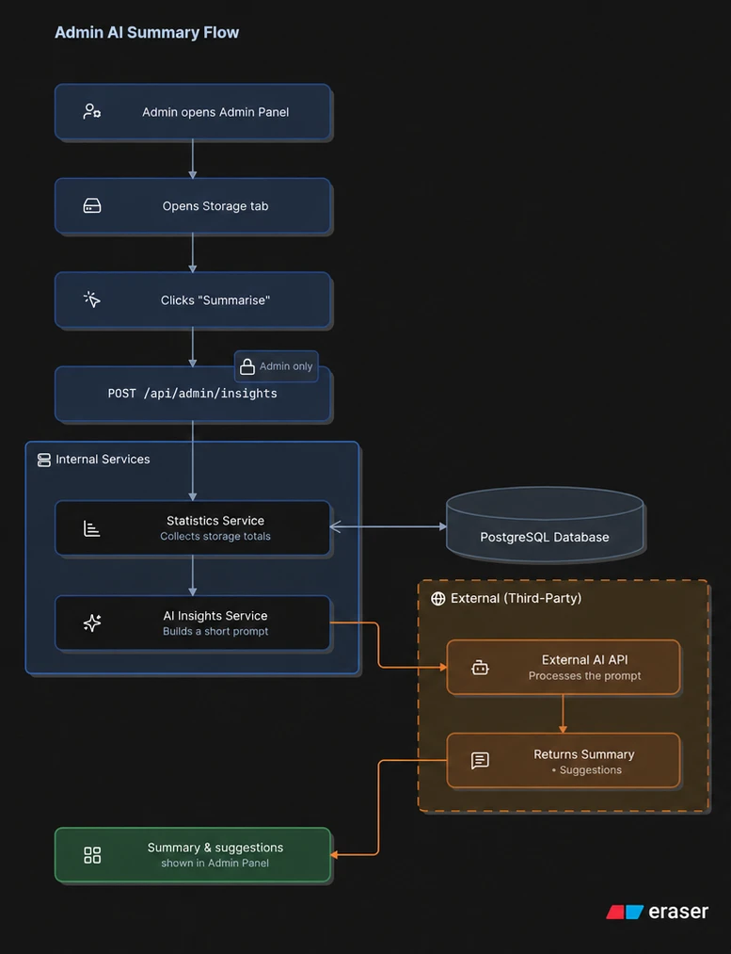
Block diagram
Left: system architecture (File Storage is implemented as 5 storage-node containers with replicated chunks). Right: admin AI summary flow.

Slide 14
Block diagram: how the system works
The user opens the React web app in the browser and signs in with Google.
The app calls the REST API (/api) of the Spring Boot application.
Security checks the session, the CSRF token, and the account's role and status.
Controllers pass the request to services: files, folders, accounts, tiering, and insights.
Metadata is read and written in PostgreSQL; file bytes are cut into chunks and each chunk is written to 3 of the 5 storage nodes (Docker containers), hot or cold.
The storage optimizer moves files between hot and cold; the insights service calls the Gemini API.

Slide 15
Block diagram: admin AI summary flow
The admin clicks "Summarise" in the admin panel.
The server confirms the caller is an administrator.
The insights service reads storage statistics from PostgreSQL.
It builds a numbers-only snapshot, with no names, contents or user details.
The snapshot is sent to the Gemini 3.8 Flash REST API with a request for a JSON answer.
The summary and suggestions are returned to the panel; a built-in summary is used if the AI is unavailable.

Slide 16
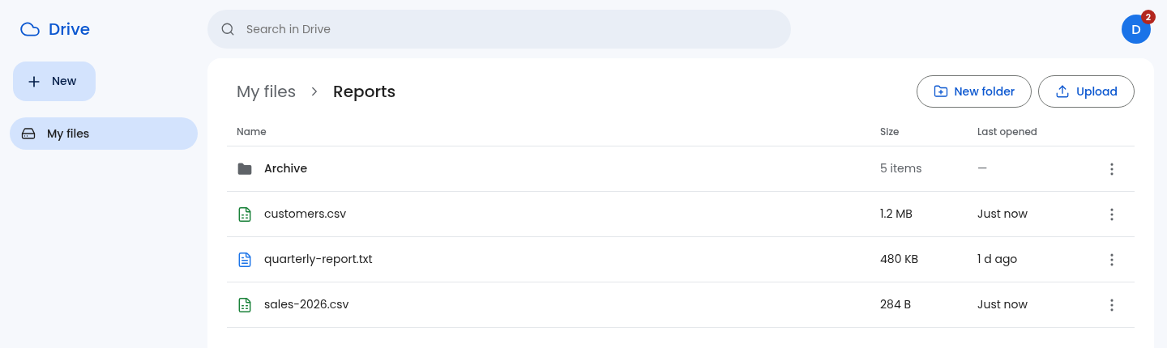
Output sample 1: the drive
Folders and files inside "Reports", with breadcrumb, New folder and Upload. Users see no hot or cold storage.

Slide 17
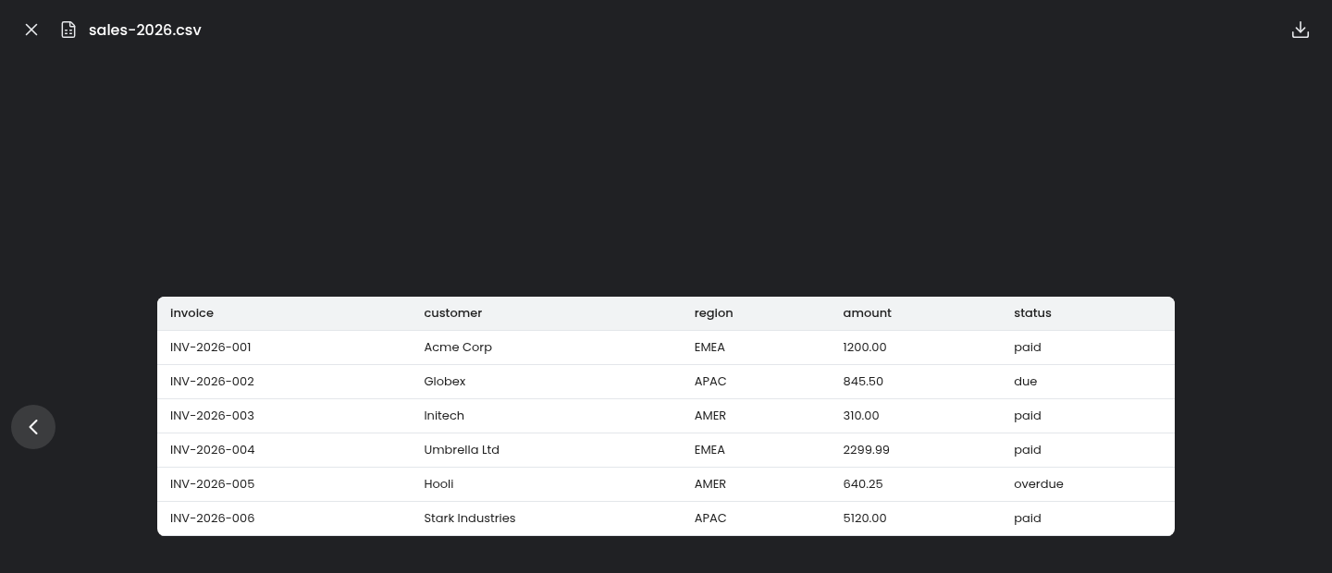
Output sample 2: in-app file viewer
A CSV file opened inside the app and shown as a table.

Slide 18
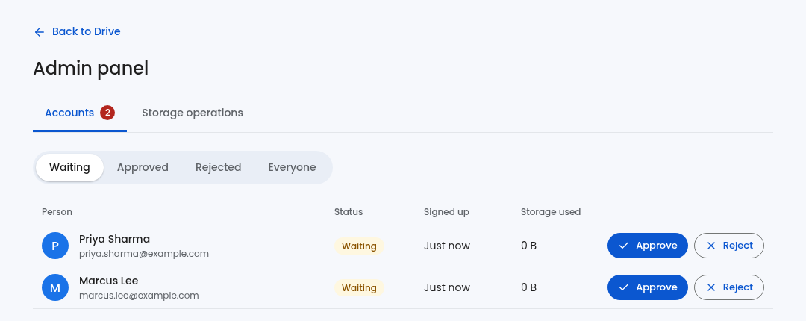
Output sample 3: admin approval of accounts
New Google sign-ins wait here until the administrator approves or rejects them.

Slide 19
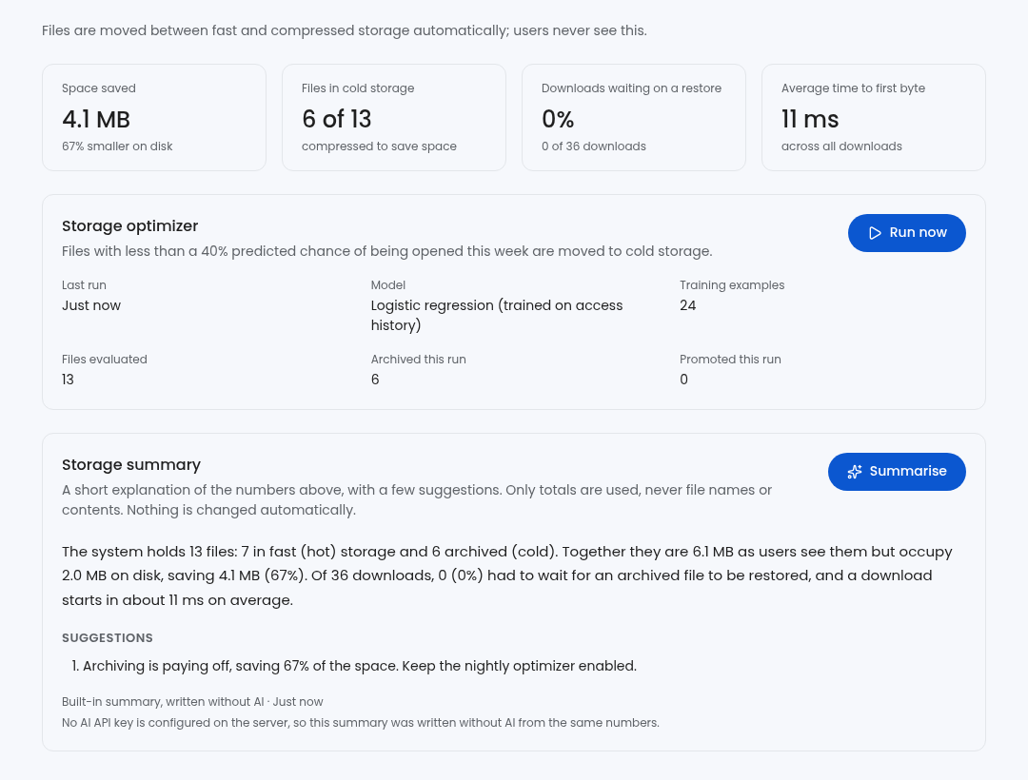
Output sample 4: storage operations and summary
Optimizer results and the storage summary. This run used the built-in summary (no API key was set), as the screen states.

Slide 20
Output sample 5: how one file is stored
A storage node is a Docker container that holds data. dataset.bin (1.1 MB) was cut into 5 chunks, and each chunk is stored on 3 of the 5 nodes.
A filled circle means that node holds a copy of that chunk. If node-1 and node-2 are down at the same moment, every chunk still has a copy on a working node, so the file can be read.
Chunk | node-1 (offline) | node-2 (offline) | node-3 | node-4 | node-5 | Served by while node-1 + node-2 are offline
chunk 0 |  | ● | ● |  | ● | node-3, node-5
chunk 1 |  |  | ● | ● | ● | node-4, node-3, node-5
chunk 2 | ● | ● | ● |  |  | node-3
chunk 3 |  | ● |  | ● | ● | node-5, node-4
chunk 4 | ● |  |  | ● | ● | node-4, node-5
Real placement from the running system: no node holds the whole file.

Slide 21
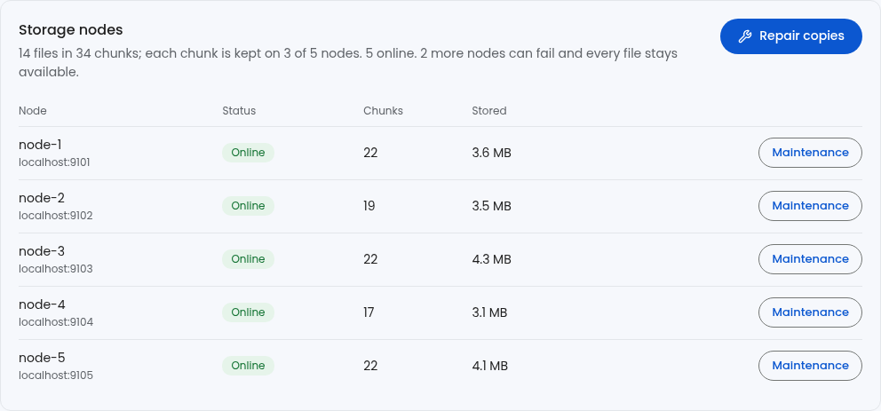
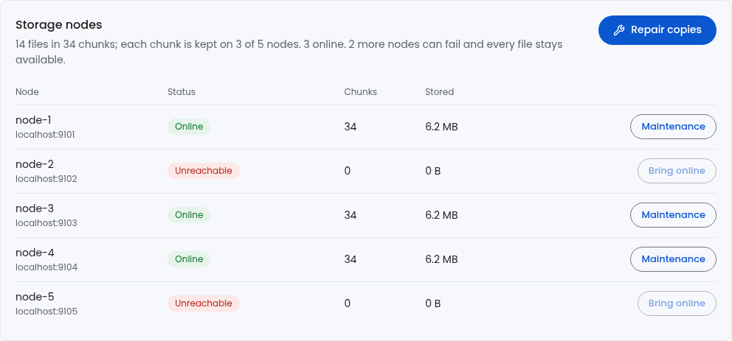
Output sample 6: storage nodes in the admin panel
All 5 nodes online
Each node shows its container address, chunk count and stored bytes.
The two stopped containers are marked Unreachable by the heartbeat; no administrator action was needed.
The three live nodes now hold every chunk: the cluster re-copied them automatically.
The panel still reports every file available, and how many more nodes can go down without losing access.
node-2 and node-5 containers stopped (docker stop)

Slide 22
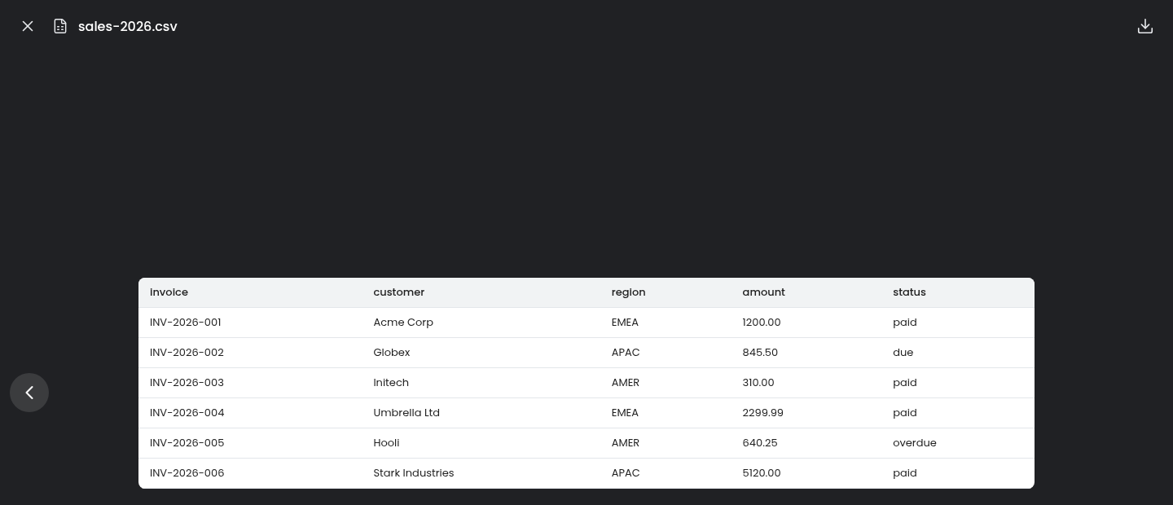
Output sample 7: file opens with two containers stopped
node-2 and node-5 containers are stopped; sales-2026.csv still opens in the viewer, served from the other nodes.

Slide 23
Output sample 8: proof under node failures
Failure | Combinations tested | All 6 files intact in | Worst case
Any 1 node offline | 5 | 5 of 5 | 6 of 6 files
Any 2 nodes offline at the same time | 10 | 10 of 10 | 6 of 6 files
3 nodes offline at the same time | 10 | 0 of 10 | 2 of 6 files
Nodes failing one after another (repair in between) | 4 failures | 4 of 4 | 6 of 6 files with 1 node online
6 files of 0.3 to 1.3 MB were uploaded; each was downloaded and its SHA-256 compared with the original.
With 3 copies, any 2 nodes can be down at the same moment without losing access; with 3 nodes down at once, some chunks can become unreadable until a node returns (HTTP 503).
When nodes fail one after another, self-healing re-creates the missing copies in between, so files stay readable until only one node is left.
Notes:
Produced by docs/prove_availability.py against the running system. Results in docs/availability-proof.json.

Slide 24
Output sample 9: containers stopped
1. Storage nodes running as containers
drive-node-1 Up 47 seconds 127.0.0.1:9101->8080/tcp
drive-node-2 Up 47 seconds 127.0.0.1:9102->8080/tcp
drive-node-3 Up 47 seconds 127.0.0.1:9103->8080/tcp
drive-node-4 Up 47 seconds 127.0.0.1:9104->8080/tcp
drive-node-5 Up 47 seconds 127.0.0.1:9105->8080/tcp
2. Upload 700000 bytes (sha256 0b3a233a15ae4314...): chunks on containers
chunk 0 on node-3, node-4, node-1
chunk 1 on node-3, node-4, node-2
chunk 2 on node-3, node-2, node-4
3. docker stop drive-node-3 drive-node-4 (two containers crash together)
heartbeat noticed both within 3.0 s, with no administrator action
node-1 ONLINE http://localhost:9101 chunks=24
node-2 ONLINE http://localhost:9102 chunks=26
node-3 UNREACHABLE http://localhost:9103 chunks=0
node-4 UNREACHABLE http://localhost:9104 chunks=0
node-5 ONLINE http://localhost:9105 chunks=27
14 files, 36 chunks | more nodes that can fail: 0
4. Download while two containers are dead
sha256 of download: 0b3a233a15ae4314... original: 0b3a233a15ae4314... -> MATCH
Real output of docs/prove_containers.sh: docker stop and docker start on the node containers.

Slide 25
Output sample 10: recovery and one-by-one failures
5. Upload a second file during the outage
chunk 0 on node-2, node-5, node-1
chunk 1 on node-5, node-2, node-1
6. docker start drive-node-3 drive-node-4
all 5 nodes online again
node-1 ONLINE http://localhost:9101 chunks=22
node-2 ONLINE http://localhost:9102 chunks=23
node-3 ONLINE http://localhost:9103 chunks=26
node-4 ONLINE http://localhost:9104 chunks=19
node-5 ONLINE http://localhost:9105 chunks=24
15 files, 38 chunks | more nodes that can fail: 2
second file after recovery:
chunk 0 on node-3, node-2, node-5
chunk 1 on node-5, node-3, node-2
7. Failures one after another: node-1, node-2, node-3, node-4 containers stopped in turn
drive-node-1 stopped, 4 container(s) left: download MATCH
drive-node-2 stopped, 3 container(s) left: download MATCH
drive-node-3 stopped, 2 container(s) left: download MATCH
drive-node-4 stopped, 1 container(s) left: download MATCH
all containers started again
Real output of docs/prove_containers.sh: docker stop and docker start on the node containers.

Slide 26
Result
Demo data set: 13 files, 6.1 MB as users see them.
One optimizer run moved 6 files to cold storage; 7 stayed hot.
On disk the same data takes 2.0 MB: 4.1 MB saved, 67% smaller.
Of 36 downloads, none waited for a restore; a download starts in about 11 ms on average.
The model trained on 24 access examples and scored all 13 files.
Distribution: files are cut into chunks, each on 3 of 5 node containers. With any 2 nodes down together, all 6 test files downloaded with the original SHA-256.
Real failures: with two containers stopped, the heartbeat marked both unreachable within about 3 seconds and the download matched; stopping 4 of 5 containers in turn, every download matched.
Privacy holds: another user's file or folder returns 404, and the AI summary is admin-only.
61 automated tests pass on a real PostgreSQL, and 68 parallel requests ran without errors.

