Slide 1

SIDDHARTH INSTITUTE OF ENGINEERING & TECHNOLOGY
(AUTONOMOUS)
(Approved by AICTE, New Delhi & Affiliated to JNTUA, Ananthapuramu)
(Accredited by NBA for Civil, EEE, Mech., ECE & CSE
Accredited by NAAC with ‘A+’ Grade)
Puttur -517583,Tirupathi District, A.P. (India)
DEPARTMENT OF COMPUTER SCIENCE AND ENGINEERING
CSE (ARTIFICIAL INTELLIGENCE AND MACHINE LEARNING
Academic Year 2025-26
Project Zeroth Review
Title of Project Intelligent Infant Health Predictor With Personalized AI Guidance
Batch Details
S.NO: | REG NO | NAME | INTERNAL GUIDE
1 | 22F61A4788 | K LALITH | B.SRINIVASULU
2 | 22F61A4793 | P MAHITHA PRANATHI
3 | 22F61A4790 | P MADHU
4 | 22F61A47A0 | K MANOJKUMAR

Slide 2
OBJECTIVE
1. Build a supervised ML model to predict infant mortality risk (classify infants into low-risk and high-risk).
2. Integrate an LLM-based AI engine to generate personalized, actionable survival plans for high-risk infants.
3. Provide a user-friendly web interface for healthcare professionals and caregivers to input data and receive recommendations in real time.
4. Improve proactive pediatric care through data-driven risk assessment and tailored intervention schedules.
5. Evaluate system accuracy and usefulness with experimental results and simulated/real datasets.

Slide 3
ABSTRACT
Infant mortality continues to be a pressing concern in pediatric healthcare, particularly for children under the age of five. Timely identification of high-risk infants is critical for implementing preventive interventions and improving survival outcomes. This paper presents a Machine Learning and AI-powered framework for predicting infant mortality risk and generating personalized survival plans. The system leverages key maternal and infant health indicators, including birth weight, maternal age, immunization status, nutrition score, socioeconomic factors, and prenatal care visits. A supervised machine learning model is trained on structured health datasets to classify infants into low- and high-risk categories, providing an accurate quantitative risk assessment.
For high-risk cases, the framework integrates Hugging Face GPT-based AI models to generate detailed, actionable survival plans. These AI-generated recommendations include nutritional guidance, preventive care measures, follow-up schedules, early childhood development activities, physical activity guidelines. The system features a user-friendly web interface, enabling healthcare professionals and caregivers to input data and receive real-time, personalized recommendations. Experimental results demonstrate that the integrated ML-AI approach achieves high predictive accuracy while delivering structured, AI-generated survival plans that support proactive pediatric care. This framework exemplifies the potential of combining machine learning and AI to bridge data-driven risk assessment with practical, individualized child healthcare interventions

Slide 4
Literature Survey
Sno | Title of the Paper | Year of publication | Author | Comments
1 | Machine Learning Approach for Infant Mortality Prediction | 2020 | A. Kumar etal. | Used logistic regression and random forest to identify risk factors in infants.
2 | AI-Based Prediction System for Early Infant Health Risks | 2021 | S. Reddy, P. Mehta | Proposed an AI framework using maternal and infant indicators for early risk detection.
3 | Predictive Modeling for Neonatal Survival using Health Indicators | 2022 | R. Sharma, L. Guptha | Demonstrated that maternal health, birth weight, and prenatal care significantly affect infant survival
4 | Intelligent Health Monitoring System for Infants Using ML | 2023 | M.Singh, K. Rao | Intelligent Health monitoring system for infant using ML.

Slide 5
Inferences from Literature Survey
Important predictors: birth weight, gestational age, immunization status, maternal age, prenatal visits, nutrition score, socioeconomic indicators.
Ensemble tree-based classifiers (Random Forest / XGBoost) and calibrated probability outputs perform well for risk stratification.
Explainability (feature importance/SHAP) is necessary for clinical trust.
LLM-generated guidance needs validation and guardrails (medical disclaimers and clinician review).
A web UI that captures structured inputs improves data quality and model reliability.

Slide 6
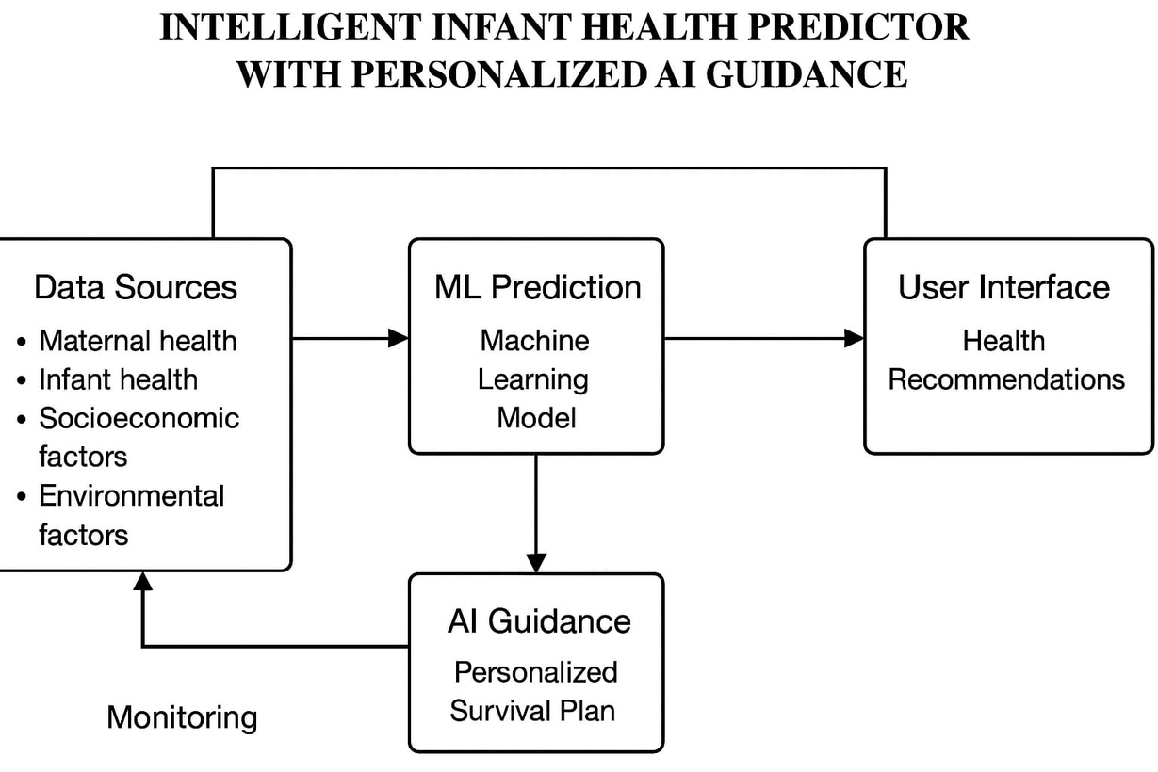
Architectural Diagram

Slide 7
Existing System
Manual clinical assessment and checklists are the primary method for identifying at-risk infants in most primary care settings.
Records are often kept on paper or in basic EMRs with inconsistent data fields and missing entries.
No automated, data-driven risk scoring is routinely available at point-of-care.
Clinical guidance is delivered verbally or via printed pamphlets — not personalized to the infant’s measured risk factors.
Limited auditability: predictions, care plans, and follow-up actions are not systematically logged for later review.
Retraining and performance tracking of any predictive models (if present) is ad hoc or absent.

Slide 8
Proposed Methodology
Data Collection & Preprosessing - Collect infant and maternal health data, clean missing values, encode features, and prepare inputs for the model.
ML Model Development - Train a supervised classifier (Random Forest/XGBoost) to predict infant mortality risk and generate probability scores.
Explainability - Use SHAP/LIME to show key factors influencing each prediction and ensure transparency.
AI Guidance Generation - For high-risk cases, use a GPT-based model to create personalized survival plans with nutrition, preventive care, and follow-up actions.
Backend & API - Implement APIs for prediction, plan generation, and data history. Connect UI → Backend → Model → AI engine.
Frontend (Web UI) - Simple interface for caregivers/clinicians to enter data and view risk results + AI-generated plan.

Slide 9
Requirement specification
Software Requirements
Python
ML libraries: scikit-learn, pandas, numpy
Backend: Flask or Fast API
AI Integration: Hugging Face API
Web UI: HTML/CSS/JS (or React)
Hardware Requirements
Standard laptop/PC
Minimum: 4-8 GB RAM
Storage: 5-10 GB
Internet connection for API access

Slide 10
Conclusion
The proposed system integrates machine learning and AI-driven guidance to address the critical challenge of early infant mortality prediction. By analyzing key maternal and infant health indicators, the ML model provides reliable risk classification, while the GPT-based AI component generates personalized survival plans tailored to each high-risk case.
This combination of predictive analytics and actionable recommendations supports timely clinical decisions, improves caregiver awareness, and encourages preventive healthcare practices. With its user-friendly interface, explainability features, and scalable architecture, the system demonstrates strong potential to enhance pediatric healthcare delivery and reduce preventable infant mortality.

