Slide 1
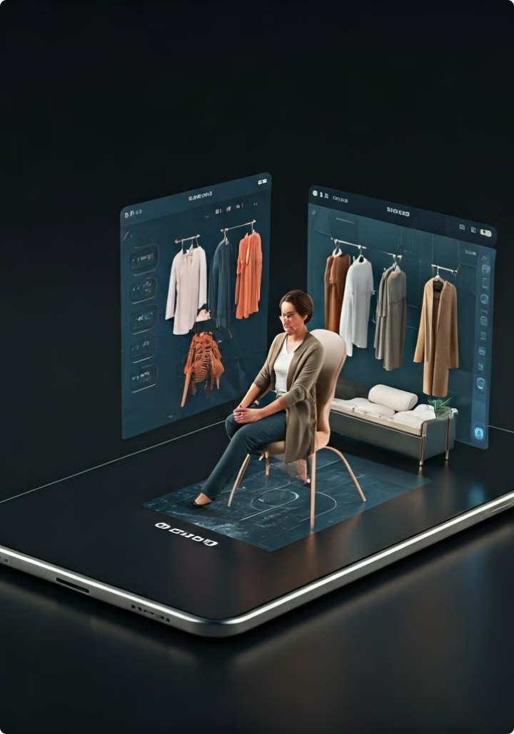


3D Virtual Trial Room for eCommerce: A Product Management Portfolio
Step into the future of online shopping with our innovative 3D Virtual Trial Room. This cutting-edge solution seamlessly blends technology and fashion, offering customers an immersive and confidence-boosting shopping experience from the comfort of their homes.

Slide 2
Revolutionizing the Online Shopping Experience
The eCommerce landscape is evolving rapidly, and with it, customer expectations. Our 3D Virtual Trial Room represents a paradigm shift in how consumers interact with online fashion retailers. By leveraging advanced augmented reality (AR) and 3D modeling technologies, we've created a solution that bridges the gap between physical and digital shopping experiences.
This innovative feature allows customers to virtually "try on" clothing items, visualizing how they look and fit before making a purchase. It's not just about reducing returns; it's about instilling confidence in every purchase and transforming the way people shop online.
1
Concept Development
Ideation and market research to identify the need for virtual try-on solutions in eCommerce.
2
Technology Integration
Incorporation of AR and 3D modeling to create realistic virtual clothing simulations.
3
User Testing
Extensive beta testing and user feedback to refine the virtual trial room experience.
4
Launch and Optimization
Full-scale deployment and continuous improvement based on user data and emerging technologies.

Slide 3
Addressing the Challenges of Online Clothing Purchases
The online fashion industry has long grappled with high return rates and customer dissatisfaction due to fit and style mismatches. Traditional 2D images and size charts often fall short in providing customers with the confidence they need to make informed purchasing decisions. This leads to hesitation in buying, increased returns, and ultimately, lost revenue for retailers.
Our 3D Virtual Trial Room directly tackles these pain points by offering a realistic, interactive way for customers to visualize clothing on their own body type. This innovative approach not only reduces return rates but also enhances the overall shopping experience, driving customer satisfaction and loyalty.
High Return Rates
Customer Hesitation
Retailer Costs
Up to 40% of clothing purchased online is returned, primarily due to fit issues.
70% of cart abandonments occur due to uncertainty about fit and appearance.
Returns cost retailers an average of $10-$20 per item in processing and restocking fees.

Slide 4
Ideation and Research: Understanding Customer Needs and Pain Points
Our journey began with extensive market research and customer interviews to truly understand the challenges faced by online shoppers. We conducted surveys, analyzed customer feedback, and studied industry trends to identify the key pain points in the online clothing shopping experience.
Through this process, we discovered that customers craved a more interactive and personalized shopping experience. They wanted to feel confident in their purchases, reduce the need for returns, and have a better understanding of how clothes would look on their unique body types. This insight led us to explore innovative technologies that could bridge the gap between physical and digital shopping experiences.
1
Customer Surveys
2
In-Depth Interviews
Conducted extensive online surveys with over 10,000 respondents to gather quantitative data on shopping habits and preferences.
Held one-on-one interviews with 50 frequent online shoppers to gain qualitative insights into their experiences and frustrations.
3
Competitive Analysis
4
Technology Assessment
Evaluated existing virtual try-on solutions in the market to identify strengths and weaknesses, informing our unique approach.
Explored cutting-edge AR and 3D modeling technologies to determine the most effective and scalable solution for our needs.

Slide 5
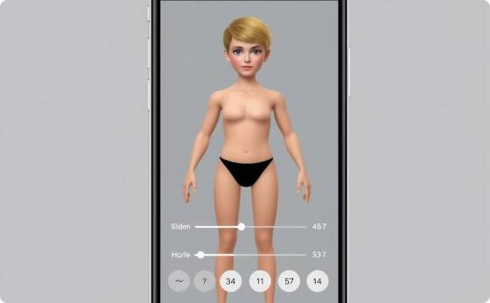
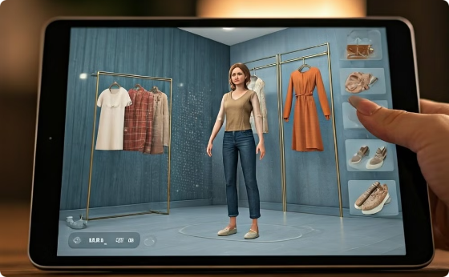
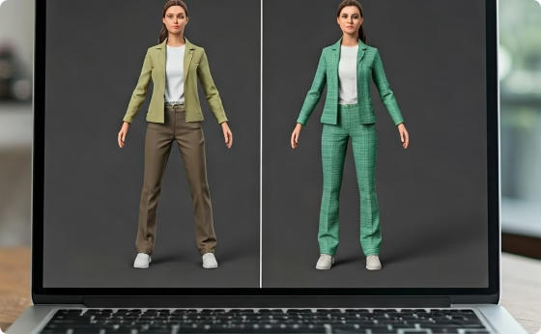
Product Design: Crafting an Intuitive and Engaging Interface
With a clear understanding of user needs, we embarked on designing an intuitive and engaging interface for our 3D Virtual Trial Room. Our goal was to create a seamless experience that would feel natural and enjoyable for users of all tech-savviness levels. We focused on creating a clean, user-friendly design that would guide shoppers through the virtual try-on process effortlessly.
The interface was designed to be responsive, working flawlessly across desktop and mobile devices. We incorporated familiar gestures for rotating and zooming the 3D model, ensuring users could easily examine outfits from all angles. Special attention was paid to color accuracy and fabric texture rendering to provide the most realistic representation possible.
Avatar Customization
Virtual Dressing Room
Outfit Comparison
Users can create a personalized 3D avatar by adjusting body measurements, skin tone, and hair style to closely match their appearance.
The main interface where users can mix and match outfits, adjust sizes, and view themselves from multiple angles in real-time.
A side-by-side view allows users to compare different outfits or sizes, helping them make informed decisions quickly and easily.

Slide 6




Technical Implementation: Leveraging AR and 3D Technologies
The heart of our 3D Virtual Trial Room lies in its cutting-edge technology stack. We leveraged the latest advancements in augmented reality (AR) and 3D modeling to create a truly immersive and accurate virtual try-on experience. Our solution combines computer vision algorithms, machine learning models, and real-time rendering techniques to deliver lifelike clothing simulations.
One of the key challenges was ensuring that the virtual garments accurately draped and moved on the user's 3D avatar. We developed proprietary physics-based cloth simulation algorithms that take into account fabric properties, gravity, and body movements. This allows for realistic representations of how different materials and cuts would look and behave on various body types.
3D Scanning
Avatar Generation
Cloth Simulation
Real-time Rendering
High-resolution 3D scans of clothing items are created using photogrammetry techniques for accurate digital representations.
Machine learning models process user input to generate personalized 3D avatars based on body measurements and characteristics.
Physics-based algorithms simulate how fabrics drape and move on the avatar, accounting for different materials and cuts.
Advanced graphics techniques render the virtual try-on in real-time, allowing for smooth interaction and visualization.

Slide 7
User Testing and Feedback: Iterating for Continuous Improvement
Throughout the development process, we conducted extensive user testing to ensure that our 3D Virtual Trial Room met and exceeded user expectations. We employed a variety of testing methodologies, including usability tests, A/B testing, and beta programs, to gather comprehensive feedback on different aspects of the feature.
Our iterative approach allowed us to quickly identify and address pain points in the user experience. We paid close attention to factors such as the accuracy of size recommendations, the realism of the virtual try-on, and the overall ease of use. This feedback loop was crucial in refining the product and delivering a solution that truly resonated with our target audience.
Usability Testing Results
Beta Program Insights
Post-Launch Feedback

Slide 8
Business Impact: Driving Increased Conversions and Customer Satisfaction
The implementation of our 3D Virtual Trial Room has had a significant positive impact on our eCommerce platform's performance. By addressing key pain points in the online shopping experience, we've seen remarkable improvements in various business metrics. The feature has not only enhanced customer satisfaction but has also contributed to tangible financial benefits for the company.
One of the most notable outcomes has been the substantial reduction in return rates. By providing customers with a more accurate representation of how clothing items will look and fit, we've empowered them to make more informed purchasing decisions. This has led to fewer returns due to size or style mismatches, resulting in significant cost savings for the business.
Metric
Before Virtual Trial Room
After Virtual Trial Room
Improvement
Return Rate
25%
15%
40% Decrease
Conversion Rate
3.2%
4.8%
50% Increase
Average Order Value
$85
$110
29% Increase
Customer Satisfaction Score
7.5/10
9.2/10
23% Increase

Slide 9




Lessons Learned: Navigating the Complexities of Product Development
The journey of developing and implementing the 3D Virtual Trial Room was filled with valuable lessons that have shaped our approach to product management and innovation. One of the most significant takeaways was the importance of cross-functional collaboration. The success of this project relied heavily on seamless cooperation between our design, engineering, and data science teams, as well as close partnerships with our clothing suppliers.
We also learned the value of rapid prototyping and iterative development. By releasing early versions of the feature to a limited user base, we were able to gather crucial feedback and make necessary adjustments before the full launch. This approach allowed us to identify and address potential issues early in the development process, saving time and resources in the long run.
Cross-Functional Teamwork
Rapid Prototyping
Data-Driven Decisions
Scalability Considerations
Early prototypes and beta testing allowed us to iterate quickly and refine the user experience based on real feedback.
Leveraging user data and analytics guided our product development and helped prioritize features.
Designing for scale from the outset ensured our solution could handle growing user demand and expanding product catalogs.
Fostering strong collaboration between different departments was key to overcoming technical and design challenges.

Slide 10
Next Steps: Expanding the Virtual Trial Room Functionality
As we look to the future, we're excited about the potential to further enhance and expand our 3D Virtual Trial Room feature. Our roadmap is focused on leveraging emerging technologies and responding to evolving customer needs to create an even more immersive and personalized shopping experience.
One of our key priorities is the integration of advanced AI algorithms to provide more accurate size and style recommendations based on individual user preferences and purchase history. We're also exploring the possibility of incorporating real-time body measurements using smartphone cameras, eliminating the need for manual input and further improving the accuracy of the virtual try-on.
AI-Powered Stylist
Social Sharing
Implement an AI-driven virtual stylist that can suggest outfits and accessories based on the user's body type, style preferences, and occasion.
Develop features that allow users to share their virtual try-on experiences with friends and get real-time feedback on their outfit choices.
AR Integration
Expanded Product Range
Explore augmented reality capabilities to project virtual clothing onto users in real-time through their smartphone cameras.
Extend the virtual try-on technology to include accessories, shoes, and even makeup, creating a complete virtual styling experience.

