Slide 1
SQL Final(IPL) Project

Slide 2

Creating table - deliveries
CREATE TABLE deliveries(
id INT NOT NULL,
inning INT NOT NULL,
over INT NOT NULL,
ball INT NOT NULL,
batsman VARCHAR NOT NULL,
non_striker VARCHAR NOT NULL,
bowler VARCHAR(100) NOT NULL,
batsman_runs INT NOT NULL,
extra_runs INT NOT NULL,
total_runs INT NOT NULL,
is_wicket INT NOT NULL,
dismissal_kind VARCHAR NOT NULL,
player_dismissed VARCHAR NOT NULL,
fielder VARCHAR NOT NULL,
extras_type VARCHAR NOT NULL,
batting_team VARCHAR NOT NULL,
bowling_team VARCHAR NOT NULL
);
-- copying the delivering data from the given csv file
COPY deliveries FROM 'C:\Program Files\PostgreSQL\16\data\10\IPL Dataset\IPL_Ball.csv’ DELIMETER ',' CSV HEADER;

Slide 3
Creating table - mATCHES
CREATE TABLE matches(
id INT,
city VARCHAR,
date DATE,
player_of_match VARCHAR,
venue VARCHAR,
neutral_venue INT,
team_1 VARCHAR,
team_2 VARCHAR,
toss_winner VARCHAR,
toss_decision VARCHAR,
winner VARCHAR,
result VARCHAR,
result_margin INT,
eliminator VARCHAR,
method VARCHAR,
umpire_1 VARCHAR,
umpire_2 VARCHAR
);
-- SELECT * FROM matches;
-- copying the delivering data from the given csv file
COPY deliveries FROM 'C:\Program Files\PostgreSQL\16\data\10\IPL Dataset\IPL_Ball.csv’ DELIMETER ',' CSV HEADER;

Slide 4
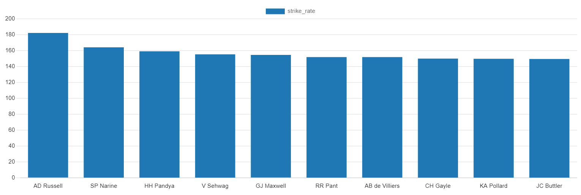

Batsmen with High Strike Rate
SELECT batsman,
COUNT(ball) AS ball_faced,
SUM(batsman_runs) AS total_runs,
(SUM(batsman_runs) * 100.0 / COUNT(ball)) AS strike_rate
FROM Deliveries
WHERE extras_type != 'wides'
GROUP BY batsman
HAVING COUNT(ball) >= 500
ORDER BY strike_rate DESC
LIMIT 10;
(strike rate is total runs scored by batsman divided by number of balls faced but remember when extras_type is 'wides' it is not counted as a ball faced neither counted as batsmen runs)

Slide 5
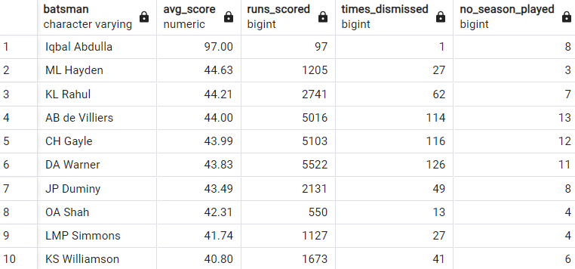
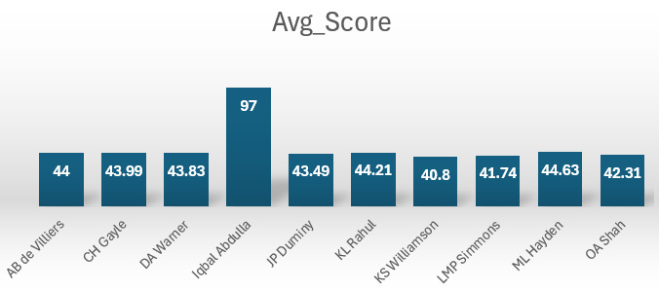
Batsmen with Good Average
SELECT d.batsman,
ROUND(SUM(d.total_runs)::DECIMAL / SUM(d.is_wicket), 2) AS avg_score,
SUM(d.total_runs) AS runs_scored,
SUM(d.is_wicket) AS times_dismissed,
COUNT(DISTINCT DATE_PART('year', m.date)) AS no_season_played
FROM Deliveries AS d
INNER JOIN Matches AS m ON d.id = m.id
GROUP BY d.batsman
HAVING SUM(d.is_wicket) >= 1
AND COUNT(DISTINCT DATE_PART('year', m.date)) > 2
ORDER BY avg_score DESC
LIMIT 10;
(Average is calculated as total runs scored divided by number of times batsman has been dismissed which can be calculated using wicket_ball field as 1 indicates out and 0 indicates not out, a batsman should’ve been dismissed at least once to calculate the sr d.e., you can exclude those players who have not been dismissed once)

Slide 6
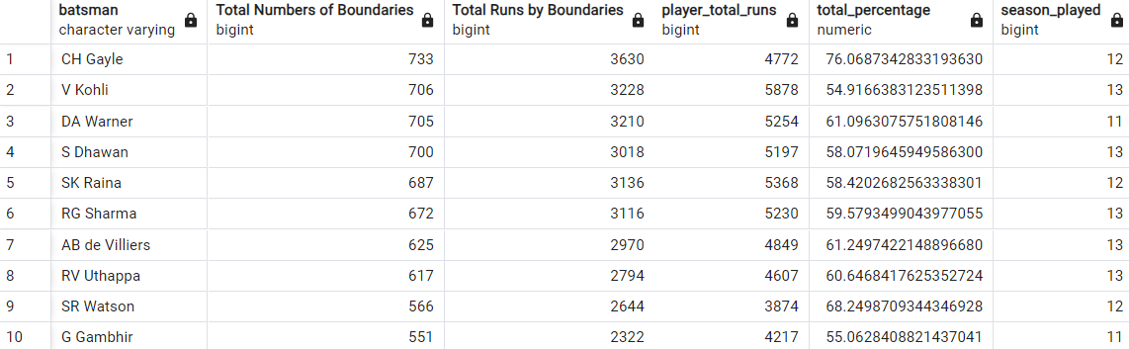
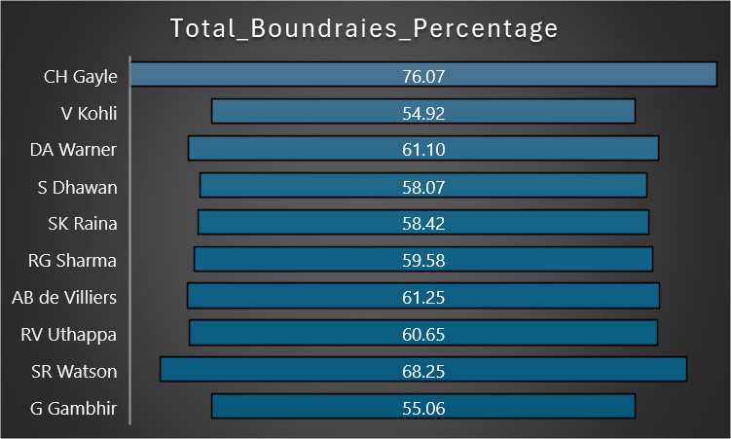
Batsmen with Most Boundries
SELECT d.batsman,
COUNT(CASE WHEN d.batsman_runs IN (4, 6) THEN 1 END) AS "Total Numbers of Boundaries",
SUM(CASE WHEN d.batsman_runs IN (4, 6) THEN d.batsman_runs ELSE 0 END) AS "Total Runs by Boundaries",
SUM(d.batsman_runs) AS Player_total_runs,
(SUM(CASE WHEN d.batsman_runs IN (4, 6) THEN d.batsman_runs ELSE 0 END) * 100.0) / SUM(d.batsman_runs) AS total_percentage,
COUNT(DISTINCT EXTRACT(YEAR FROM m.date)) AS no_season_played
FROM Deliveries AS d
INNER JOIN Matches AS m ON d.id = m.id
GROUP BY d.batsman
HAVING COUNT(DISTINCT EXTRACT(YEAR FROM m.date)) > 2
ORDER BY "Total Numbers of Boundaries“ DESC
LIMIT 10;
(only 4 and 6 will be counted as boundaries so calculate how many 4 and 6 has been hit by each batsman and also calculate total runs scored to get the output as boundary percentage which will be runs in boundary divided by total runs scored)

Slide 7
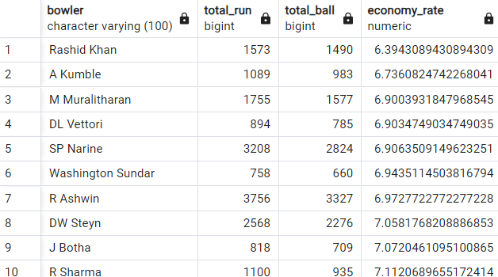
Bowlers with Good Economy
SELECT bowler,
SUM(total_runs) AS total_run,
COUNT(ball) AS total_ball,
(SUM(total_runs)*6.0 / (COUNT(ball) - (SUM(CASE WHEN extras_type IN ('wides') THEN 1 ELSE 0 end)))) AS economy_rate
FROM
Deliveries
GROUP BY
bowler
HAVING
COUNT(ball) >= 500
ORDER BY
economy_rate ASC
LIMIT 10;
(economy can be calculated by dividing total runs conceded with total overs bowled)

Slide 8
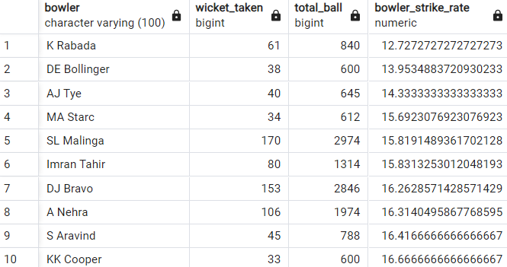
Bowlers with Best Strike-Rate
SELECT bowler,
SUM(CASE WHEN dismissal_kind NOT IN ('run out','obstructing the field','NA') THEN 1 ELSE 0 END) AS wicket_taken,
COUNT(ball) AS total_ball,
(COUNT(ball)*1.0 / SUM(is_wicket)) AS bowler_strike_rate
FROMDeliveries
GROUP BY bowler
HAVING COUNT(ball) >= 500
ORDER BY bowler_strike_rate ASC
LIMIT 10;
(strike rate of a bowler can be calculated by number of balls bowled divided by total wickets taken )

Slide 9
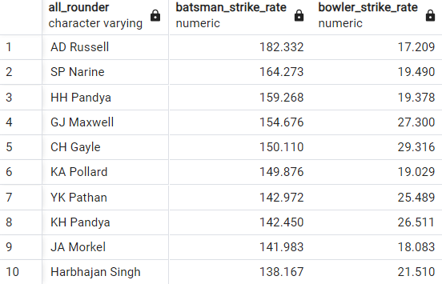
All-Rounders with Best Batting and Bowling Strike-Rate
SELECT a.batsman AS all_rounder,
ROUND(SUM(a.batsman_runs) * 100.0 / CAST(COUNT(a.ball) AS DECIMAL), 3) AS batsman_strike_rate,
b.bowler_strike_rate
FROM Deliveries AS a
INNER JOIN (
SELECT bowler,
COUNT(ball) AS balls_bowled,
ROUND(CAST(COUNT(ball) AS DECIMAL) / SUM(is_wicket), 3) AS bowler_strike_rate
FROM Deliveries WHERE extras_type NOT IN ('wides')
GROUP BY bowler HAVING COUNT(ball) >= 300) AS b
ON a.batsman = b.bowler
WHERE a.extras_type NOT IN ('wides')
GROUP BY a.batsman, b.bowler_strike_rate
HAVING COUNT(a.ball) >= 500
ORDER BY batsman_strike_rate DESC LIMIT 10;
(strike rate of an all rounder can be calculated using the same criteria of batsman similarly the bowling strike rate can be calculated using the criteria of a bowler)

Slide 10
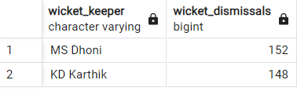
Wicket-Keeper(s) Now you need to get 2 wiecket keeper. A wicket keeper who surpasses in achieving dismissals through 'stumped' or 'caught' methods is considered one of the best in wicket keeper.
SELECT fielder AS Wicket_Keeper, COUNT(*) AS Wicket_Dismissals
FROM Deliveries
WHERE dismissal_kind IN('stumped','caught')
GROUP BY fielder
ORDER BY Wicket_Dismissals DESC
LIMIT 2;
For this query I used dismissal_kind = (‘stumped’,’caught’)
Wicket_Keepers | Sum of wicket_dismissals
KD Karthik | 148
MS Dhoni | 152
Grand Total | 300

Slide 11

Additional Question - 1 The count of cities that have hosted an IPL match
SELECT COUNT (distinct city) AS "Total_City_Hosted" FROM matches;

Slide 12
Additional Question – 2 Create table deliveries_v02 with all the columns of the table ‘deliveries’ and an additional column ball_result containing values boundary, dot or other depending on the total_run (boundary for >= 4, dot for 0 and other for any other number)
CREATE TABLE deliveries_v02 AS SELECT *,
CASE
WHEN total_runs >= 4 THEN 'boundary'
WHEN total_runs = 0 THEN 'dot'
ELSE 'other'
END AS ball_result
FROM Deliveries;
-- SELECT * FROM deliveries_v02;

Slide 13
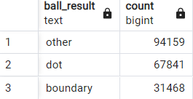
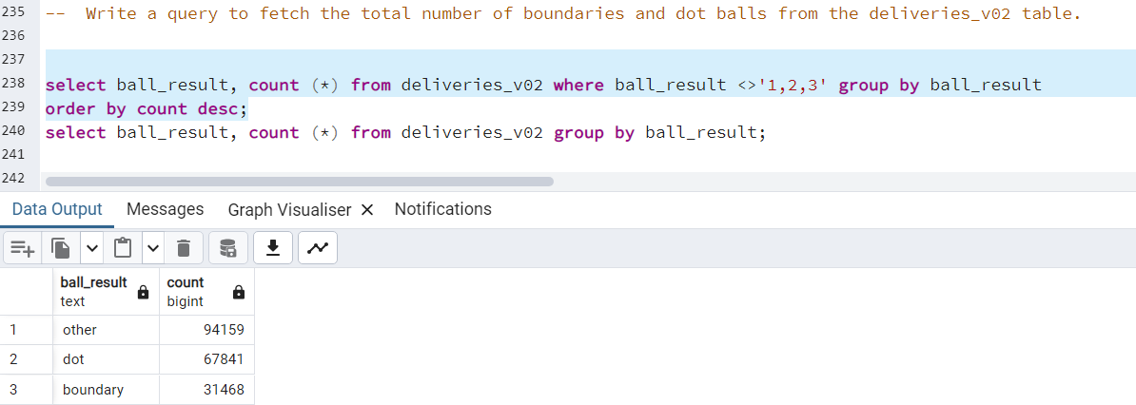
Additional Question - 3 query to fetch the total number of boundaries and dot balls from the deliveries_v02 table
SELECT ball_result, COUNT (*) FROM deliveries_v02 WHERE ball_result <>'1,2,3' GROUP BY ball_result
ORDER BY count DESC;
Or
SELECT ball_result, COUNT (*) FROM deliveries_v02 GROUP BY ball_result;

Slide 14
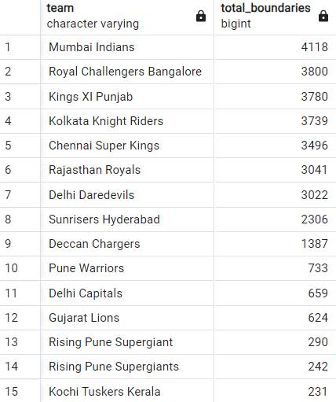
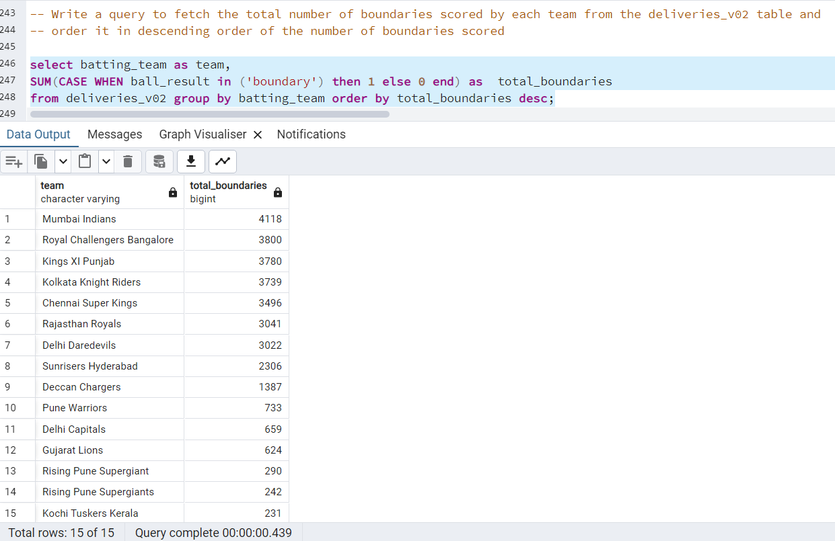
Additional Question - 4 query to fetch the total number of boundaries scored by each team from the deliveries_v02 table and order it in descending order of the number of boundaries scored
SELECT batting_team AS team,
SUM(CASE WHEN ball_result IN ('boundary') THEN 1 else 0 end) AS total_boundaries
FROM deliveries_v02 GROUP BY batting_team ORDER BY total_boundaries DESC;

Slide 15
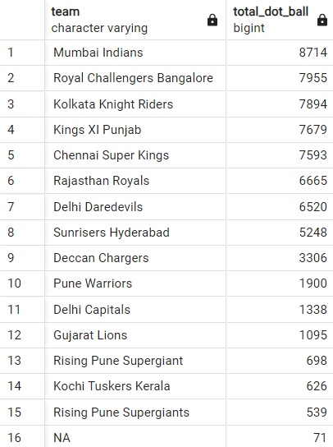
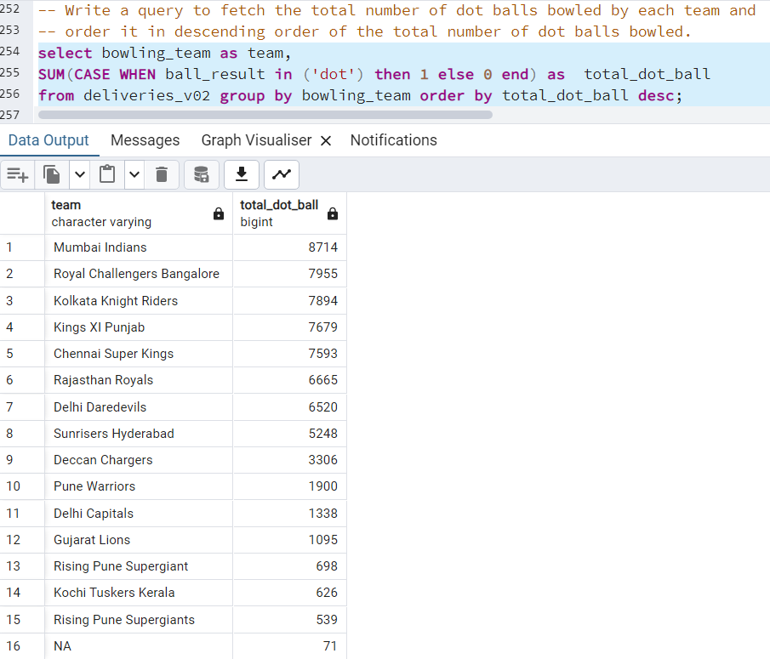
Additional Question - 5 query to fetch the total number of dot balls bowled by each team and order it in descending order of the total number of dot balls bowled.
SELECT bowling_team AS team,
SUM(CASE WHEN ball_result IN ('dot') THEN 1 ELSE 0 END) AS total_dot_ball
FROM deliveries_v02 GROUP BY bowling_team ORDER BY total_dot_ball DESC;

Slide 16

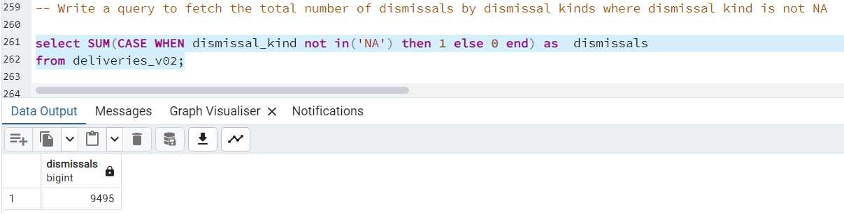
Additional Question - 6 query to fetch the total number of dismissals by dismissal kinds where dismissal kind is not NA
SELECT SUM(CASE WHEN dismissal_kind NOT IN('NA') THEN 1 ELSE 0 END) AS dismissals
FROM deliveries_v02;

Slide 17
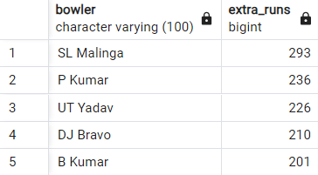
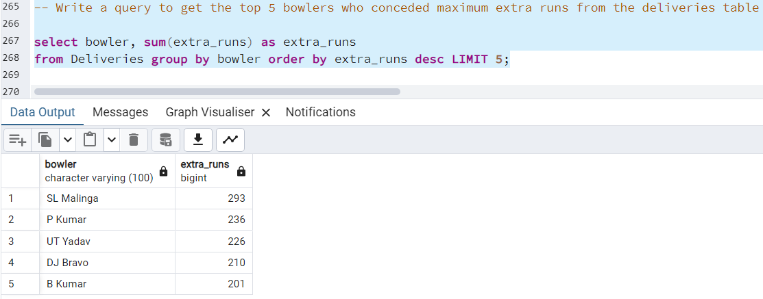
Additional Question - 7 query to get the top 5 bowlers who conceded maximum extra runs from the deliveries table .
SELECT bowler, SUM(extra_runs) AS extra_runs FROM Deliveries GROUP BY bowler ORDER BY extra_runs DESC LIMIT 5;

Slide 18
Additional Question - 8 query to create a table named deliveries_v03 with all the columns of deliveries_v02 table and two additional column (named venue and match_date) of venue and date from table matches
CREATE TABLE deliveries_v03 AS SELECT b.*, a.venue AS venue, a.date AS match_date
FROM deliveries_v02 AS b
JOIN Matches AS a
ON a.id = b.id;

Slide 19
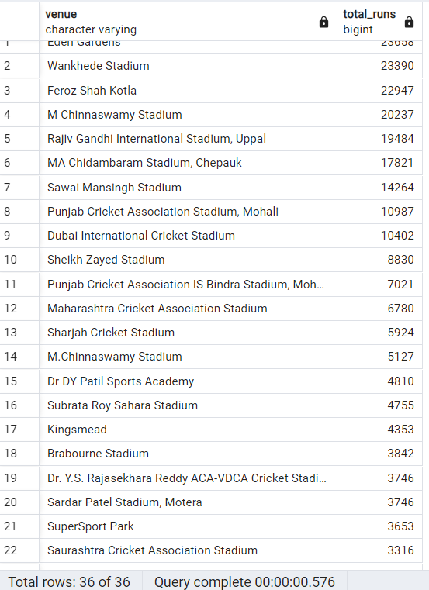
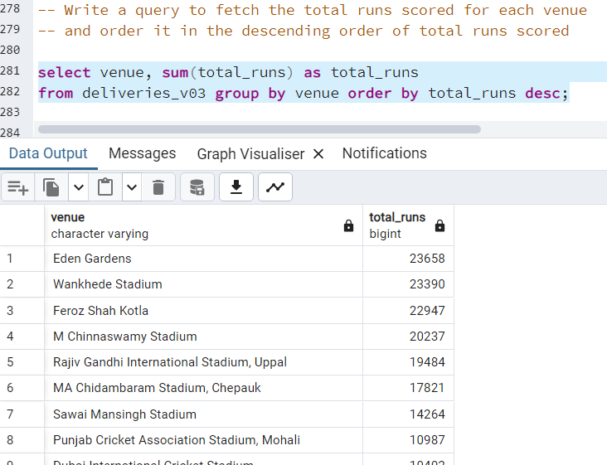
Additional Question - 9 query to fetch the total runs scored for each venue and order it in the descending order of total runs scored
SELECT venue, SUM(total_runs) AS total_runs FROM deliveries_v03 GROUP BY venue ORDER BY total_runs DESC;

Slide 20
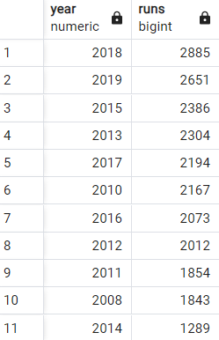
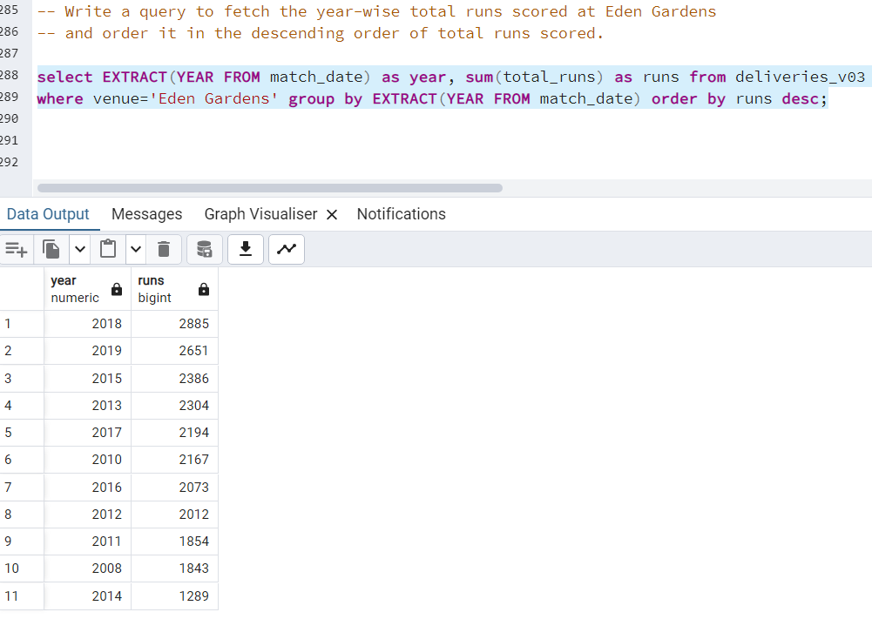
Additional Question - 10 query to fetch the year-wise total runs scored at Eden Gardens and order it in the descending order of total runs scored.
SELECT EXTRACT(YEAR FROM match_date) AS year, SUM(total_runs) AS runs FROM deliveries_v03 WHERE venue='Eden Gardens' GROUP BY EXTRACT(YEAR FROM match_date) ORDER BY runs DESC;

Slide 21
Thank you

