Slide 1


Project (KCA451)
Even Semester
Session 2024-25
GB11: Take Your Care
Meenakshi Bharadwaj (2300290140102)
Ritakshi Singh (2300290140141)
Project Supervisor:
Mr. Arpit Dogra
Assistant Professor

Slide 2
Project Abstract
In modern society, rapid technological advancements and increased digital connectivity have reshaped human interactions, work dynamics, and lifestyle patterns. While these advancements offer numerous benefits, they have also contributed to the rise of mental health issues such as anxiety, depression, and stress-related disorders. The growing prevalence of mental health conditions, coupled with social stigma and limited access to professional care, has created a need for innovative, technology-driven solutions.
In recent years, individuals have increasingly turned to digital platforms such as social media, blogs, and online forums to express their thoughts and emotions. This presents an opportunity to leverage advances in Natural Language Processing (NLP) to detect signs of mental health conditions through text analysis.
This research explores the development of an AI-powered text-based emotion analysis model designed to identify potential mental health disorders. By leveraging Natural Language Processing (NLP) and machine learning techniques, the model analyses user-generated text to detect conditions associated with mental issues like depression, anxiety. The system integrates transformer-based architectures such as BERT, RoBERTa, trained on publicly available mental health datasets, to achieve high accuracy in classification.
The proposed solution aims to bridge the gap between individuals experiencing mental health concerns and professional intervention by providing preliminary insights and recommendations. While the model does not replace clinical diagnosis, it serves as a supportive tool for early detection and awareness. This research contributes to the intersection of AI and mental health, emphasizing the importance of ethical AI applications in addressing modern psychological challenges.

Slide 3

Project Objectives
Develop an Emotion Detection Model
Combine multiple text-based emotion recognition approaches to improve accuracy.
Explore NLP techniques such as transformer models, sentiment analysis, and deep learning.
Identify Mental Health Disorders from Text Inputs
Analyse textual symptoms to match potential mental health conditions.
Develop a classification model that correlates symptoms with possible disorders.
Improve Early Detection and Intervention
Provide insights into emotional and psychological states based on user text input.
Generate recommendations for consulting a professional if risk indicators are identified.
Ensure Model Accuracy and Fairness
Minimize bias in text-based emotion detection across different demographics.
Validate the model using diverse datasets to improve generalization.
Develop an Explainable and Interpretable AI Model
Implement interpretable techniques for understanding model predictions.
Provide users with reasons for detected emotions and suggested mental health concerns.

Slide 4

Project Goals
1. Achieve High Accuracy in Emotion and Disorder Detection
Optimize the hybrid model to improve detection precision and recall.
2. Create a User-Friendly Application or API
Allow seamless integration into mental health platforms or mobile applications.
3. Contribute to Mental Health Research
Publish findings in relevant academic or clinical research communities.

Slide 5

Alignment with UN Sustainable Development Goals
This research aligns with United Nations Sustainable Development Goal (UN SDG) 3: Good Health and Well-being by promoting mental health awareness and early detection using AI-driven analysis. By leveraging technology to identify potential mental health concerns, the model contributes to Target 3.4, which aims to reduce premature mortality from non-communicable diseases through prevention and treatment. Additionally, it fosters inclusivity by providing accessible mental health support, addressing gaps in traditional healthcare systems.

Slide 6








Technology (Hardware and Software Requirements)
Hardware Requirements
Processor (CPU): Multi-core processor (Minimum intel i5)
Graphics Card (GPU): On Local system, NVIDIA GPU with CUDA support (e.g., GTX 1650, RTX 3060, 3080, or A100); On Google Colab, Tesla T4 for training deep learning models.
RAM: 8–16 GB (for handling large datasets and running multiple services).
Storage: 1 GB–20 GB SSD (for storing datasets, models, and code).
Operating System: Windows 10/11, macOS, Linux.
Software Requirements
Google Colab / Jupyter Notebook
Kaggle / Hugging Face: for datasets such as the Emotions Dataset, Sentiment Analysis for Mental Health, etc.
Models: Transformer models (like BERT, RoBERTa.)
Programming Language: Python
Frontend: HTML, CSS, JS
Backend: Flask, Ngrok

Slide 7
WorkFlow
Visits website
Welcome Page
Sharing inputs via text
Text Box
Process to
Deployed Model
Recommends Therapist
Critical Condition
Generates Result
Normal
Condition
Provides self-care ideas

Slide 8
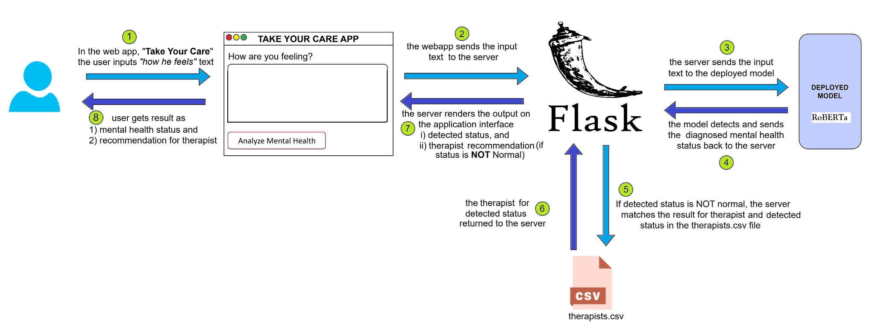
WorkFlow

Slide 9
Methodology and Approach
Collection of Dataset
Pre-processing of Data
Training of Model
Testing of Model
Fine-tuning of Model
Web App Development (UI)
Model deployment in the Web App (Integration of UI and model)
Testing of Web App
Deployment of Web App

Slide 10
Models Selected for Training

Slide 11
1. BERT
Base Architecture: Transformer Encoder
Specialization: General-purpose language understanding
Why Chosen: Benchmark model for comparison
Bidirectional Encoder Representations from Transformer

Slide 12
2. RoBERTa
Base Architecture: Optimized BERT
Specialization: Trained with larger batch size, dynamic masking
Why Chosen: Better performance on downstream tasks
Robustly Optimized BERT Approach

Slide 13
Model Evaluation & Comparison

Slide 14
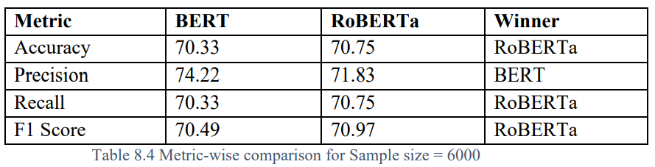
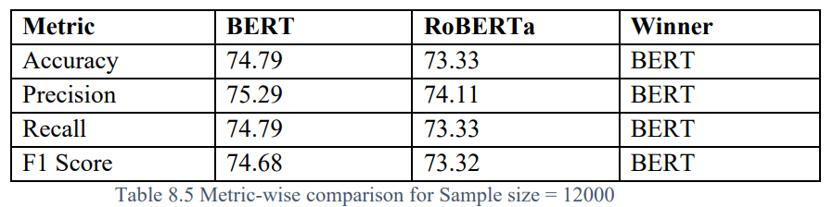
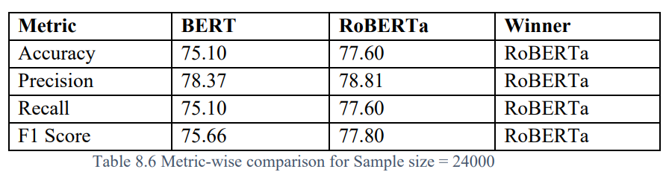
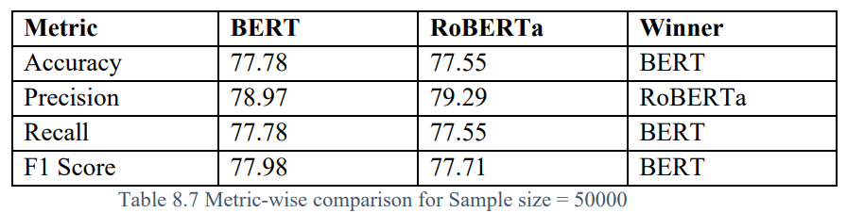
1:
2:
3:
4:

Slide 15
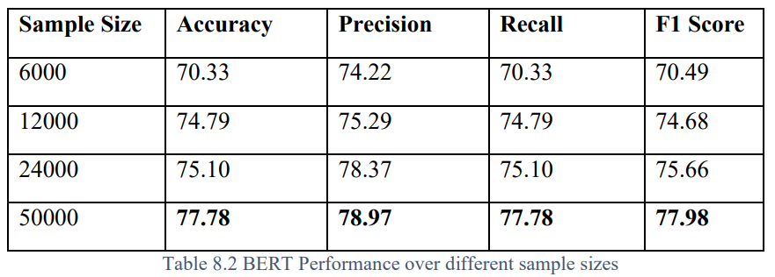
BERT Best Performance at sample_size=50000
5:

Slide 16
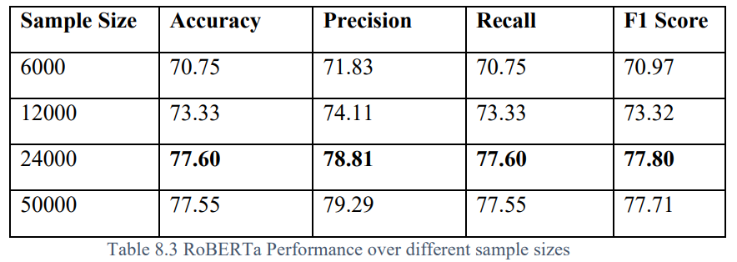
RoBERTa Best Performance at sample_size=24000
6:

Slide 17
Key Observations for Model Deployment
The highlighting observations of the model comparison for the selected models are listed below —
RoBERTa exhibits more stable growth in performance with increasing data, especially between 6000 and 24000 samples.
BERT peaks slightly higher at 50000 samples, but the improvement over RoBERTa is minimal and may not justify the extra training and inference cost.
F1 Score, a critical metric in mental health classification, is highest for:
BERT at 50000 (77.98)
RoBERTa at 24000 (77.80)
The marginal difference suggests RoBERTa generalizes better with fewer samples and reaches near-peak performance faster than BERT.

Slide 18
RoBERTa
Model deployed in the “TakeYourCare” application is –

Slide 19
Home Page UI

Slide 20
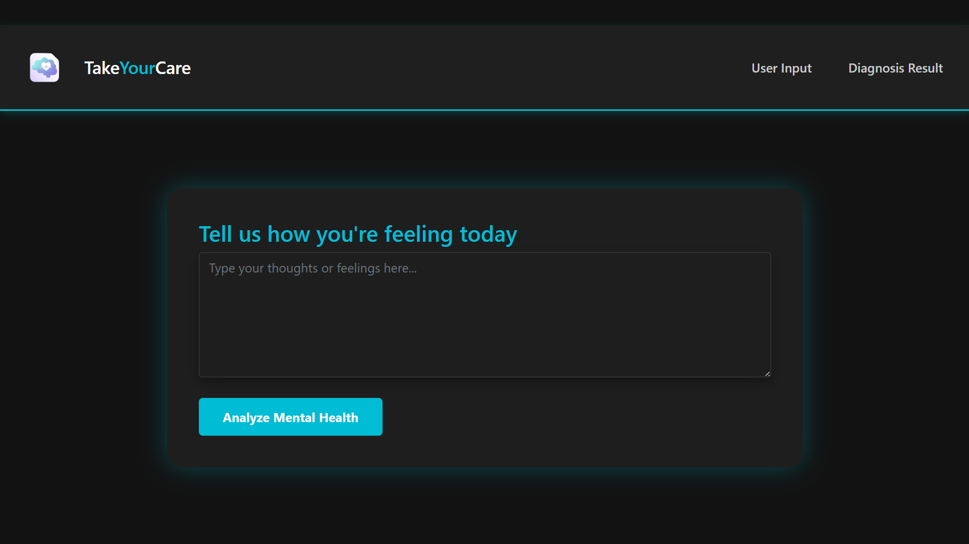

Slide 21
Results Page UI

Slide 22
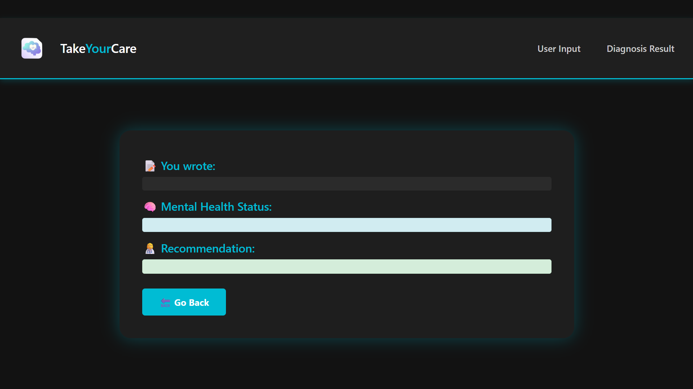

Slide 23
Output for Different Cases

Slide 24
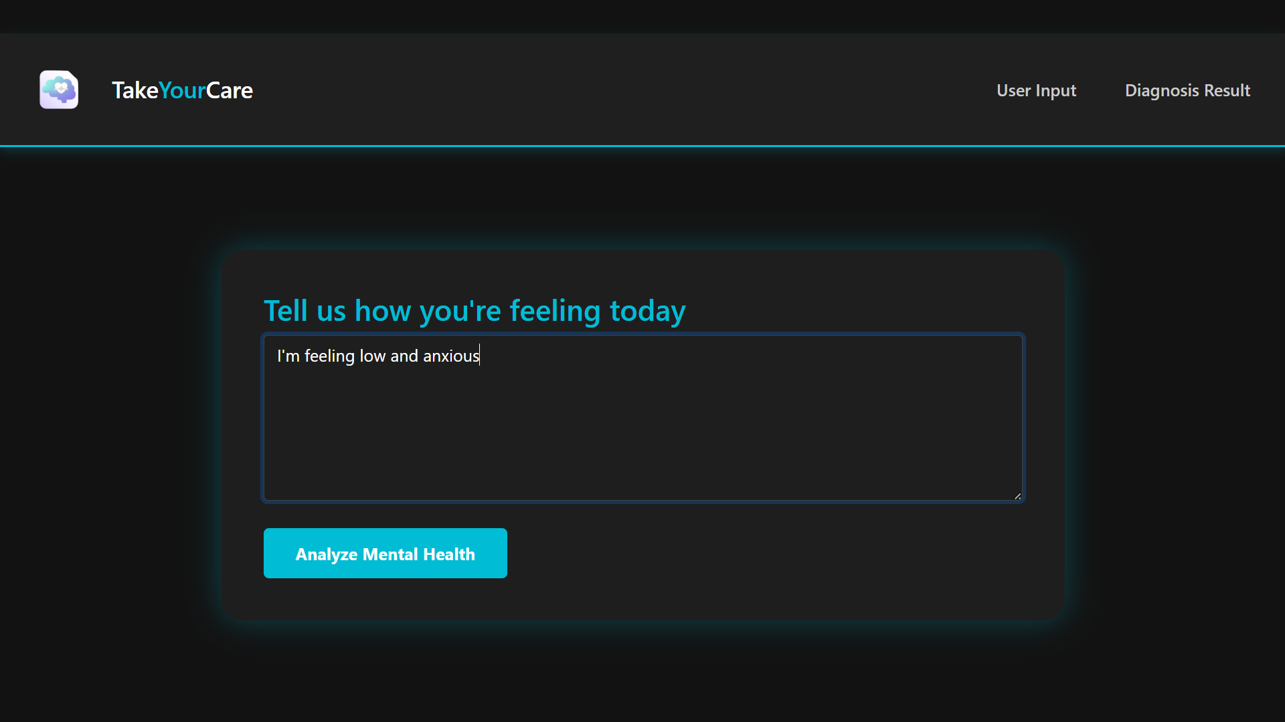
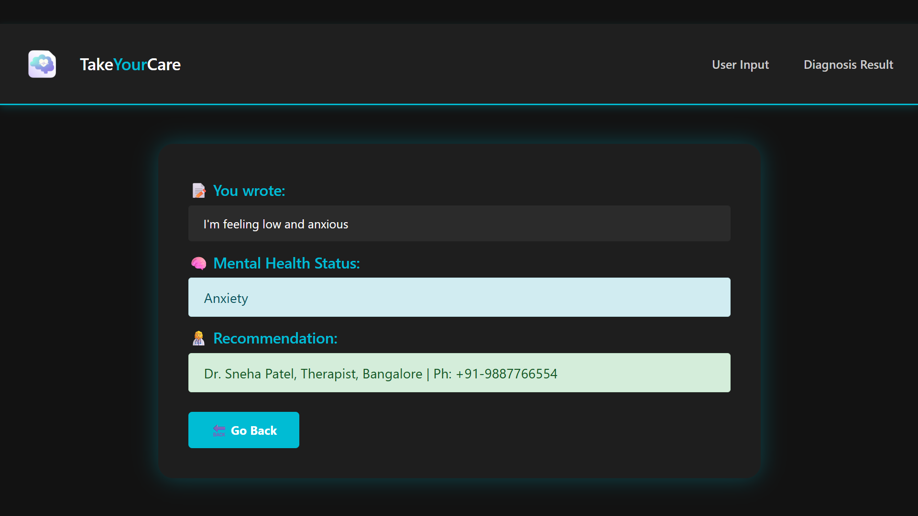
Case: Anxiety
Input Screen
Result Screen

Slide 25
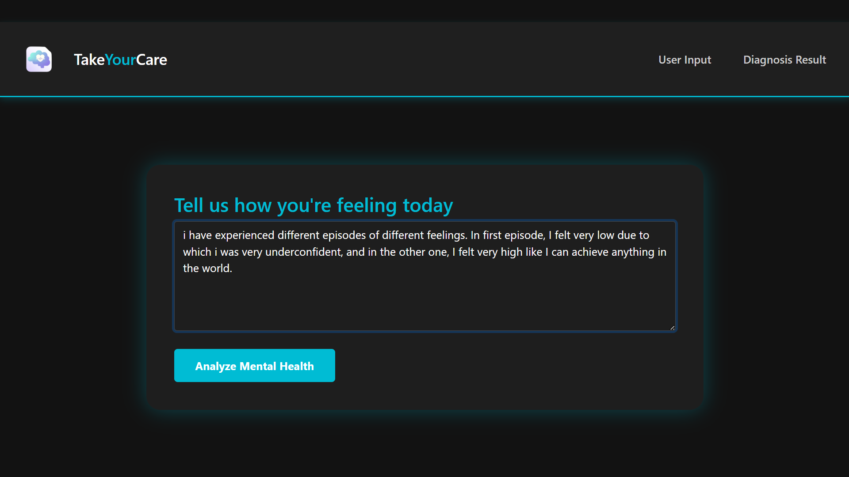
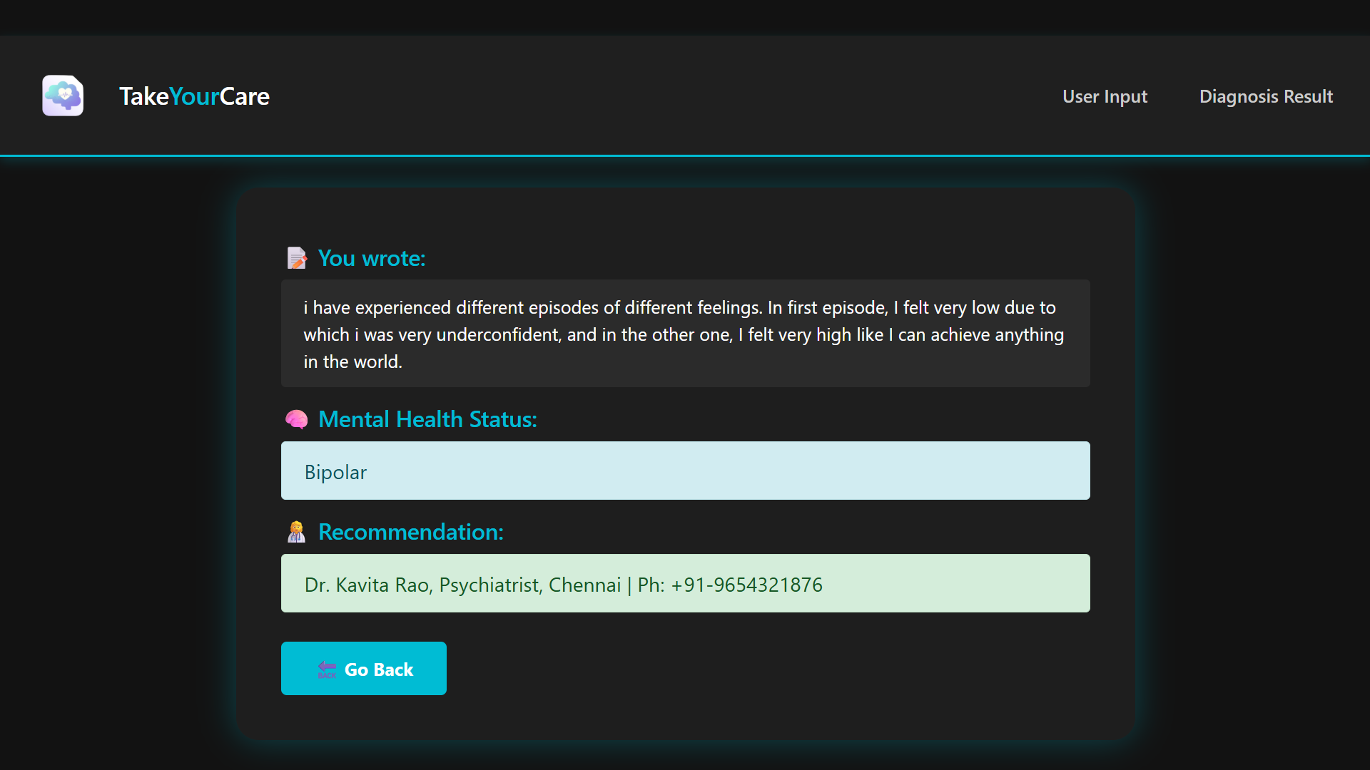
Case: Bipolar
Input Screen
Result Screen

Slide 26
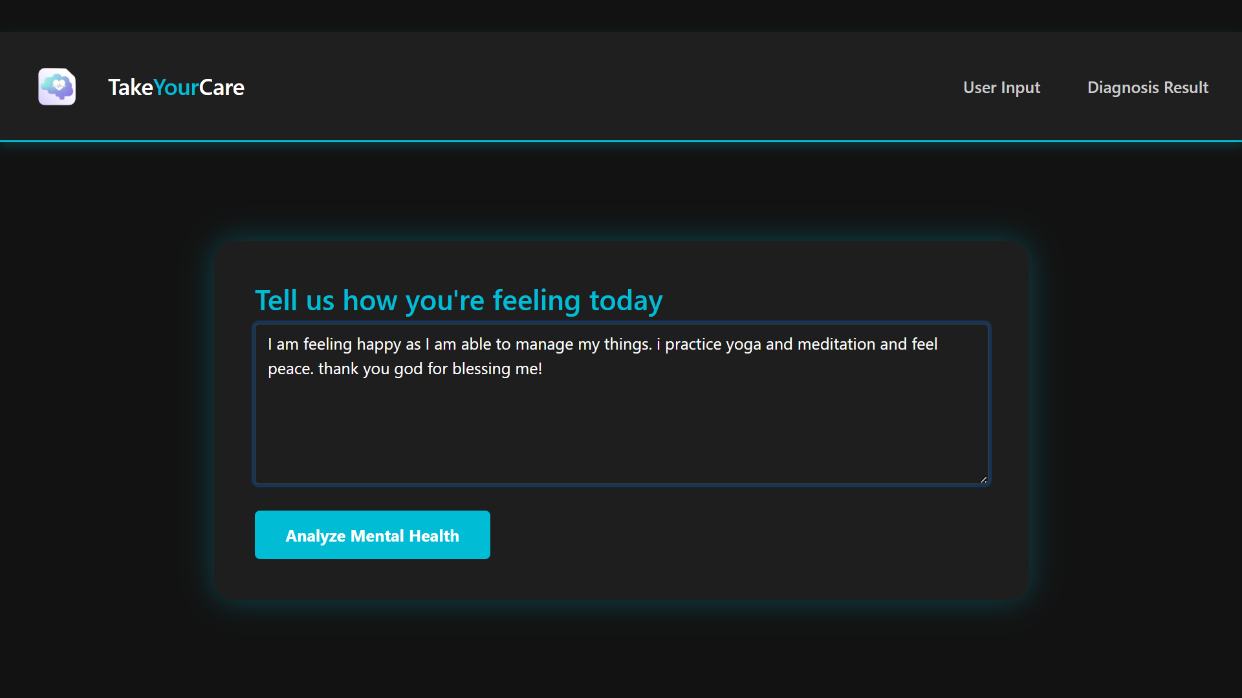
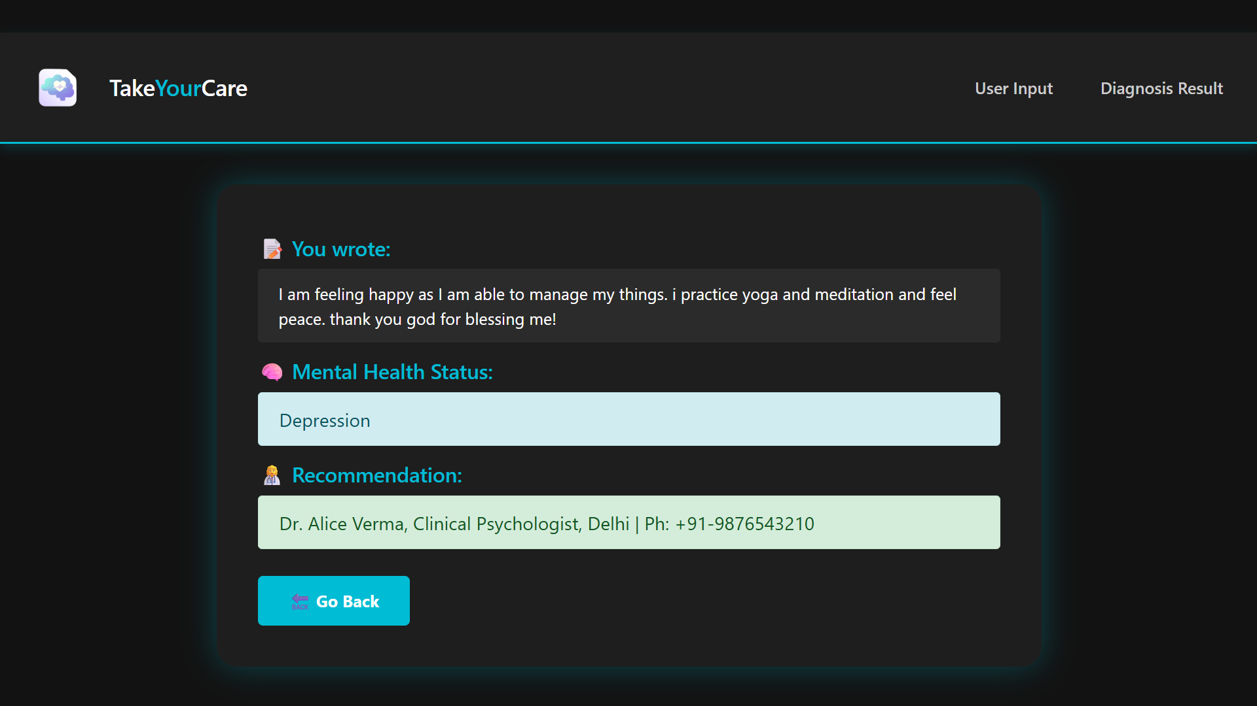
Case: Depression
Input Screen
Result Screen

Slide 27
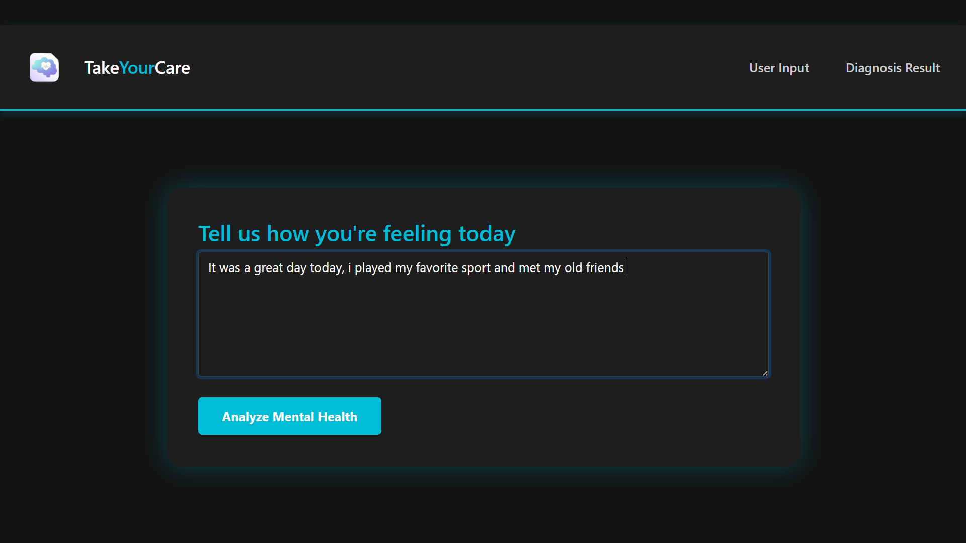
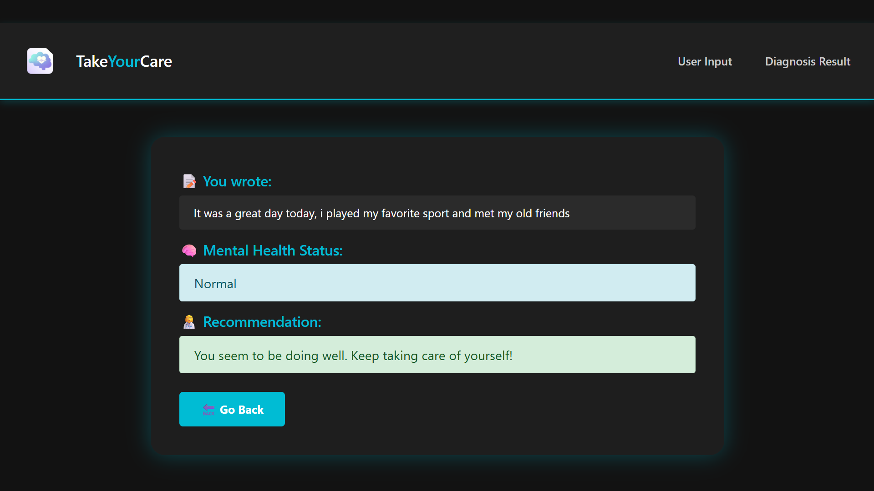
Case: Normal
Input Screen
Result Screen

Slide 28
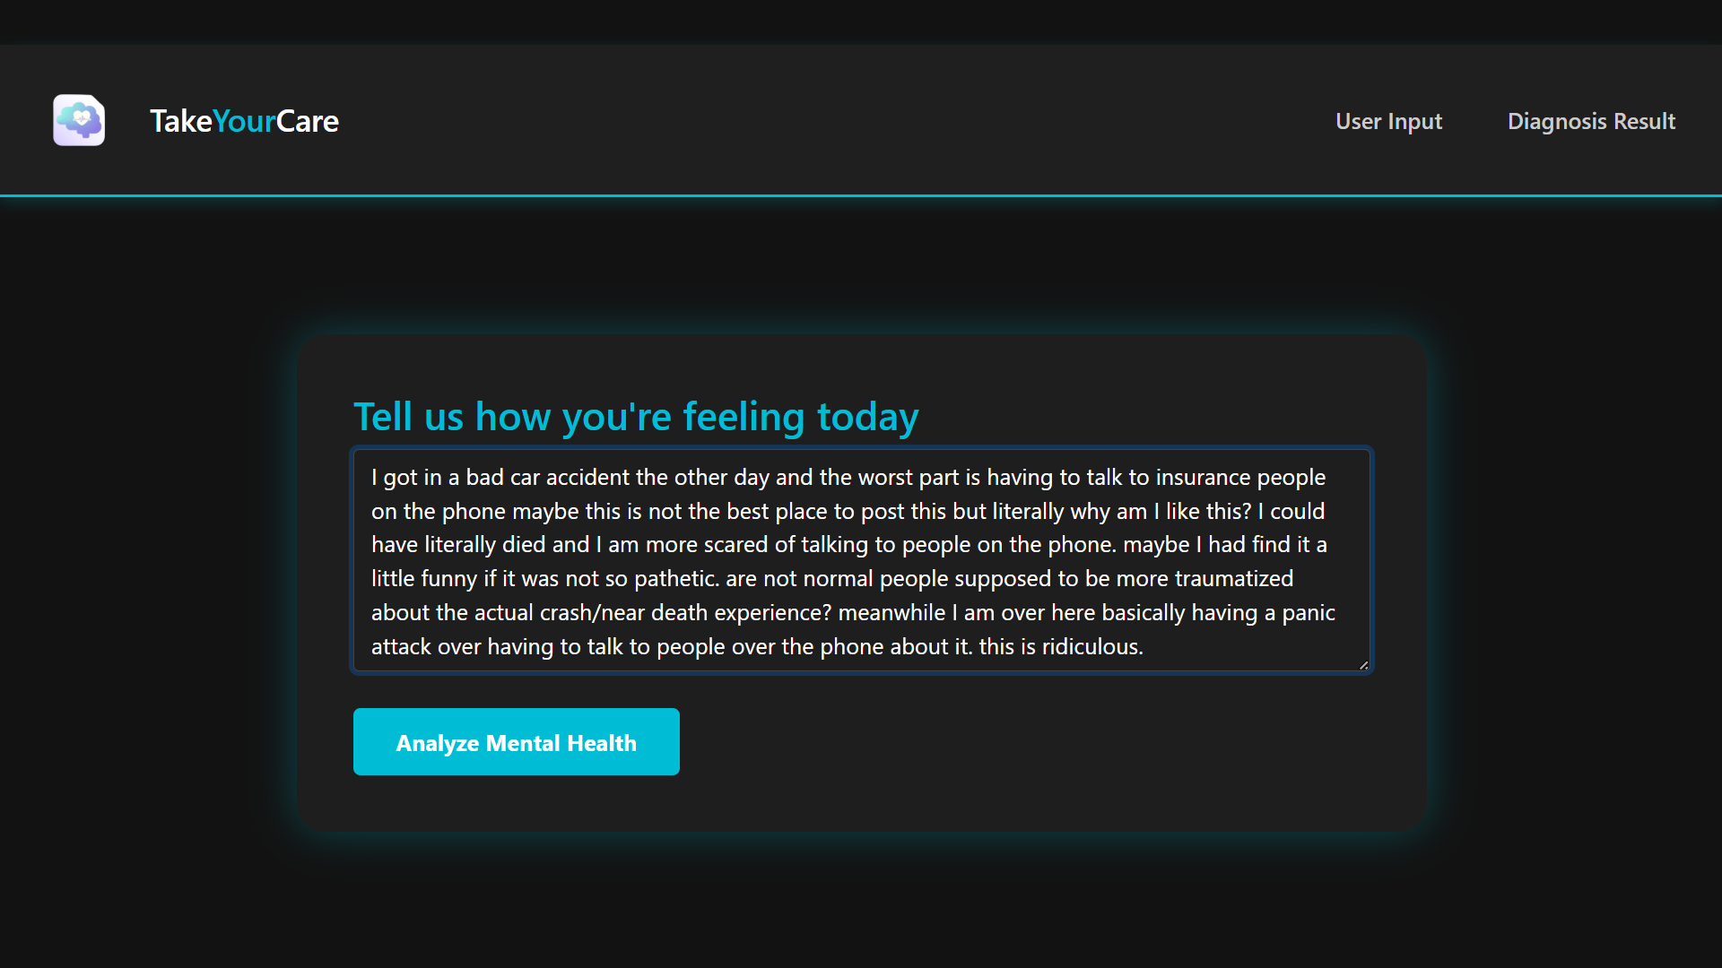
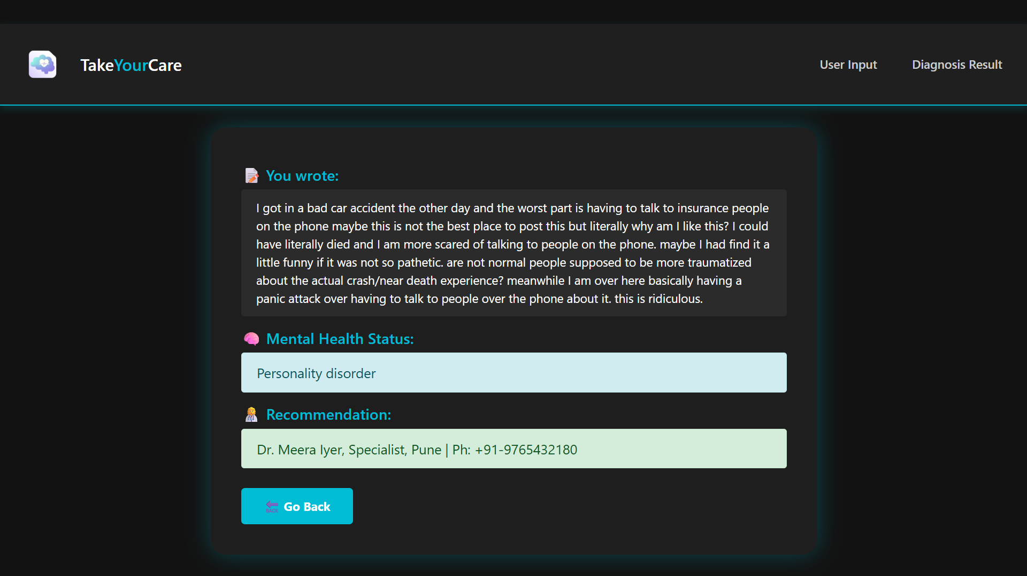
Case: Personality Disorder
Input Screen
Result Screen

Slide 29
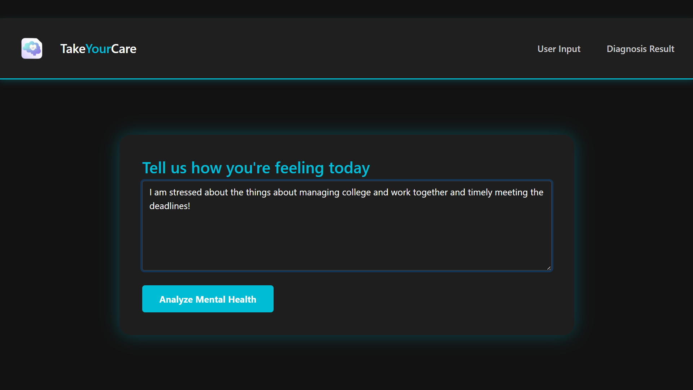
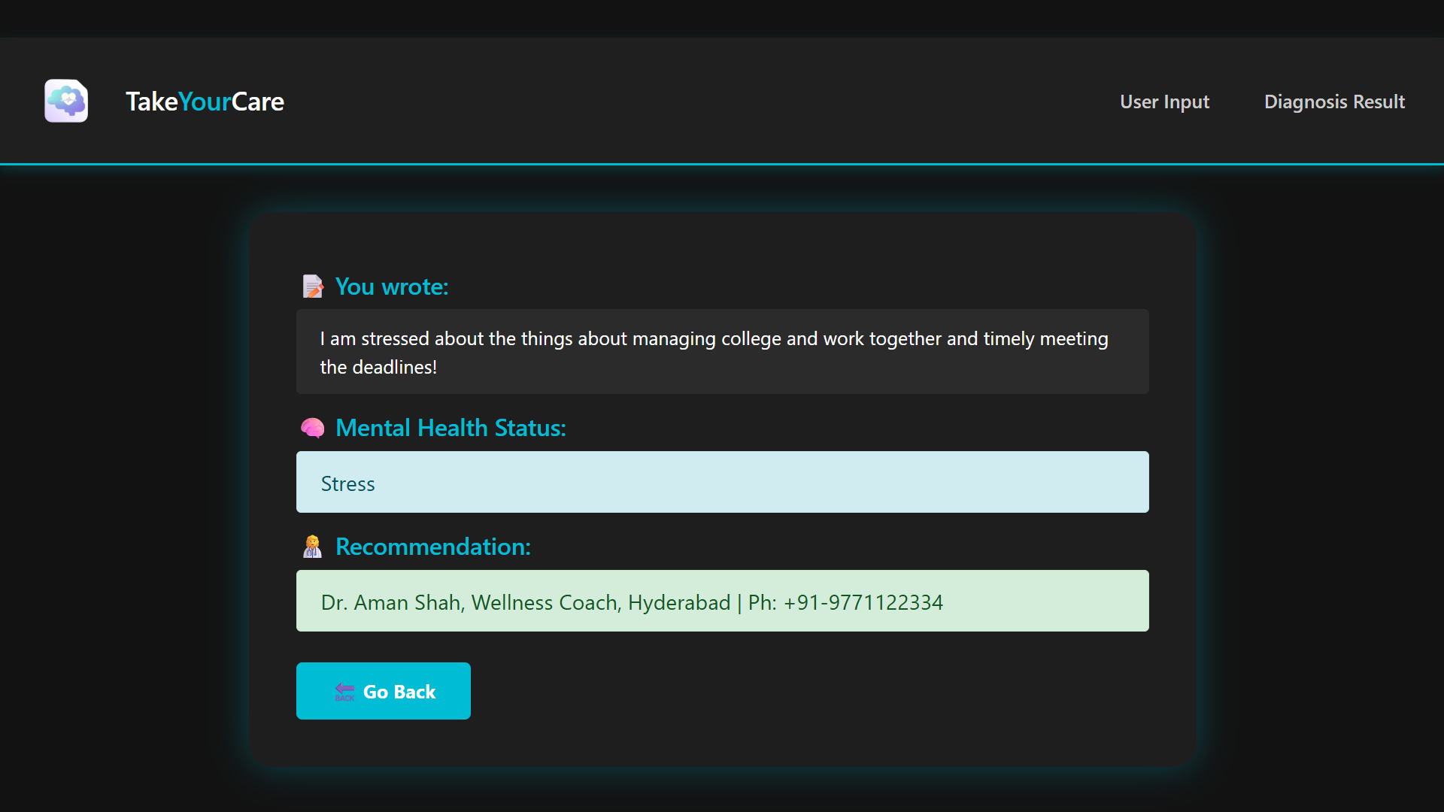
Case: Stress
Input Screen
Result Screen

Slide 30
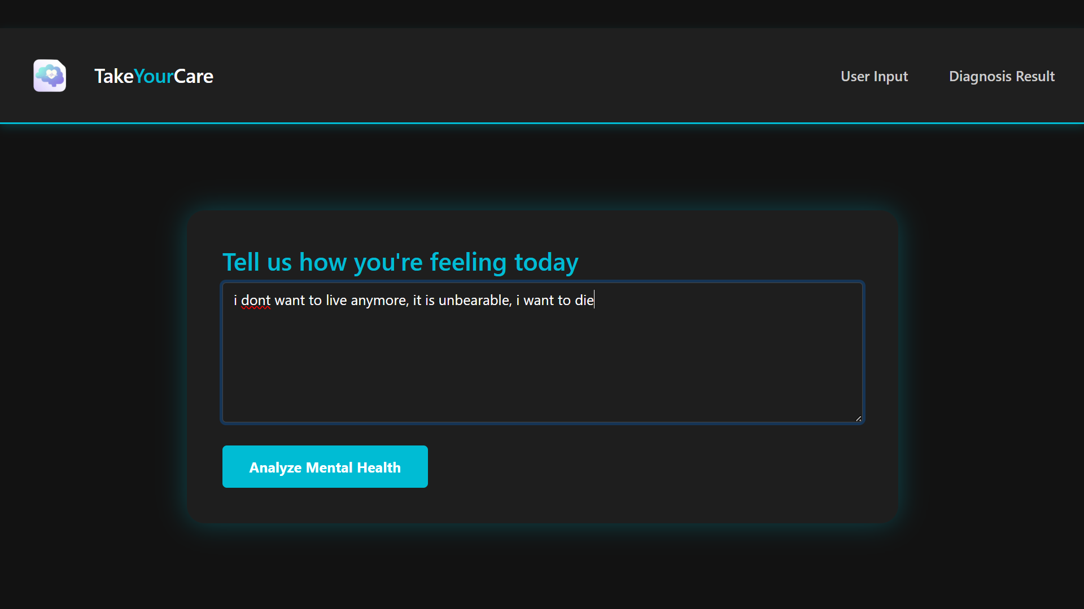

Case: Suicidal
Input Screen
Result Screen

Slide 31
Project Outcomes
Detection of Mental Health Condition
This system provides the result on the mental health status of the user with the help of the text-based inputs provided by the user.
Provides Recommendation
After assessing the user's health status, if the condition is determined to be critical, the system provides contact information for a therapist or psychiatrist. For cases identified as normal or mild, it offers self-care tips and suggestions for improvement.

Slide 32
References
Devlin, J., Chang, M. W., Lee, K., & Toutanova, K. (2019). BERT: Pre-training of Deep Bidirectional Transformers for Language Understanding. Proceedings of NAACL-HLT. arXiv:1810.04805
Liu, Y., Ott, M., Goyal, N., Du, J., Joshi, M., Chen, D., ... & Stoyanov, V. (2019). RoBERTa: A Robustly Optimized BERT Pretraining Approach. arXiv preprint arXiv:1907.11692. arXiv:1907.11692
Guntuku, S. C., Yaden, D. B., Kern, M. L., Ungar, L. H., & Eichstaedt, J. C. (2017). Detecting depression and mental illness on social media: an integrative review. Current Opinion in Behavioral Sciences, 18, 43–49.
Sarkar, S. (2022). Sentiment Analysis for Mental Health [Dataset]. Kaggle. https://www.kaggle.com/datasets/suchintikasarkar/sentiment-analysis-for-mental-health
Trotzek, M., Koitka, S., & Friedrich, C. M. (2018). Utilizing neural networks and linguistic metadata for early detection of depression indications in text sequences. IEEE Transactions on Knowledge and Data Engineering, 32(3), 588–601.
Rajput, S., Arora, A., & Kansal, V. (2021). A survey on sentiment analysis methods, applications, and challenges. AI Open, 2, 68–85.
Barros, J. M., Duggan, J., & Rebholz-Schuhmann, D. (2020). The application of Natural Language Processing to mental illness detection: A narrative review. NPJ Digital Medicine, 3(1), 1–11.
Schwartz, H. A., Eichstaedt, J. C., Kern, M. L., Dziurzynski, L., Lucas, R. E., Agrawal, M., ... & Ungar, L. H. (2014). Towards assessing changes in degree of depression through Facebook. Proceedings of the Workshop on Computational Linguistics and Clinical Psychology: From Linguistic Signal to Clinical Reality.
Hossain, M.M., Hossain, M.S., Mridha, M.F. et al. Multi task opinion enhanced hybrid BERT model for mental health analysis. Sci Rep 15, 3332 (2025). https://doi.org/10.1038/s41598-025-86124-6
Simon D’Alfonso, AI in mental health, Current Opinion in Psychology, Volume 36, 2020, Pages 112-117, ISSN 2352-250X, https://doi.org/10.1016/j.copsyc.2020.04.005.
M. N. Alrasheedy, R. C. Muniyandi and F. Fauzi, "Text-Based Emotion Detection and Applications: A Literature Review," 2022 International Conference on Cyber Resilience (ICCR), Dubai, United Arab Emirates, 2022, pp. 1-9, doi: 10.1109/ICCR56254.2022.9995902.
Daniel Yohanes, Jessen Surya Putra, Kenneth Filbert, Kristien Margi Suryaningrum, Hanis Amalia Saputri, Emotion Detection in Textual Data using Deep Learning, Procedia Computer Science, Volume 227, 2023, Pages 464-473, ISSN 1877-0509, https://doi.org/10.1016/j.procs.2023.10.547.
Kusal, Sheetal & Patil, Shruti & Choudrie, Jyoti & Kotecha, Ketan & Vora, Deepali & Pappas, Ilias. (2022). A Review on Text-Based Emotion Detection -- Techniques, Applications, Datasets, and Future Directions. 10.48550/arXiv.2205.03235.

Slide 33
THANK YOU!

