Slide 1

Major Project (KCA451)
ODD SEMESTER 2024-25
StudyNotion
Rakshit Rajput 2300290140134
Prashu Pandey 2300290140124
Payal Pundir 2300290140114
Project Supervisor
Mrs. Arpit Dogra
Associate Professor

Slide 2
Content
Introduction
Literature Review
Objective of the Project
Technology
Hardware Requirements (Development Environment, Server requirement (if required), Client requirement (if
required).
Software Requirements (Language and Platforms like Frameworks, VS code, Android Studio and Jupyter notebook etc. )
Modules
Workflow
Reports (For Example: Project : Student Monitoring System, so reports like: Student Marks, Subjects, companies visit, and student appears in placement etc.)
References

Slide 3
Introduction
Online Learning Platform for Accessible and Flexible Education
This project aims to develop an online learning platform offering diverse courses across multiple fields.
The platform provides tools for instructors to create interactive content (videos, quizzes, etc.) and for learners to engage with the material flexibly.
The main goal is to make quality education accessible and adaptable to all learners, regardless of their geographical location or personal schedules.

Slide 4
Literature Review
Online Learning Platforms: A Review of Literature
Global Reach: Online platforms eliminate geographic barriers, allowing access to education from anywhere
Flexibility: Online education provides time flexibility, making it ideal for working professionals and remote learners
Scalability: Platforms can easily scale to accommodate increasing numbers of learners with minimal infrastructure
Cost-Effectiveness: Lower operational costs for both learners and institutions as compared to traditional classrooms.

Slide 5
Literature Review (Contd.)
Key Factors in Effective E-Learning
Interactivity: Engaging learners through quizzes, live sessions, and forums enhances understanding and retention
Learner Autonomy: Self-paced courses improve learner satisfaction and completion rates, particularly for adult learners
Completion Rates: Studies show that learners who receive certificates upon completion are more likely to finish their courses
Social Learning: Peer discussions and collaborative projects foster a sense of community, improving motivation and learning outcomes.

Slide 6
Objective of the Project
Key Objectives of the Online Learning Platform
Course Diversity: Provide courses covering various fields including technology, humanities, business, and arts.
Interactive Content: Equip instructors with tools to create multimedia-rich, engaging content such as videos, quizzes, and assignments.
Learner Flexibility: Offer self-paced courses that allow learners to study anytime, anywhere.
Certification: Issue completion certificates to help learners validate their achievements.
Scalability: Design the platform to support an increasing number of courses and learners as demand grows.

Slide 7
Technology (Hardware Requirements)
Development Environment:
Minimum: Intel i3 Processor, 8GB RAM
Cloud-based infrastructure (AWS) for scalability and high availability.
Must support multiple concurrent users, with load balancing to ensure smooth performance.
Client Requirement (if applicable):
Any laptop/PC or mobile device with internet access.
Platform optimized for mobile and desktop browsers for seamless use on different devices.

Slide 8
Technology (Software Requirements)
Languages & Frameworks:
Frontend: HTML5, CSS3, JavaScript (React) for dynamic and responsive interfaces.
Backend: Node.js, Express and Cloudinary for managing user data, course content, and authentication(Using JWT), Postman for API Testing.
Platforms & IDEs:
VS Code: Primary code editor for development.
Database:
MongoDB for handling user data, course enrollments, and assessments.

Slide 9
Modules
Core Modules of the Platform
Instructor Module:
Course Creation: Instructors can upload videos, assignments, and quizzes using an intuitive interface.
Learner Analytics: Tools for tracking student progress and engagement, with insights into learner performance.
Interactive Features: Live sessions, discussion boards, and peer collaboration to increase engagement.
Learner Module:
Course Access: Learners can browse courses, enroll, and track their progress.
Self-Paced Learning: Flexibility to pause, revisit, and complete lessons at their own convenience.
Quizzes & Assessments: Regular quizzes to reinforce learning, with immediate feedback.

Slide 10
Modules (Contd.)
Supplementary Modules:
Admin Module:
User Management: Admins can manage instructors, learners, and courses, along with monitoring platform usage.
System Management: Admins oversee backend tasks, performance monitoring, and troubleshooting.
Reports Generation: Admins can generate reports on course enrollments, completion rates, and learner engagement.
Certification Module:
Automated Certificates: Upon successful completion of courses, learners receive downloadable certificates.
Progress Tracking: Track learner progress and display the percentage of course completed

Slide 11
Modules (Contd.)
Supplementary Modules:
Group formation
This module enables students to create and join collaboration groups for seamless interaction, resource sharing, and academic discussions. Users can form groups based on subjects, projects, or interests, facilitating knowledge exchange and teamwork. Features include group chat, file sharing, role-based permissions, and integration with study resources. The system ensures easy discoverability of groups and enhances peer learning through structured collaboration.

Slide 12
Modules (Contd.)
Additional Modules
Discussion Forum:
Peer Interaction: Learners can ask questions, discuss topics, and collaborate with peers.
Instructor Engagement: Instructors can monitor discussions and provide clarifications.
Feedback and Review System:
Course Ratings: Learners can rate and review courses, providing feedback to improve the content.
Instructor Feedback: Instructors receive feedback on teaching effectiveness, helping them improve course delivery.

Slide 13
Modules (Contd.)
Additional Modules
AI Module
The AI integration enhances the platform by providing text summarization, answering user queries, and generating interview questions. This feature helps students quickly grasp key concepts, clarify doubts, and practice with AI-generated questions, improving their preparation efficiency.
Quiz Module
The quiz module enables students to generate and attempt quizzes for practice and revision. It supports dynamic question generation, multiple-choice and subjective formats, and performance tracking to help users assess their knowledge and identify improvement areas.

Slide 14
Modules (Contd.)
Additional Modules
Leaderboard:
The leaderboard ranks students based on their quiz performance, encouraging healthy competition and motivation. It dynamically updates scores, displays top performers, and provides insights into individual progress. This feature fosters engagement and helps students track their improvement over time.

Slide 15
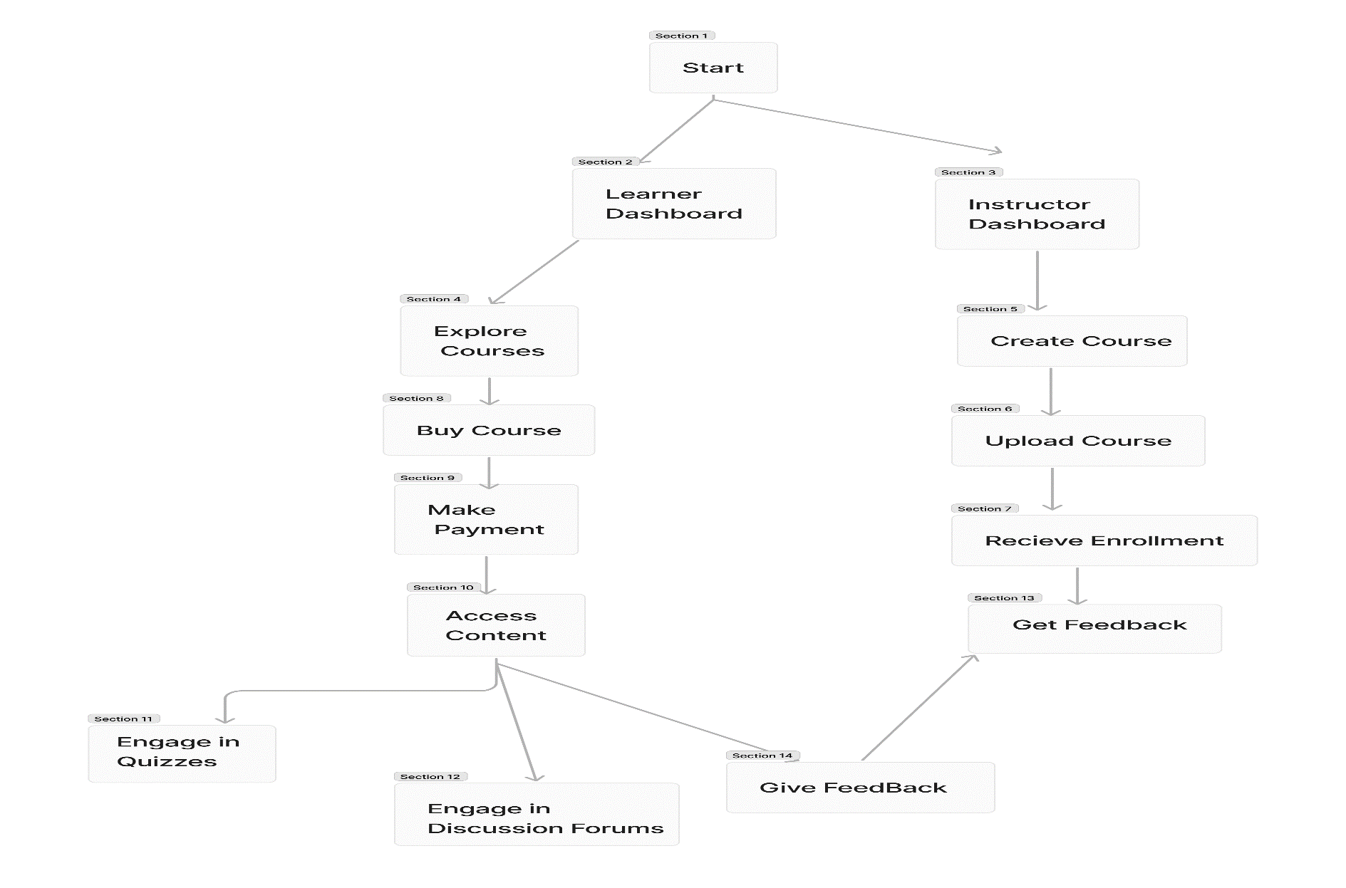
Workflow

Slide 16
Reports
Sample Reports for the Online Learning Platform
Udemy Course EDA, SQL and modelling 👩‍🏫 (kaggle.com)
Learner Progress Reports: Detailed view of learner activities, course progress, quiz scores, and assessment results.
Course Completion Reports: Reports on the number of students completing courses, and average time taken.
Instructor Performance Reports: Feedback and ratings for instructors, showing their effectiveness.
Platform Usage Reports: Track platform traffic, popular courses, and peak usage times.

Slide 17
References
Node.js Documentation Node.js — How much JavaScript do you need to know to use Node.js? (nodejs.org)
React.js Documentation React Reference Overview – React
Express.js Documentation expressjs.com/en/guide/routing.html
Cloudinary Documentation Cloudinary Image & Video Management - Documentation Home | Cloudinary
MongoDB Documentation MongoDB Documentation

