Slide 1

Project (KCA451) Even Semester Session 2024-25
GreenTech
Kapil Maheshwari (2300290140085)
Kavya Verma (2300290140087)
Hritik Chaudhary (2300290140077)
Prabal Pratap Singh (2300290140119)
Project Supervisor:
Dr. Akash Rajak
Professor
1.

Slide 2
Content
2.
Introduction
Literature Review
Objective of the Project
Technology
Hardware Requirements
Software Requirements
Modules
Workflow
Reports
References
Notes:
Font Styles: Times New Roman + Font Size: 25

Slide 3
Introduction
3.
GreenTech energy is an online platform designed for the sale and management of solar panel products, providing a user friendly E-Commerce site that automates inventory, transactions, and customer interactions.
The integration of e-commerce with sustainable energy solutions presents a significant opportunity for digital transformation in the solar energy market. GreenTech Energy aims to leverage these technologies to offer a seamless, automated, and customer-centric online shopping experience for solar products.
Notes:
Font Styles: Times New Roman + Font Size: 25

Slide 4
Literature Review
4.
Evolution of E-Commerce
E-commerce has revolutionized the way businesses operate by enabling digital transactions and automating inventory management. Early e-commerce platforms focused on basic product listings and manual order processing, but modern advancements have introduced automated inventory tracking, secure payment systems, and AI-driven customer interactions.
2. Challenges in E-Commerce Development
Security Concerns: Cyber security threats, data breaches, and fraud risks require robust security measures such as SSL encryption and multi-factor authentication.
Scalability Issues: As demand grows, ensuring system scalability is essential for handling high traffic and large product inventories.
User Experience: Simplified navigation, mobile responsiveness, and fast load times are crucial for enhancing user engagement.
Notes:
Font Styles: Times New Roman + Font Size: 25

Slide 5
Literature Review
5.
3. E-Commerce and Renewable Energy Market
The renewable energy sector, particularly solar energy, has seen increasing online adoption. Studies highlight that online platforms play a crucial role in promoting sustainable energy solutions by making solar products accessible to a wider audience. E-commerce in this sector enables better customer education, real-time product availability tracking, and streamlined logistics.
4. Sustainable Energy Practices:
Research showcases how digital solutions contribute to reducing carbon footprints and promoting renewable energy adoption.
Automated control systems help businesses and households efficiently manage their energy consumption.
5. Case Studies and Practical Implementations:
Various real-world implementations of energy management systems have demonstrated significant cost savings and sustainability improvements.
Government policies and corporate strategies increasingly integrate smart energy management solutions.
Notes:
Font Styles: Times New Roman + Font Size: 25

Slide 6
Objective & Scope of the Project
6.
Objectives:
Develop a user-friendly web platform.
Provide an efficient reporting and visualization module.
Scope:
Accessible via web and mobile browsers.
Functional Scope : User Account Management, Shopping Cart, Admin Panel etc.
Notes:
Font Styles: Times New Roman + Font Size: 25

Slide 7
Technology (Hardware Requirements)
7.
Server Requirements:
Processor: Intel Core i5 or higher
RAM: 8GB or above
Storage: 512GB SSD or higher
Operating System: Windows 10 or Linux
Network: High-speed internet connection
Client Requirements:
Processor: Intel Core i3 or higher
RAM: 4GB or above
Storage: 256GB SSD or higher
Operating System: Windows 10, macOS, or Linux
Browser: Google Chrome, Mozilla Firefox, or Microsoft Edge
Notes:
Font Styles: Times New Roman + Font Size: 25

Slide 8
Technology (Software Requirements)
8.
Operating System: Windows 10, macOS, or Linux
Development Tools: VS Code
Programming Languages: Python, JavaScript
Frameworks: React
Database Management System: SQLite / PostgreSQL
Version Control: Git, GitHub
Web Server: Apache / Nginx
API Services: RESTful APIs for data communication
Notes:
Font Styles: Times New Roman + Font Size: 25

Slide 9
Modules
9.
Profile Module
User registration & authentication.
Admin Module
Energy data monitoring, reporting, and user management.
User Module
Energy consumption tracking, data analysis, and visualization.
Reporting Module
Generate detailed energy reports and insights.
Analytics Module
Advanced analytics for energy optimization and forecasting.
Notes:
Font Styles: Times New Roman + Font Size: 25

Slide 10
Workflow
10.
User Registration & Login
Users register and authenticate before accessing the system.
2. Energy Consumption Tracking
Users input or sync energy usage data.
3. Data Processing & Analysis
System processes data and generates insights.
4. Reporting & Visualization
Users can access energy reports and visual analytics.
5. Admin Management
Admin oversees system operations and user management.
Notes:
Font Styles: Times New Roman + Font Size: 25

Slide 11
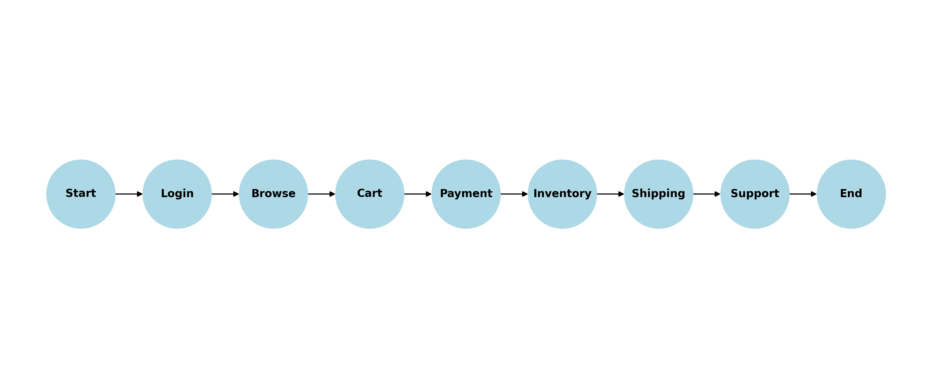
Workflow
11.
Notes:
Font Styles: Times New Roman + Font Size: 25

Slide 12
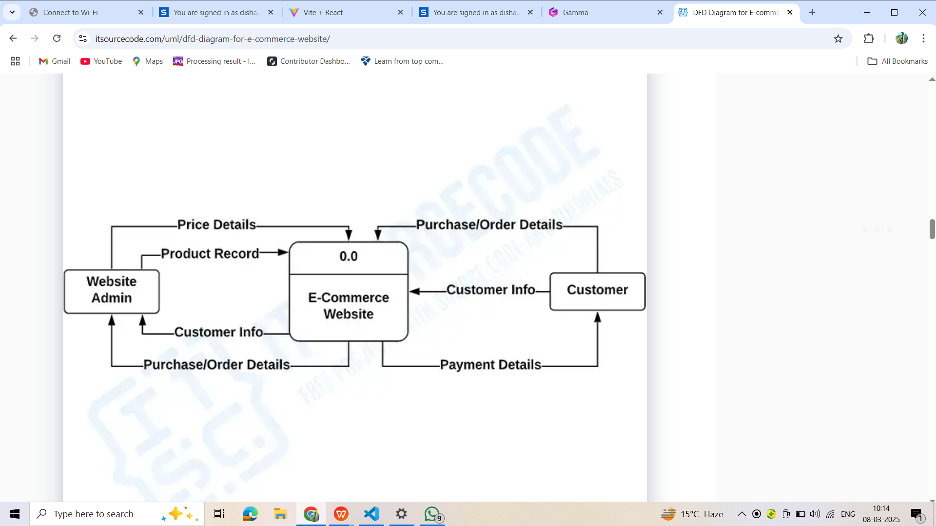

Slide 13
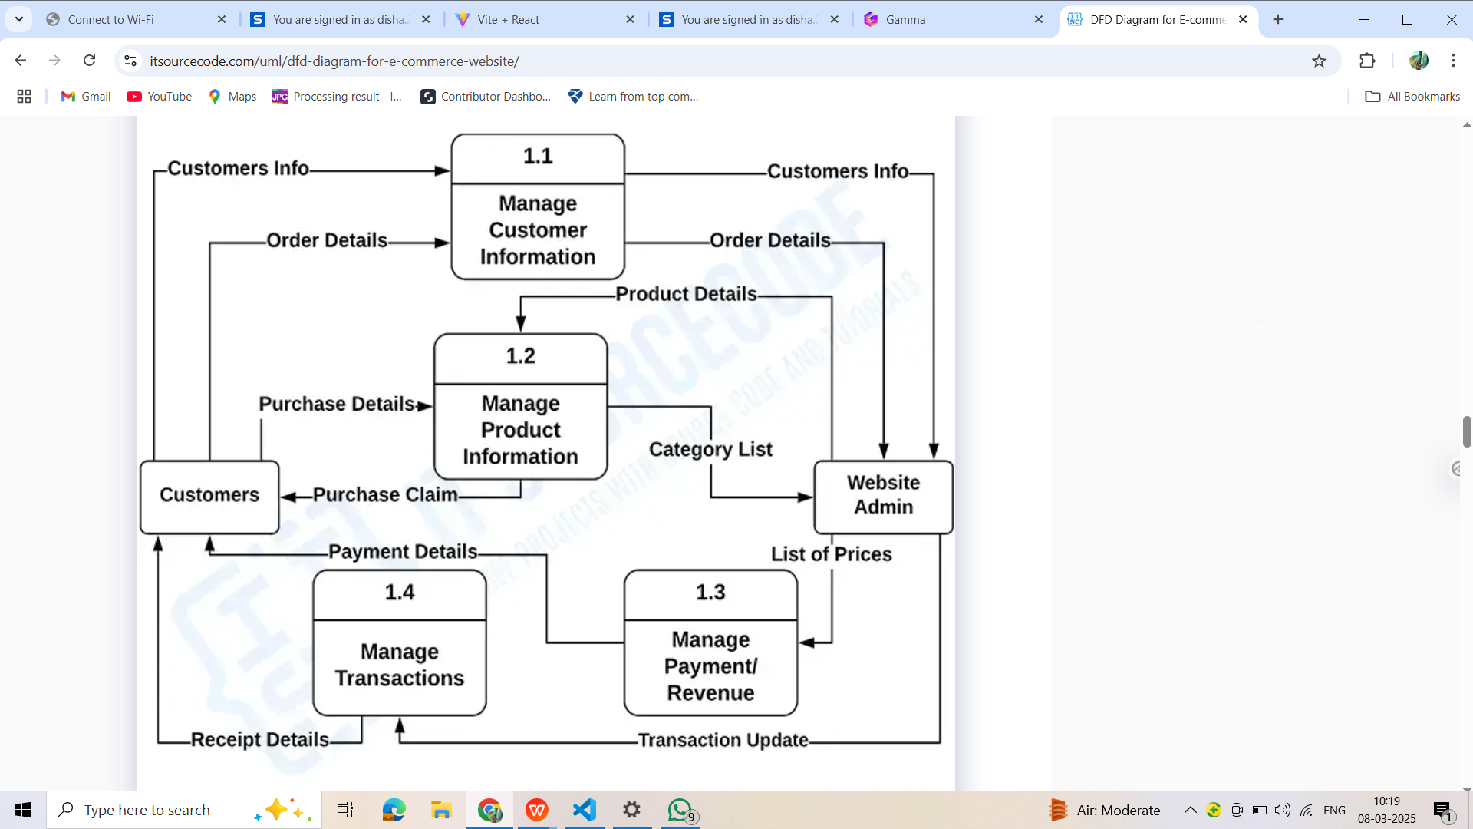

Slide 14
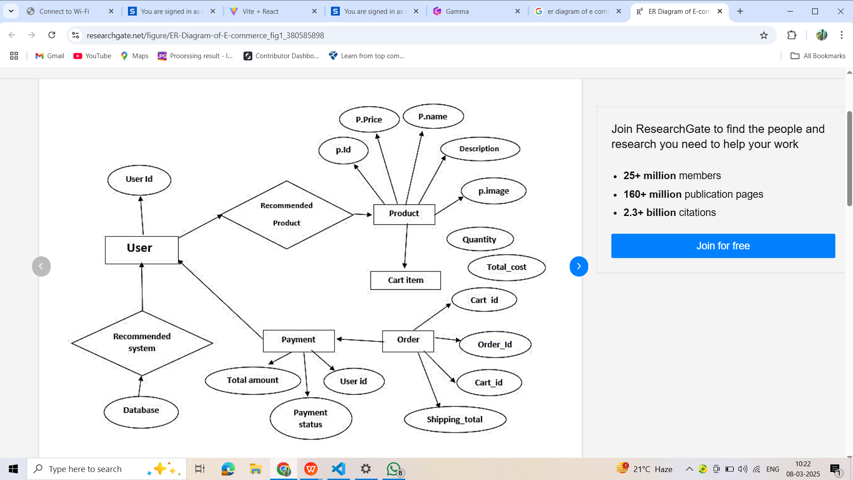

Slide 15
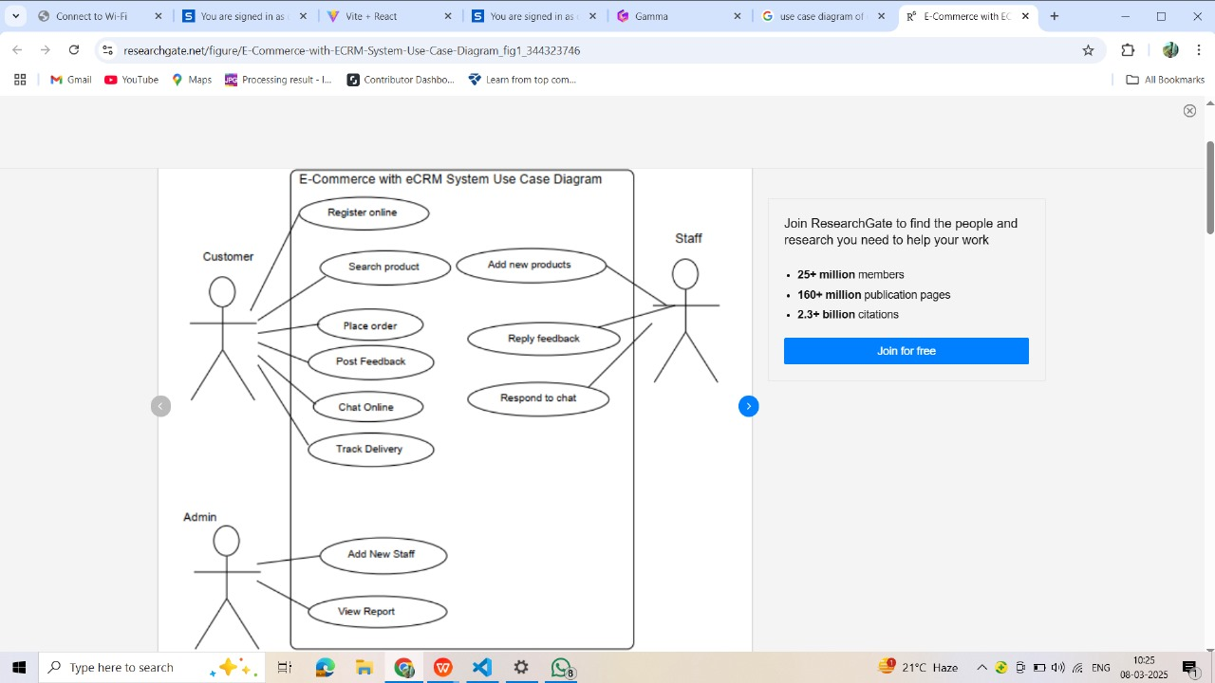

Slide 16
Reports
12.
The system provides various reports to enhance data-driven decision-making and system monitoring:
Energy Consumption Report:
Displays historical and real-time energy usage.
User Activity Report:
Tracks user interactions and engagement with the platform.
Shopping Cart :
User can add products.
System Performance Report:
Monitors uptime, response time, and overall system efficiency.
Optimization Suggestions Report:
Provides recommendations for reducing energy consumption based on data analysis.
Notes:
Font Styles: Times New Roman + Font Size: 25

Slide 17
References
13.
SQLite Database: https://www.sqlite.org/
JavaScript : https://www.w3schools.com/js/
Web Development Resources: https://www.w3schools.com/
Cloud Computing for Energy Management: Research papers from IEEE, Springer
Energy Optimization using Data Analytics: Published studies from Elsevier, ScienceDirect
Notes:
Font Styles: Times New Roman + Font Size: 25

Slide 18
Thank You !

