Slide 1

Project (KCA451) Even Semester Session 2024-25
InnovateX_kiet
Mr. Amit Kumar Singh - 2300290140020
Mr. Anand Dhar Dwivedi - 2300290140022
Mr. Aditya Pandey - 2300290140012
Project Supervisor:
Ms. KOMAL SALGOTRA
(Assistant Professor)

Slide 2
Introduction
InnovateX_KIET : A Collaborative Platform for Students
InnovateX_KIET as a platform for fostering collaboration and innovation among students at institutions.
Campus-exclusive platform for tech collaboration.
Promotes peer-to-peer learning and project-based learning.
Notes:
Font Styles: Times New Roman + Font Size: 25

Slide 3
Literature Review
Existing Platforms for Student Collaboration
Current student collaboration platforms (GitHub,LinkedIn, etc.)
Shortcomings in academic environments (lack of peer support, limited access to mentors)
Notes:
Font Styles: Times New Roman + Font Size: 25

Slide 4
Literature Review (Contd.)
The Importance of Peer-Driven Learning
Collaborative learning in academia.
Studies supporting knowledge sharing and mentorship in tech education.
Notes:
Font Styles: Times New Roman + Font Size: 25

Slide 5
Objective of the Project
Foster Peer Learning: Promote knowledge-sharing activities.
Support Project Development: Provide tools for real-time communication and project management.
Encourage Innovation: Enable students to experiment with emerging technologies.
Strengthen Tech Community: Foster a tech ecosystem and networking at institutions (like KIET).
Notes:
Font Styles: Times New Roman + Font Size: 25

Slide 6
Technology (Hardware Requirements)
Development Environment: Laptops or PCs with minimum specifications (8 GB RAM, Core i5 or equivalent).
Server Requirement: Cloud-based server or local server for platform deployment.
Client Requirement: Access to web browsers on laptops, tablets, or smartphones with internet connection.
Notes:
Font Styles: Times New Roman + Font Size: 25

Slide 7
Technology (Software Requirements)
Programming Languages: JavaScript, TypeScript.
Frameworks: Next.js, Tailwind CSS, Material UI, Redux.
Cloud Storage: Cloudinary.
Tools & IDEs: Visual Studio Code, Git, MongoDB Atlas (for database), Postman (for API testing).
Notes:
Font Styles: Times New Roman + Font Size: 25

Slide 8
Modules
User Module:
User registration, profile management, and authentication.
Communities and project discussions.
Mentorship and Feedback Module:
User feedback, skill tracking.
Notes:
Font Styles: Times New Roman + Font Size: 25

Slide 9
Modules (Contd.)
Project Management Module:
Task assignment, Progress tracking.
Collaborative brainstorming and Discussion forums.
Leaderboard section.
Notes:
Font Styles: Times New Roman + Font Size: 25

Slide 10
Modules (Contd.)
WebRTC Module:
Real-time audio, video, and messaging.
Secure peer-to-peer connections with encryption.
Adaptive streaming and network optimization.
Notes:
Font Styles: Times New Roman + Font Size: 25

Slide 11
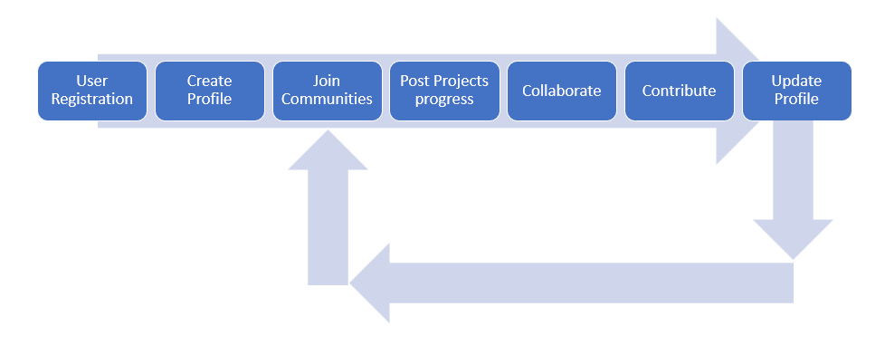
Workflow/Gantt Chart
Notes:
Font Styles: Times New Roman + Font Size: 25

Slide 12
Reports
User Activity Report: Tracking active users, projects, and collaborations.
Mentorship Report: Mentorship points logged, feedback provided, user growth.
Project Success Report: Completed projects, time to completion, team performance.
Notes:
Font Styles: Times New Roman + Font Size: 25

Slide 13
References
Amos, Doug, Austin Lesea, and René Richter. FPGA-based prototyping methodology manual: Best practices in design-for-prototyping. Happy About, 2011.
Krishna, V. Vamsi, and G. Gopinath. "Process of Requirement Gathering and Techniques for Web Application." Webology 18, no. Special Issue on Information Retrieval and Web Search (2021): 140-152.
Lindley, Cody. "Frontend developer handbook 2017." Frontend masters (2017).
Kaluža, Marin, Marijana Kalanj, and Bernard Vukelić. "A comparison of back-end frameworks for web application development." Zbornik veleučilišta u rijeci 7, no. 1 (2019): 317-332.
Roscoe, Rod D., Laura K. Allen, Jennifer L. Weston, Scott A. Crossley, and Danielle S. McNamara. "The Writing Pal intelligent tutoring system: Usability testing and development." Computers and Composition 34 (2014): 39-59.
Krusche, Stephan, Dora Dzvonyar, Han Xu, and Bernd Bruegge. "Software theater—teaching demo-oriented prototyping." ACM Transactions on Computing Education (TOCE) 18, no. 2 (2018): 1-30.
Notes:
Font Styles: Times New Roman + Font Size: 25

Slide 14
Thank You
Notes:
Font Styles: Times New Roman + Font Size: 25

