Slide 1
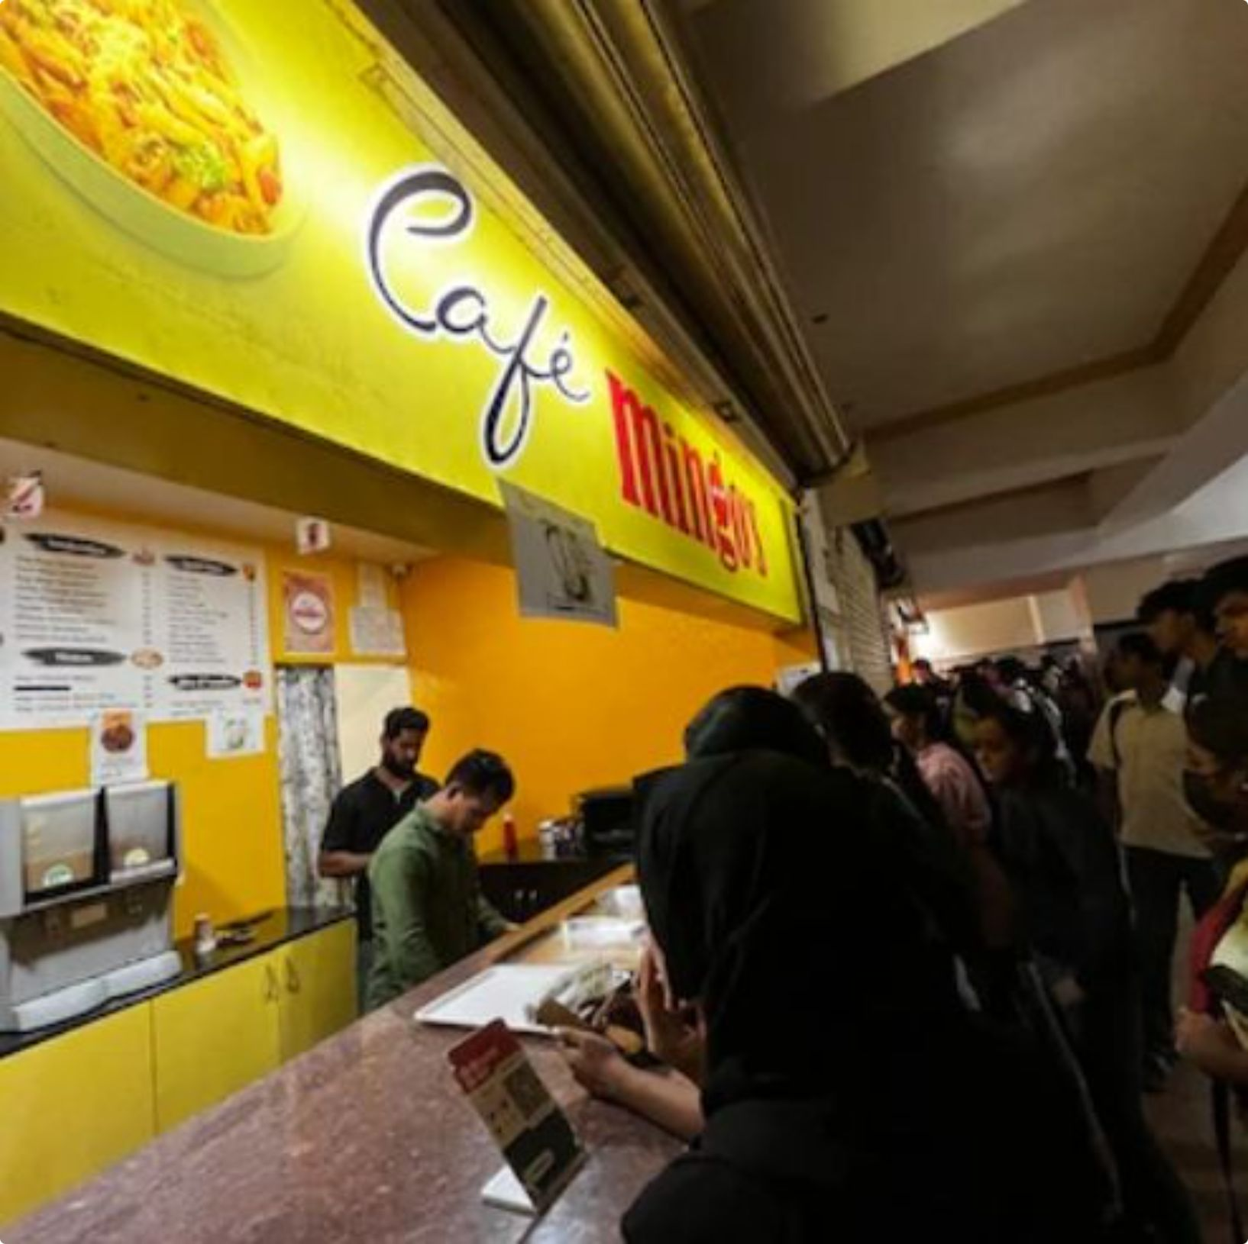
PS-3Y-01 • SDG 2 — ZERO HUNGER
Intelligent Food Demand Forecasting
An AI-powered canteen management system that predicts tomorrow's meal demand and cuts food wastage — one plate at a time.

Slide 2

The Problem: Canteens Plan on Gut Feeling, Not Data
Over-Preparation
Fixed cooking quantities ignore daily attendance swings, creating surplus food every single day.
Blind to Calendar Effects
Holidays, exam weeks, and events swing turnout by 30–50%, yet menus are planned the same way regardless.
Silent, Unmeasured Waste
Without tracking, canteens cannot see how much food — or money — is thrown away, so nothing improves.
No Visibility for Managers
Staff have no dashboard to compare forecasts vs. actual consumption or spot waste trends over time.

Slide 3




Objectives & Deliverables
What we are building, end to end
Time-Series Demand Model
Wastage Estimation & Insights
Forecast next-day meal counts per menu item from historical consumption, attendance, and calendar signals.
Quantify predicted surplus/shortfall and surface concrete reduction recommendations to canteen staff.
Interactive Analytics Dashboard
Historical Trend Analysis
A single pane for forecasts, waste trends, and data management — built for daily use, not just demos.
Drill-down views of past consumption patterns to explain why the model predicts what it predicts.

Slide 4

System Architecture
From raw canteen data to a same-day forecast — automated every morning before service begins.
Analytics Dashboard
Data Sources
Forecasting Engine
A nightly batch job retrains features and updates forecasts each morning — always current, always actionable.

Slide 5
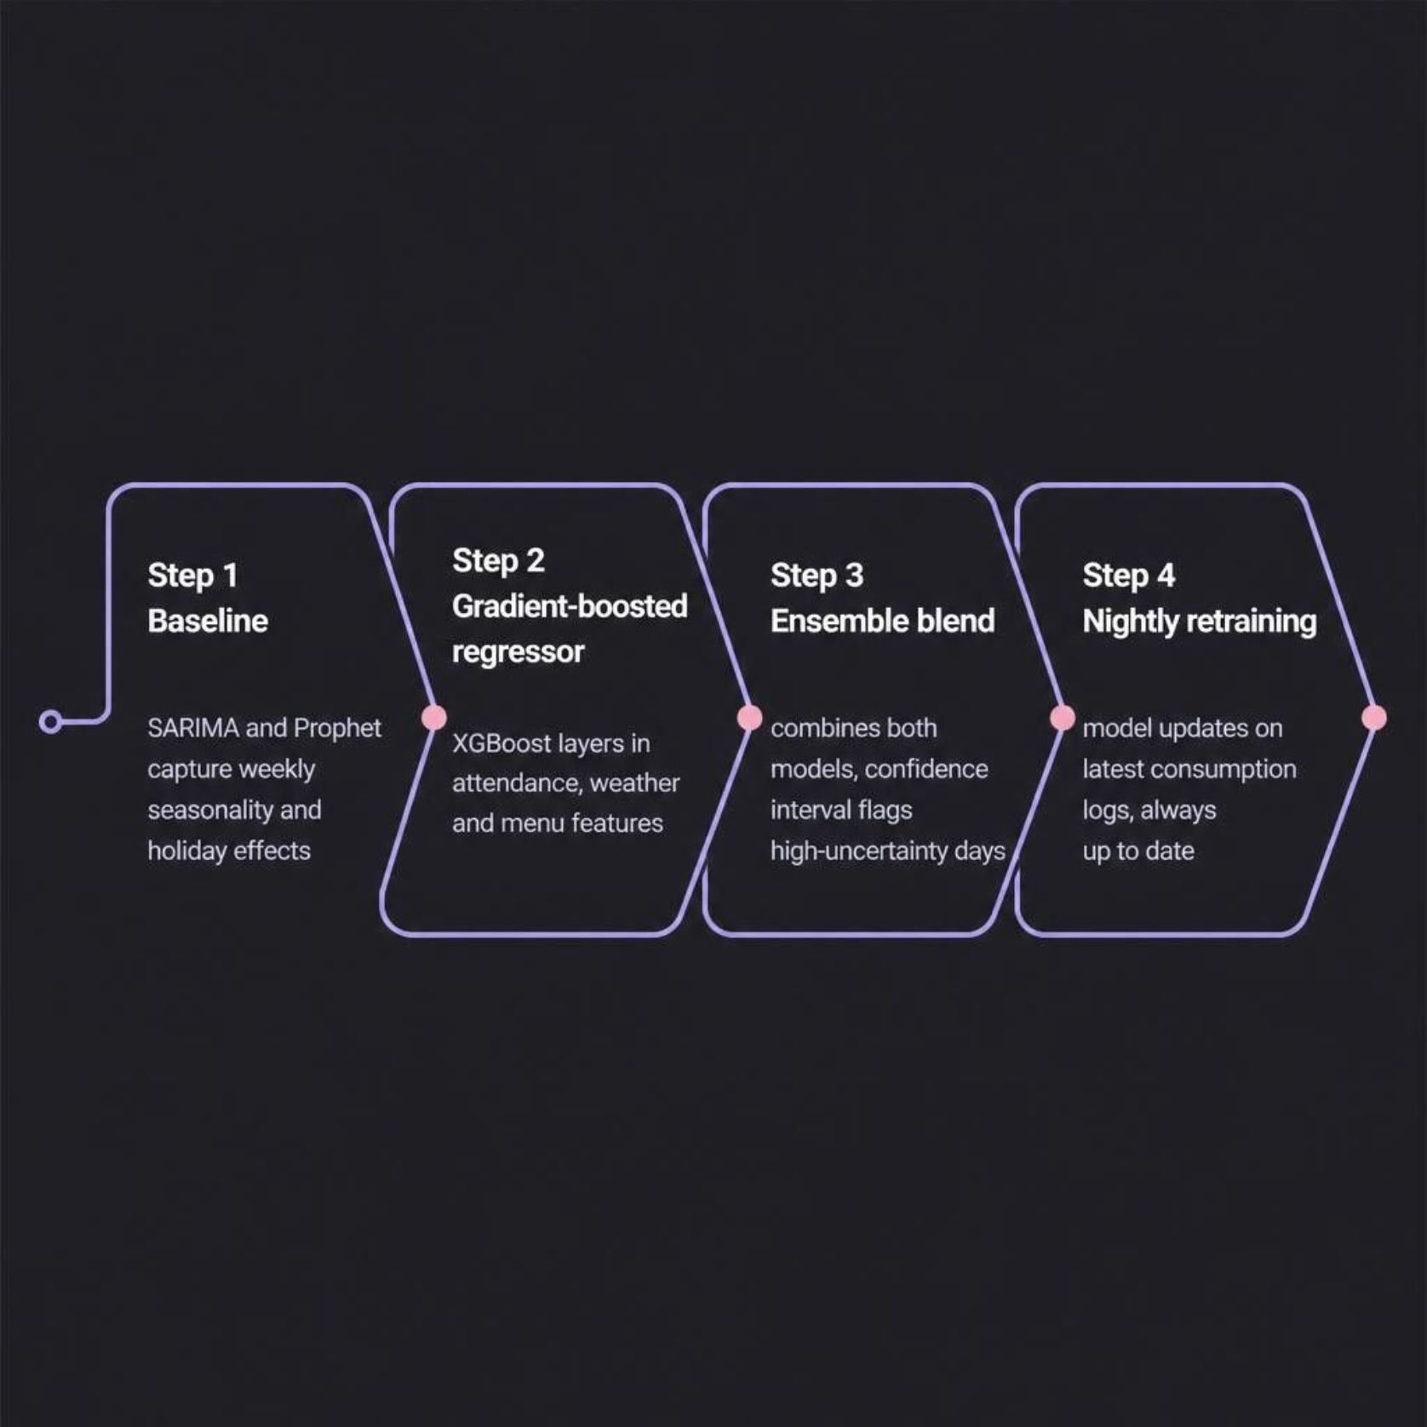
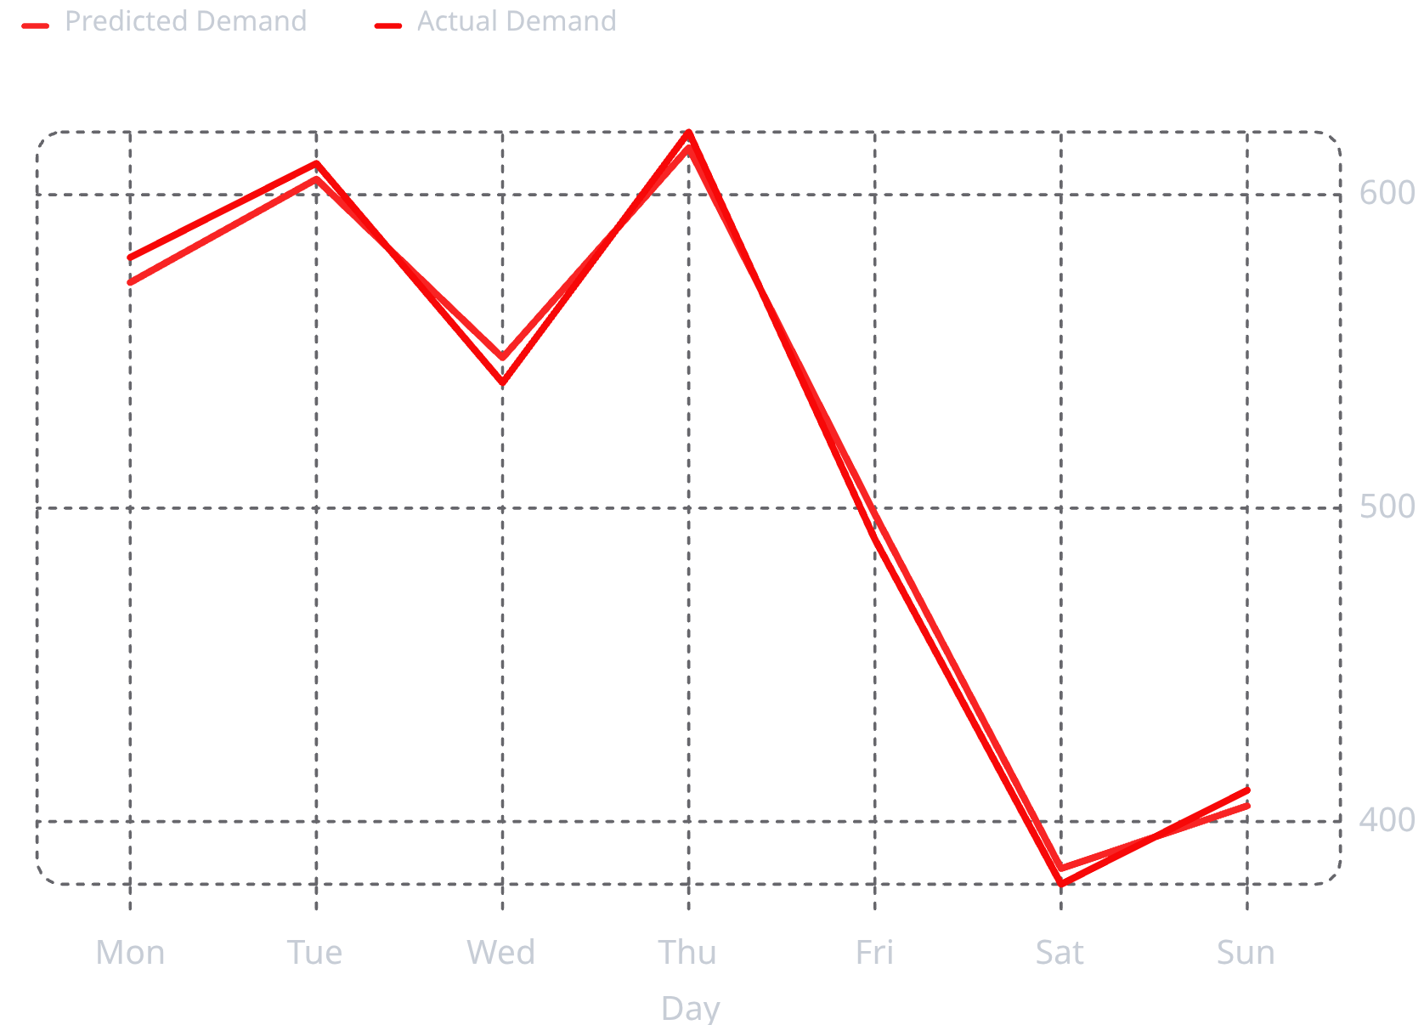
AI Component — Forecasting Approach
A regression + time-series ensemble tuned for daily meal counts
Sample Output: Actual vs. Predicted Demand
Illustrative sample data for demonstration purposes

Slide 6
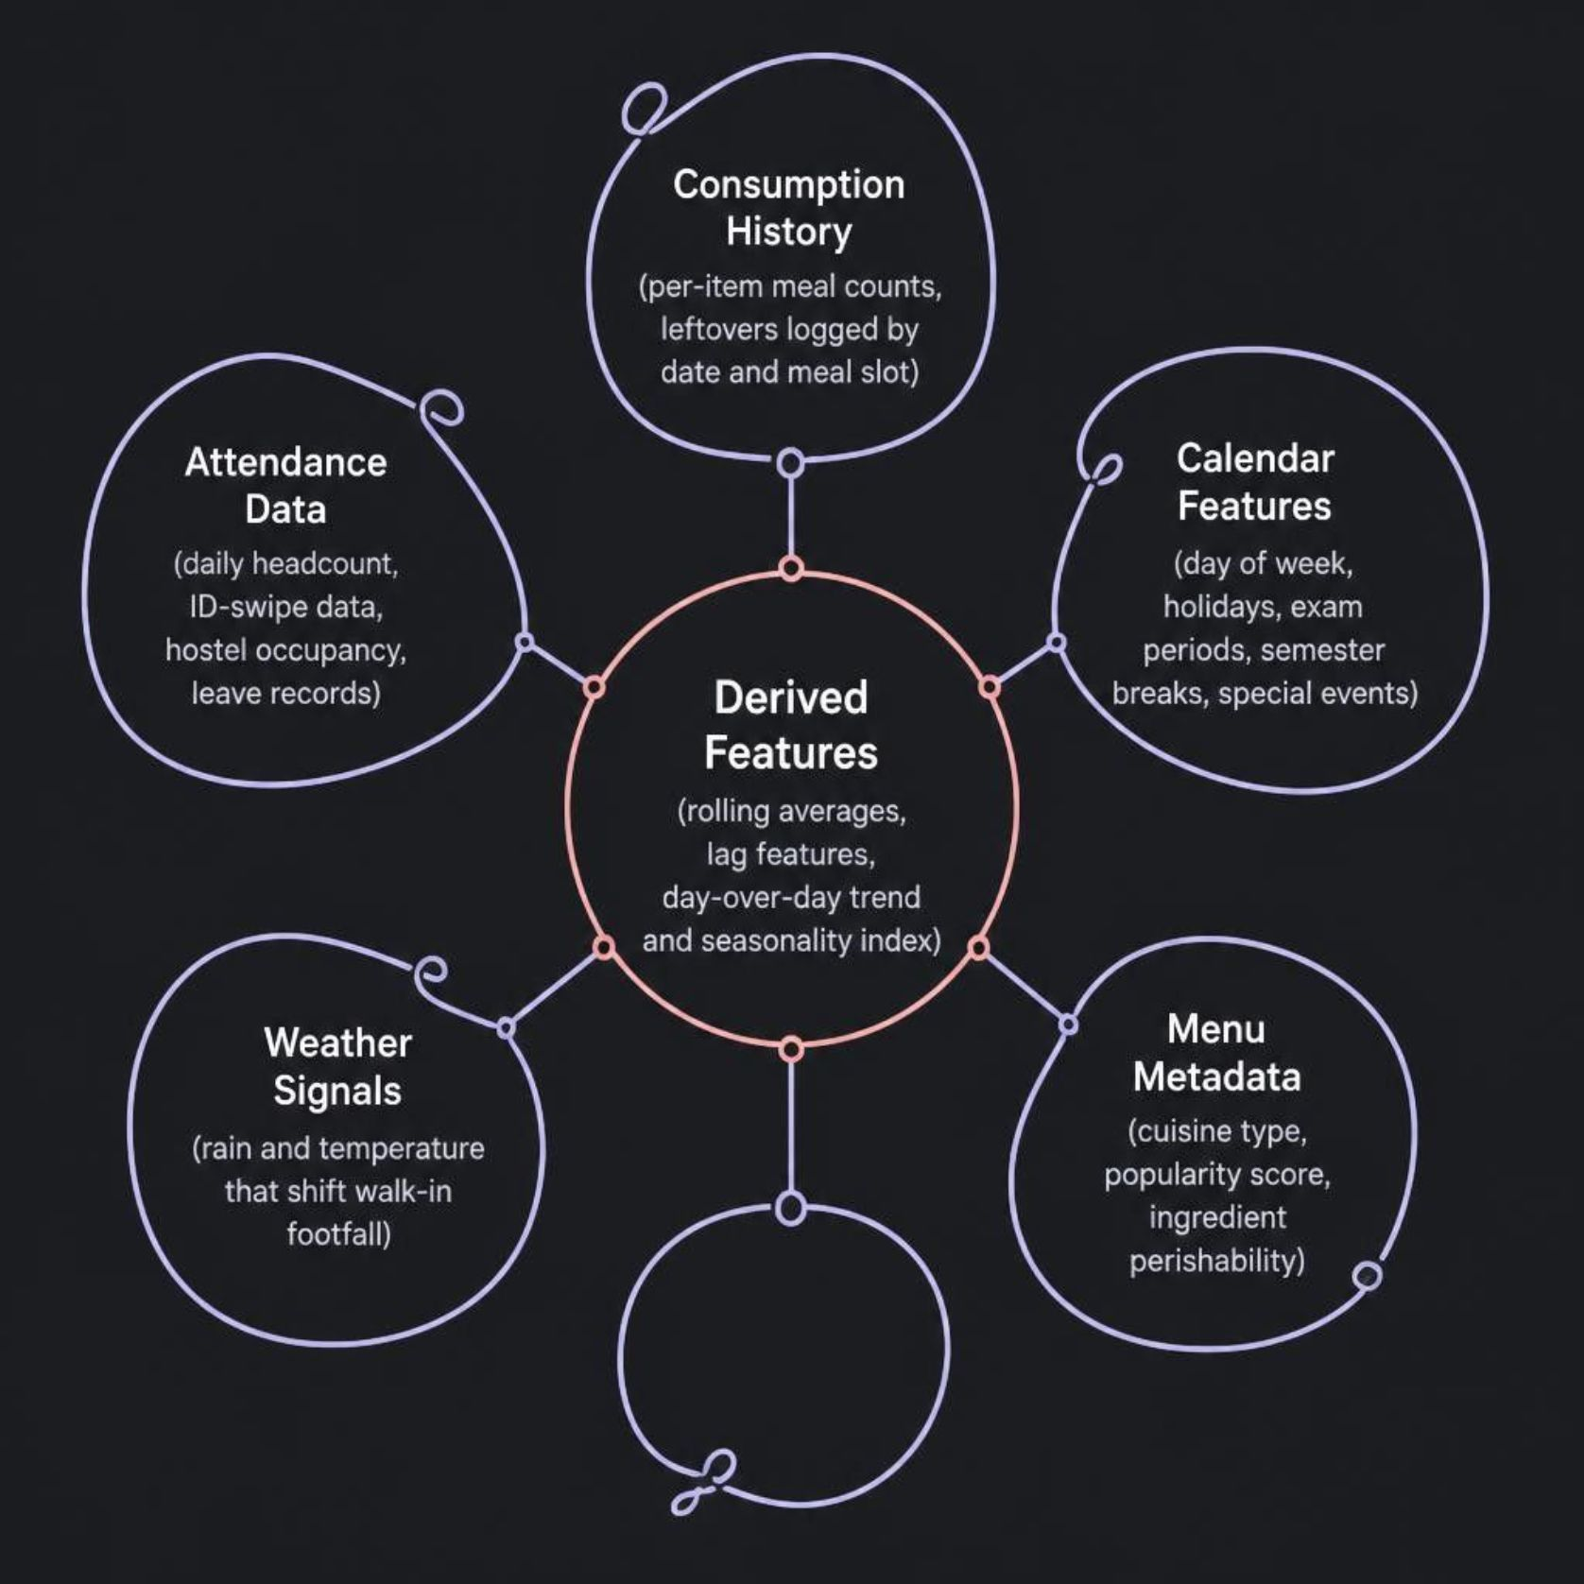
Data Sources & Feature Engineering
What the model learns from
Feature Engineering in Action
Raw signals are transformed into predictive features — rolling averages smooth noise, lag features capture momentum, and a seasonality index encodes weekly patterns. Together, they give the model the context to distinguish a normal Tuesday from a rainy exam-week Friday.

Slide 7

Waste Estimation & Reduction Insights
Turning the demand gap into an actionable waste signal
~12% Average Daily Surplus
How the Dashboard Helps Reduce It
Identified across the sample week — representing meals and money that could be saved with smarter planning.
Illustrative sample data for demonstration purposes
Right-size prep quantities against the forecast, not last year's guess.
Flag high-surplus-risk days — rainy days, low-attendance Fridays — before cooking begins.
Feed actual leftovers back into the model to sharpen next week's forecast.

Slide 8




Full-Stack Technology
A pragmatic, well-supported stack for a hackathon build
Frontend
Backend / API
React + Recharts / Chart.js for analytics; Tailwind CSS for fast, consistent UI.
FastAPI (Python) or Node.js/Express exposing REST endpoints for forecasts, waste & CRUD data.
ML Service
Data Layer
Python: pandas, scikit-learn, XGBoost, Prophet/statsmodels — scheduled retraining via cron.
PostgreSQL for structured records; scheduled ETL jobs to pull attendance & consumption logs.

Slide 9

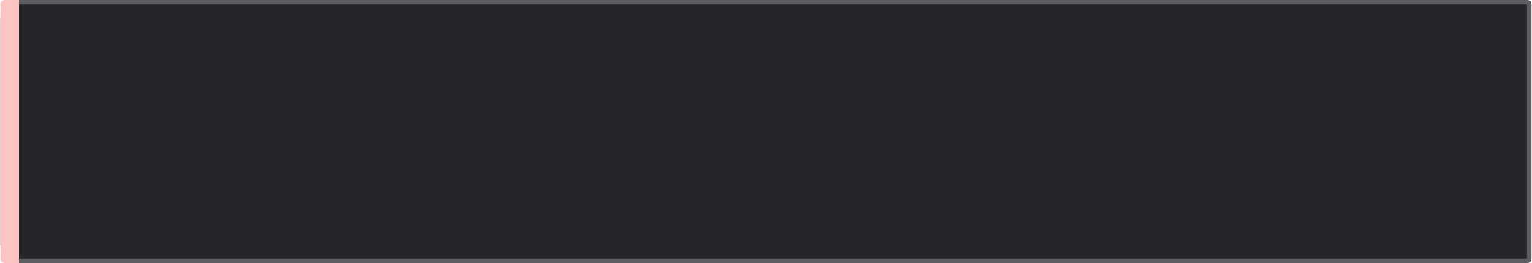
Innovation Highlights
What sets this apart from a plain forecasting script
Calendar-Aware Ensemble
Blends classical time-series with gradient boosting so holidays and events aren't just noise — they're signals.
Feedback-Driven Retraining
Actual leftovers and shortages flow back into the pipeline, so the model keeps improving on its own.
Actionable Waste Alerts
Not just a forecast number — the dashboard recommends the specific quantity to prep for each menu item.
Explainable Predictions
Feature-importance view shows staff why tomorrow's forecast changed, building trust and adoption.

