Slide 1
Name: Lalitya Dodla
Project name: 🌸MIRA (Mindful Interactions for Reflective Awareness)
PROBLEM STATEMENT
PROPOSED SOLUTION
Mental Health Check-In Agent: Create an AI agent that acts as a friendly, non-intrusive companion, autonomously checking in with users at set intervals, analyzing their responses for signs of stress or low mood, and suggesting simple, positive actions or resources—like a digital well-being buddy.
MIRA is a soothing, AI-driven mental health companion that independently checks in with users each day. Constructed as an independent agent with n8n and OpenAI, MIRA interprets user feedback for emotional tone, categorizes mood, and provides tailored action such as journal prompts, breathing reminders, or soothing affirmations.
In contrast to other chatbots, MIRA builds a safe, non-critical space for emotional consideration. It learns with every interaction to become more intuitive—recalling mood patterns and providing richer insights as time passes. MIRA shares its care in gracefully crafted message cards and easily integrates with tools like Telegram or email for daily delivery.
This solution sets out to integrate emotional health into daily life through considered conversation, regular check-ins, and compassionate design
TECH STACK:
Azure AI chatbot for: Mood analysis, reflection generation, affirmations n8n for: Core workflow engine for agentic automation
Figma for – UI/UX design of check-in interface and feedback screens Canva: PPT and presentation deck
Discord / Email for – Delivering affirmations and insights and Webhooks for: personalized responses
Google Sheets / Docs for – Storing mood logs

Slide 2
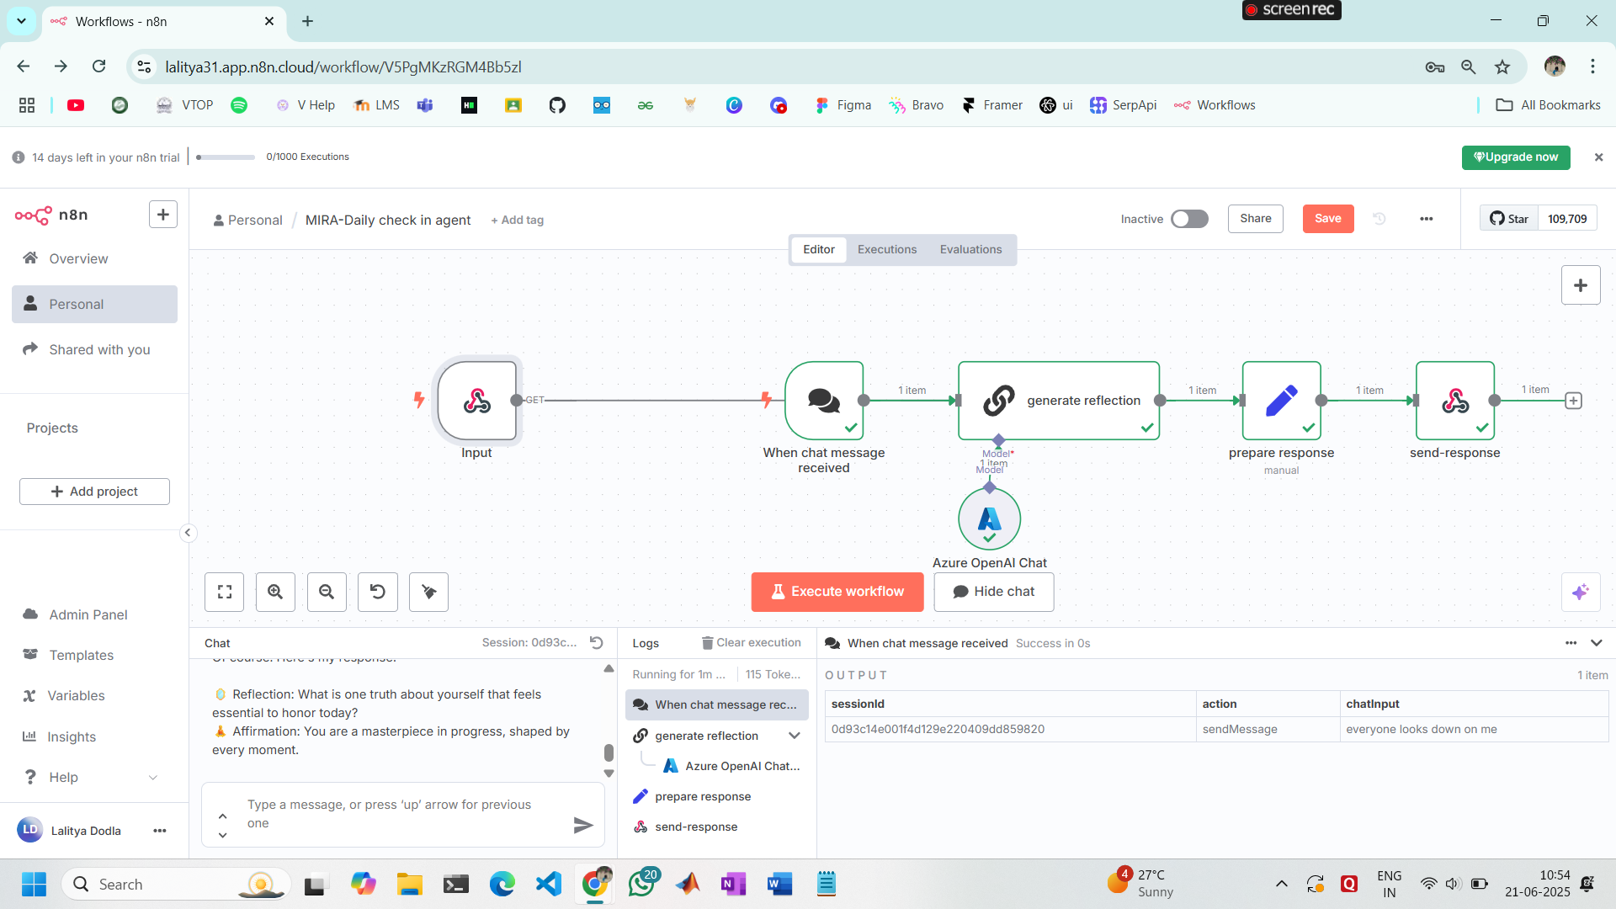
USE CASE
MIRA is intended for students, freelancers, and everyone who goes through emotional highs and lows in this fast-paced and competitive world. MIRA checks in once a day with one soft reminder, hears the user's mood out in regular language, examines their emotions with AI, and provides: comfort, not a robot but a friend.
By presenting it through a Discord bot, MIRA integrates perfectly into the user's daily routine — no additional apps, no additional hassle to keep them up.
With time, MIRA is a serene, steady friend—providing a secure haven to stop, think, and be seen.

Slide 3
✅ Advantages
1. Emotionally Intelligent Agent
MIRA doesn't merely respond to the "prompt" — it feels. To engage with sentimentally-aware prompts, MIRA adjusts its tone and introspection according to the user's mood, providing an incredibly human-like experience.
2. Seamless & Non-Intrusive for the user
Transmitted via Discord, MIRA is integrated into the user's daily life without app installations or intrusive notifications. A single check-in, once a day — gently and purposefully.
3. Crafted for the Soul and not a device
With elegantly designed UI screens and poetic affirmations, MIRA unites function with feeling — wellness not only actionable, but beautiful.
4. Designed to Grow and develop
Modular agent design in n8n is easily upgradable — mood journaling, streak tracking, or even syncing with Spotify for music therapy.
5. Memory + Growth + Support
(Optional memory logging) enables MIRA to retain a memory of how the user felt over time, building a timeline of healing, patterns, and small progress.
Business Model
Free Plan – MIRA Basic
1 soothing mood check-in a day
Personalized care advice + reflection + affirmation
1 month mood memory
Functions natively in Discord — no app required
Premium Plan – MIRA+
More daily check-ins
Monitors mood trends & streaks
Soothing UI themes and voice journaling (coming as an add-on)
Optional music, breathing, or journaling prompts
₹99/month or $1.49/month
For Teams & Communities
MIRA can be added to student groups, remote teams, or mental health
servers as a follow up.
Provides collective wellness space & daily motivation
Subscription rates per server/workspace
Future Expansion
Mobile application
Mood charts & data
Therapist-supported escalation (optional)

