Slide 1


Sales Forecasting for Walmart Dataset
Berkeley AI ML - Final Capstone Project
By Lalitya Sawant

Slide 2
Contents
Executive summary
Research Question
Data Source
Methodology
Analysis Key Findings
Feature Selection
Time Series Analysis
Auto-ARIMA Prediction
Model Exploration and Tuning
Recommendations
Further Steps
Conclusion

Slide 3
Executive Summary
Objective
Utilize AI/ML models to predict sales forecasts for Walmart.
Rationale
Sales forecasting is crucial for revenue optimization and profit maximization.
Here are some key reasons why sales forecasting is essential:
Strategic Planning
Financial Management
Inventory Management
Production Planning
Marketing Strategy
Customer Service
Risk Management
Performance Evaluation
Investor Confidence
Adaptation to Market Changes

Slide 4

BUSINESS BENIFITS
Understanding sales trends enables organizations to strategically order the necessary quantities of goods across various departments and locations.
Leveraging AI/ML for Sales Forecasting
Optimized Inventory Management
Improved Supply Chain Efficiency
Enhanced Financial Planning
Maximized Revenue Generation
Customer Satisfaction
Data-Driven Decision Making
Competitive Edge

Slide 5
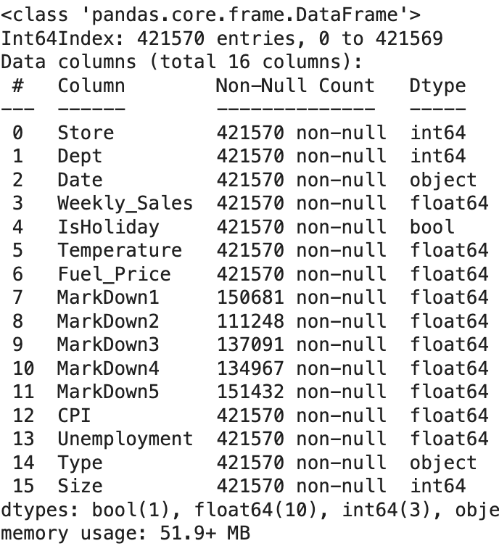
Data Source
I picked up the Walmart sales dataset from Kaggle

Slide 6

Methodology
I used the CRISP framework for this analysis and modeling
Steps involved were as below:
Data Cleaning
Outlier Detection
Bias Assessment
Data Transformation
Data Distribution
Application of Algorithms

Slide 7
Analysis Key Findings
Data Compilation:
The data was initially provided in 4 separate CSV files.
I merged the store, features, and train CSVs to create a comprehensive dataset.
Data Quality Enhancement:
Identified and addressed null values in markdown columns by removing those columns.
Ensured better data quality for subsequent analysis.
Sales Data Anomalies:
Detected and addressed rows with negative sales values, likely data anomalies.
Removed such instances, maintaining the integrity of the dataset.
Key Attributes Impacting Sales:
Explored attributes like holidays, fuel price, unemployment, and temperature.
Holiday Analysis:
Categorized holidays into four types: Labor Day, Super Bowl, Thanksgiving, and Christmas.
Thanksgiving showed a strong positive impact on sales, while Super Bowl had a moderate impact.
Labor Day and Christmas did not exhibit a significant positive impact on sales.
Other Sales Influencers:
Explored factors beyond holidays, finding no clear positive or negative impact on sales.
Yearly Sales Trend:
Observed a consistent pattern of increased sales at the end of each year.

Slide 8
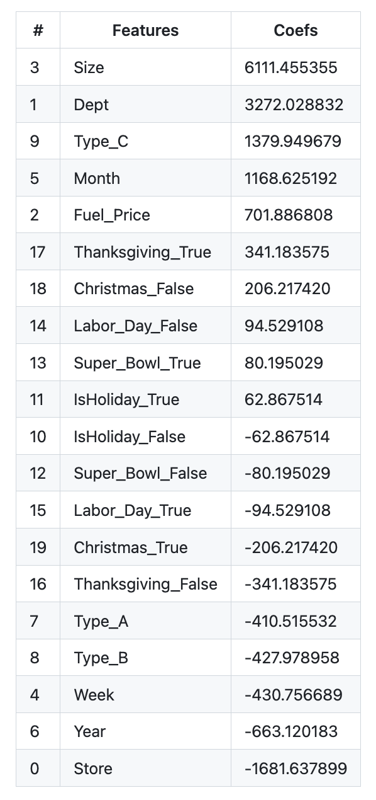
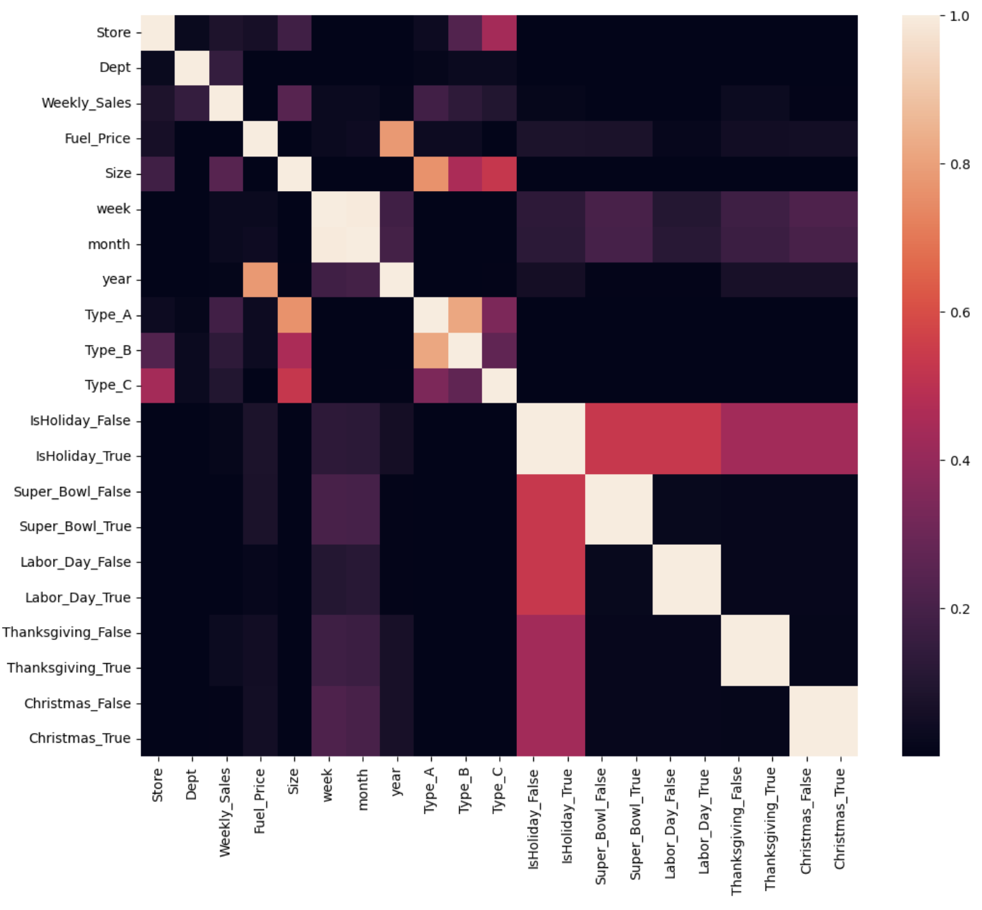
Feature Selection
Upon executing Ridge Regression for feature selection, I obtained the following correlation coefficient data

Slide 9
Time Series Analysis - ARIMA
Time Series Analysis and Modeling
After performing time series decomposition and the augmented Dickey-Fuller test, we concluded that the data is nonstationary. Subsequent decomposition at weekly and monthly intervals revealed a repetitive pattern in the data.
To address nonstationarity, I applied difference, shift, and log algorithms. The differential data emerged as the most effective in achieving stationarity.
For the final time series model, we utilized the auto_arima algorithm, identifying the following as the optimal model for predictions:
Best model: ARIMA(3,0,2)(0,0,0)[1] intercept
Total fit time: 10.236 seconds

Slide 10
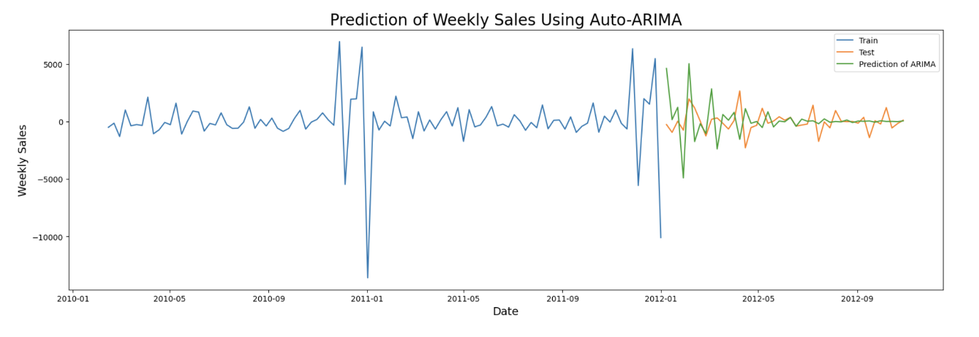
Auto-ARIMA Prediction
Next steps
The predictions from the above model exhibit a slightly lower trend than the test data. Further tuning or exploring alternative algorithms may help achieve a closer alignment between the predictions and the test data.

Slide 11
Model Exploration and Tuning
The previous iteration of the sales forecasting model has shown a slightly lower trend than the test data. To enhance the model's performance and achieve a closer alignment with the test data, I have undertaken further steps in model tuning and exploration of alternative algorithms.
New models created to forecast the data:
Exponential Smoothing
CNN LSTM and GRU Models (Required a data transformation step to fit a CNN model)

Slide 12
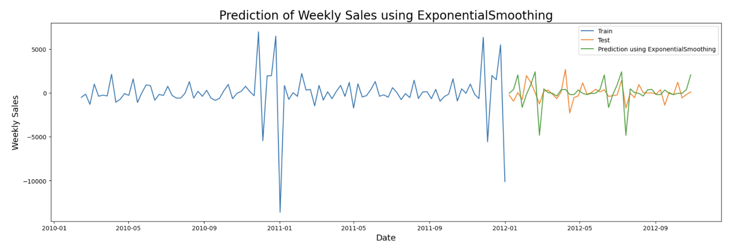
Exponential Smoothing - Prediction
The Exponential Smoothing model was applied to the dataset, revealing promising results in terms of prediction accuracy.
This method leverages a weighted average of past observations, assigning exponentially decreasing weights to older data points.
The adaptability of Exponential Smoothing makes it effective in capturing trends and seasonality in time-series data.

Slide 13
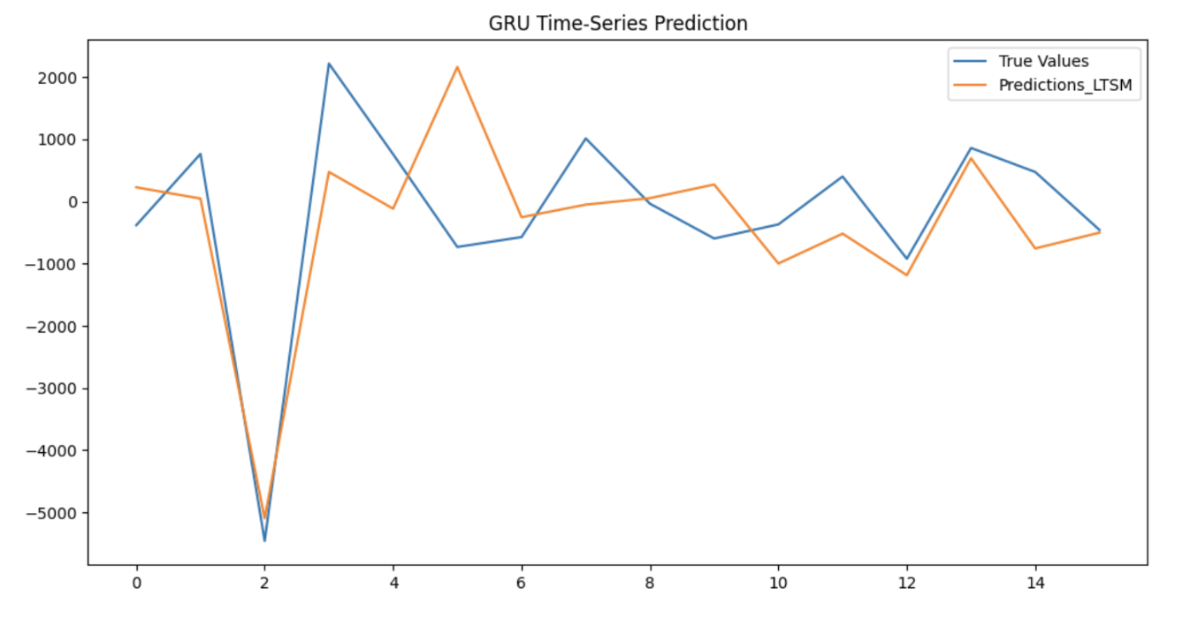
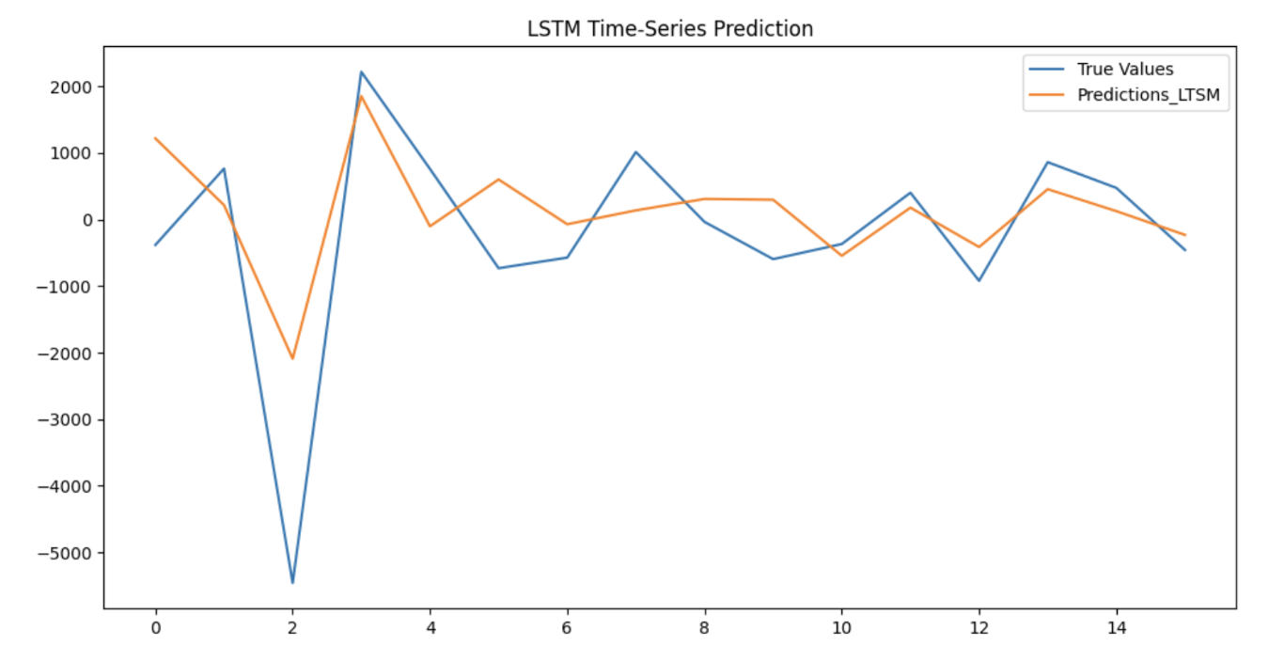
LSTM AND GRU - Prediction
Two deep learning models, Long Short-Term Memory (LSTM) and Gated Recurrent Unit (GRU), were implemented to further explore the dataset.
Both LSTM and GRU exhibited notable improvements in prediction accuracy. Long Short-Term Memory Networks are known for their ability to capture long-term dependencies in sequential data, while Gated Recurrent Units, a more efficient variant of LSTM, also demonstrated competitive performance.

Slide 14
Recommendations / Lessons Learned for Current Iteration:
Fine-Tuning Parameters: Ongoing efforts have been made to fine-tune the parameters of the current models, especially focusing on hyperparameter tuning for LSTM and GRU.
Feature Engineering: Some initial attempts at feature engineering have been made to enhance the representation of underlying patterns in the data. Additional features are being considered for future iterations.
Data Augmentation: Data augmentation techniques have been experimented with to artificially expand the dataset, providing the models with more diverse examples for improved generalization.
Evaluation Metrics: Evaluation metrics have been reassessed and fine-tuned to ensure alignment with the specific goals of the project. Iterative testing with various combinations of features, algorithms, and hyperparameters is ongoing.

Slide 15
Further Steps and Conclusion
Further Steps:
Ensemble Modeling: Exploration of ensemble modeling can be conducted, combining the strengths of multiple models to enhance predictive performance.
In Conclusion:
The current iteration has seen progress in the exploration, tuning, and experimentation of models. Exponential smoothing and LSTM models performed better than the previously used ARIMA model on the Walmart sales forecasting data.

