Slide 1
Capstone Presentation
ETL and Analysis on Covid Data of US Counties
Presented By:
Lallith Prasath

Slide 2
The New York Times released a series of data files with cumulative counts of coronavirus cases in the United States, at the state and county level, over time which is compiled as this time series data from state and local governments and health departments to provide a complete record of the COVID-19 outbreak. As of late January 2020, The New York Times has tracked cases of coronavirus in real time as they were identified after testing. Because of the widespread shortage of testing, the data is necessarily limited in the picture it presents of the outbreak. The data begins with the first reported coronavirus case in Washington State on Jan. 21, 2020.
2

Slide 3
Dataset Description
Data Column | Description
Date | Ranging from 21-01-2020 to 20-02-2021
County | With 1926 counties spread across the USA
State | Covering the 50 states along with other districts in USA
FIPS Code | Which stands for Federal Information Processing Standard code which is a combination of state and county code
Cases | A cumulative count of the number of cases reported each day in each county
Deaths | A cumulative count of the number of deaths reported each day in each county
3

Slide 4
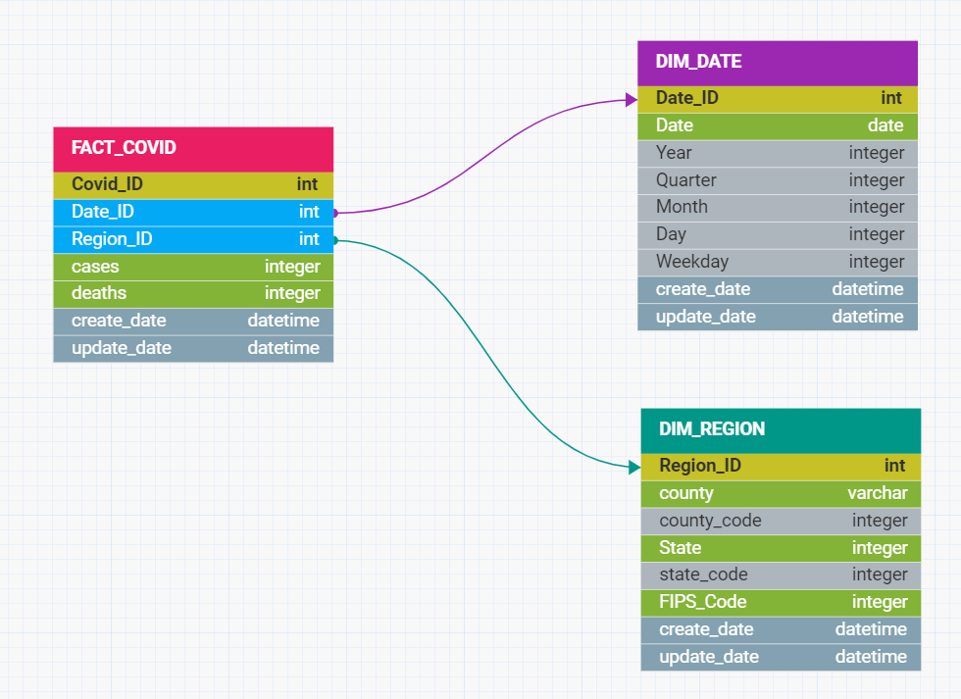
Data Warehouse Model
4

Slide 5
Dataflow in the Project
1. Load the Source File
The source file is provided as a Flat File which is loaded into the relational source table SRC_COVID having columns of the required data fields, create the connections using a parameter file.
3. Create Dimension Tables
Using the staging table, create required Dimension Tables (DIM_DATE and DIM_REGION) storing the attributes describing facts from the fact table in each table respectively.
2. Create Staging Tables
Using the table SRC_COVID, load the data into a staging table which do not have the FIPS code as NULL named STG_COVID using a router and the rejected rows into another database STG_COVID_REJECT.
4. Create the Fact Table
Create and use the Fact Table (FACT_COVID) to store quantitative information for analysis such as measurements, metrics or facts of a business process along with IDs of attributes from records of the Dimension Tables using Lookups.

Slide 6
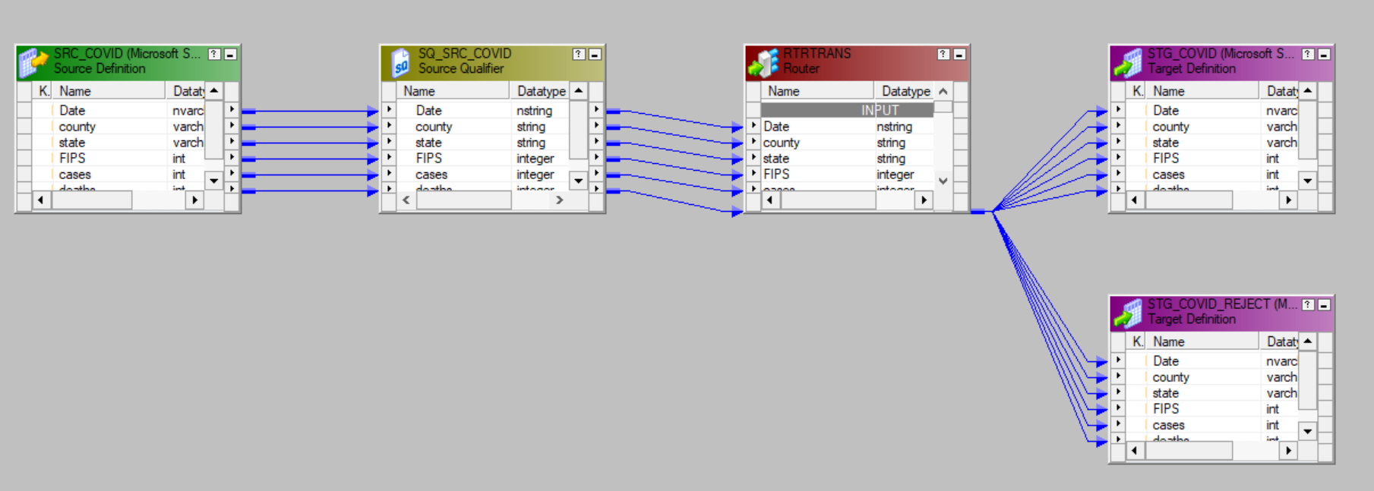
Mapping on Informatica Designer for ETL
Staging
North America
Europe, Middle East & Africa
Asia
6

Slide 7
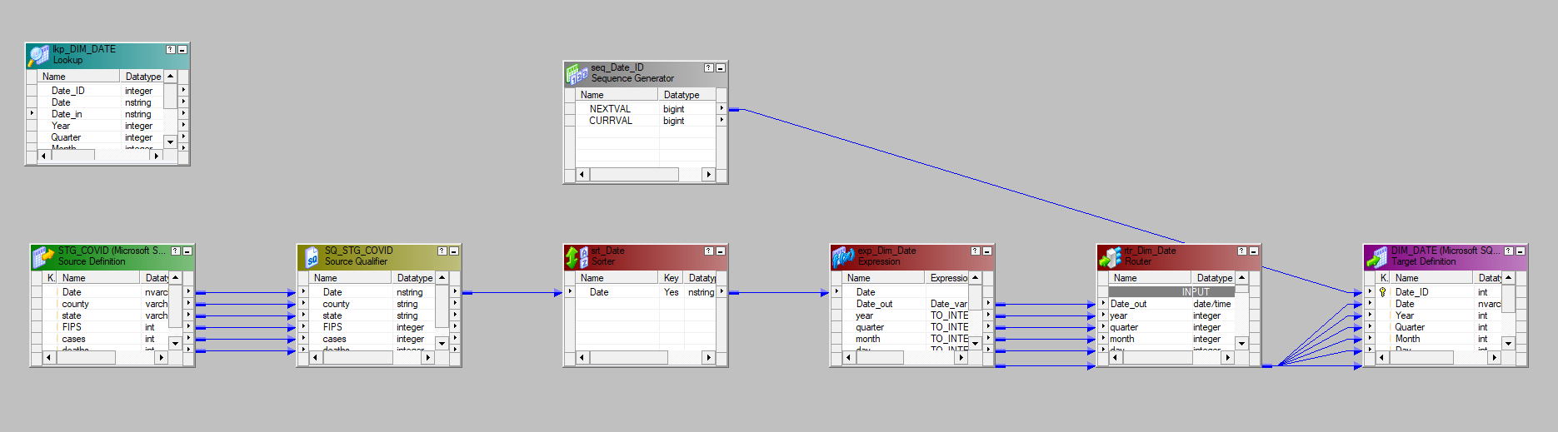
Mapping on Informatica Designer for ETL
Dimension Tables-DIM_DATE
North America
Europe, Middle East & Africa
Asia
7

Slide 8
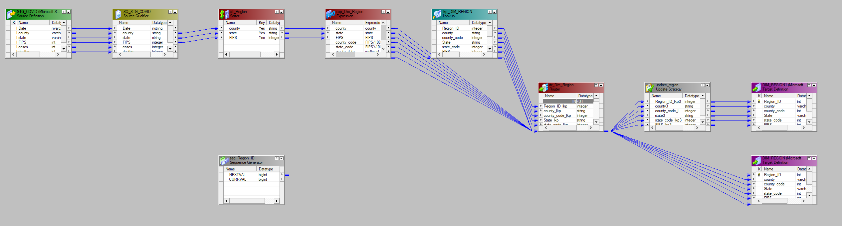
Mapping on Informatica Designer for ETL
Dimension Tables – DIM_REGION
North America
Europe, Middle East & Africa
Asia
8

Slide 9
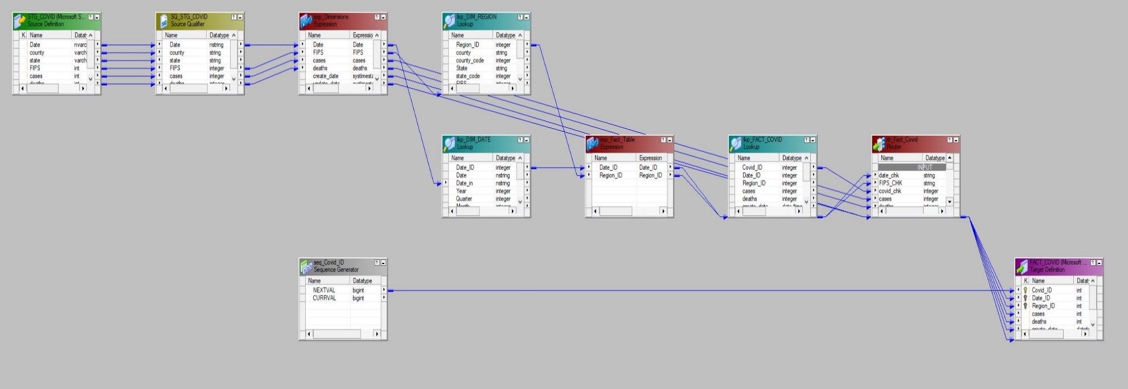
Mapping on Informatica for ETL
Fact Table – FACT_COVID
North America
Europe, Middle East & Africa
Asia
9

Slide 10
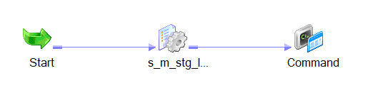
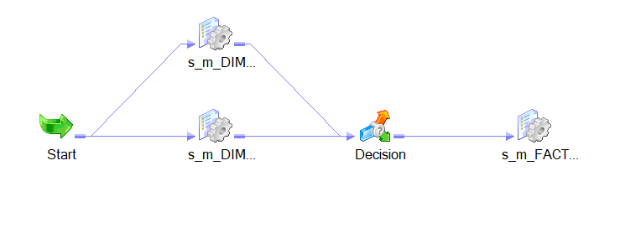
Workflow Manager
Staging, Dimension and Fact Table
5

Slide 11
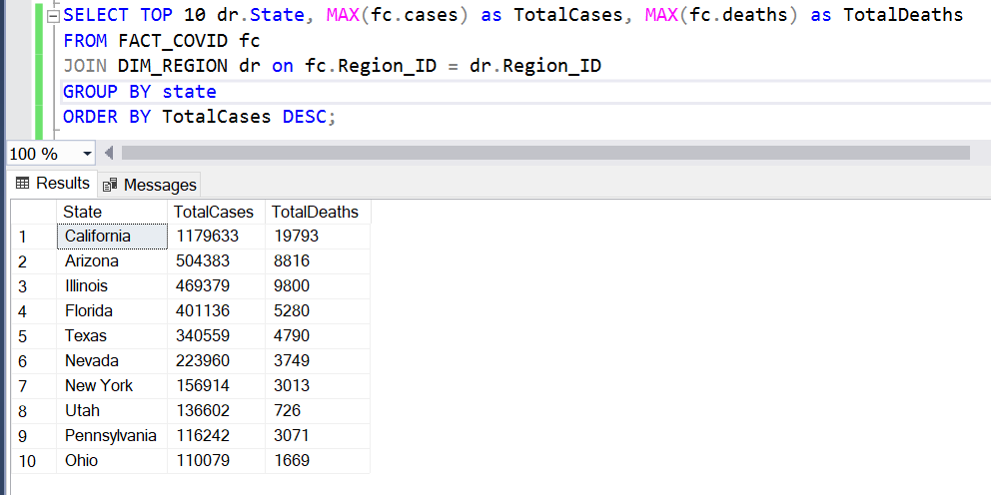
SQL Insights
Top 10 states with maximum cases
5

Slide 12
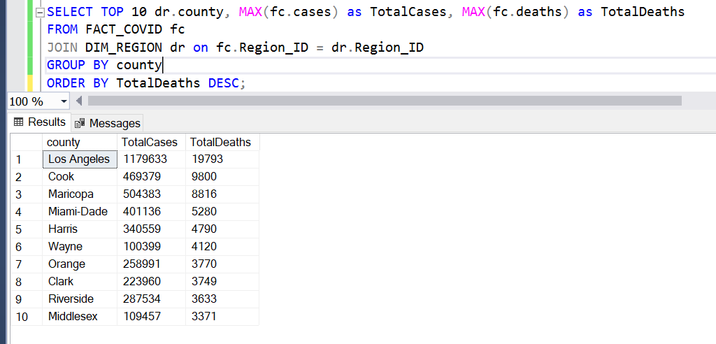
SQL Insights
Top 10 counties with maximum deaths
5

Slide 13
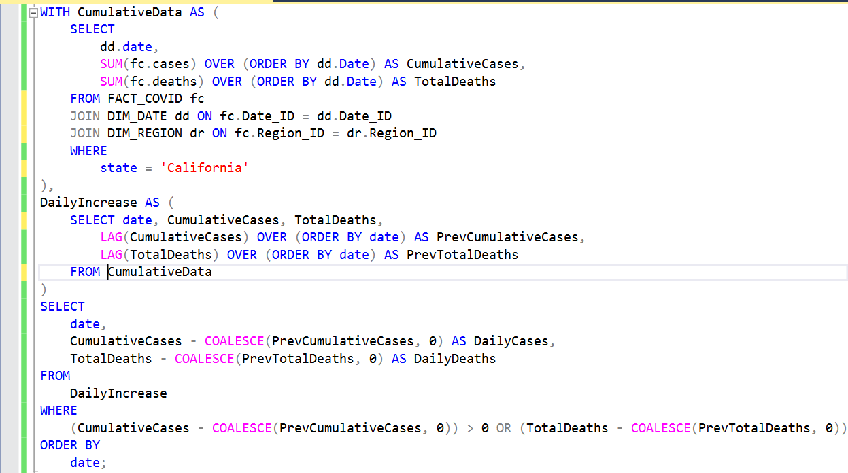
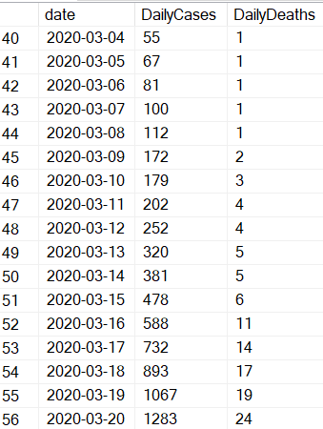
SQL Insights
Daily cases and deaths in California
5

Slide 14
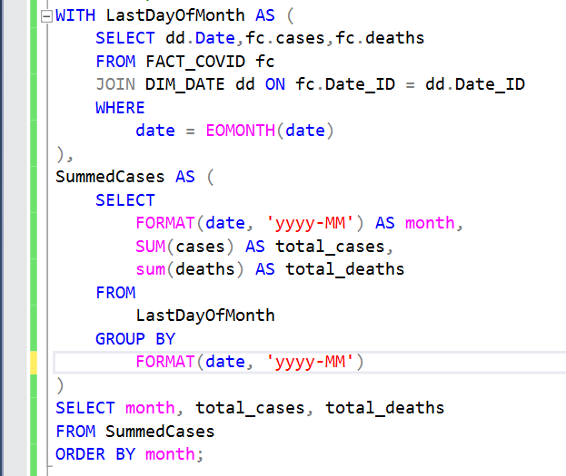
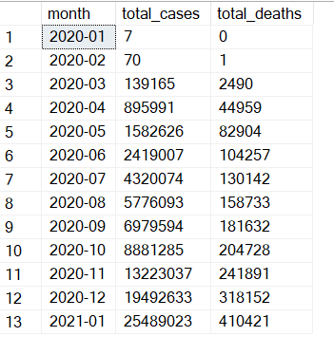
SQL Insights
Monthly Cases and deaths
5

Slide 15
SQL Insights
Monthly Cases and deaths
5

Slide 16
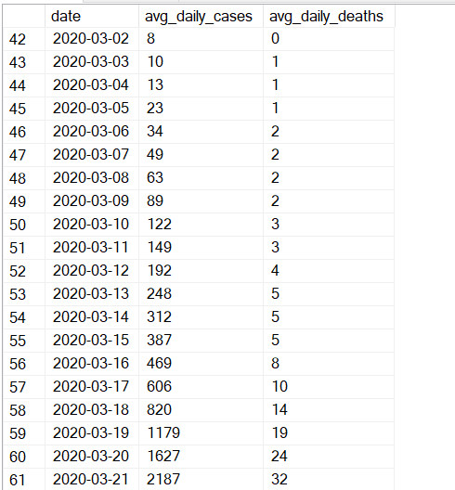
SQL Insights – Average Cases per week
WITH DailyIncrease AS (
SELECT
dd.Date,
SUM(fc.cases) AS total_cases,
SUM(fc.deaths) AS total_deaths
FROM FACT_COVID fc
JOIN DIM_DATE dd ON fc.Date_ID = dd.Date_ID
GROUP BY
date
),
DailyIncreaseCalculated AS (
SELECT
date,
total_cases - COALESCE(LAG(total_cases) OVER (ORDER BY date), 0) AS daily_cases,
total_deaths - COALESCE(LAG(total_deaths) OVER (ORDER BY date), 0) AS daily_deaths
FROM
DailyIncrease
),
MovingAverage AS (
SELECT
date,
AVG(daily_cases) OVER (ORDER BY date ROWS BETWEEN 6 PRECEDING AND CURRENT ROW) AS avg_daily_cases,
AVG(daily_deaths) OVER (ORDER BY date ROWS BETWEEN 6 PRECEDING AND CURRENT ROW) AS avg_daily_deaths
FROM
DailyIncreaseCalculated
)
SELECT TOP 396
date,
avg_daily_cases,
avg_daily_deaths
FROM
MovingAverage
WHERE
date >= (SELECT MIN(date) FROM DIM_DATE)
ORDER BY
date;
5

Slide 17
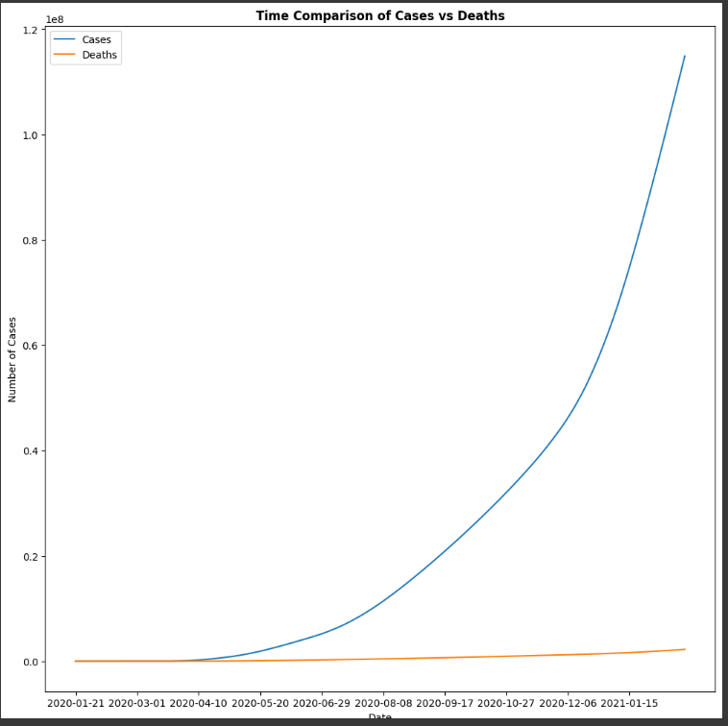
Python Analysis
Comparison of Cases v/s Deaths over Time
5

Slide 18
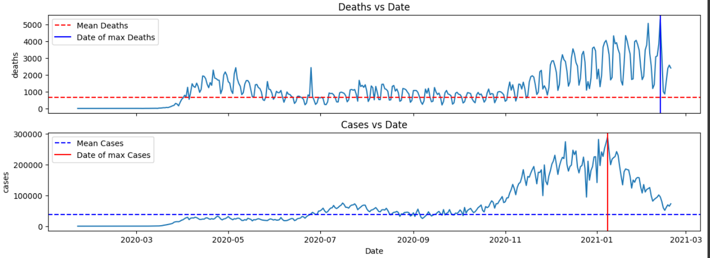
Python Analysis
Comparison of Cases and Deaths v/s Date
5

Slide 19
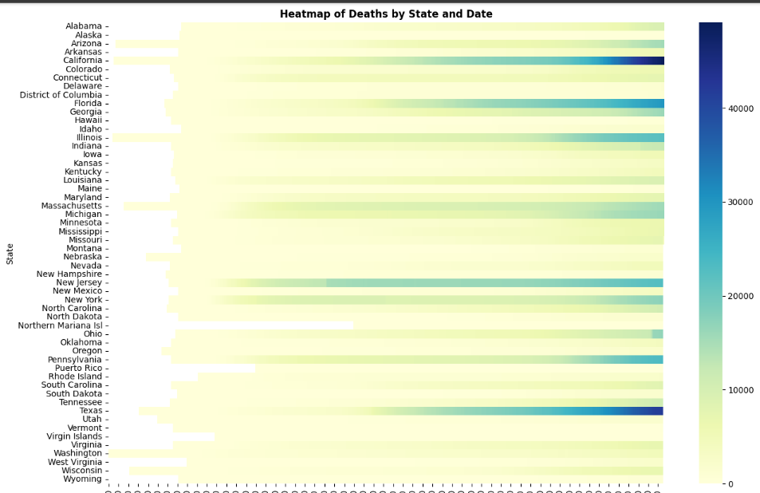
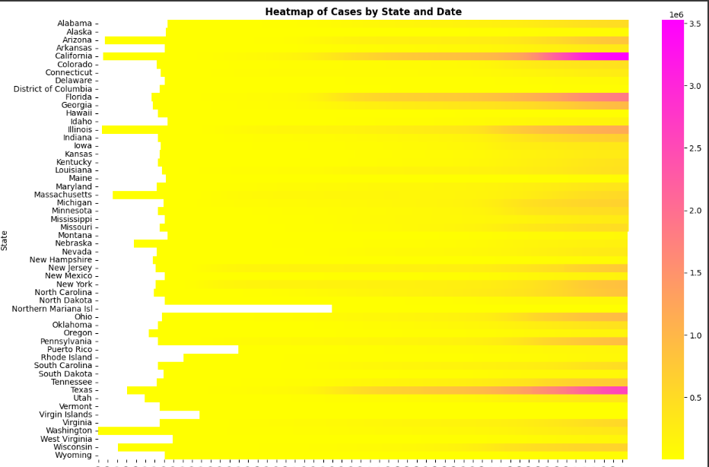
Python Analysis
Heatmap of Cases and Deaths in each State over Date
5

Slide 20
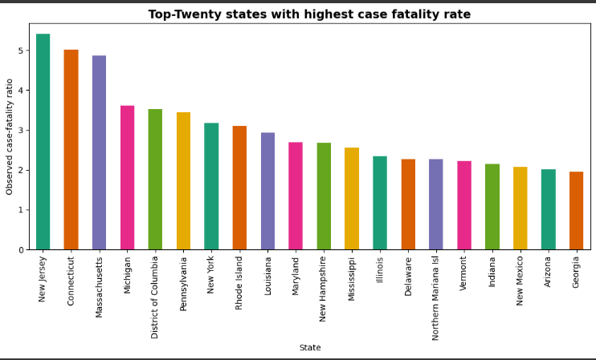
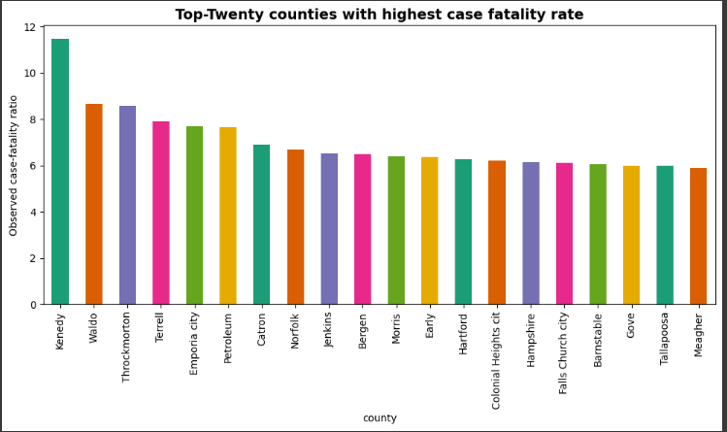
Python Analysis
Top 20 States and Counties with highest mortality rate
5

Slide 21
Thank You!

