Slide 1
INFO 5100 – Application Engineering and Development
Organ Donation and Transplantation System
Group members: Apoorva Lakhmani
Neha Lalwani

Slide 2
Problem Statement
The motivation behind this project is to make the organ donation and transplantation available at a global level to the patients through technology. We aim to build a transparent system (managed by a central authority like WHO) for this process in order to minimize the deaths caused due to unavailability of organs for transplantation

Slide 3
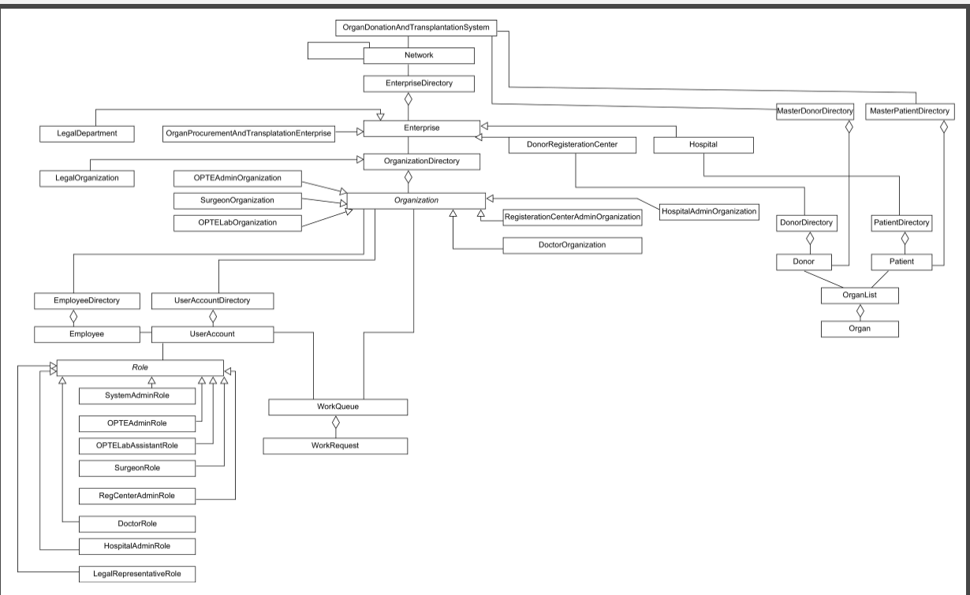
Object Model

Slide 4
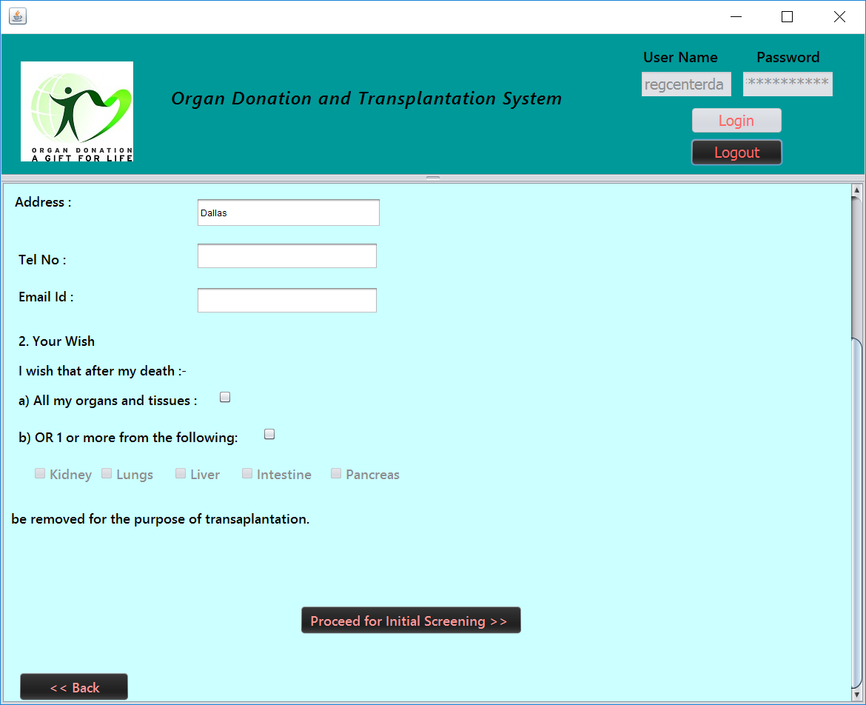
Donor Registration

Slide 5
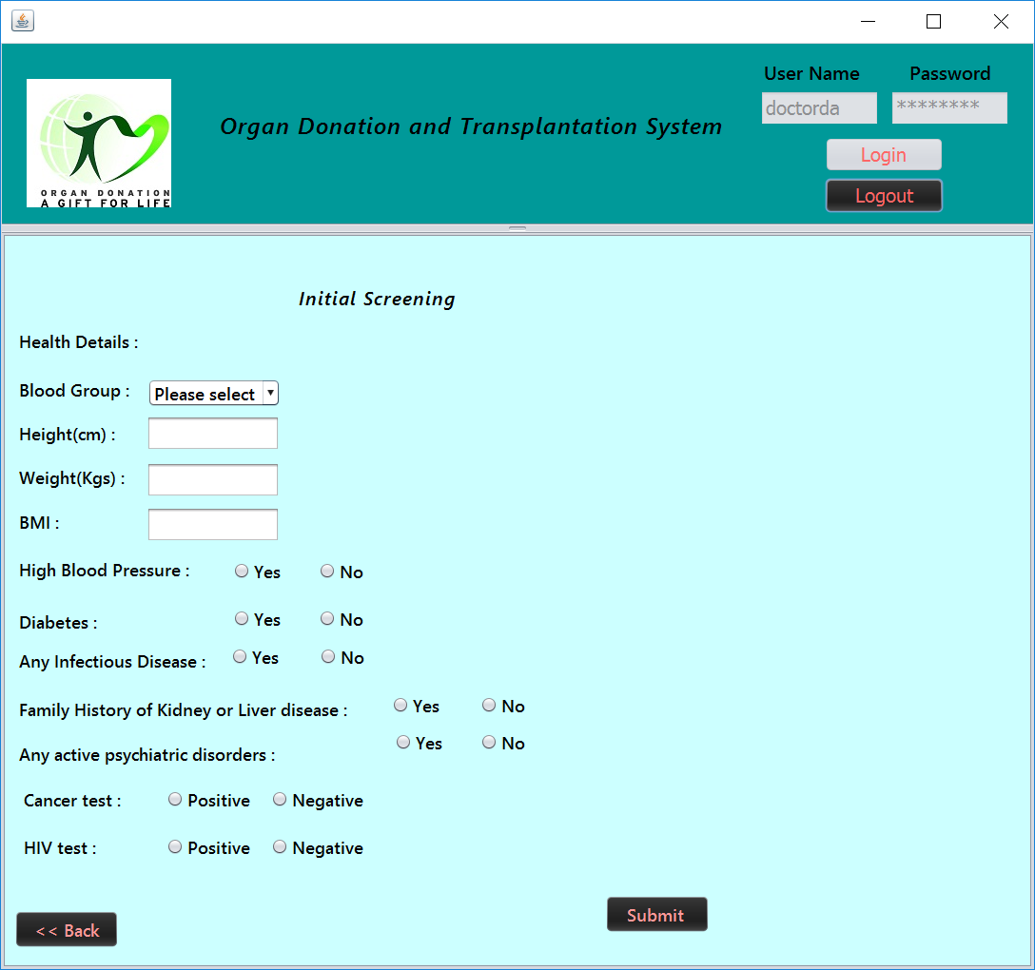
Initial Screening Panel

Slide 6
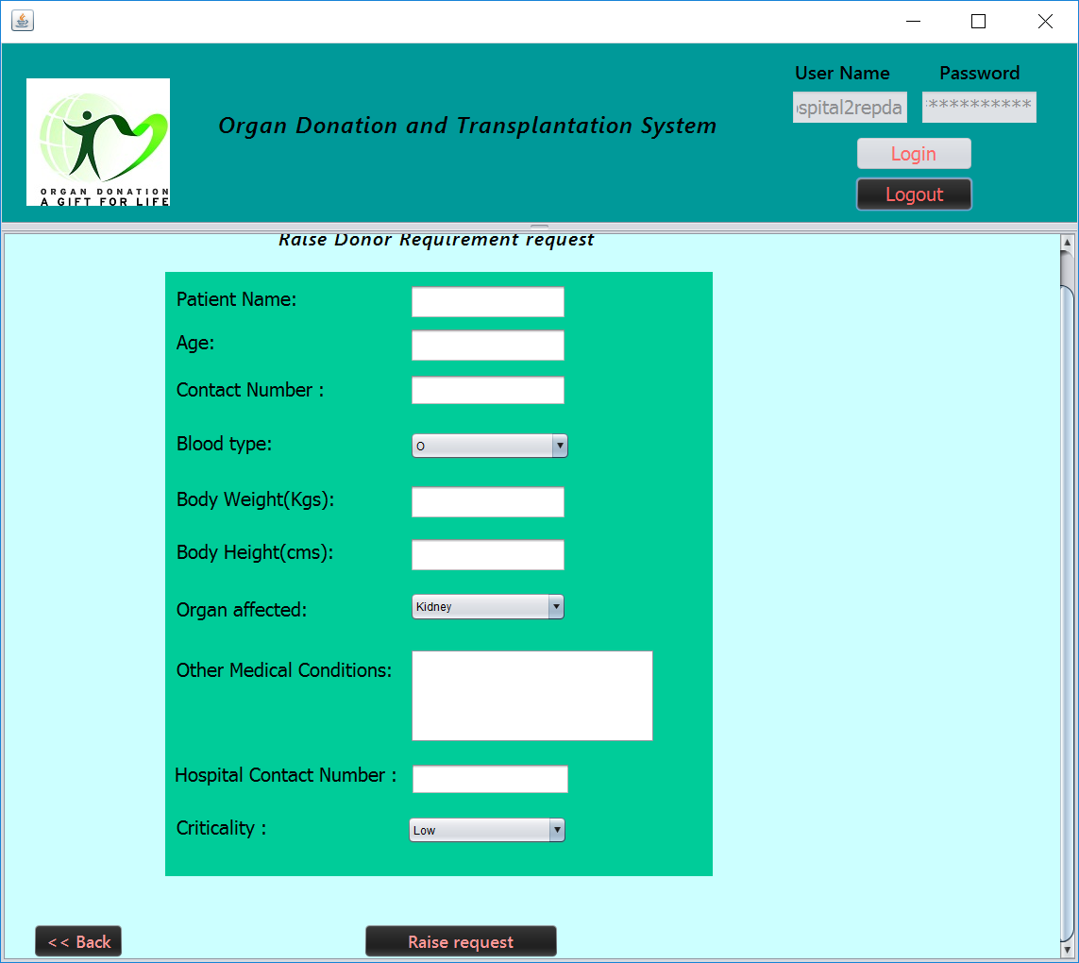
Find Donor Request

Slide 7
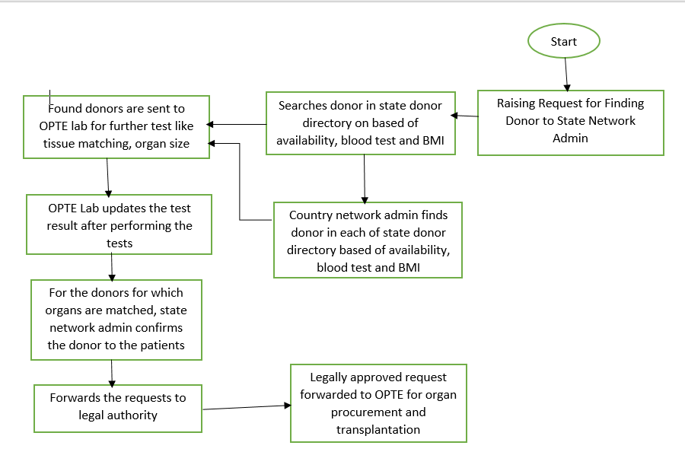
Flow of Find a donor request

Slide 8
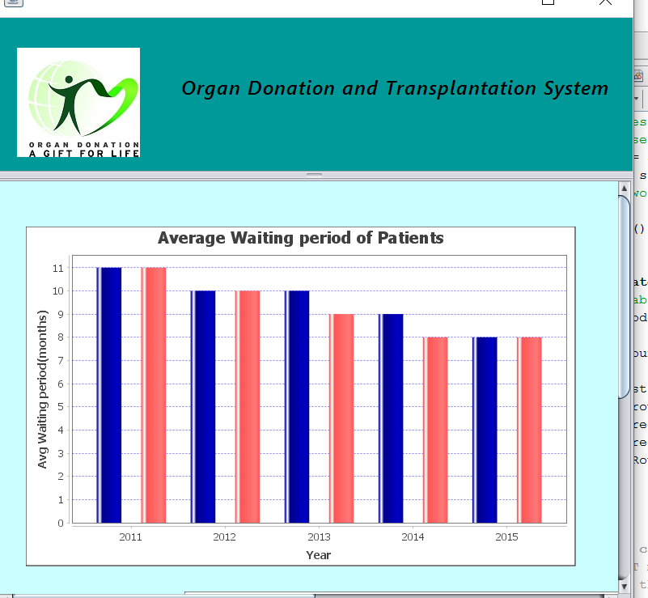
State level Reports
Comparison of average waiting period for organ transplantation in 2 cities of a state

Slide 9
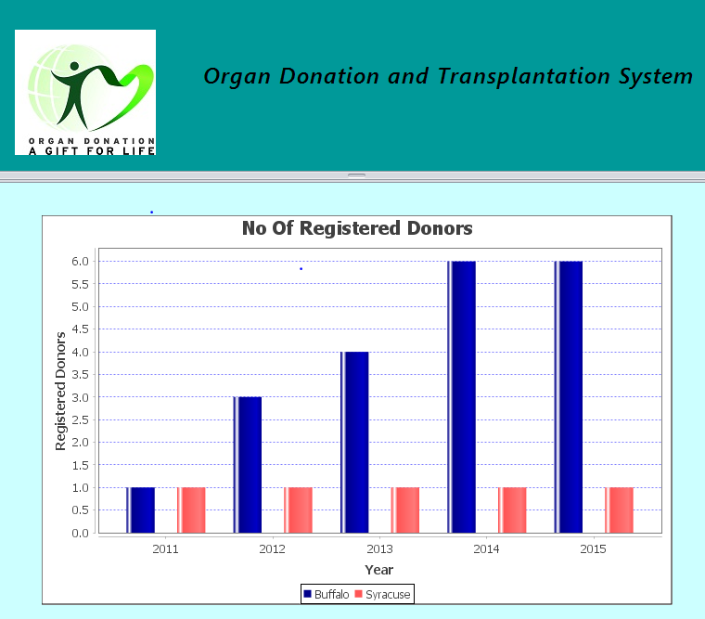
State level Reports
City wise Number of donors over 5 years:

Slide 10
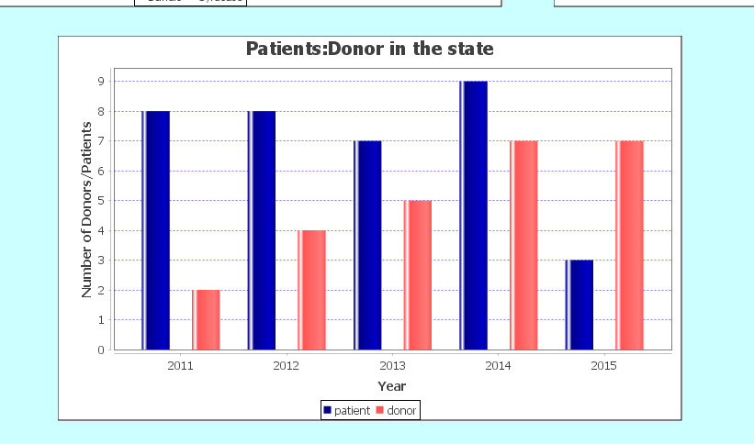
State level reports
Patients to Donor ratio over 5 years

Slide 11
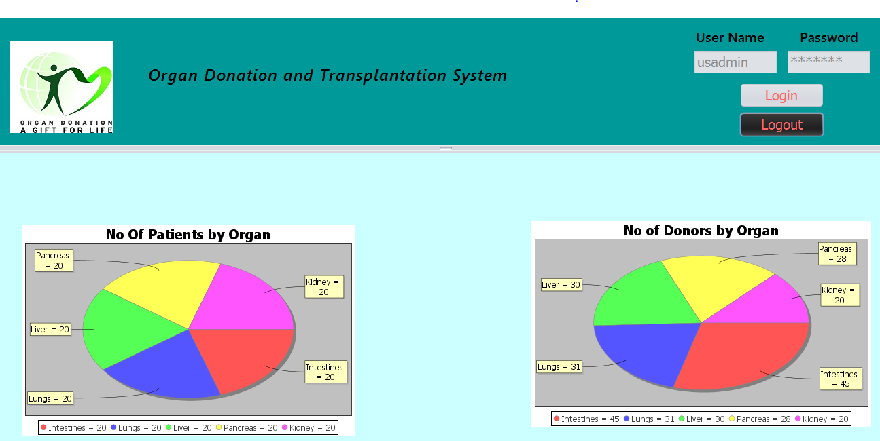
Country Level Reports
Availability of donors for patients by organ

Slide 12
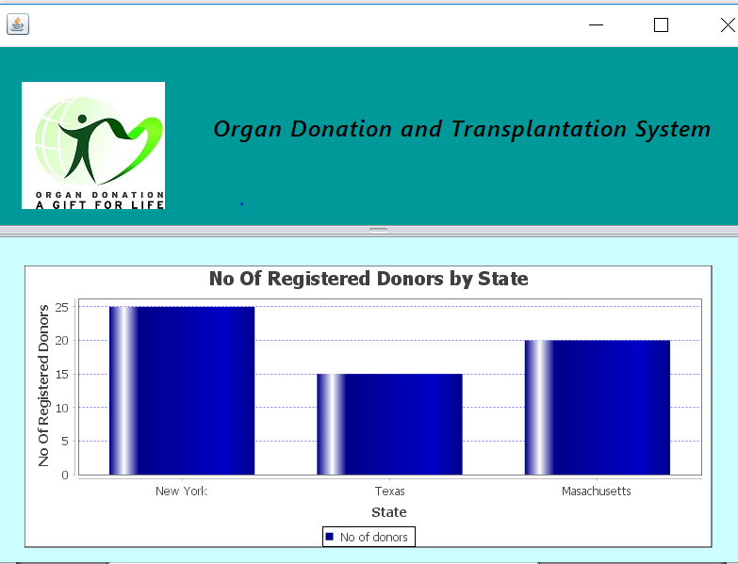
Country Level Reports
Number of Donors in every state :

Slide 13
Thank You

