Slide 1
BA Sentimental Analysis
From 3000 customer reviews from Skytrax

Slide 2
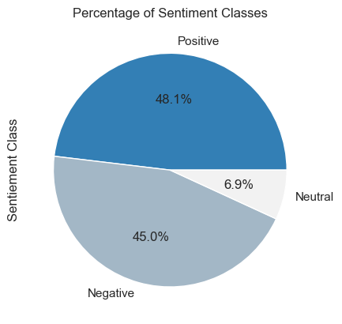
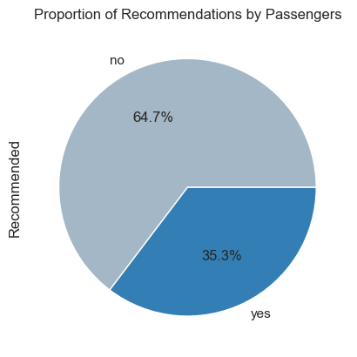
The outcome
Analysis shows a near equal distribution of positive (48.1%) and negative (45%) sentiments, with a minimal 6.9% neutral sentiment.
Recommendation:
Despite a slightly higher positive sentiment, a significant 64.7% of respondents would not recommend flying with BA.
Urgent action is required to address this discrepancy.
Further analysis is necessary to pinpoint factors driving negative reviews, enabling targeted improvements.
Simultaneously, identification of positive factors is essential to sustain and enhance existing strengths.

