Slide 1

ESWEEK 2022 – CODAI Workshop
Integration of a systolic array based hardware accelerator into a DNN operator auto-tuning framework
Federico Nicolás Peccia
FZI Research Center for Information Technology
Karlsruhe, Germany
Oliver Bringmann
University of Tübingen
Tübingen, Germany
Notes:
1

Slide 2
Table of contents
Motivation
Scheduling instructions
Integration between TVM and Gemmini
Experiments
Future
2
FZI Forschungszentrum Informatik
12.10.2022
Notes:
We want to generate a C code to run this operation on our accelerator. But how? Scheduling is not a trivial problem! The way you choose to partition this operation to be run in your accelerator modifies how you enter data into the accelerator and how you take it out, and also the data reuse that you are going to implement. This modifies the energy consumption of the entire operation and how long it takes to execute it.
2

Slide 3
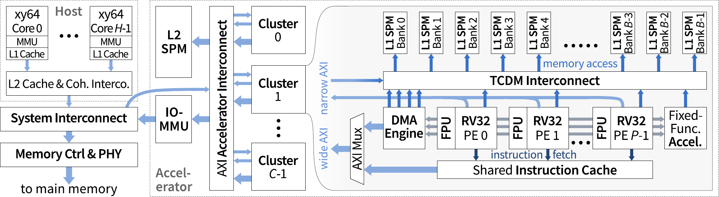

Motivation
HeroV2
Open source SoC generators are becoming increasingly popular!
Accelerators are developed for these SoC generators
Accelerator developers provide basic functions/instructions to run typical NN workloads (convolutions, dense layers)
There is no guarantee that these default functions will provide the best throughput across all possible SoC configurations/workloads combinations!
3
FZI Forschungszentrum Informatik
12.10.2022
Notes:
We want to generate a C code to run this operation on our accelerator. But how? Scheduling is not a trivial problem! The way you choose to partition this operation to be run in your accelerator modifies how you enter data into the accelerator and how you take it out, and also the data reuse that you are going to implement. This modifies the energy consumption of the entire operation and how long it takes to execute it.
3

Slide 4
Motivation
Solution: Auto-tuning process to automate the search of the best instruction sequence for a specific workload/SoC combination!
But first, we need to find a way to generate this instructions in the correct sequence!
4
FZI Forschungszentrum Informatik
12.10.2022
Notes:
We want to generate a C code to run this operation on our accelerator. But how? Scheduling is not a trivial problem! The way you choose to partition this operation to be run in your accelerator modifies how you enter data into the accelerator and how you take it out, and also the data reuse that you are going to implement. This modifies the energy consumption of the entire operation and how long it takes to execute it.
4

Slide 5
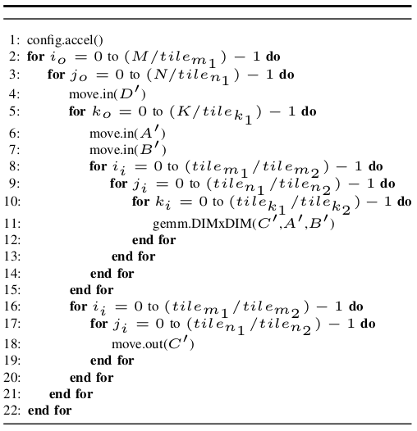
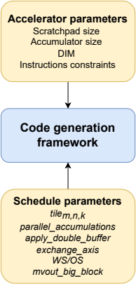
Scheduling instructions
Goal
C=A*B+D (General Matrix Multiplication)
Typically, accelerators provide 2 kind of instructions:
Layerwise (“CISC”-type): execute an entire operation (convolution layer)
Fine-grained: give the developer complete control over the behavior of the accelerator
Goal
Automate the generation of instruction schedules
Compare this generated schedules against the standard ones provided by the accelerator developers
5
FZI Forschungszentrum Informatik
12.10.2022
Notes:
We want to generate a C code to run this operation on our accelerator. But how? Scheduling is not a trivial problem! The way you choose to partition this operation to be run in your accelerator modifies how you enter data into the accelerator and how you take it out, and also the data reuse that you are going to implement. This modifies the energy consumption of the entire operation and how long it takes to execute it.
5

Slide 6
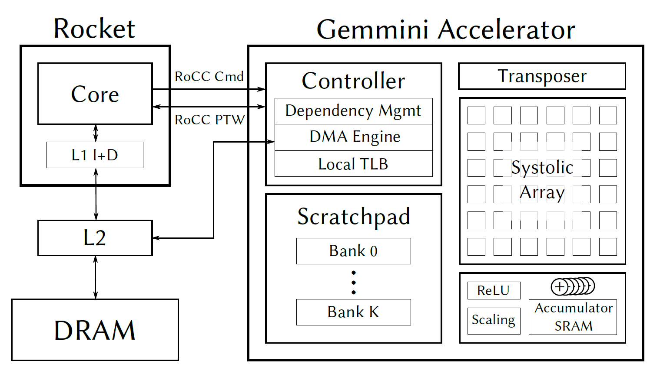
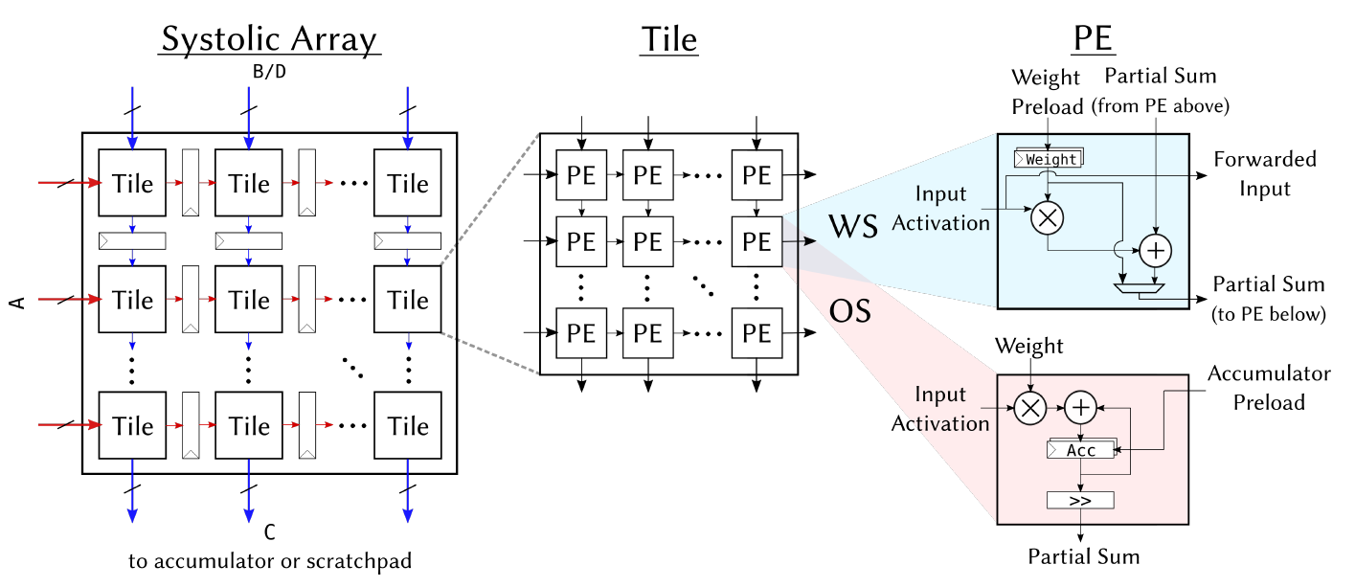
TVM and Gemmini integration
Gemmini overview
Tighly-coupled accelerator (ROCC commands)
Connected to the System Bus (L2 cache)
SRAM scratchpad and accumulator
Modules to optionally apply ReLU functions, pooling, scaling, etc
Square systolic array tile of dimensions DIMxDIM
FZI Forschungszentrum Informatik
12.10.2022
Notes:
6

Slide 7
TVM and Gemmini integration
Gemmini provided instructions
“CISC” type instructions:
GEMM
CONV
Provides 2 kind of instructions:
Intrinsics
CISC-type (layerwise)
COMPUTE
PRELOAD
Developers provide C functions which use the CISC-type instructions!
MVIN
MVOUT
FZI Forschungszentrum Informatik
12.10.2022
Notes:
7

Slide 8
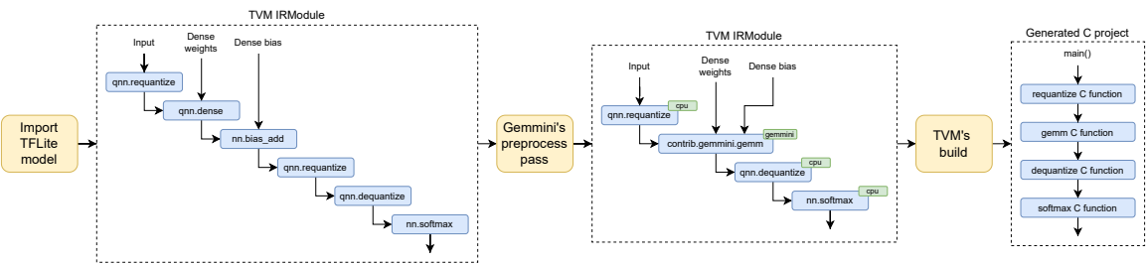
TVM and Gemmini integration
TVM passes
Grouping of operations into “supported by the accelerator” vs “not supported”
TVM selects the best schedule for each operator (with AutoTVM) or defaults to a user defined schedule
C function can generate the calls to the default functions, or generate code that uses the intrinsic intructions
8
FZI Forschungszentrum Informatik
12.10.2022
Notes:
We insert a model exported from Tensorflow Lite (this is the frontend we are currently using). Then, we obtain this TVM operator graph, which we preprocess CLICK by grouping together the operators that can be runned into our accelerator, and we tag each operator (operators that are not supported by Gemmini are defaulted to the CPU).
Finally, CLICK the TVM build selects the parameters to generate the best schedule for each operator (this is the AutoTVM process, if no AutoTVM log is available, default parameters are chosen) and we obtain a C language project, where each operator is a different C function, and we have a main entry point to run the complete network.
8

Slide 9
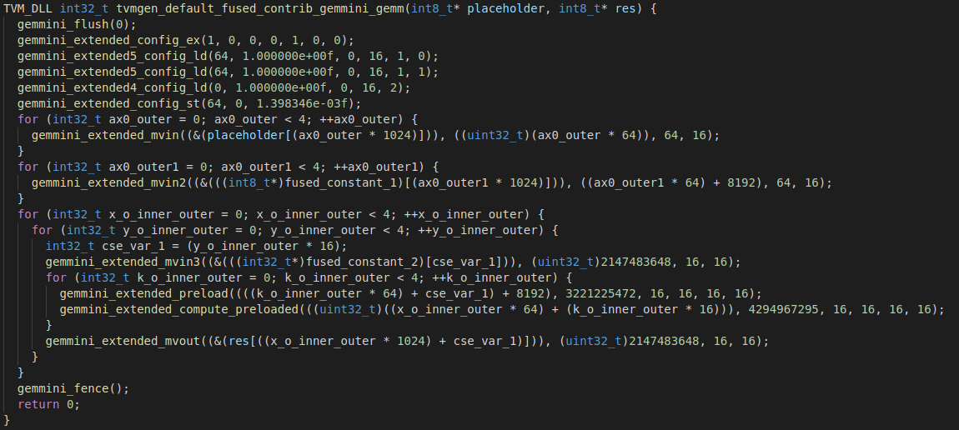
TVM and Gemmini integration
Examples of generated code for a [64,64]x[64,64]+[64,64] GEMM
First
Configuration
Move in of data
Matrix multiplications
Move out of data
Data is first moved into the accelerator. Patches are computed and are moved out as soon as they are ready.
9
FZI Forschungszentrum Informatik
12.10.2022
Notes:
We insert a model exported from Tensorflow Lite (this is the frontend we are currently using). Then, we obtain this TVM operator graph, which we preprocess CLICK by grouping together the operators that can be runned into our accelerator, and we tag each operator (operators that are not supported by Gemmini are defaulted to the CPU).
Finally, CLICK the TVM build selects the parameters to generate the best schedule for each operator (this is the AutoTVM process, if no AutoTVM log is available, default parameters are chosen) and we obtain a C language project, where each operator is a different C function, and we have a main entry point to run the complete network.
9

Slide 10
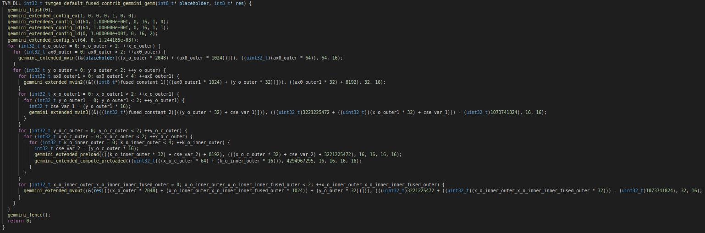
TVM and Gemmini integration
Examples of generated code for a [64,64]x[64,64]+[64,64] GEMM
Data move in and compute instructions are interleaved. Multiple patches are computed and stored in the accumulator before moving them out.
10
FZI Forschungszentrum Informatik
12.10.2022
Notes:
We insert a model exported from Tensorflow Lite (this is the frontend we are currently using). Then, we obtain this TVM operator graph, which we preprocess CLICK by grouping together the operators that can be runned into our accelerator, and we tag each operator (operators that are not supported by Gemmini are defaulted to the CPU).
Finally, CLICK the TVM build selects the parameters to generate the best schedule for each operator (this is the AutoTVM process, if no AutoTVM log is available, default parameters are chosen) and we obtain a C language project, where each operator is a different C function, and we have a main entry point to run the complete network.
10

Slide 11
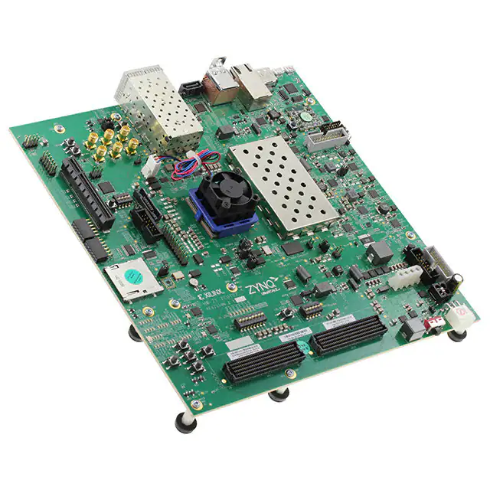

Experiments
Test setup
FPGA
Xilinx Zynq Ultrascale+ ZCU102
Linux host
Rocket
Gemmini
Core
Scratchpad
Systolic
Array
UART
RoCC
L1 I+D
Accumulator
DMA
Controller
Parameters:
1 Rocket-Core (@100 MHz)
1 Gemmini tile with 16x16 PEs
Scratchpad (256 KB): 4 banks 4096 rows each, 16 bytes per row
Accumulator (64 KB): 1024 rows, 16 bytes each
L2 Cache: 512 KB
L2
DRAM
11
FZI Forschungszentrum Informatik
12.10.2022
Notes:
So, one of our ideas was to try to replicate the result of this paper which was published in a conference in 2020. The goal of this paper was to use AutoTVM to find the best schedules to run different GEMM workloads on Gemmini. This graph condensates our results so far. We have throughput in GOPs in the y axis, and the different workload sizes in the x axis.
First, look at the paper results (the striped bars). There seems to be a consistency: using AutoTVM achieves better GOPs than the hand tuned kernels from the Gemmini developers. They also note a small improvement in the throughput when using the L2 cache (yellow against blue and green against brown).
Now lets take a look at our results.
First look only at the CISC instructions: our results are much faster than the ones from the paper. As far as I was able to understand, this is because there were improvements in the FSM of the CISC instructions in Gemmini after this paper was published (for example, double buffering was added).
Now lets look only at the AutoTVM results. This results only use the intrinsic instructions to schedule the matrix multiplication, and as you can see the schedules found by our AutoTVM are consistently much faster for all workloads, except for the 512 workload which I still need to check.
Now if we look at the throughput of the CISC instruction vs the AutoTVM schedule, we see that they are equal (actually the AutoTVM is a little bit better) until the 64 size workload. After that, the AutoTVM throughput kind of stucks. I have an idea of what I have to change in order to solve this.
11

Slide 12
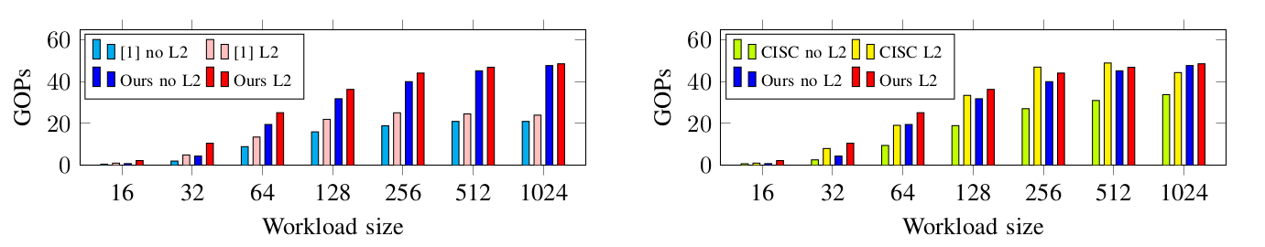
Experiments
Results
Workload: C_{[M,N]}=A_{[M,K]}*B_{[K,N]}+D_{[M,N]} → M = N = K = Workload size
Our schedules against the ones provided by the Gemmini developers using the CISC instructions
Our work against a previous work
The schedules found by our integration are faster than the ones proposed in [1]
The schedules found by our integration are faster than the default ones provided by the Gemmini developers for (almost) all workloads
[1] P. Xu and Y. Liang, “Automatic code generation for rocket chip rocc accelerators,” CARRV, 2020.
12
FZI Forschungszentrum Informatik
12.10.2022
Notes:
So, one of our ideas was to try to replicate the result of this paper which was published in a conference in 2020. The goal of this paper was to use AutoTVM to find the best schedules to run different GEMM workloads on Gemmini. This graph condensates our results so far. We have throughput in GOPs in the y axis, and the different workload sizes in the x axis.
First, look at the paper results (the striped bars). There seems to be a consistency: using AutoTVM achieves better GOPs than the hand tuned kernels from the Gemmini developers. They also note a small improvement in the throughput when using the L2 cache (yellow against blue and green against brown).
Now lets take a look at our results.
First look only at the CISC instructions: our results are much faster than the ones from the paper. As far as I was able to understand, this is because there were improvements in the FSM of the CISC instructions in Gemmini after this paper was published (for example, double buffering was added).
Now lets look only at the AutoTVM results. This results only use the intrinsic instructions to schedule the matrix multiplication, and as you can see the schedules found by our AutoTVM are consistently much faster for all workloads, except for the 512 workload which I still need to check.
Now if we look at the throughput of the CISC instruction vs the AutoTVM schedule, we see that they are equal (actually the AutoTVM is a little bit better) until the 64 size workload. After that, the AutoTVM throughput kind of stucks. I have an idea of what I have to change in order to solve this.
12

Slide 13
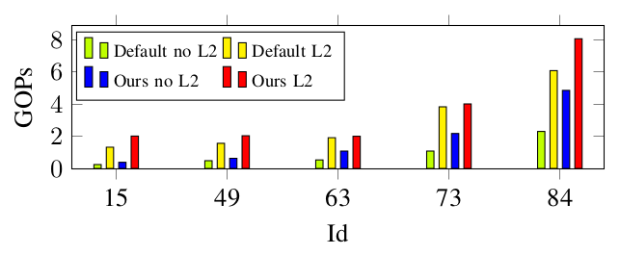
Experiments
Results
Our schedules against the ones provided by the Gemmini developers using the CISC instructions, measured on worloads from the Baidu DeepBench dataset [1]
The schedules found by our integration are faster than the default ones provided by the Gemmini developers for all tested workloads
[1] S. Narang and G. Diamos, “Baidu deepbench,” GitHub Repository, 2017.
13
FZI Forschungszentrum Informatik
12.10.2022
Notes:
So, one of our ideas was to try to replicate the result of this paper which was published in a conference in 2020. The goal of this paper was to use AutoTVM to find the best schedules to run different GEMM workloads on Gemmini. This graph condensates our results so far. We have throughput in GOPs in the y axis, and the different workload sizes in the x axis.
First, look at the paper results (the striped bars). There seems to be a consistency: using AutoTVM achieves better GOPs than the hand tuned kernels from the Gemmini developers. They also note a small improvement in the throughput when using the L2 cache (yellow against blue and green against brown).
Now lets take a look at our results.
First look only at the CISC instructions: our results are much faster than the ones from the paper. As far as I was able to understand, this is because there were improvements in the FSM of the CISC instructions in Gemmini after this paper was published (for example, double buffering was added).
Now lets look only at the AutoTVM results. This results only use the intrinsic instructions to schedule the matrix multiplication, and as you can see the schedules found by our AutoTVM are consistently much faster for all workloads, except for the 512 workload which I still need to check.
Now if we look at the throughput of the CISC instruction vs the AutoTVM schedule, we see that they are equal (actually the AutoTVM is a little bit better) until the 64 size workload. After that, the AutoTVM throughput kind of stucks. I have an idea of what I have to change in order to solve this.
13

Slide 14
Future
Next steps
Integration of support for auto-tuning of other kind of layers (convolutions, adding layers, depthwise convolutions, etc)
Demonstration of the power of this integration by accelerating entire neural networks
Improvement of the convergence of the auto-tuning search algorithm
Open source the integration
14
FZI Forschungszentrum Informatik
12.10.2022
Notes:
So, one of our ideas was to try to replicate the result of this paper which was published in a conference in 2020. The goal of this paper was to use AutoTVM to find the best schedules to run different GEMM workloads on Gemmini. This graph condensates our results so far. We have throughput in GOPs in the y axis, and the different workload sizes in the x axis.
First, look at the paper results (the striped bars). There seems to be a consistency: using AutoTVM achieves better GOPs than the hand tuned kernels from the Gemmini developers. They also note a small improvement in the throughput when using the L2 cache (yellow against blue and green against brown).
Now lets take a look at our results.
First look only at the CISC instructions: our results are much faster than the ones from the paper. As far as I was able to understand, this is because there were improvements in the FSM of the CISC instructions in Gemmini after this paper was published (for example, double buffering was added).
Now lets look only at the AutoTVM results. This results only use the intrinsic instructions to schedule the matrix multiplication, and as you can see the schedules found by our AutoTVM are consistently much faster for all workloads, except for the 512 workload which I still need to check.
Now if we look at the throughput of the CISC instruction vs the AutoTVM schedule, we see that they are equal (actually the AutoTVM is a little bit better) until the 64 size workload. After that, the AutoTVM throughput kind of stucks. I have an idea of what I have to change in order to solve this.
14

Slide 15

Thanks for your attention!
Ing. Federico Nicolás Peccia
FZI Research Center for Information Technology
ISPE-SIM
peccia@fzi.de
Twitter: @PecciaF
15
FZI Forschungszentrum Informatik
22.10.2021
Notes:
15

