Slide 1
C++ Exercise WS15/16
Project: NUMA Migration
Martin Wenzel,
Dennis Sebastian Rieber

Slide 2
Structure
Introduction
  What is NUMA?
  Motivation – Why are we doing this?
  State of the Art – What else is out there?
Realization – What can we do about the Problem?
  Goals and Concepts
  Interface
  Implementation
Verification – Was it all worth it?
  Migration
  Stencil
Summary

Slide 3
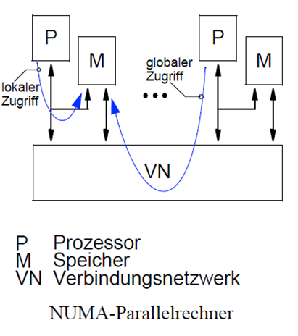
What is NUMA?
Non-Uniform Memory Architecture
Multisocket Systems
shared memory systems
cache coherent

Slide 4
Motivation – Why are doing this?
Remote data access
first touch policy
  Employed by all modern operating systems
  Initializes memory page on the domain of the thread, which is the first to touch the data

Slide 5
Motivation – Costs of remote memory access

Slide 6
State of the Art – What else is out there?
Hwloc – hardware locality
  Explores system architecture
  Creates architectural model of the system
  Huge interface
Libnuma
  Only available on Unix systems
  Classic C style interface
  Memory page and thread migration possibilities

Slide 7
State of the Art – libnuma

Slide 8
Structure
Introduction
  What is NUMA?
  Motivation – Why are we doing this?
  State of the Art – What else is out there?
Realization – What can we do about the Problem?
  Goals and Concepts
  Interface
  Implementation
Verification – Was it all worth it?
  Migration
  Stencil
Summary

Slide 9
Goals
Core
  Container
  First touch migration of complete data block
Target
  Distribute pages over several domains
  Templated Container
Enhanced
  Intelligent distribution based on access patterns
  Complete portability

Slide 10
Concepts
NUMA aware container class
  Knowing the available domains
  Move data between domains
STL-like behavior
  Iterators
  Support foreach Syntax
  Templates
Using first-touch to move data, no syscalls required
easy user Interface with c++ language features

Slide 11
Realization - Interface

Slide 12
Realization

Slide 13
Realization – Thread pin

Slide 14
Structure
Introduction
  What is NUMA?
  Motivation – Why are we doing this?
  State of the Art – What else is out there?
Realization – What can we do about the Problem?
  Goals and Concepts
  Interface
  Implementation
Verification – Was it all worth it?
  Migration
  Stencil
Summary

Slide 15
Verification - Migration

Slide 16
Verification – Stencil

Slide 17
Structure
Introduction
  What is NUMA?
  Motivation – Why are we doing this?
  State of the Art – What else is out there?
Realization – What can we do about the Problem?
  Goals and Concepts
  Interface
  Implementation
Verification – Was it all worth it?
  Migration
  Stencil
Summary

Slide 18
Summary
Achieved core and target goals
Created easy to use container that hides NUMA complexity
Future Goals
  Intelligent distribution
  Portable Version
  Separate NUMA administration and Container administration

Slide 19
C++11 Features
Mutex
Move Semantics
Threads
Initializer lists
Constructor delegation

