Slide 1
Characterization of GPU Communication
A scientific exploration

Slide 2
Outline
Motivation & Goals
Methodology
LLVM and SSA
Instrumentation for Dynamic GPU Tracing
Characterization of GPU Communication
Conclusion & Future Work

Slide 3
Motivation – Why are we doing this?
Distributed memory communication (MPI) is well researched
Intra-GPU communication not researched…
  ...although there are similarities distributed memory communication
  Existing GPU research not concerned with intra-application data movement
Fundamental for multi-GPU scaling
GPU parallel hardware and software continues scaling
  Volume
  Patterns
  Frequency

Slide 4
Goals – What are we going to do?
Instrument applications to crate traces
  Trace all memory operations potentially being communication
  Use compilers to augment applications. No framework for this kind of instrumentation available.
Characterize communication based on traces
  Quantitative: Volumes, frequency
  Qualitative: Communication Partners, regularity, patterns

Slide 5
Outline
Motivation & Goals
Methodology
LLVM and SSA
Instrumentation for Dynamic GPU Tracing
Characterization of GPU Communication
Conclusion & Future Work

Slide 6
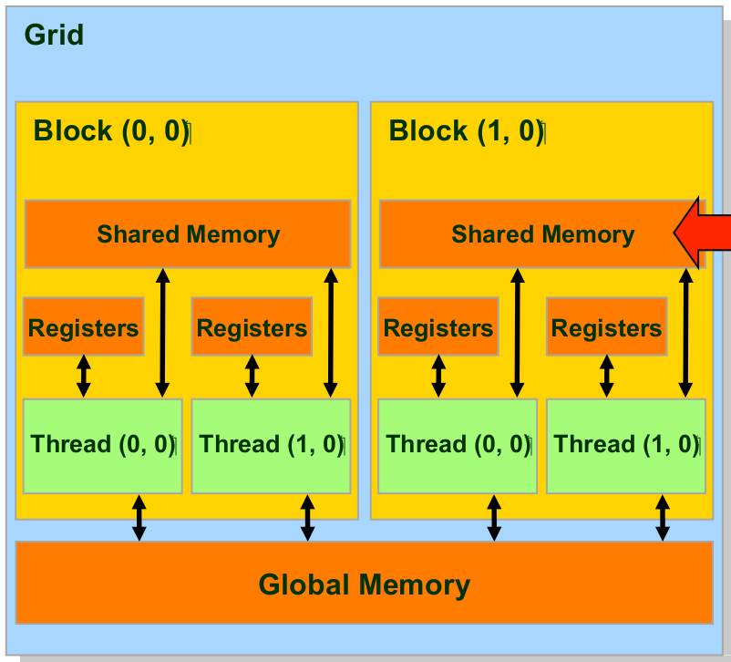
Methodology - GPGPU
Thread hierarchy
  Grid, CTA, Thread
Memory hierarchy
Global memory is shared
  Allows side effects!
No CRCW memory

Slide 7
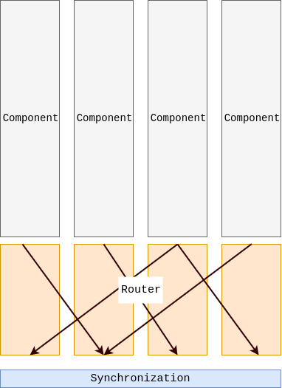
Methodology – BSP
Bridging Model for parallel computing
Algorithm split up into steps
  Compute
  Communicate
  Synchronize
Steps form supersteps
Multiple supersteps form program

Slide 8
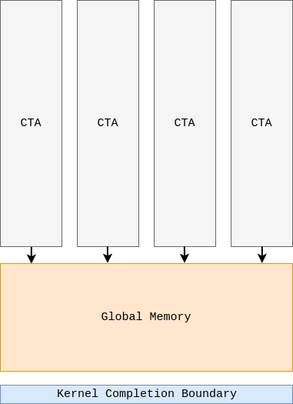
Methodology - BSP to GPU

Slide 9
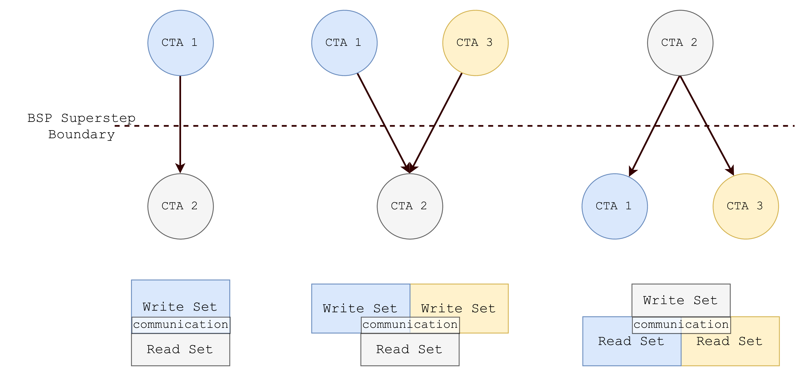
Methodology – Communication

Slide 10
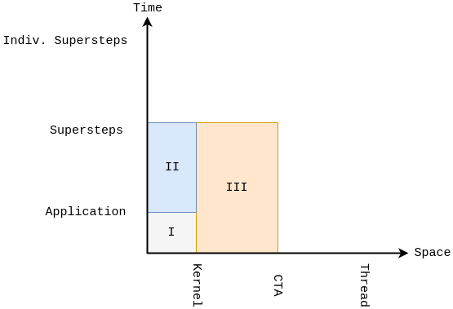
Methodology – Analysis Space
Communication as function of space and time
Tiers of analysis
Caveats
  No Thread analysis
  No distinct collectives
  Superstep serialization

Slide 11
Outline
Motivation & Goals
Methodology
LLVM and SSA
Instrumentation for Dynamic GPU Tracing
Characterization of GPU Communication
Conclusion & Future Work

Slide 12
LLVM and SSA - Fundamentals
LLVM has three components
  Front-end → Syntax and IR generation
  Optimizer → Analysis and tranform.
  Back-end → not important here
LLVM IR is based on SSA
  Static Single Assignment
  Each variable, only defined at one location in the code

Slide 13
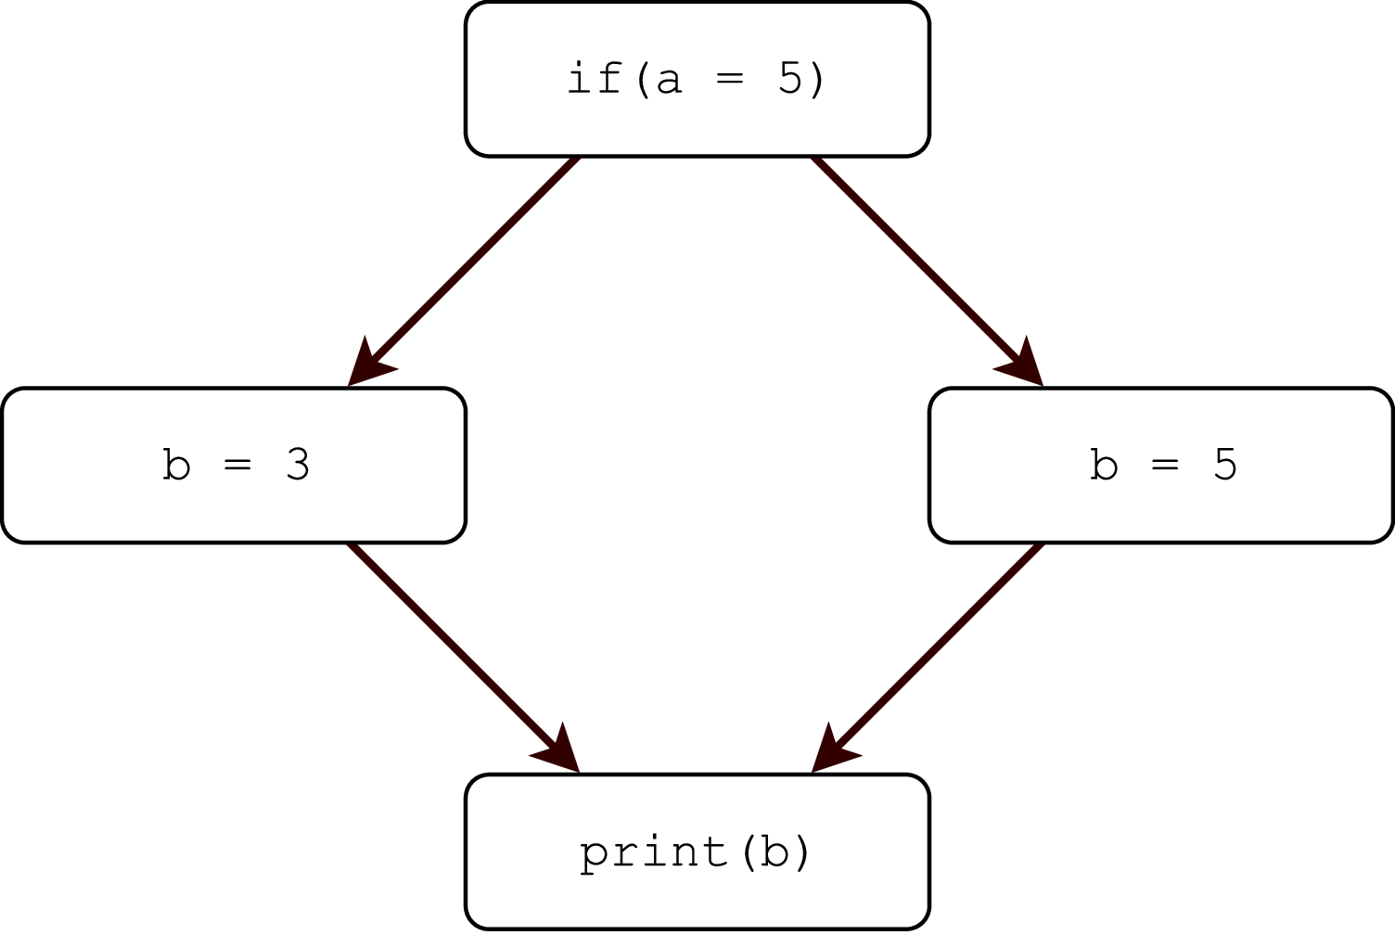
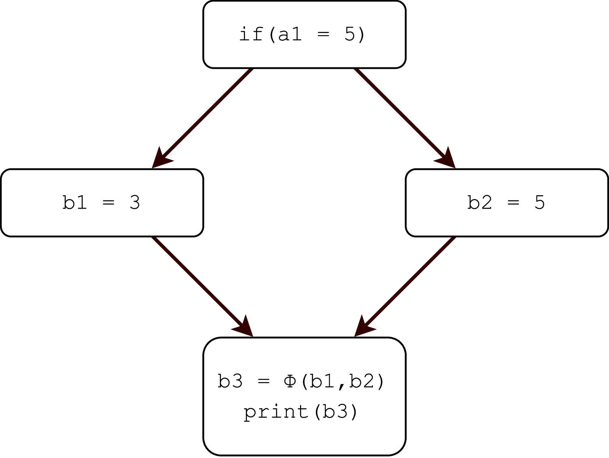
SSA - Phi-Functions

Slide 14
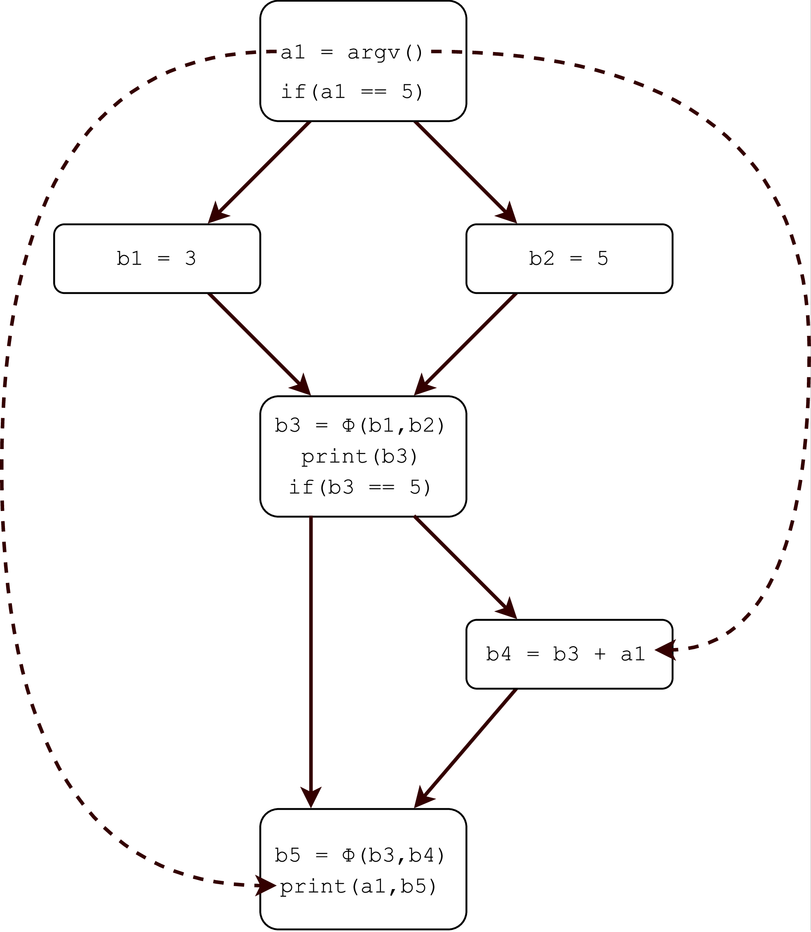
SSA – Def-Use/Use-Def
Uni-directional connection between definition and use of variable
Use-def connection trivial in SSA
Def-Use constructed form Use-Def

Slide 15
Outline
Motivation & Goals
Methodology
LLVM and SSA
Instrumentation for Dynamic GPU Tracing
Characterization of GPU Communication
Conclusion & Future Work

Slide 16
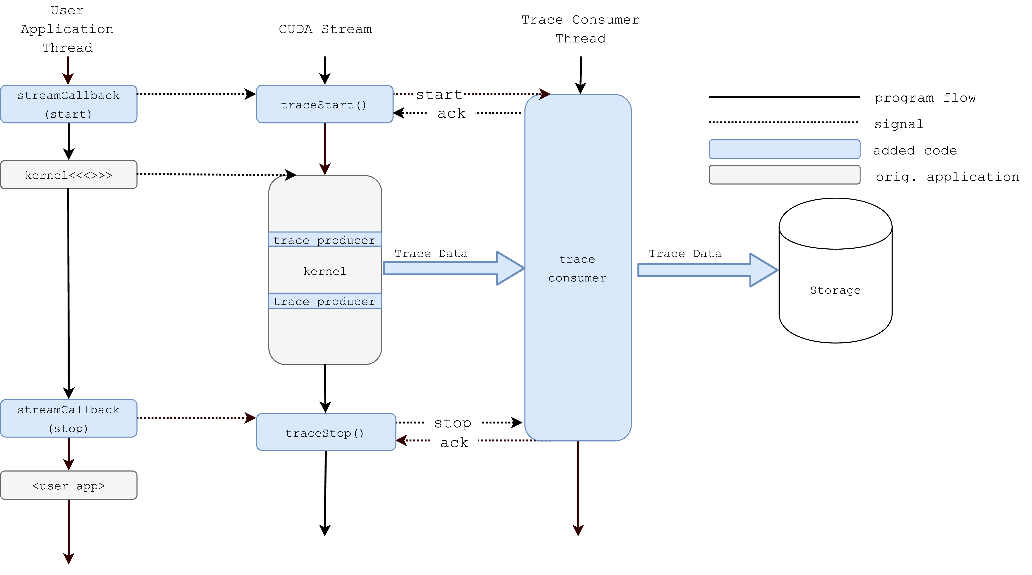
Instrumentation - Overview

Slide 17
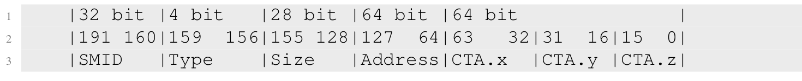
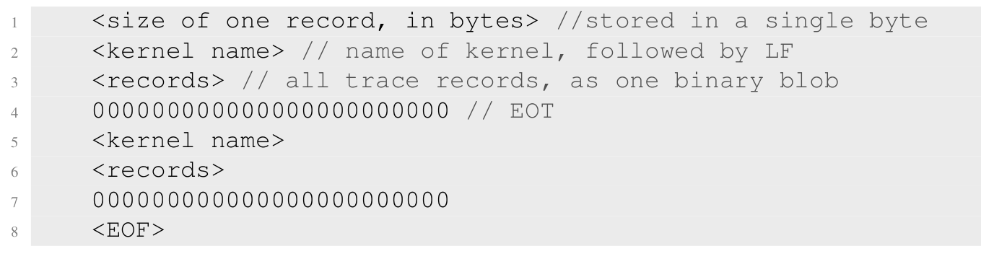
Instrumentation – Trace Format

Slide 18
Instrumentation – Address Space Analysis
Lowering destroys address space information
Backwards analysis not feasible
  Missing function context information
Solution: Forward analysis
  Observation: Limited number of sources for global memory pointer
    Kernel argument, Global Variable, Ptr. Type Load
Program Representation as sparse SSA def-use tree
Algorithm travels into functions

Slide 19
Instrumentation – Address Space Analysis
Problem Space as sets:
  Memory operation: MOp = {Load/Store/Atomic}
  Parent operation: POp = {FuncCall, Cast, GEP, PtrLoad}
  No operation: NOp = {inst; inst ∉ POp, inst ∉ MOp }
Transfer Function
  Classifies each instruction into MOp, POp or NOp
  MOp pushed to trace list, POp pushed to work stack, NOp is ignored
Flow and context sensitive

Slide 20
Instrumentation – Address Space Analysis
__device__ f func(f* a, f* b){ load_addr = gep(b, tix+bix) a1 = load(load_addr) a2 = add(a1, 1) return a2 } __global__ k(f* in, int offset) { res = func(sx, in) store_addr = gep(in, +offset tix+bix) store(store_addr, res) }
Initial Pointers: {in}
Users(in) = {func, gep}
  Users(Gep) = { store }
  Users(Func) = {Gep}
    Users(Gep) = {load}
Final List: {store, load}

Slide 21
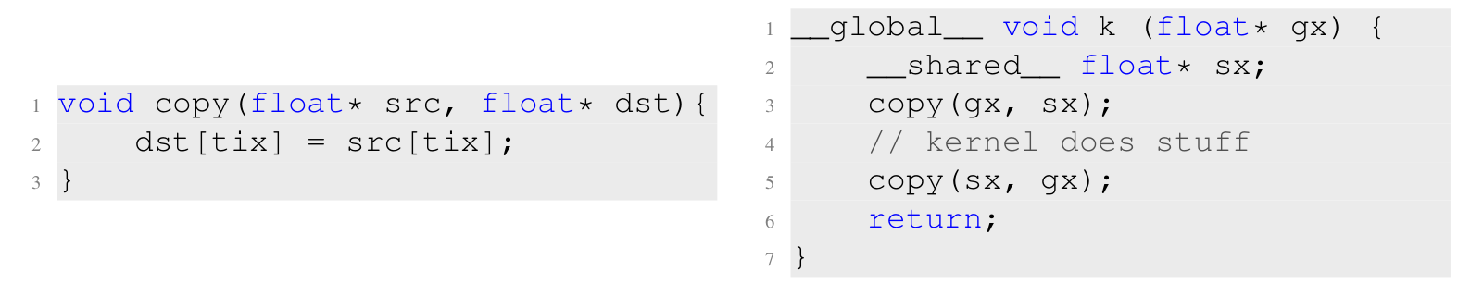
Instrumentation – Function Specialization
Function possibly called several times, with different calling contexts
Naive algorithm follows analysis and marks visited Mops
  => Creates wrong trace data!

Slide 22
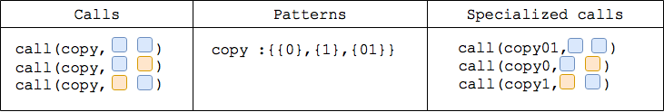
Instrumentation – Function Specialization
Def-use tree traversal visits call one or more times (or never…)
Visits form“patterns”
Create clone for every pattern
Replace original function with clones

Slide 23
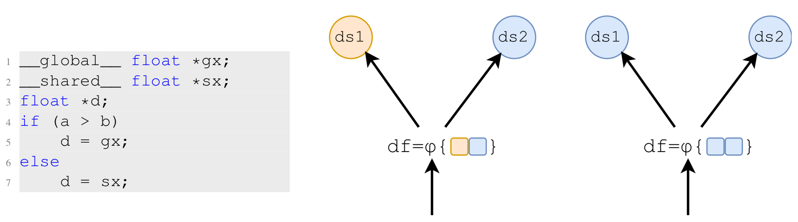
Instrumentation – φ Nodes

Slide 24
Instrumentation – Dynamic Tracing
Problem: Applications with non-deterministic run-time
  No predictions of buffer space possible
  Static buffers not enough
Solution: Dynamic data generation and consumption between host and device
  GPU produces data, stalls if buffer is full
  Host clears buffer if its full and resets buffer index for GPU
  Not offered by any current GPU instrumentation framework

Slide 25
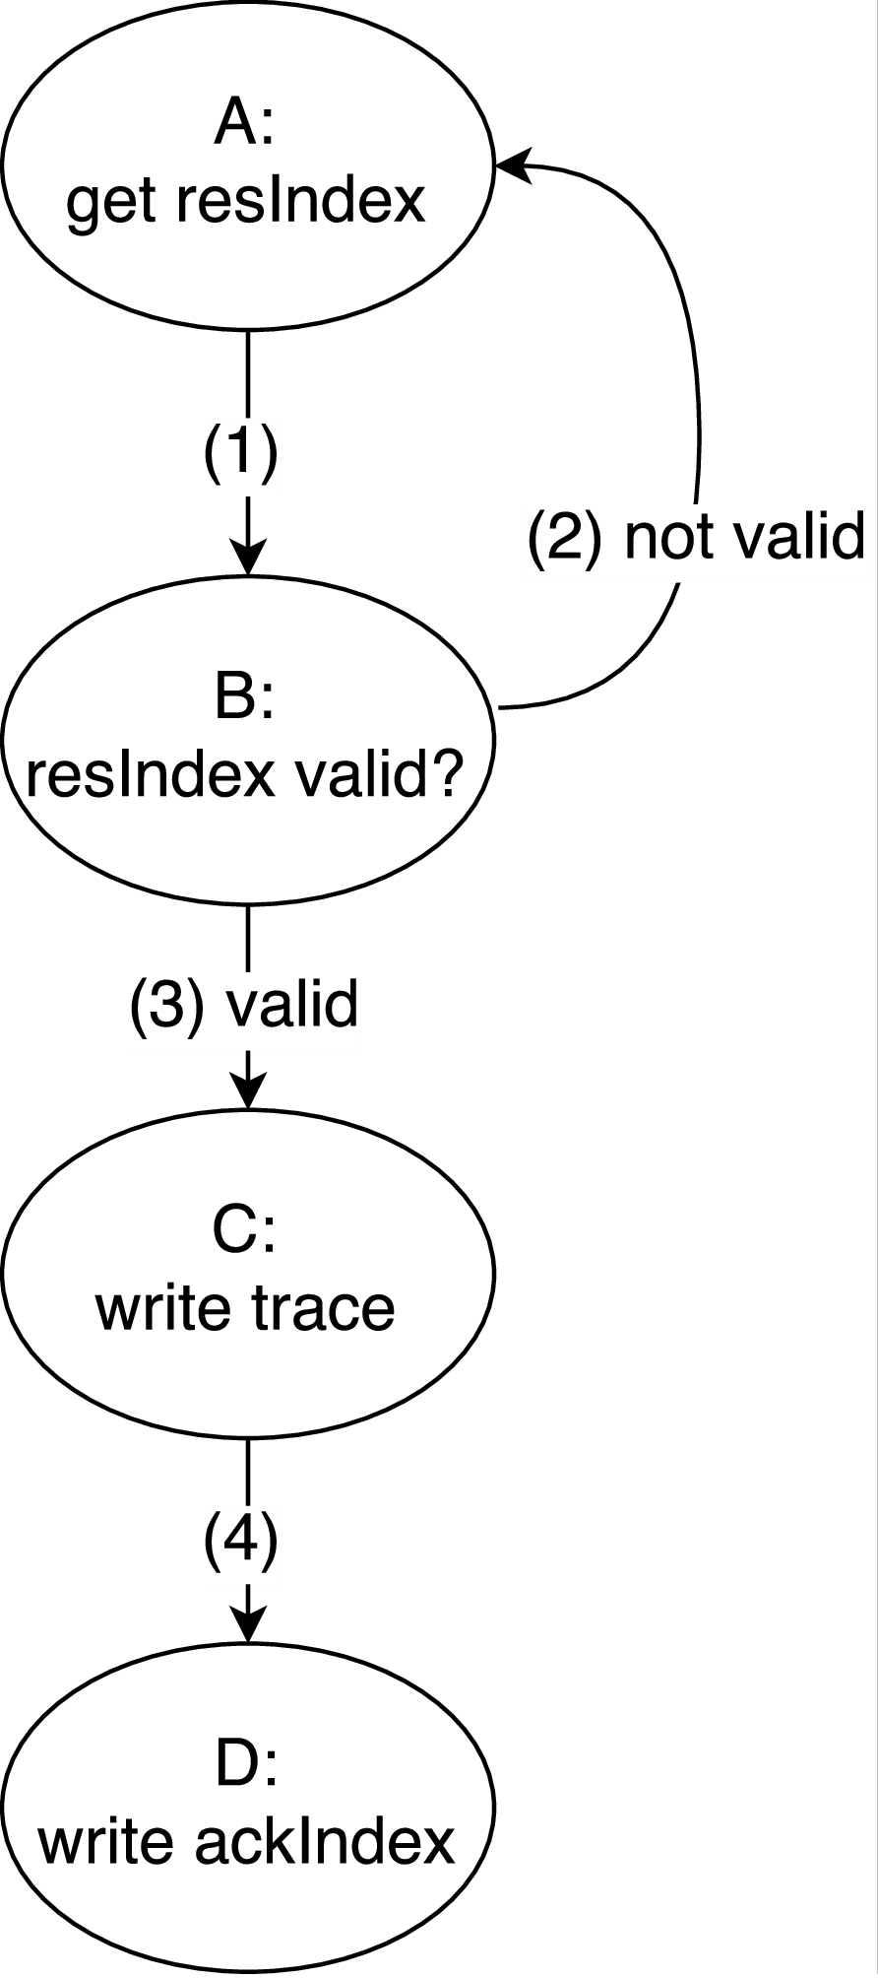
Instrumentation – Dynamic Tracing
Basic algorithm: Two indices, reservation and write acknowledgment
  Implementation more complex due to warp scheduling
  Warp stalls at branch-merge if threads act individually
  => Deadlock
Solution: Implement on Warp scope
  Use Warp intrinsic to count population and select thread to handle buffer space reservation and write ack.
  Either whole warp stalls, or whole warp progresses

Slide 26
Outline
Motivation & Goals
Methodology
LLVM and SSA
Instrumentation for Dynamic GPU Tracing
Characterization of GPU Communication
Conclusion & Future Work

Slide 27
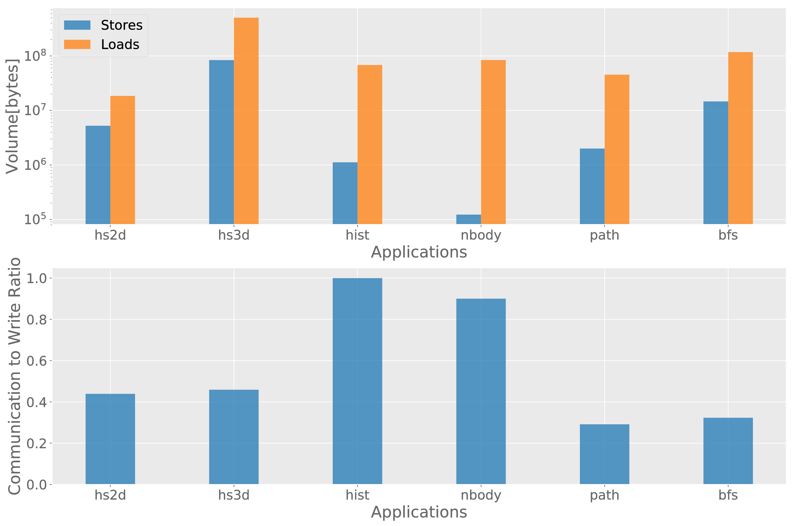
Analysis – Write/Com Ratio

Slide 28
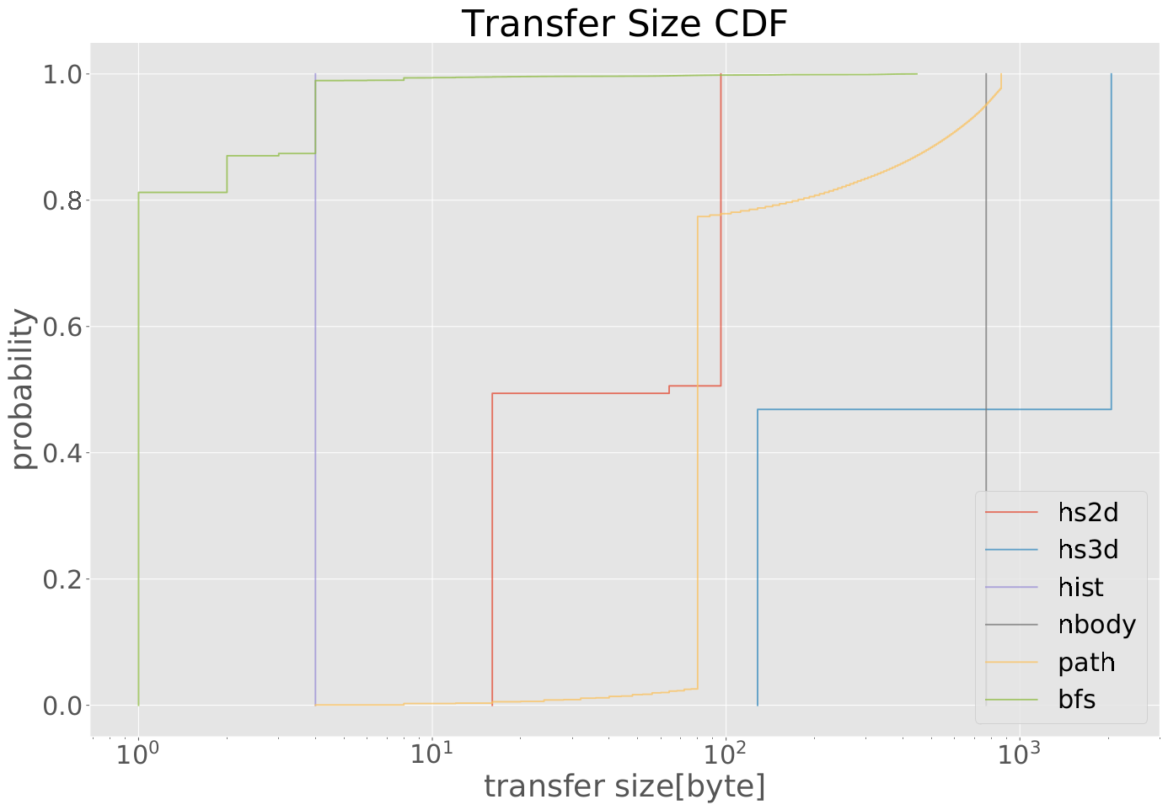
Analysis T1 – Message Size CDF

Slide 29
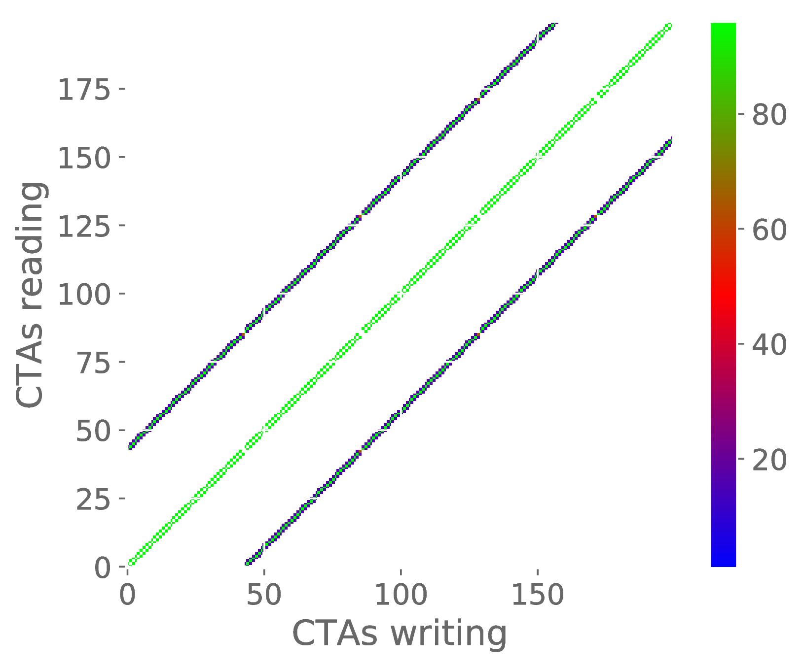
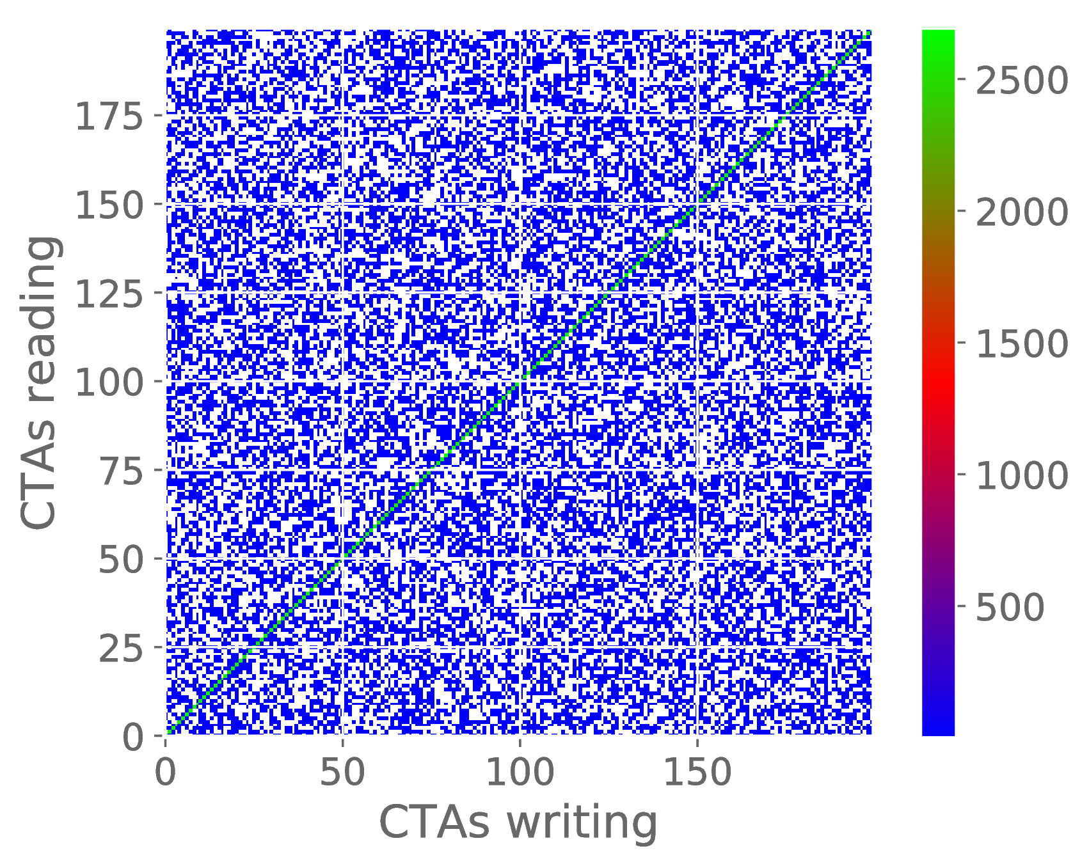
Analysis T1 – Density Heatmap

Slide 30
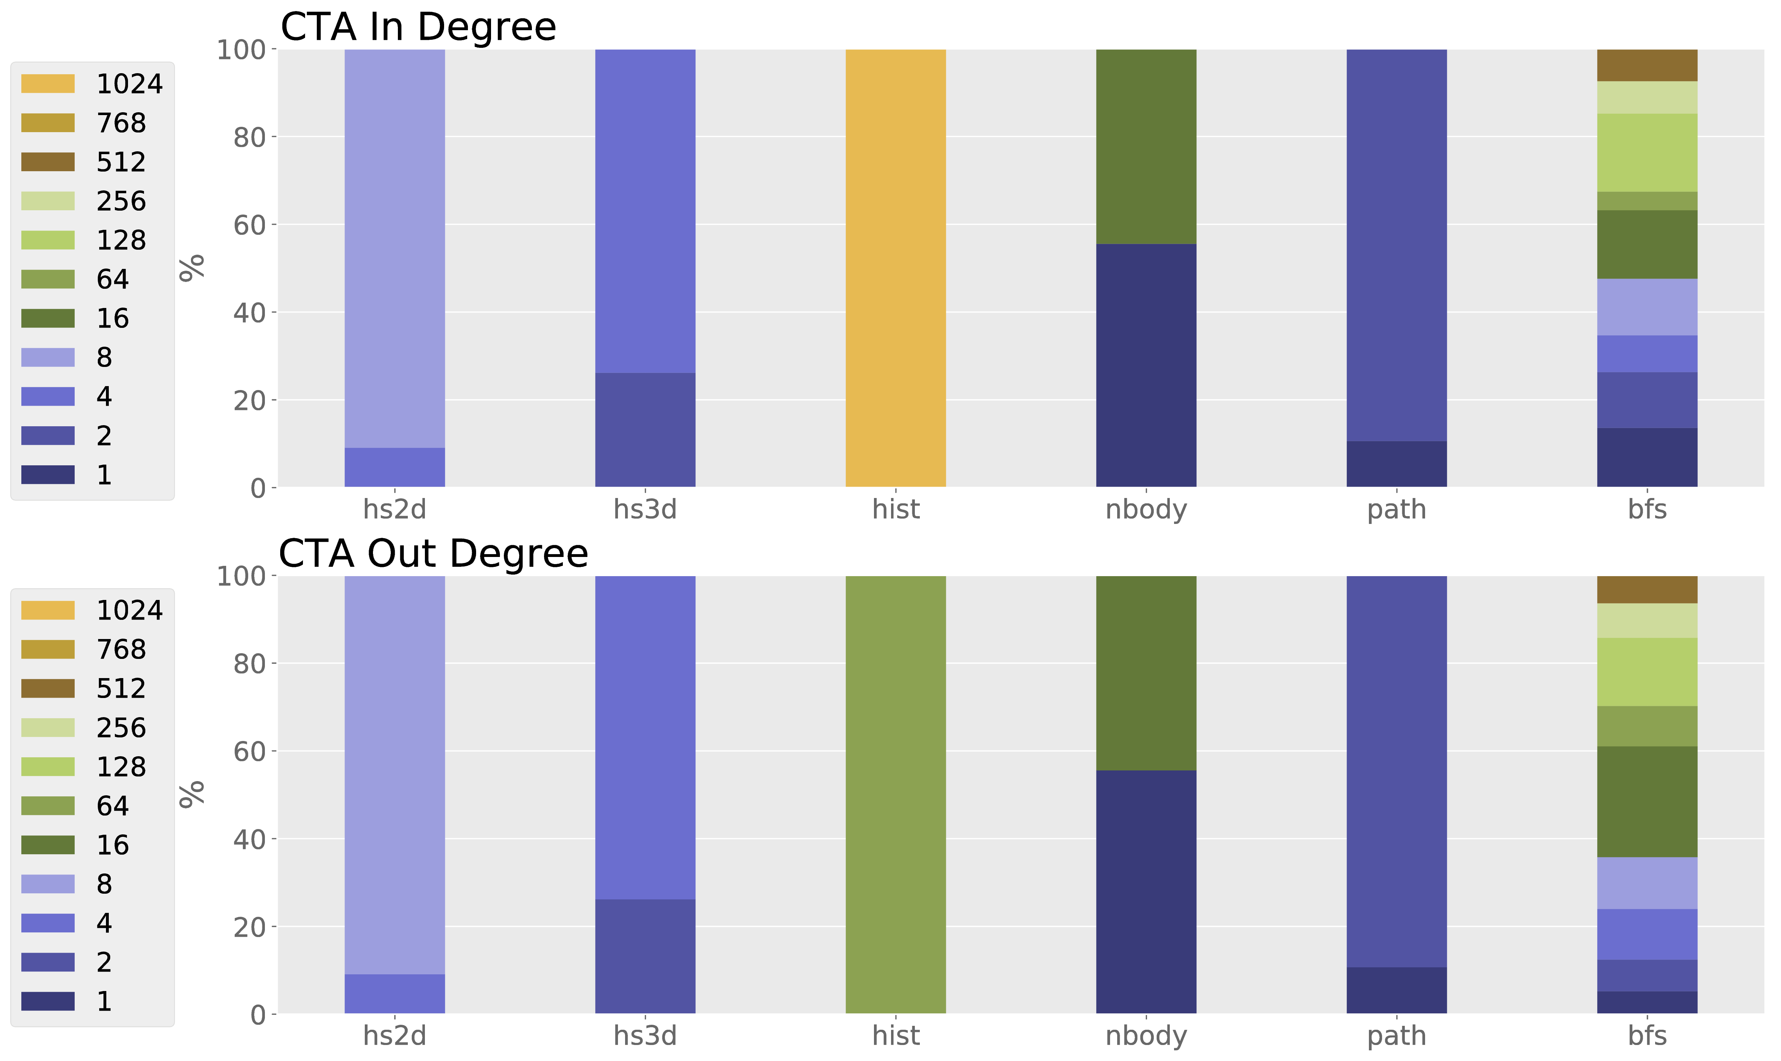
Analysis T1 – CTA In/OutDegree

Slide 31
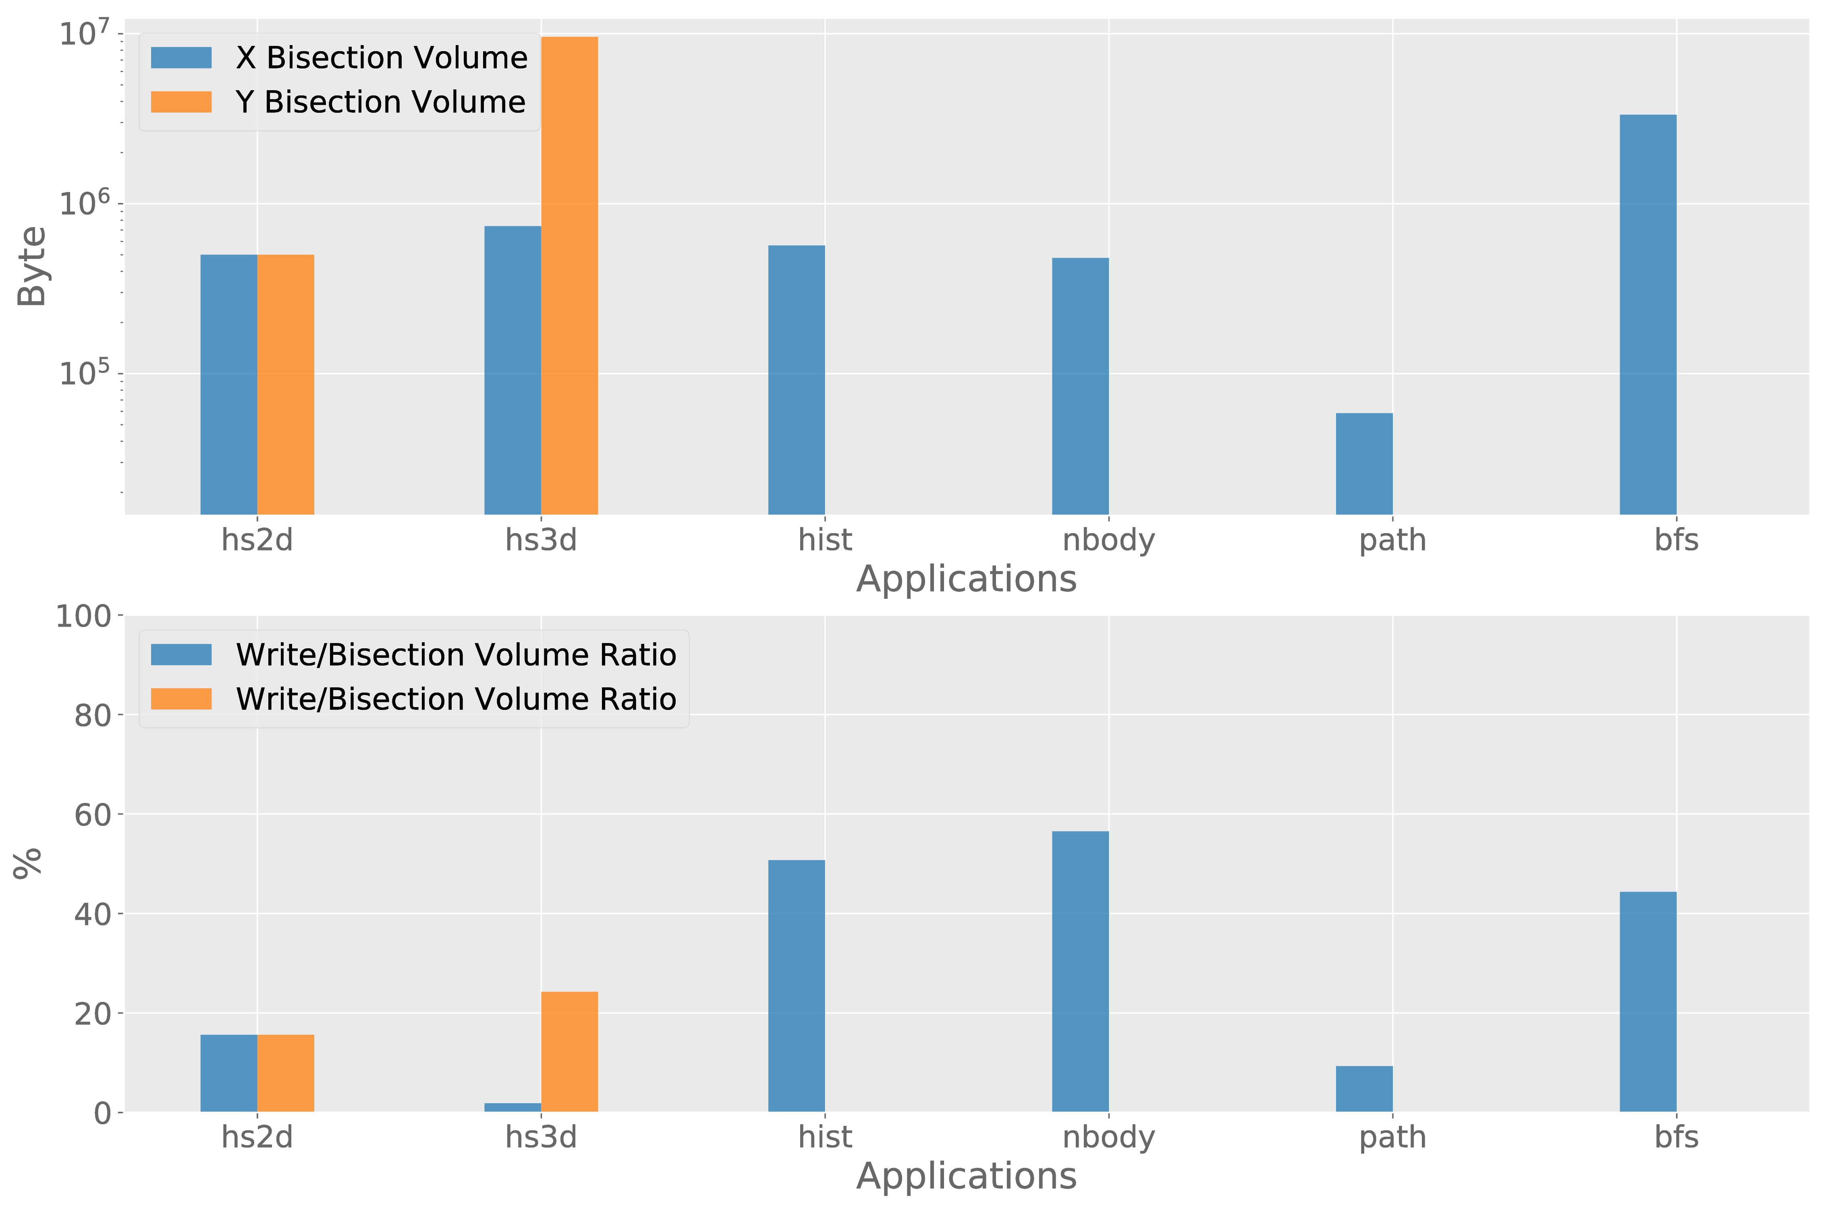
Analysis T1 – Bisection Volume

Slide 32
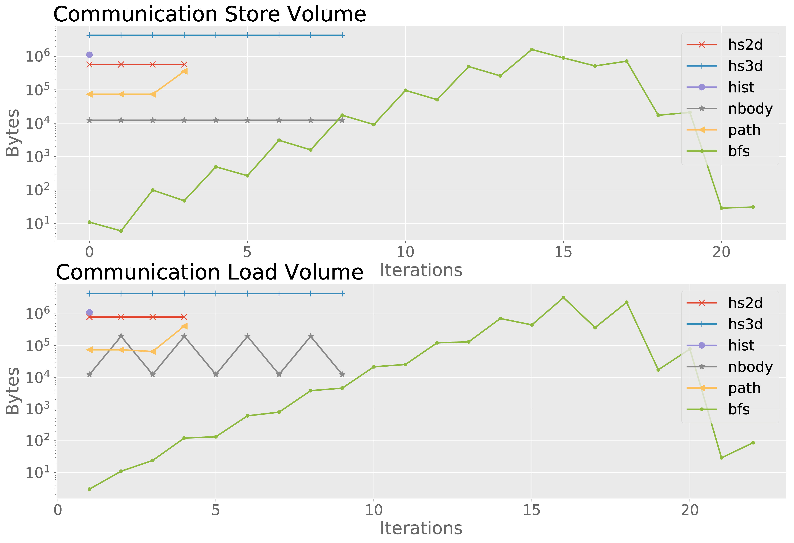
Analysis T2 – Kernel Load/Store evolution

Slide 33
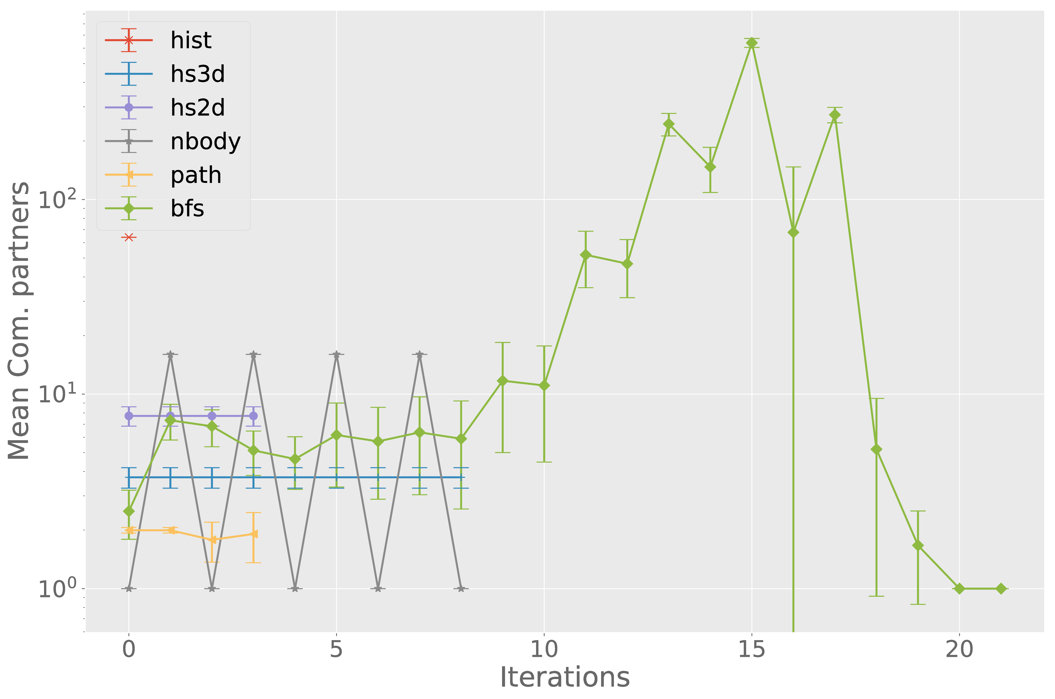
Analysis T3 – CTA OutDegree Evolution

Slide 34
Outline
Motivation & Goals
Methodology
LLVM and SSA
Instrumentation for Dynamic GPU Tracing
Characterization of GPU Communication
Conclusion & Future Work

Slide 35
Conclusion
Working tools for source instrumentation
Provide dynamic tracing, with actual logging instead of counters
Communication volume is significant in all applications (>30%)
Mostly collective communication
Low/No and regular stride in communication
Communication usually only between subsequent supersteps

Slide 36
Future Work
OpenCL compatible
Enable tracing of inline asm and macrose like ldg()
Multi GPU tracing
More applications (Complete Rodina, Parboil, …)
Deeper analysis of specific applications
Model to predict multi GPU scalabiltiy of applications

Slide 37
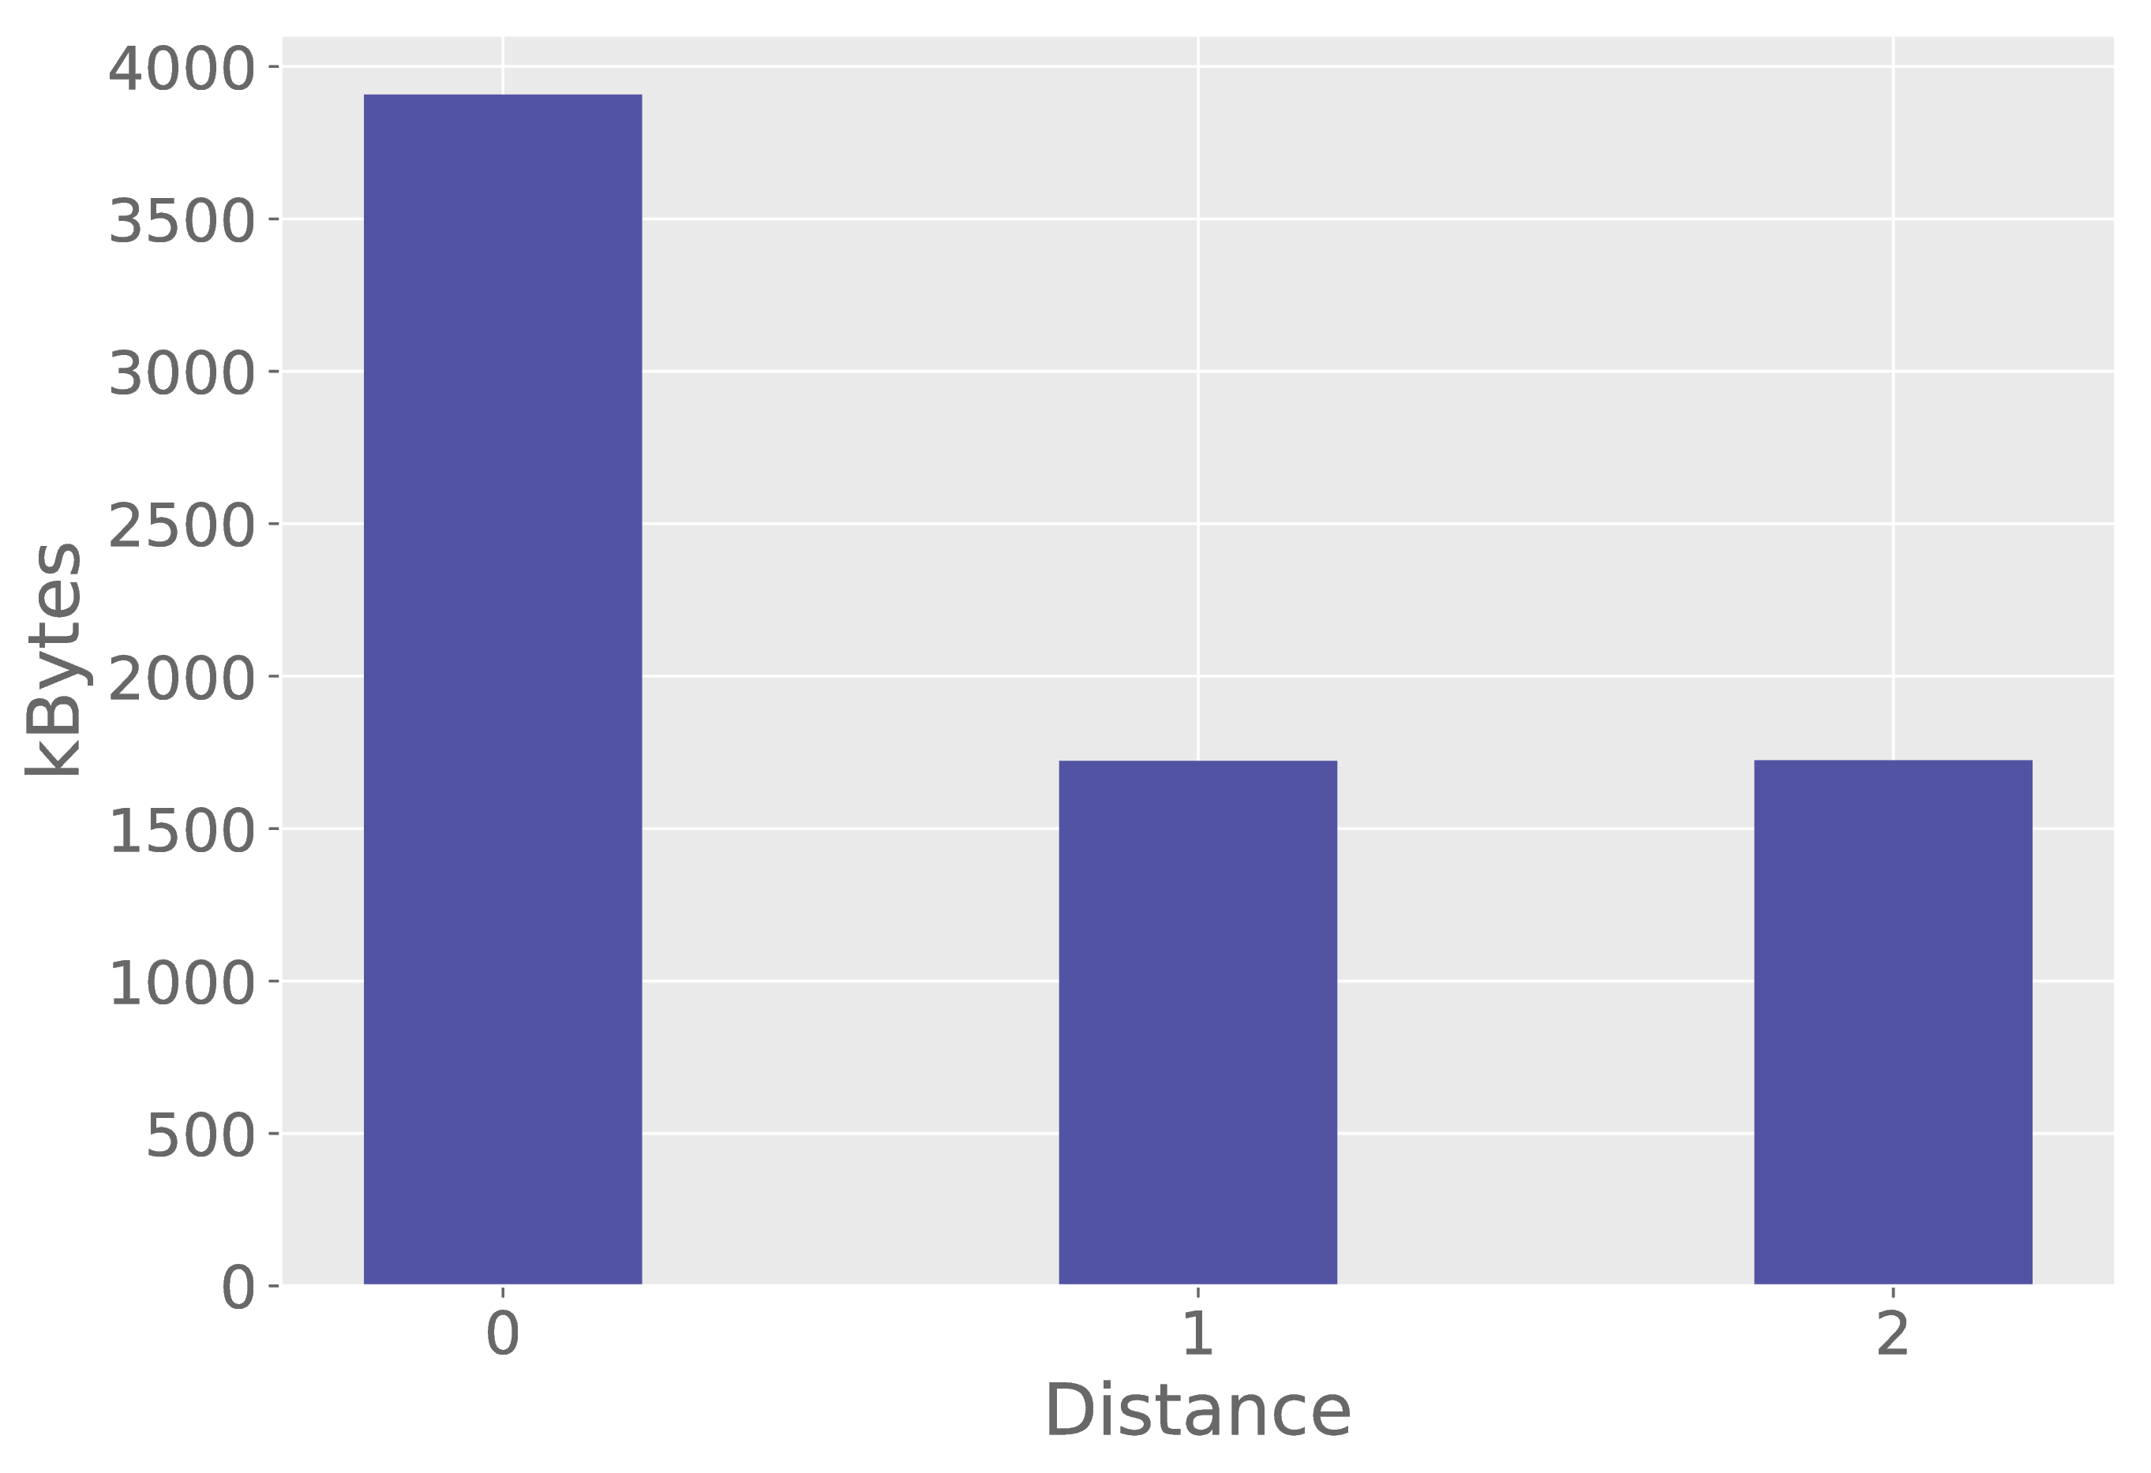
Analysis T2 – Superstep Distance

Slide 38
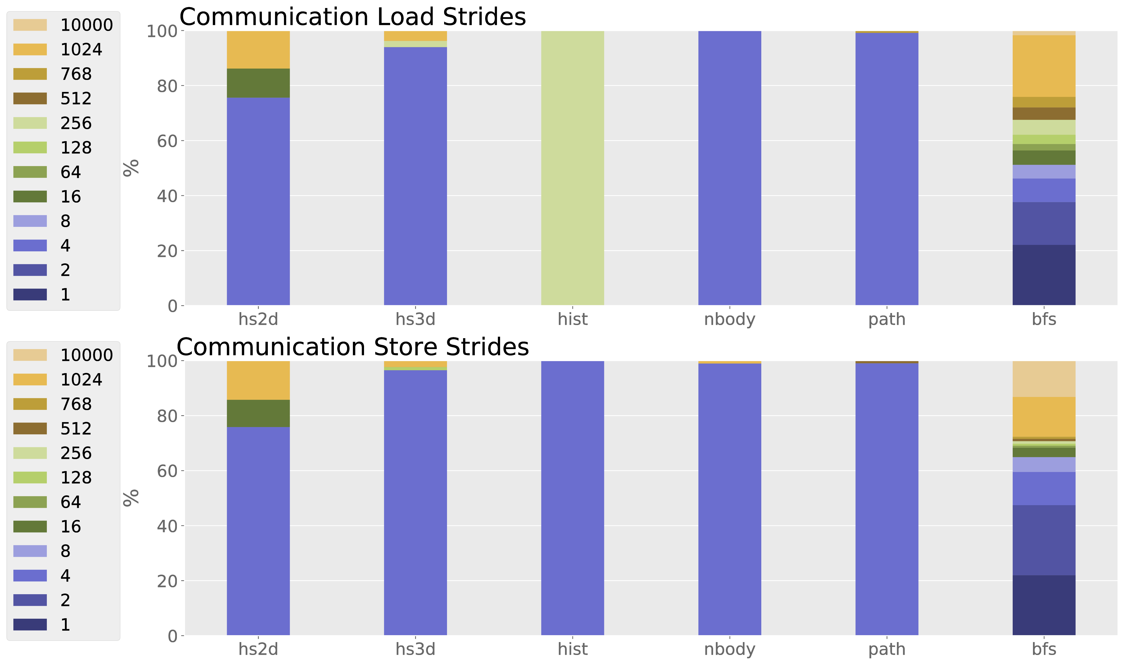
Analysis T1 – Load/Store Strides

