Slide 1

How to set up your PC motherboard
By Daniel Lam (40248073)
ENTER

Slide 2



01.
INTRODUCTION
01
02
03
04
Some things you should know beforehand…

Slide 3
Definitions
Main ones being…
CPU: Acronym for Central Processing Unit
RAM: Acronym for Random Access Memory
Motherboard: printed circuit board containing the principal components of a computer or other device
CPU Slot: location on the motherboard where you can put in your CPU
Latch: allows to hold your CPU in place
01
02
03
04

Slide 4
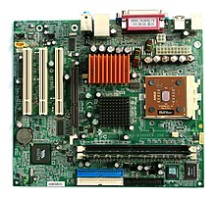
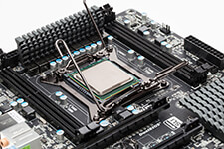
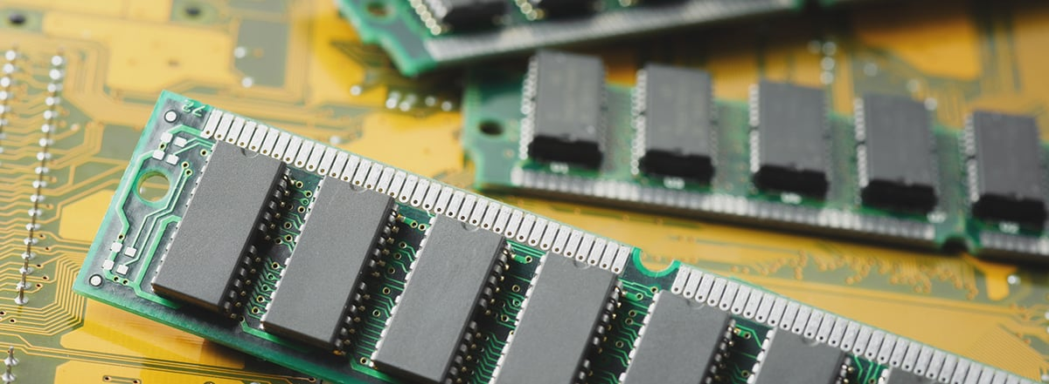
Required Materials
01
02
Figure 1 [1]
Figure 2 [2]
Figure 3 [3]
03
Motherboard
CPU
RAM
04
Printed circuit board containing the principal components of a computer
Primary component of a computer that processes instructions
Temporary memory bank where your computer stores data it needs to retrieve quickly

Slide 5
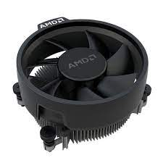
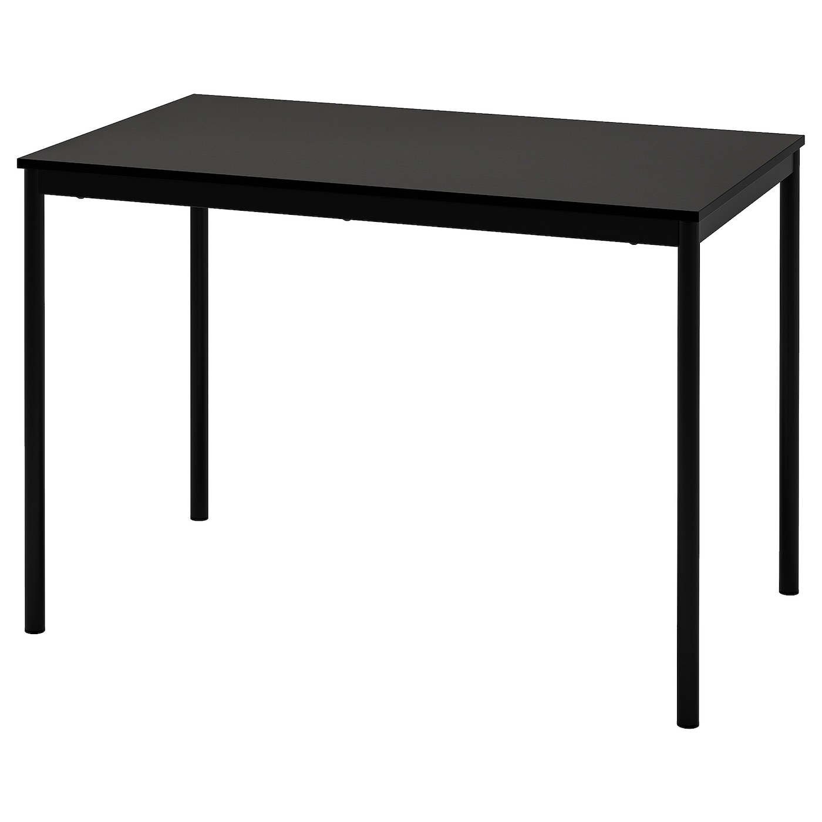
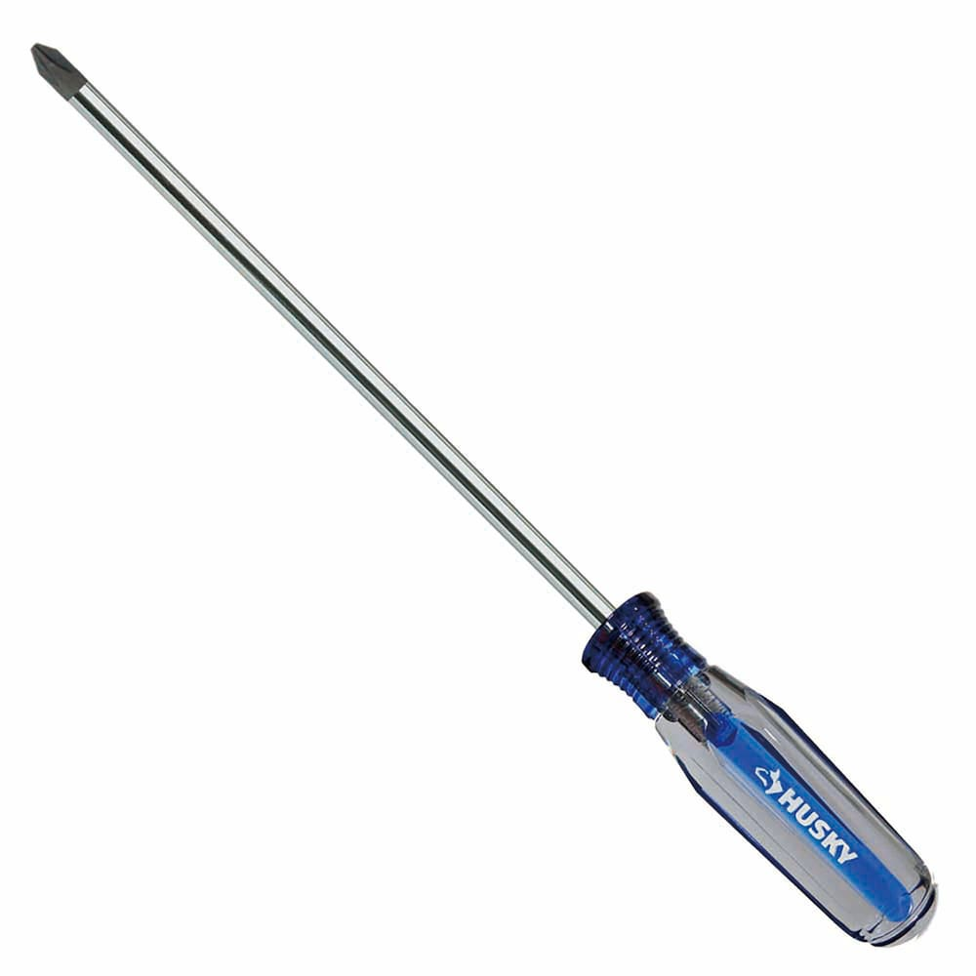
Required Materials
01
02
Figure 4 [4]
Figure 5 [5]
Figure 6 [6]
03
CPU Fan/Cooler
Screwdriver
A Flat Surface
04
To screw the bolts of the CPU fan
Draws heat away from the CPU chip
Flat place to install the components (table, desk, etc…)

Slide 6
Required Materials
01
02
Figure 4 [4]
Figure 5 [5]
03
Screwdriver
A Flat Surface
04
To unscrew the bolts of the CPU slot (optional)
Flat place to install the components (table, desk, etc…)

Slide 7


!!! CAUTION & RISKS !!!
1. Incompatible motherboard & CPU
Not all motherboards and CPU are compatible with each other!
Make sure to verify on the manufacturer’s website or use PCPartPicker.com!
Two common brands of CPU: AMD and Intel
01
02
03
04
Figure 7 [7]
Figure 8 [8]

Slide 8
02.
Building
01
02
03
04
Steps to set up the motherboard

Slide 9
Step 1
Opening up the latch of the CPU slot
Open up the latch of the CPU slot so we can insert the CPU
Put pressure on the lever to release it
01
02
03
04

Slide 10
Step 2
Insert the CPU into the CPU slot
Align the triangle on the corner of the CPU with the corner of the CPU slot
Gently place the CPU into the CPU slot
01
02
03
04

Slide 11
!!! CAUTION & RISKS !!!
2. Fragile Pins
The CPU contains pins under it that are very fragile and can easily bend
Be VERY careful as if one of the pins break, the motherboard will no longer work
Grab the sides of the CPU with both thumb and index fingers and do not force the CPU into the CPU slot if it does not fit
01
02
03
04

Slide 12
Step 3
Close the lever to tighten the CPU into the CPU slot
Align the triangle on the corner of the CPU with the corner of the CPU slot
Gently place the CPU into the CPU slot
Close the lever (don’t be afraid to put a bit of force onto the lever)
01
02
03
04

Slide 13
Step 4
Insert the RAM into the RAM slots
Open up the RAM slots located on the motherboard
RAM must face right way (should easily fit into the slot)
Close up the RAM slots
01
02
03
04

Slide 14
!!! CAUTION & RISKS !!!
3. Which RAM slot should I use?
If you’re using only one RAM stick, make sure to check your manufacturer manual to know which RAM slot to insert your RAM stick!
Otherwise, it might cause some unexpected behaviour
If you have enough RAM sticks to fill in all the slots, you can skip this warning
01
02
03
04

Slide 15
Step 5
Insert the CPU fan on top of the CPU
Align the screws of the CPU fan with its respective slots around the CPU slot
Use your screwdriver to tighten the CPU fan on the CPU (you can screw diagonally to not put too much pressure on one side)
Connect your CPU fan to the motherboard
01
02
03
04

Slide 16
03.
Conclusion
01
02
03
04
Thank you for listening!

Slide 17
References
01
[1] Wikipedia, July 28th, https://en.wikipedia.org/wiki/Motherboard
[2] TechTerms, July 28th, https://techterms.com/definition/cpu
[3] Avast, July 28th, https://www.avast.com/c-what-is-ram- memory#:~:text=RAM%20stands%20for%20random%20access,it%20n eeds%20to%20retrieve%20quickly.
[4] The Home Depot, July 28th, https://www.homedepot.ca/product/husky-2-x-8-inch-phillips- screwdriver-with-acetate-handle/1000842507
[5] Amazon, July 28th, https://www.amazon.ca/Stealth-Connector- Aluminum-Heatsink-3-93-Inch/dp/B079PZWX2L
02
03
04

Slide 18
References
[6] IKEA, July 28th, https://www.ikea.com/ca/en/p/sandsberg-table-black- s29420393/
[7] WikiMedia, July 28th, https://commons.wikimedia.org/wiki/File:AMD_Logo.svg
[8] WikiMedia, July 28th, https://commons.wikimedia.org/wiki/File:Intel_logo_%282006- 2020%29.svg
01
02
03
04

