Slide 1
GifHub
By the Bro-grammers

Slide 2
Brief - Overview
This project is about developing a social media application named "GifHub" by the team Bro-grammers.
This interactive platform aims to connect people by allowing them to create profiles, post updates on their walls, and interact with each other via likes and comments.

Slide 3
Brief - MVP
* User Profiles: Allows users to create and manage their own profiles, showcasing their personal details, interests, and activities
* View Profiles: Users can view other profiles to learn more about their friends and people they follow.
* Post Updates: Users can share updates, thoughts, and experiences by posting on their wall.
* View All Posts: A feature that enables users to view all recent posts from the people they follow on their feed.
* View Specific User's Posts: Users can go to specific profiles and view all their posts.
* Edit Posts: Users can edit their posts after publishing if required.
* Interactions: Users can connect with each other by liking and commenting on posts through gifs, fostering a sense of community and interaction.

Slide 4
Brief - Extensions
* Spotify API Integration: This will allow users to choose and share their favourite songs on their profiles or posts, adding a unique touch to user interactions.
* Search Bar: A feature to help users quickly find and connect with friends, discover posts, music, and much more.
* Friendship Feature: This will allow users to add friends, which will improve the social aspect of the app and make it easier to keep up with friends' activities.
* Authentication: A secure user login and authentication feature to ensure data privacy and security.

Slide 5
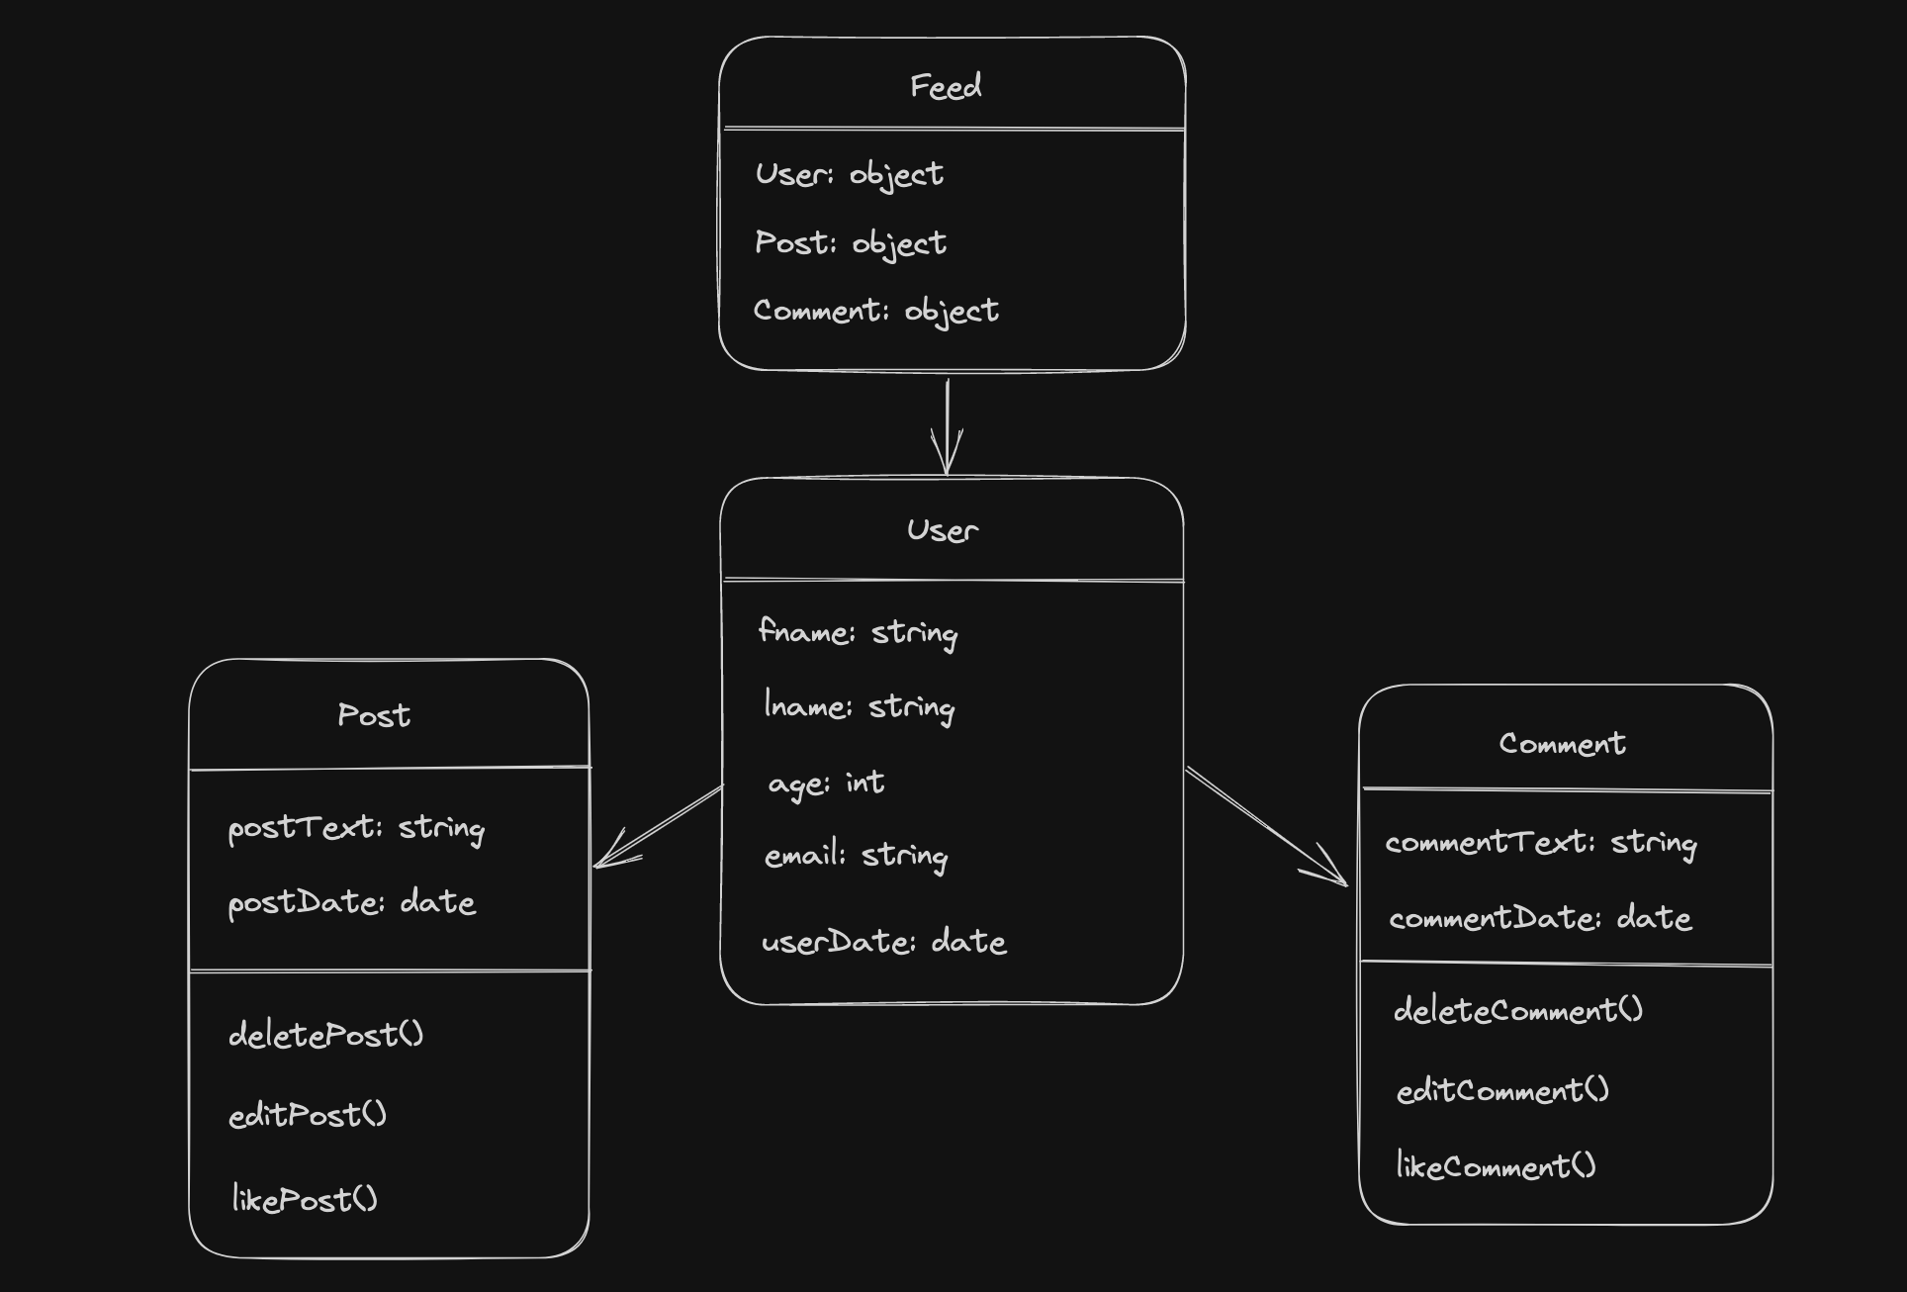
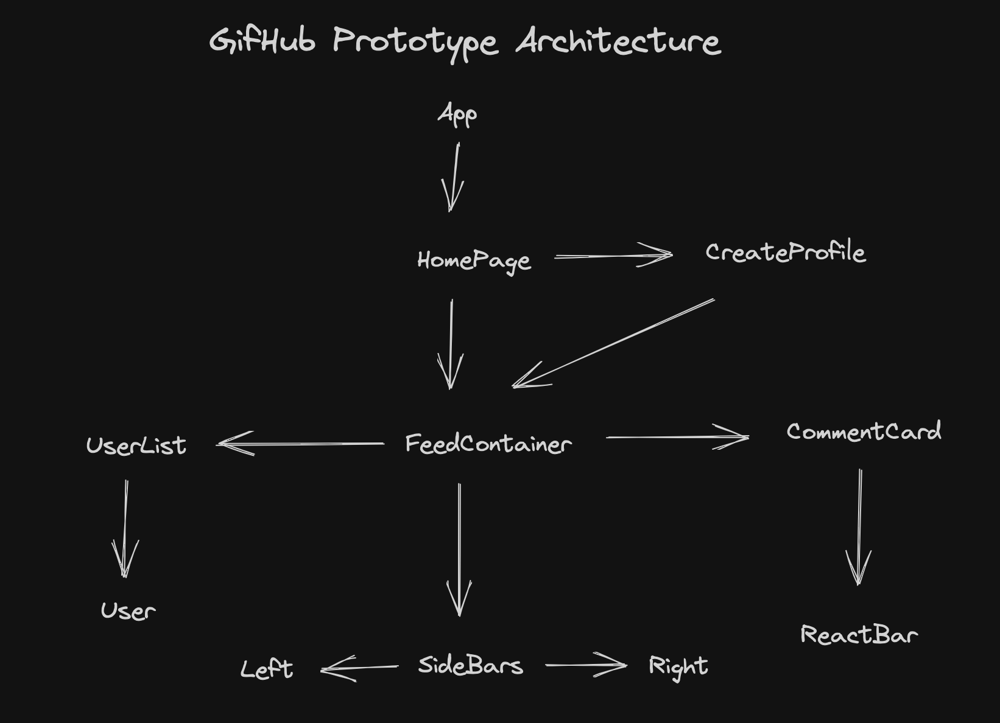
Design - Diagrams

Slide 6
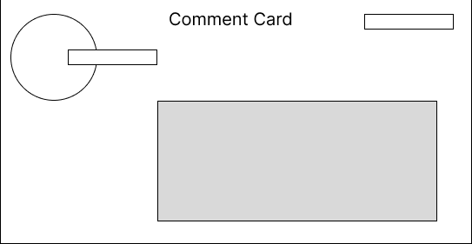
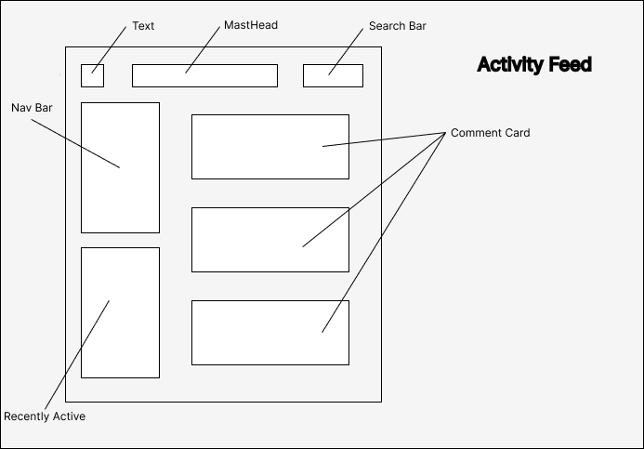
Wireframes

Slide 7
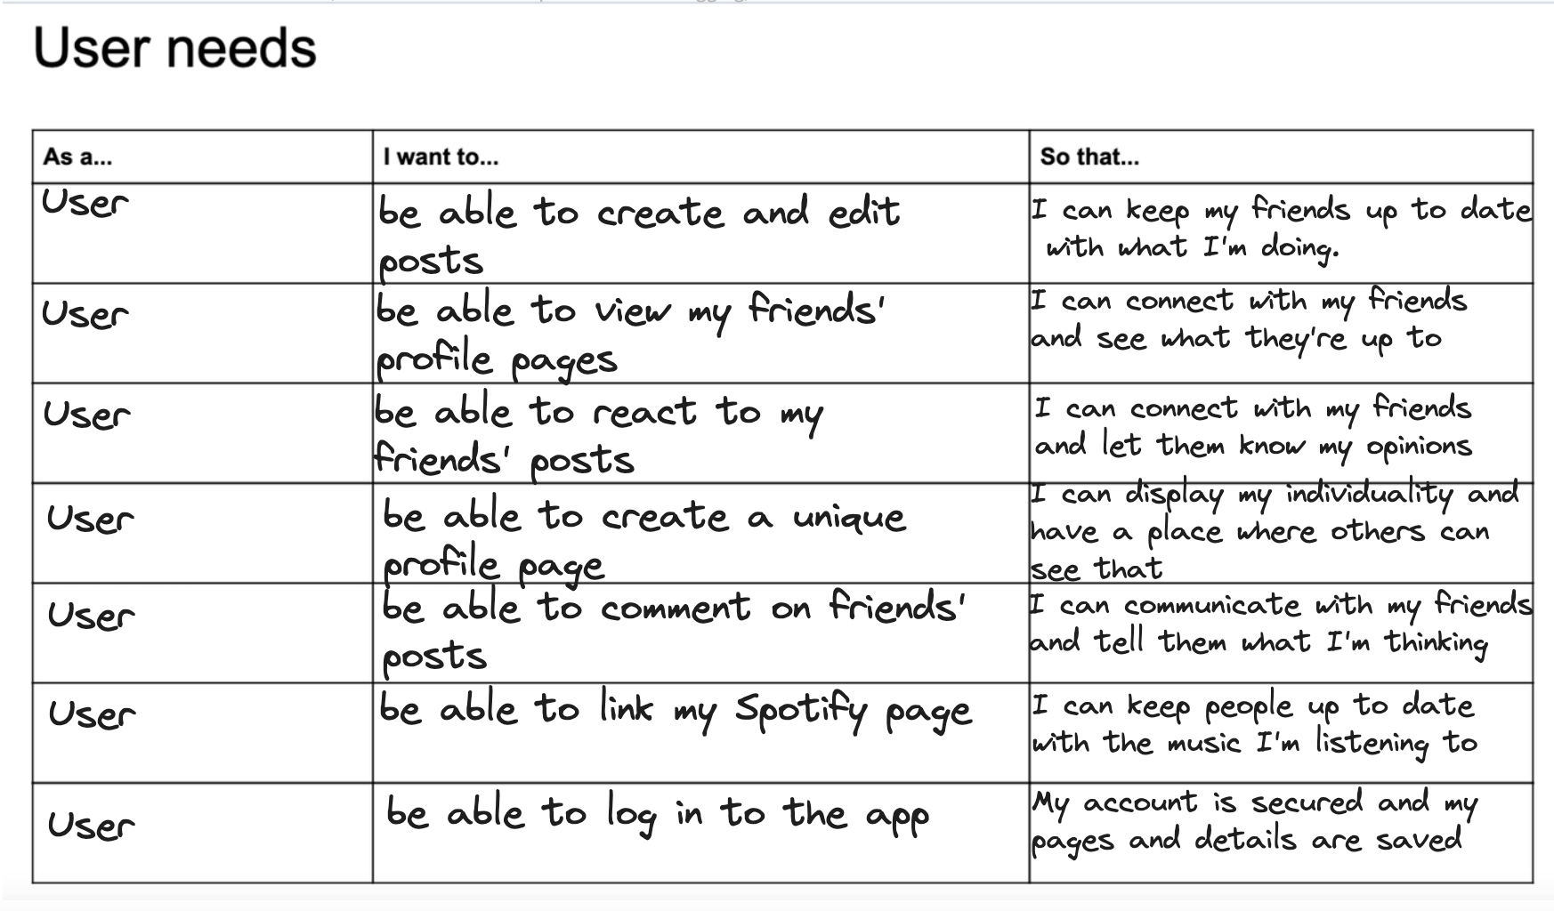
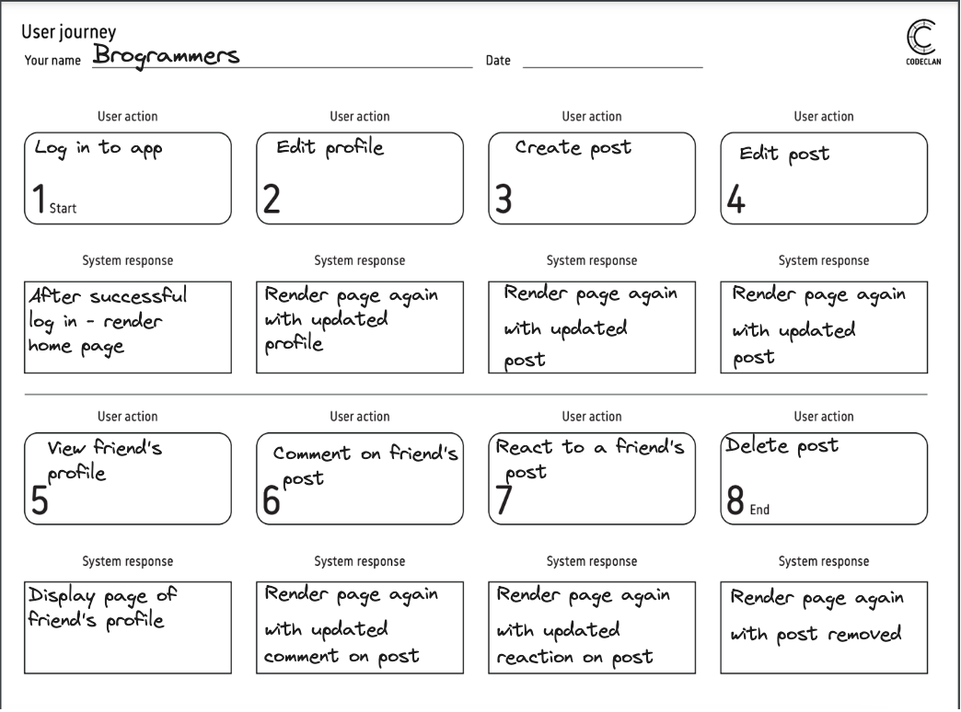
Design - User Diagrams

Slide 8
Challenges
Gifpicker
Setting up Mongodb
Relationship between posts, comments and users.
Css
Organisation & availability (over the weekend esp…)

Slide 9
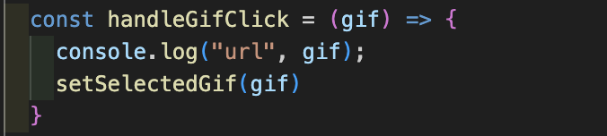
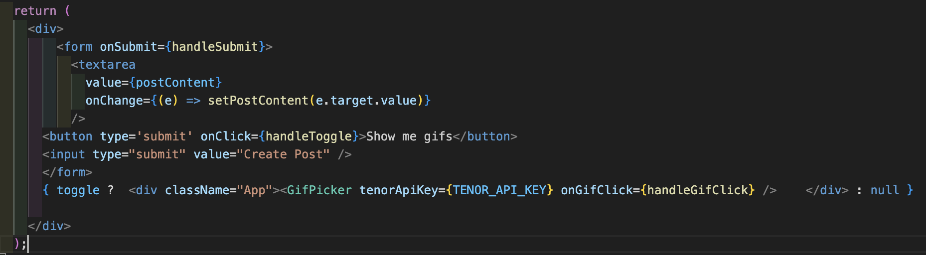
Code we’re proud of!

