Slide 1
Parameter Passing - Matrix Multiplication
Gary Machorro, Lam Lieu, Juan Vera, Brandon Prak

Slide 2
Abstract
Explore and compare different parameter passing methods in different languages
Java, Python and C++
By writing a program that multiplies large matrices, we can:
compare several aspects of performance
compare language specific properties of parameter passing.

Slide 3
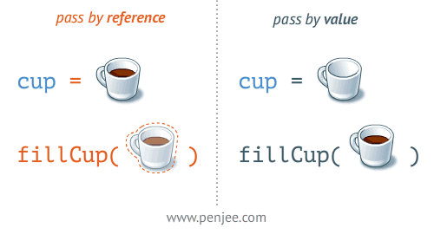
Introduction
Two main passing methods
Pass By Value
Pass By Reference
Java - pass by value
Python - call by object
C++ - pass by value and pass by reference

Slide 4
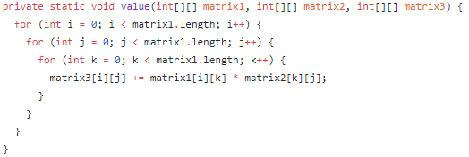
Methods/Algorithms/Concepts - Java
Pass By Value

Slide 5
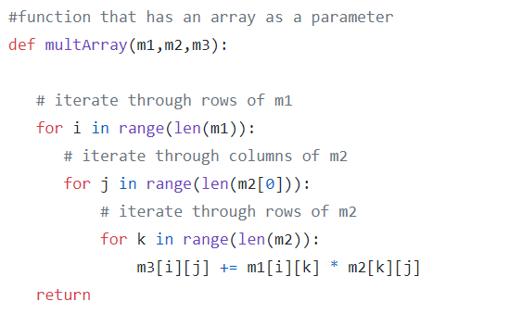
Methods/Algorithms/Concepts - Python
Pass By Object

Slide 6
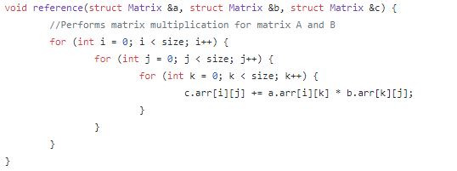
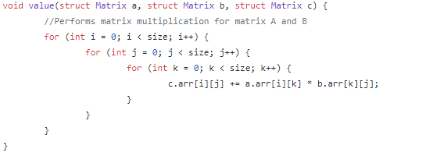
Methods/Algorithms/Concepts - C++
Pass By Reference
Pass by Value

Slide 7
Experiments
Measure time and memory spent running algorithm
Starting at size 200, incrementing by 200 each iteration
Disregard initializations and setups for each iteration
Create comparison graphs
Find averages via multiple samples
Time vs. Size, Memory vs. Size

Slide 8
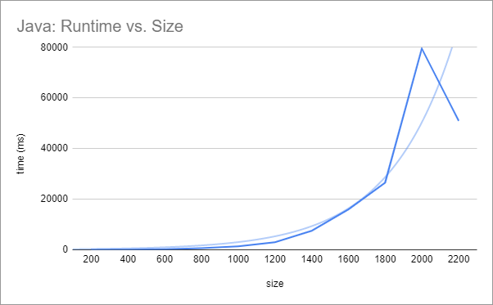
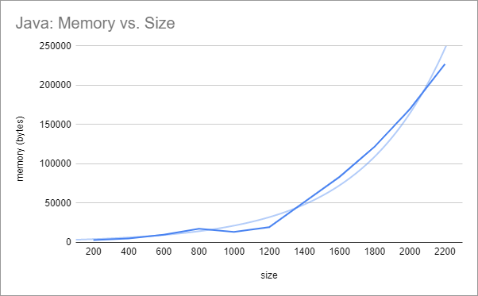
Results - Java

Slide 9
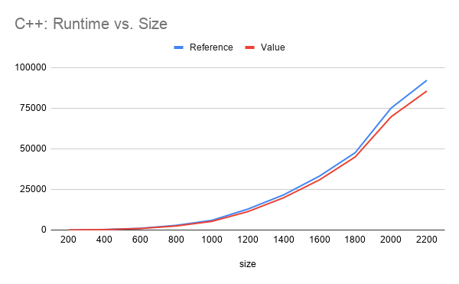
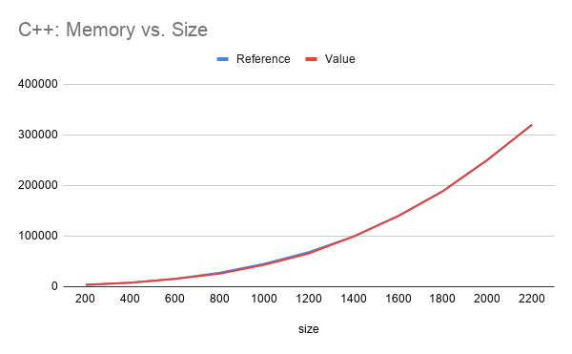
Results - C++

Slide 10
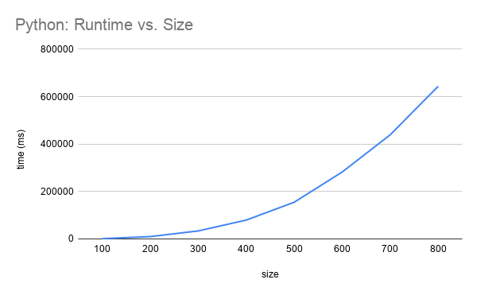
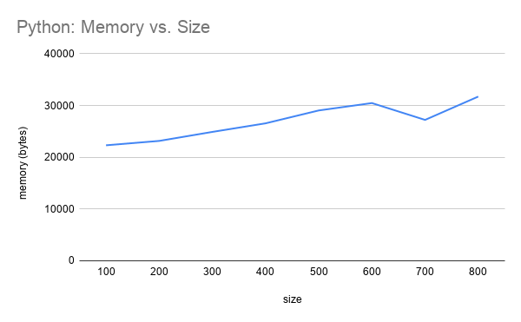
Results - Python

Slide 11
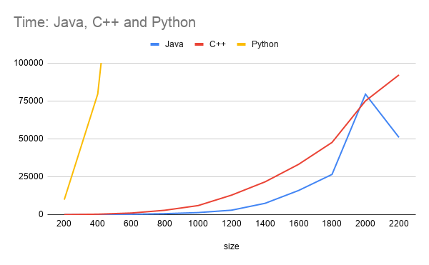
Results Comparison

Slide 12
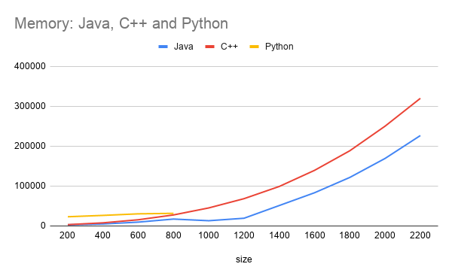
Results Comparison (cont’d)

Slide 13
Future Work
Improve Precision
More samples for average
Better methods to get memory usage
Test on multiple desktops
More accurate averages
Figure out spikes in Java data

Slide 14
Conclusion
Passing Parameters methods have little to no effect on memory/time when performing matrix multiplications
Passing by value preferred so that data is more secure
Java’s time/memory is most likely to fluctuate
Garbage Collector
Python cannot handle large matrices multiplication
C++ has steadiest growth and data
Difficult to implement C++ Matrix Multiplication via pass by value

