Slide 1

Partisen：Scalaing the Distributed Actor Runtime
Christopher S.Meiklejohn and Healther Miller Peter Alvaro
Carnegie Mellon University US Santa Cruz
汇报人：吴泽
学号：M201973263
日期：2019.10.18

Slide 2
1
Background
目录
2
Design&Implemantation
3
Experiments&Results
4
Conclusion
5
Thanks

Slide 3
1
Background

Slide 4


Distributed Actors

Slide 5
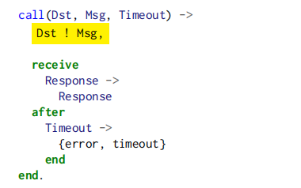
Programming Model
Actor creation
Pid = spawn(fun() -> call(otherPid,message,1000) end)

Slide 6
Executive Summary
We're going to look at how we can improve distributed actor systems considering their two limitations.
Scalability Latency
We're going to increase scalability by growing clusters to larger numbers of nodes and reduce latency by leveraging available bandwidth
We'll achieve this with minimal modifications to the programming model and at the library level without requiring runtime system modifications

Slide 7
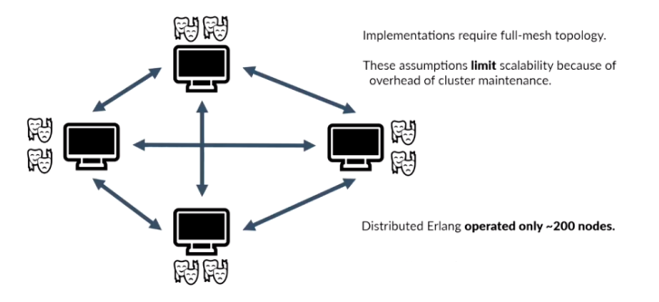
Limitations:Scalability

Slide 8
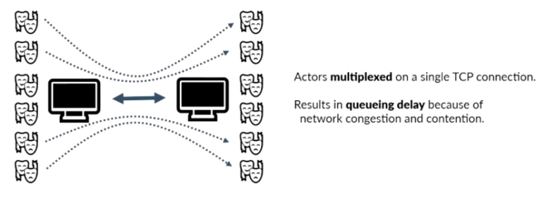
Limitations:Latency

Slide 9
2
Design&Implemention

Slide 10
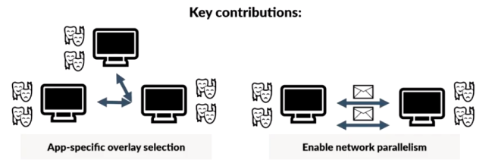
Partisan
System designed to remove assumptions made by current implementations
Provided as a library to be extensible and able to be leveraged immediately

Slide 11
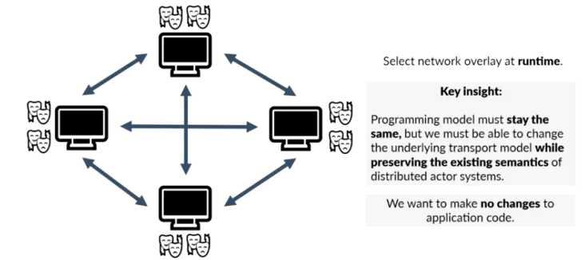
Dynamic Overlay Selection

Slide 12
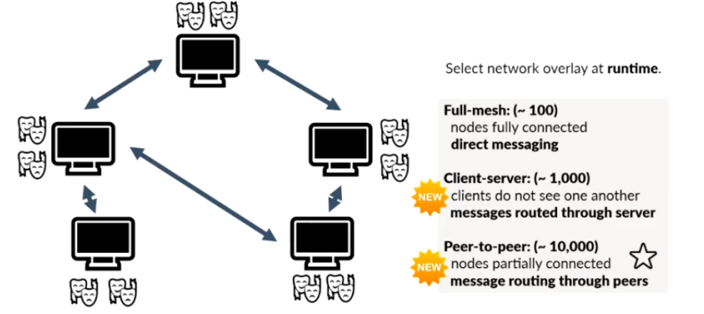
Dynamic Overlay Selection

Slide 13
Partisan
System designed to remove assumptions made by current implementations
Provided as a library to be extensible and able to be leveraged immediately

Slide 14
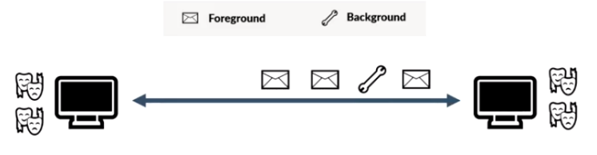
Parallelism

Slide 15
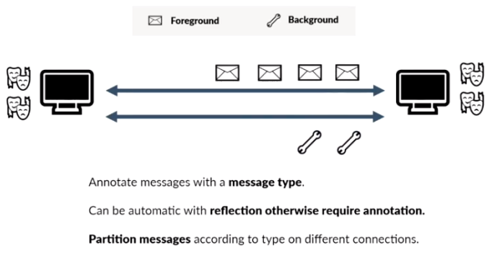
Named Channels

Slide 16
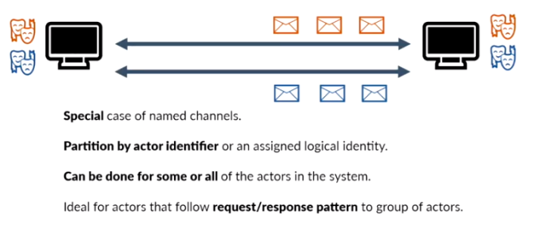
Affinitized Parallelism

Slide 17
3
Experiments&Results

Slide 18


Experiments

Slide 19
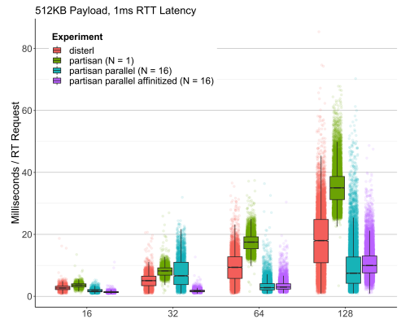

Reducing Latency:Microbenchmarks
Point to point
messaging between pairs of
actors located on different
nodes,1ms RTT latency

Slide 20
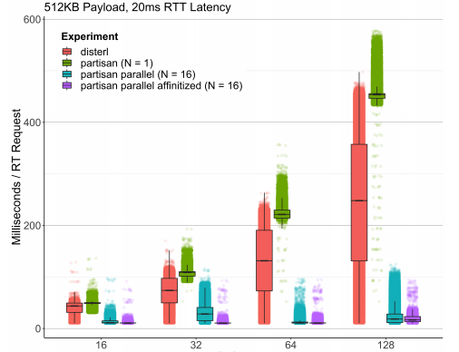
Reducing Latency:Microbenchmarks
Point to point
messaging between pairs of
actors located on different
nodes,20ms RTT latency

Slide 21

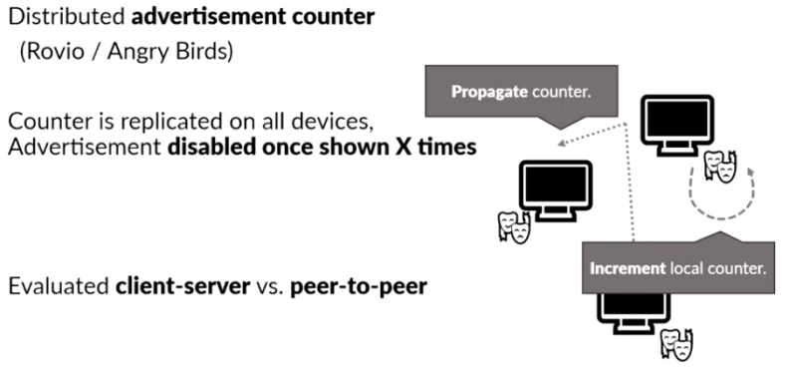
Evaluating Scalability

Slide 22
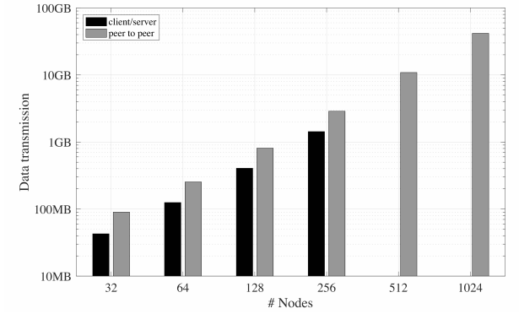
Increasing Scalability

Slide 23
4
Conclusion

Slide 24
Conclusion
PARTISAN：an alternative runtime system for improved scalability
and reduced latency in actor applications.
higher scalability: allowing the application developer to specify the network overlay
reduces message latency :a combinationof three predominately automatic optimizations
·parallelism
·named channels
·affinitized scheduling.

Slide 25
Thanks

