Slide 1

MOOMOOBANK APPLICATION
Truong Dang Truc Lam – B2111933
Le Xuan Thanh – B2111952

Slide 2
Contents:
1. Funtions
2. Database
3. Interfaces

Slide 3
1. Funtions:
- Sign Up
- Login
- Show/Hide Balance
- Show Information
- Show History Balance Changes
- Internal Transfer
- External Transfer
- Phone Recharge
- Enter PIN
- Change password

Slide 4
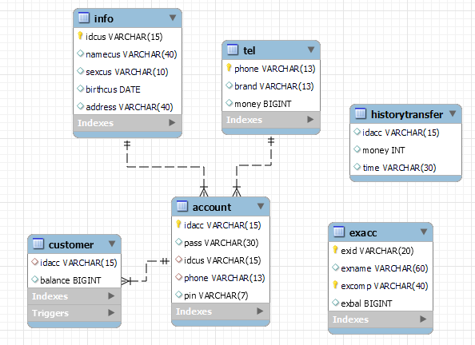
2. Database:

Slide 5
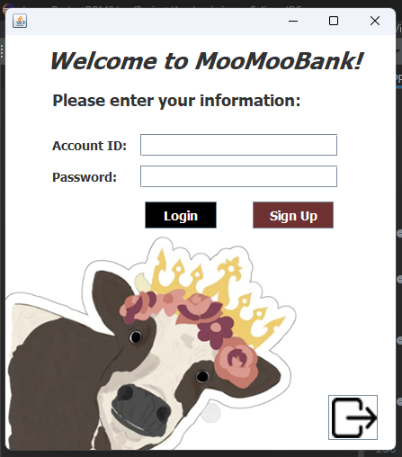
3. Interfaces:

Slide 6
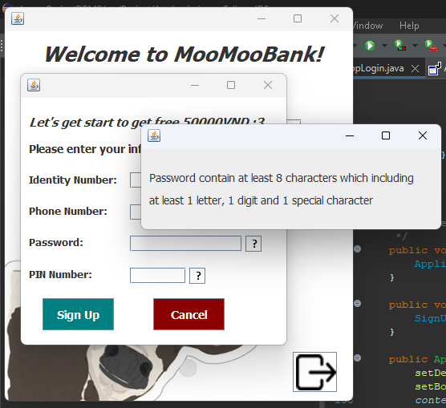
SIGN UP

Slide 7
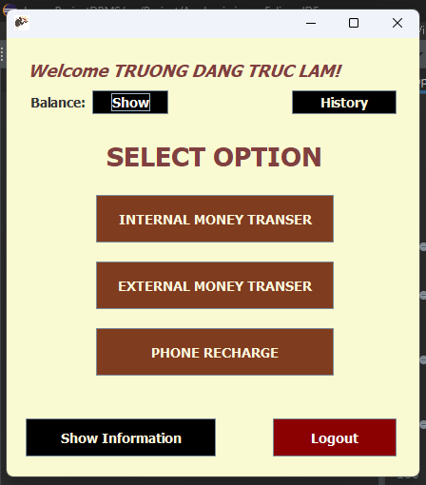
Some options you can make when you log in successfully:

Slide 8
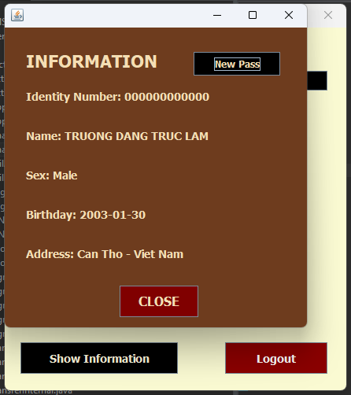
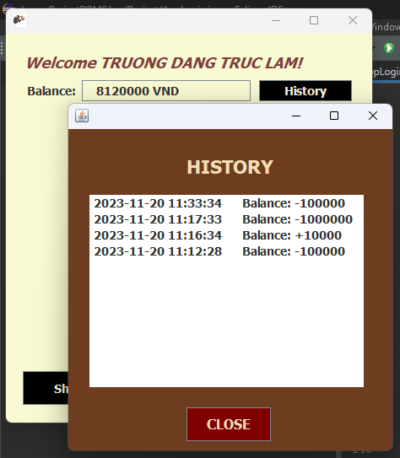
SHOW INFORMATION AND HISTORY

Slide 9
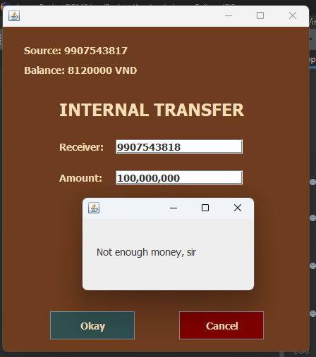
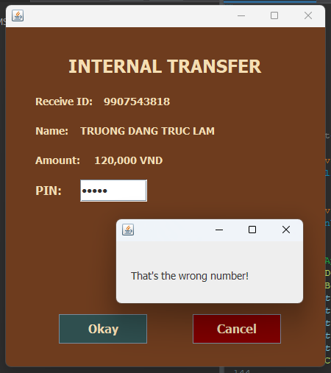
INTERNAL TRANSFER WITH FAILURES

Slide 10
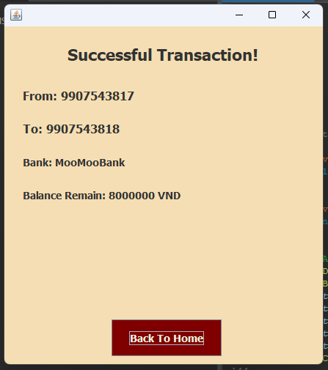
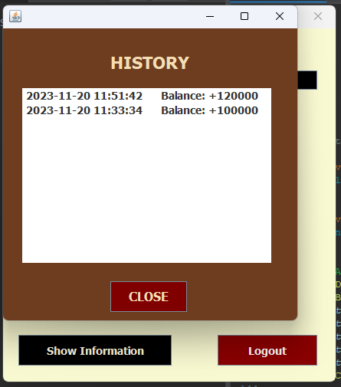
INTERNAL TRANSFER SUCCESSFULLY

Slide 11
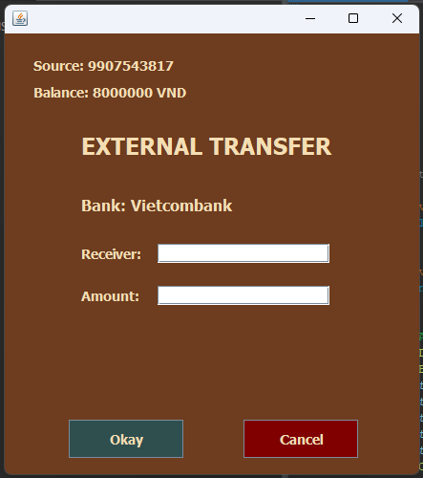
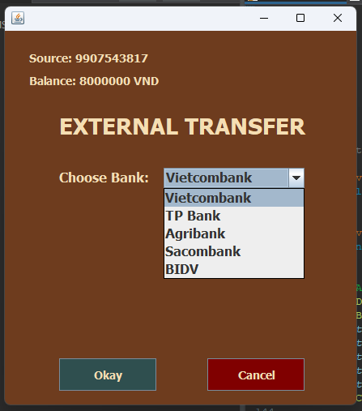
EXTERNAL TRASNFER

Slide 12
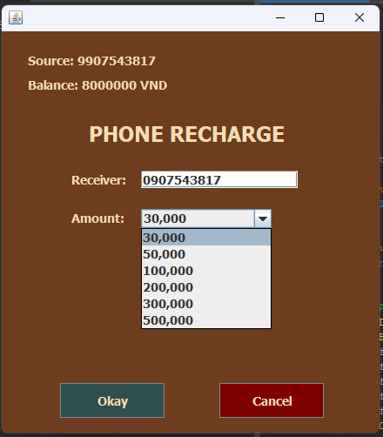
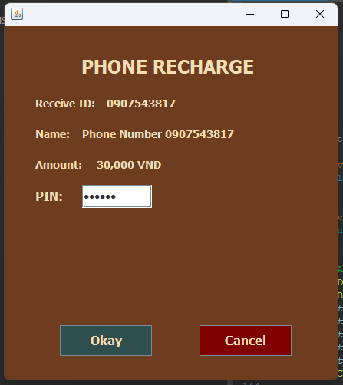
PHONE RECHARGE

Slide 13
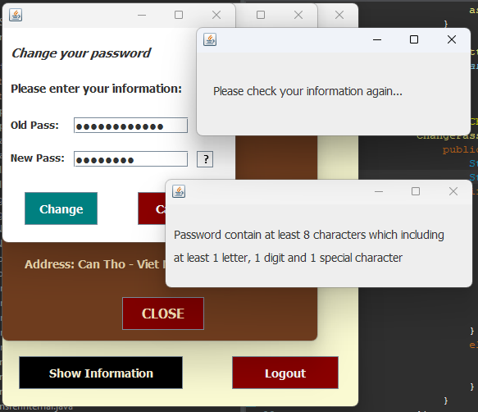
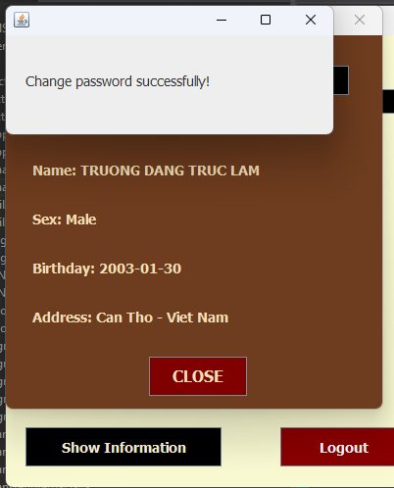
CHANGE PASSWORD

Slide 14
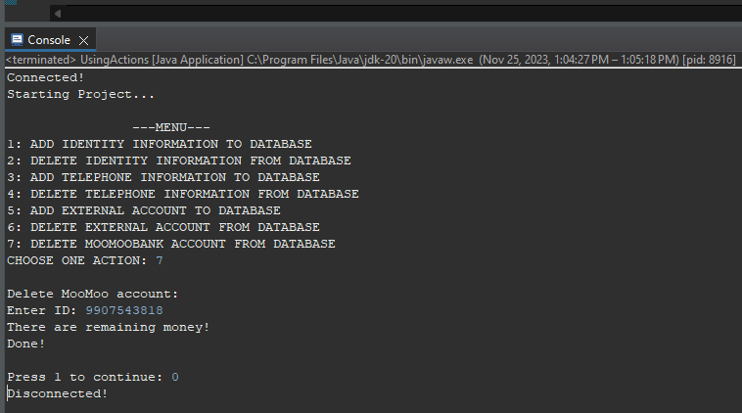
And there more things you can do (on Database):

Slide 15
THANKS FOR YOUR WATCHING

