Slide 1


FACULTY OF COMPUTER ENGINEERING

Slide 2
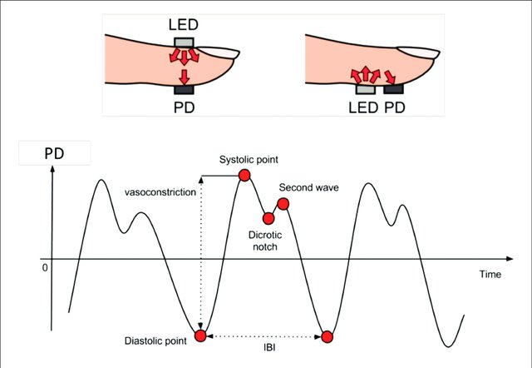
FACULTY OF COMPUTER ENGINEERING

Slide 3
FACULTY OF COMPUTER ENGINEERING

Slide 4
FACULTY OF COMPUTER ENGINEERING

Slide 5
FACULTY OF COMPUTER ENGINEERING

Slide 6
FACULTY OF COMPUTER ENGINEERING

Slide 7
FACULTY OF COMPUTER ENGINEERING

Slide 8
FACULTY OF COMPUTER ENGINEERING

