Slide 1
E-Commerce Trends In Saudi Arabie 2020
Lama Alziyad
T509

Slide 2

What is E-Commerce ?
Ecommerce is the buying and selling of goods and services over the Internet.

Slide 3
Commercial record

Slide 4
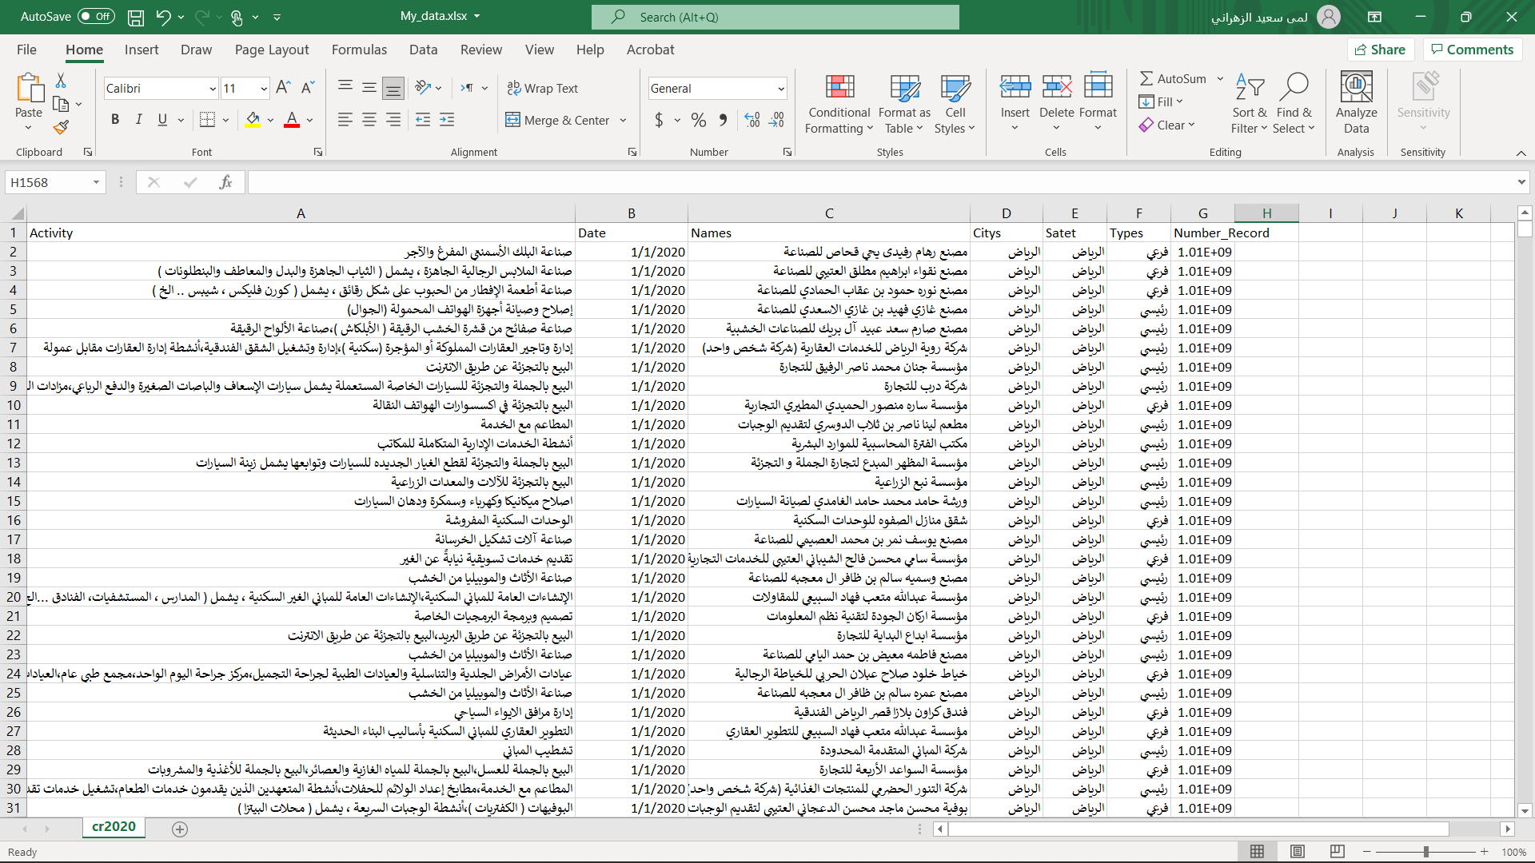

Slide 5
198,176
Commercial Record IN 2020

Slide 6
PROBLEM & QAUSTION
01
PROJECT PROPOSAL
Reduce Saudi market in COVIED-19 which effected to economy in Saudi so that they orientation to digital transformation

Slide 7
PROJECT PROPOSAL
DATA & SOLVE
02
I use date base from Commercial record in 2020 to know how many person orientation to buy online market .
1-What are the most popular cities for e-commerce?
2-Did the Saudis turn to e-commerce at the time of Covid-19?
3-Does Riyadh city have the most start-ups in Saudi Arabia?
Data scource: Open saudi Data.

Slide 8
TOOLS
03
PROJECT PROPOSAL
I use it tools :
Open saudi Data
SQL Coomiend, Python Languges
SQLlite, Jubtyer NootBook
Excel
Python Librarys

Slide 9
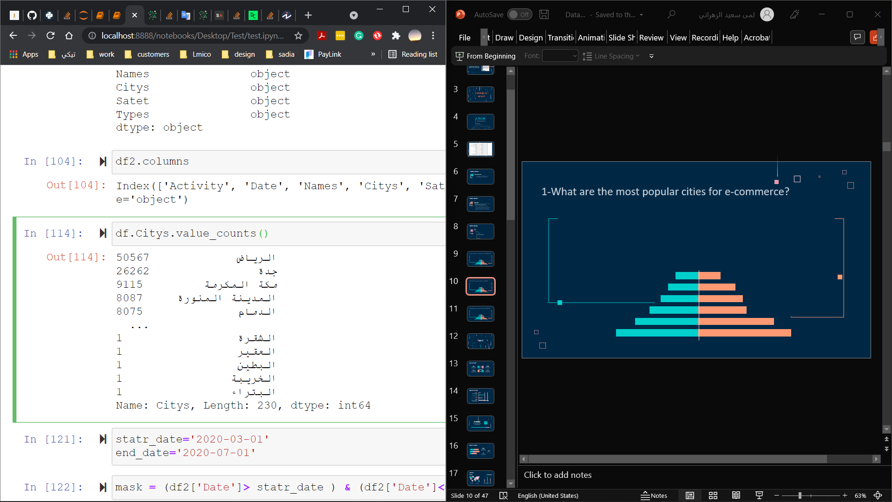
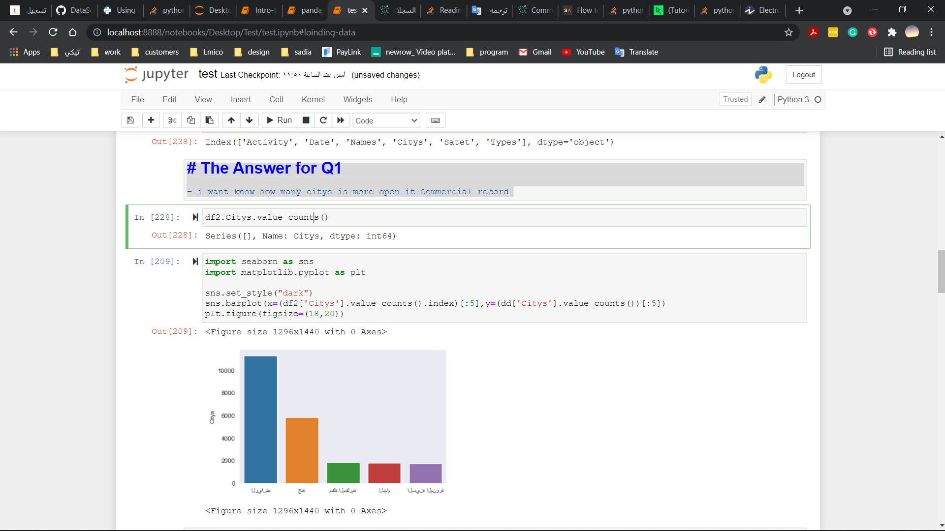
1-What are the most popular cities for Commercial record ?
الرياض
جدة
مكة
المدينة
الدمام

Slide 10
GOALS
Record
2020
Understand the market and the most trade-oriented cities
Notes:
50567

Slide 11
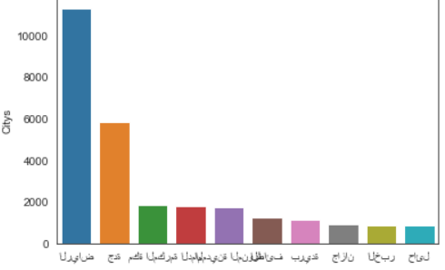
2-Did the Saudis turn to e-commerce at the time of Covid-19?
الرياض
جدة
مكة
المدينة
بريدة
الطائف
جازان
حائل
Notes:
11297

Slide 12
GOALS
E-Commerce
2020
Awareness and education of small cities to e-commerce

Slide 13
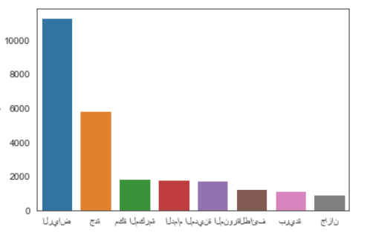
3-Does Riyadh city have the most start-ups in Saudi Arabia?
الرياض
جدة
مكة
المدينة
بريدة
الطائف
جازان
حائل

Slide 14
GOALS
Start- up
2020
Directing investors in the Riyadh region and accelerating business and finance

Slide 15
Benefits
flexible work
Additional income
economy profits
More Jobs

Slide 16
THANKS

