Slide 1
Cardiovascular Disease: prediction
Minakhanim Hajimuradova
Laman Rahimli
RDS102

Slide 2
Outline:
Dataset description
Exploratory Data Analysis & Data manipulation
Feature engineering
Model
Evaluation
Results

Slide 3
Cardiovascular Disease dataset description
Features types:
Objective: factual information;
Examination: results of medical examination;
Subjective: information given by the patient.
70000 values with 12 features

Slide 4
Exploratory Data Analysis
Features types:
Objective: factual information;
Examination: results of medical examination;
Subjective: information given by the patient.
70000 values with 12 features

Slide 5
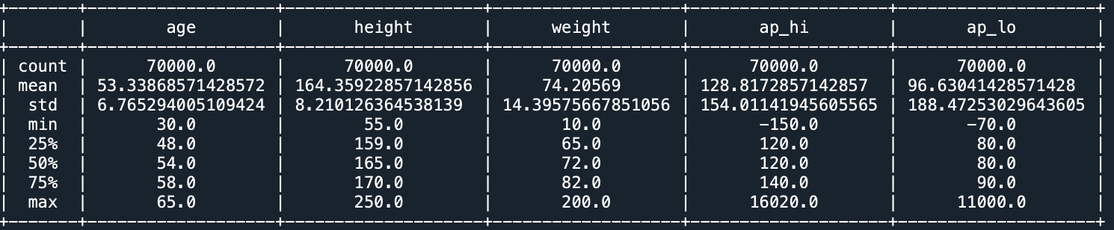
Descriptive statistic of the numerical values
Minimum and maximum height sounds faulty.
Minimum weight is 10, however min age is 29, so it has to be an error
Systolic and diastolic blood pressure can't be negative
Maximum Systolic and diastolic blood pressure seem to be an error
Systolic blood pressure is lower than diastolic one: 1234 rows

Slide 6
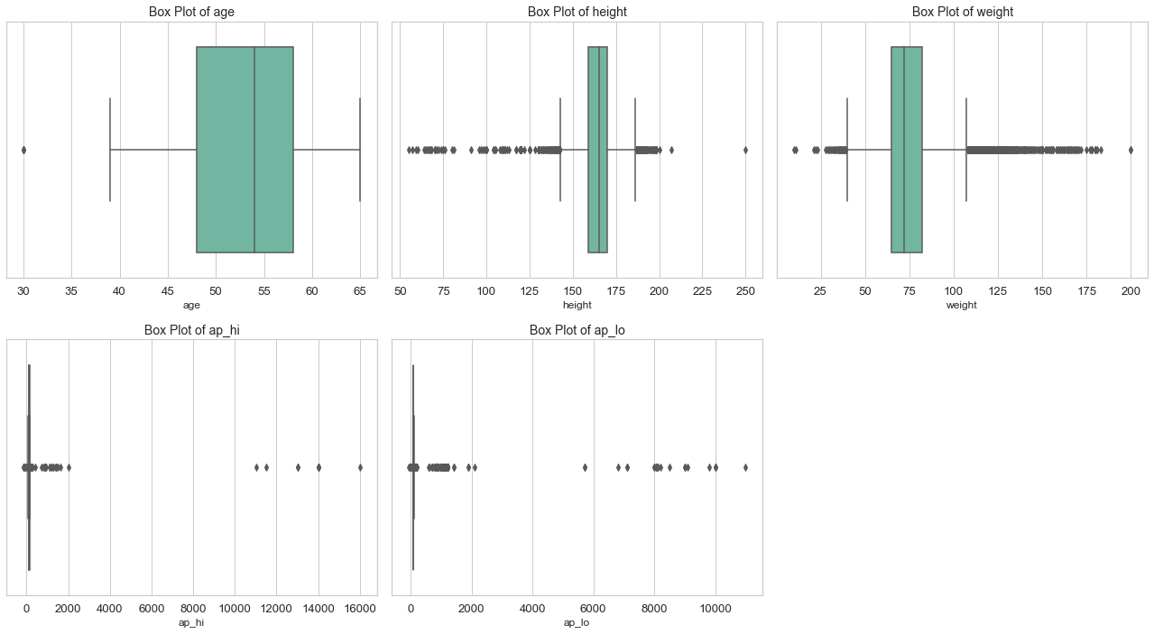
Box plots for numerical values to visualize outliers

Slide 7
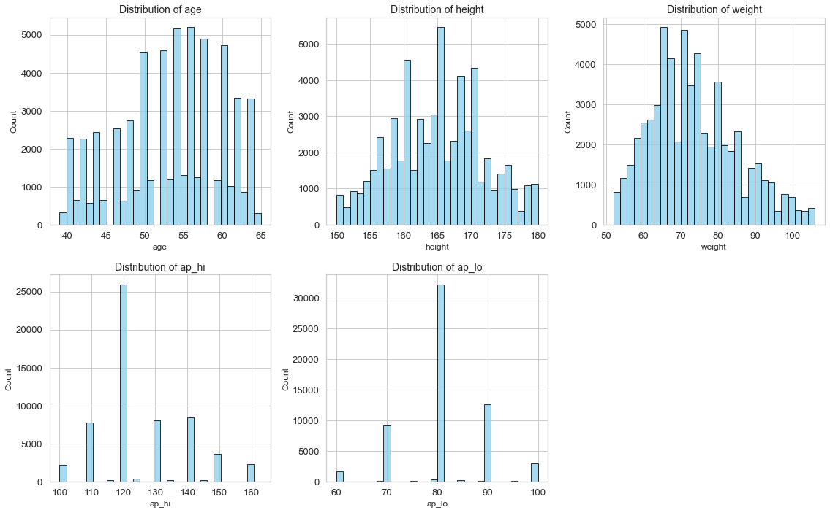
Distribution of the numerical values

Slide 8
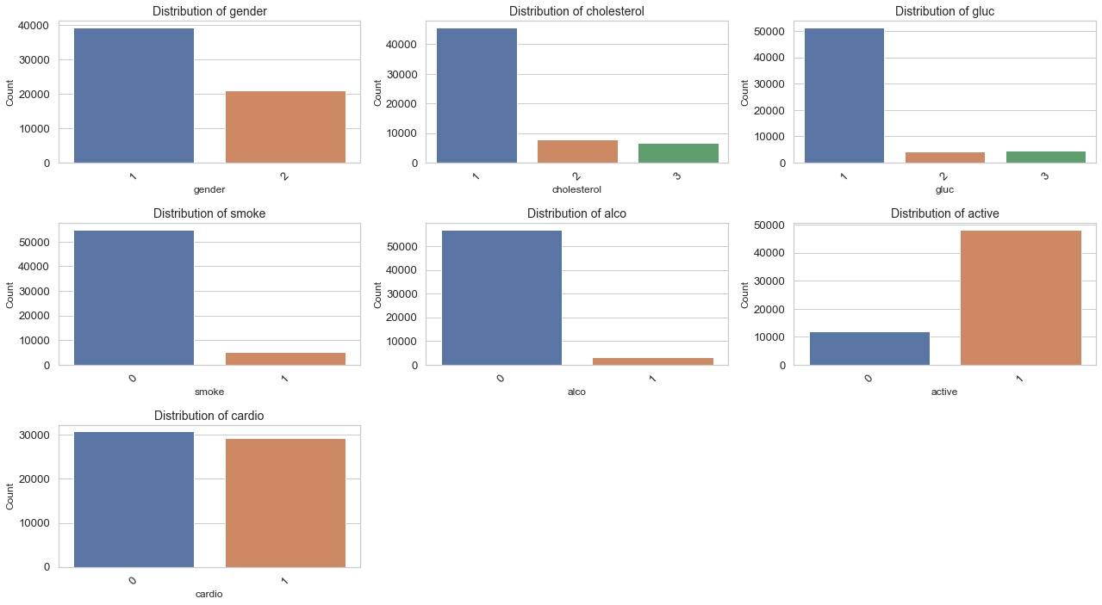
Distribution of the categorical values

Slide 9
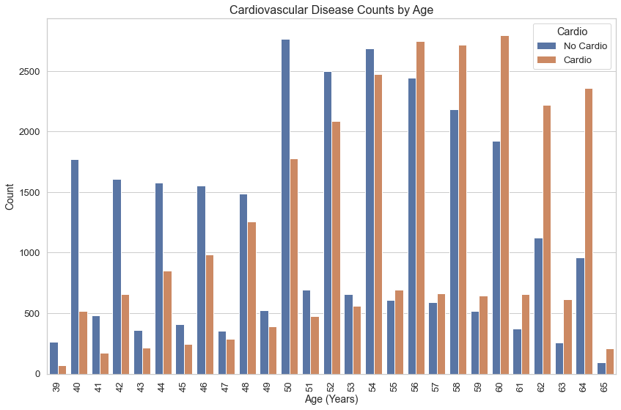
Age by target (cardio) class
It can be observed that people over 55 of age are more exposed to CVD

Slide 10
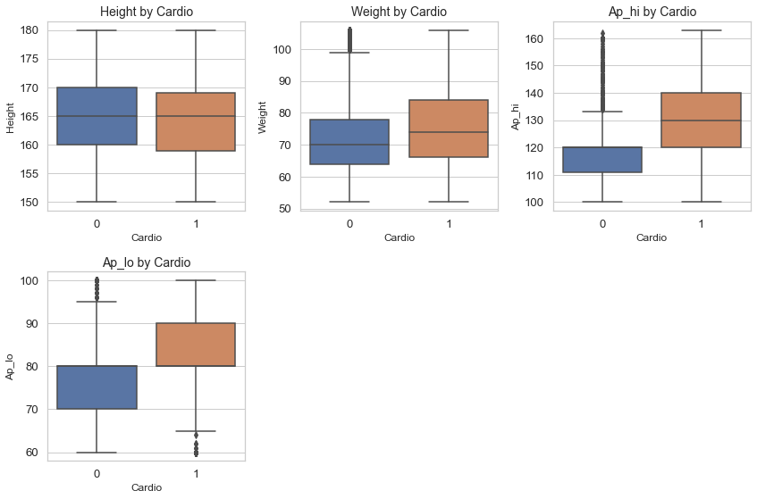
Numerical features by target (cardio) class
Presence of CVD is related to higher weight and higher blood pressure

Slide 11
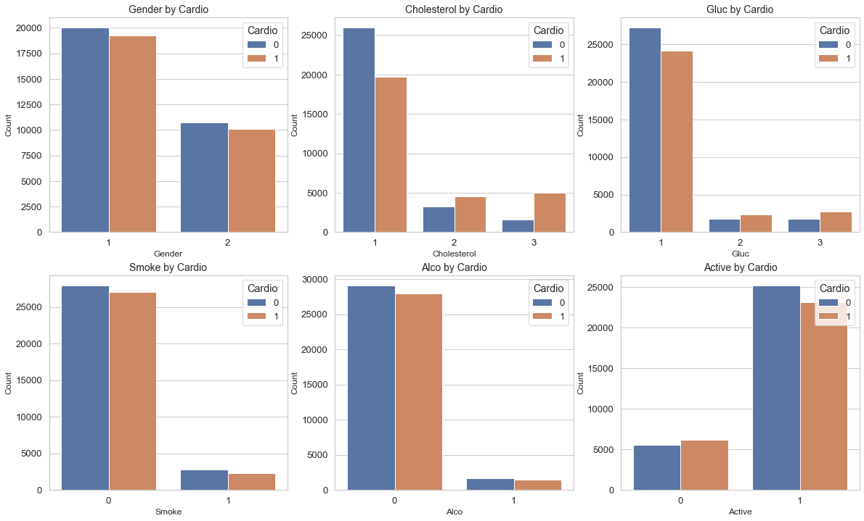
Categorical features by target (cardio) class
It can be observed that patients with CVD have higher cholesterol and blood glucose level, and generally, they are less active.

Slide 12
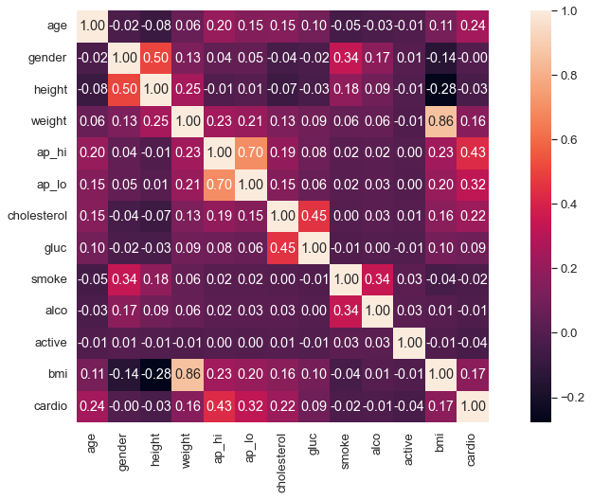
Correlation matrix
ap_hi has the maximum correlation with target value
bmi has slightly more correlation with target than height and weight
gender is the least correlated feature

Slide 13
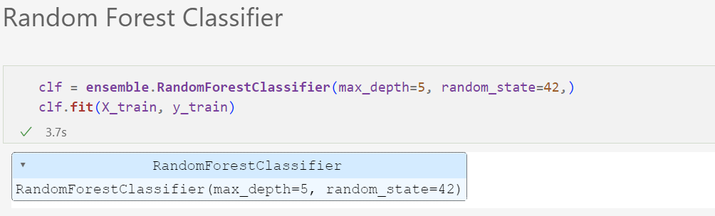
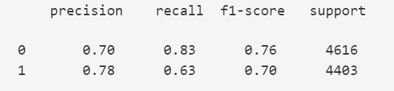

Slide 14
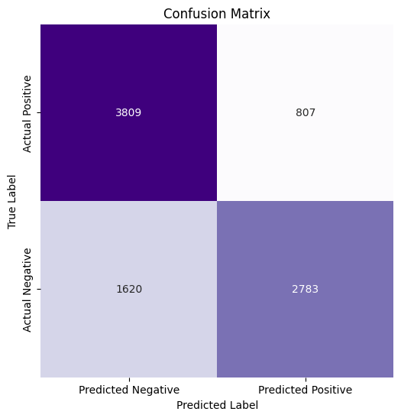
3809 => Model said not cardio, but cardio
807 => Model said cardio, really cardio
1620 => Model said not cardio, really not cardio
2783 => Model said cardio, but not cardio

Slide 15
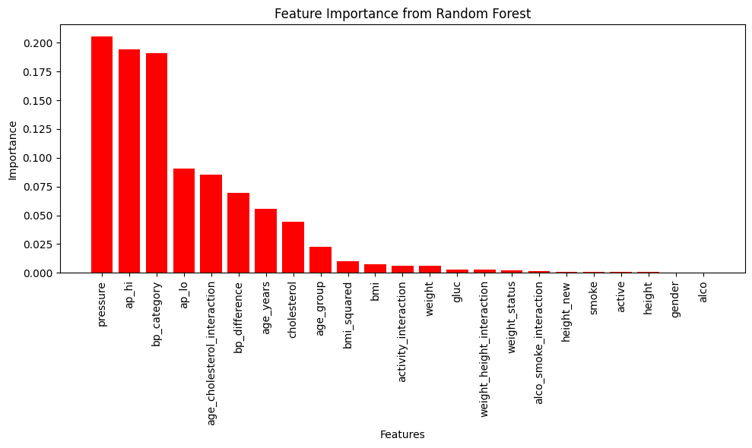
pressure, ap_hi, ap_lo, age_cholesterol_interaction,
bp_difference, age_years, cholesterol, age_group

Slide 16
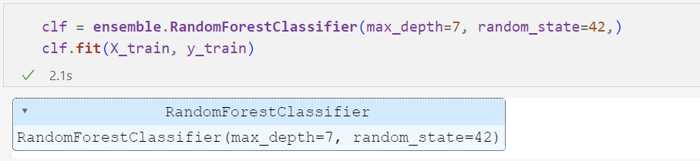
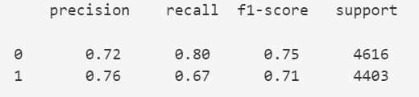

Slide 17
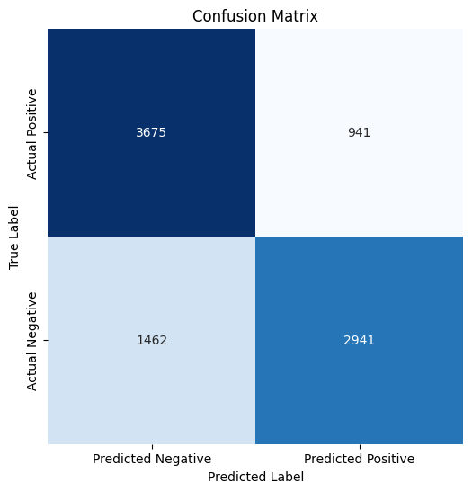
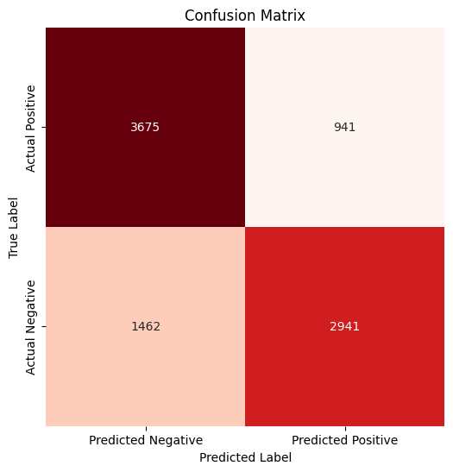
Test
Validation

Slide 18
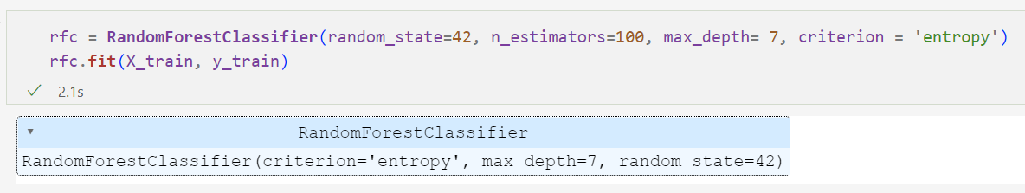
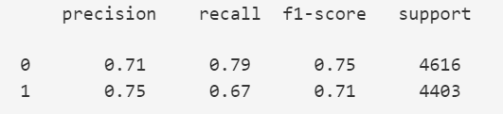
Best Hyper Parameters
{'criterion': 'entropy', 'max_depth’: 7, 'n_estimators': 100}

Slide 19


Test
Validation

Slide 20


