Slide 1


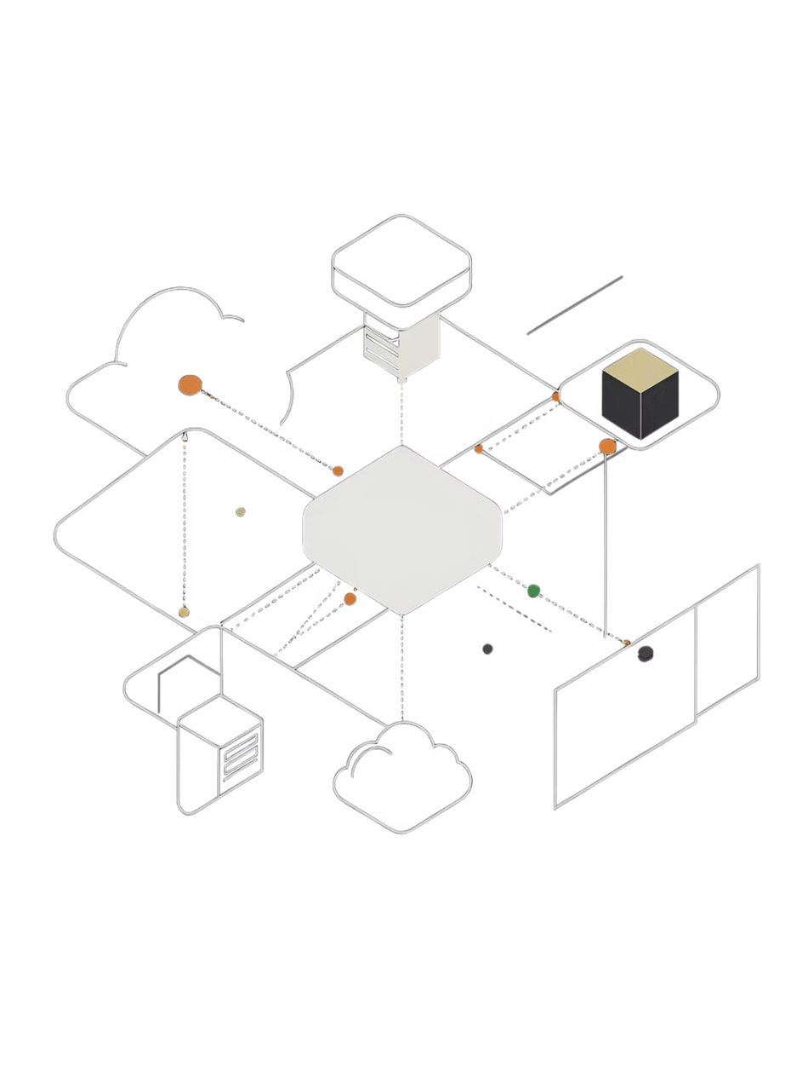


DVSA Vulnerability Discovery & Remediation
Analyze a vulnerable serverless AWS application (DVSA)
Name: Lamar Alshehri ID: 202282400
Find Vulnerabilities, exploit fix & Verify
Basic Workflow: User → API Gateway → Lambda → Database (S3/DynamoDB)
Focus: Cloud security issues in real-world architecture
Notes:
1

Slide 2


LESSON #1
Event Injection: Insecure Deserialization
Issue
Impact
User input treated as executable code
Remote Code Execution (RCE) — full Lambda compromise
Root Cause
Fix
Unsafe library (node-serialize)
Replace with JSON.parse() + strict input validation
Key Lesson: Never treat user input as code
Notes:
2

Slide 3


LESSON #2
Broken Authentication: JWT Signature Not Verified
Issue
Impact
Token payload trusted without signature verification
User impersonation and unauthorized data access
Root Cause
Fix
Only decoding JWT, not verifying the signature
Verify JWT using Cognito public keys
Key Lesson: Authentication = verification, not decoding
Notes:
3

Slide 4
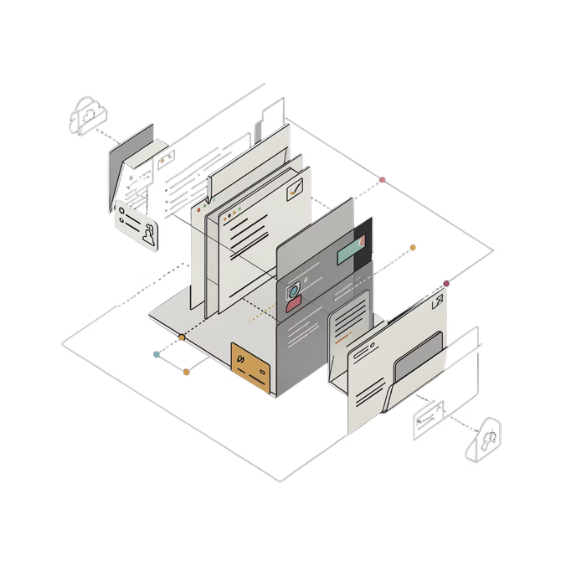

LESSON #3
Sensitive Data Exposure: S3 Data Leakage
Issue
Impact
Unauthorized access to receipt files
Exposure of sensitive user data
Root Cause
Fix
Weak access control on S3 bucket
Restrict access to authorized users only; use secure signed URLs
Key Lesson: Protect storage, not just APIs
Notes:
4

Slide 5
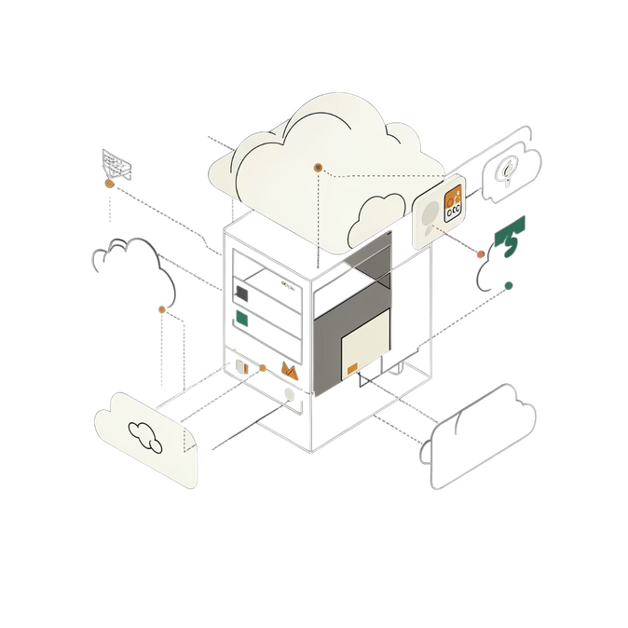
LESSON #4
Insecure Cloud Configuration: Misconfigured S3 Bucket
Issue
Impact
Malicious file uploads allowed
Code execution and backend abuse
Root Cause
Fix
Over-permissive bucket policies
Restrict upload permissions; validate file inputs
Key Lesson: Cloud misconfigurations are a major attack vector
Notes:
5

Slide 6
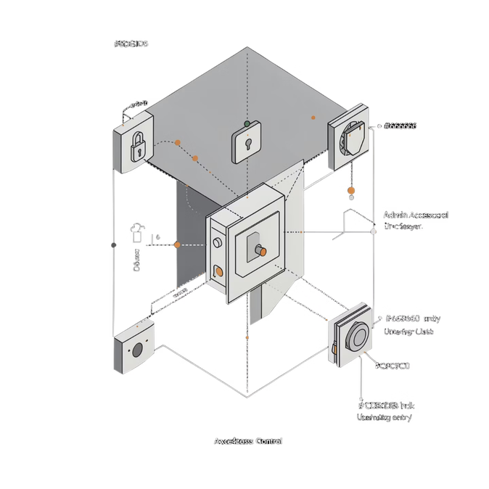
LESSON #5
Broken Access Control: Unauthorized Admin Access
Issue
Impact
Regular users can call admin API endpoints
Modify orders without payment
Root Cause
Fix
Missing authorization checks on endpoints
Implement Role-Based Access Control (RBAC)
Key Lesson: Always enforce authorization on every request
Notes:
6

Slide 7
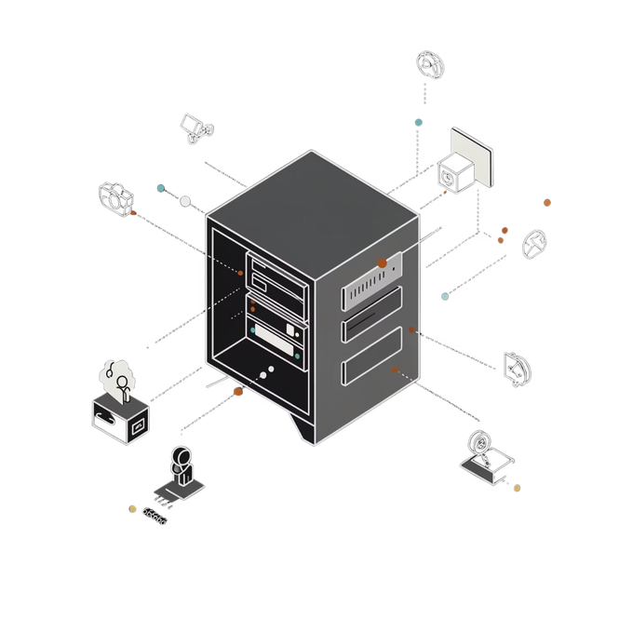
LESSON #6
Denial of Service (DoS): No Rate Limiting
Issue
Impact
Unlimited request flooding allowed
Service becomes unavailable to legitimate users
Root Cause
Fix
No request throttling or rate limiting
Rate limiting, API throttling, and queuing mechanisms
Key Lesson: Availability is part of security
Notes:
7

Slide 8
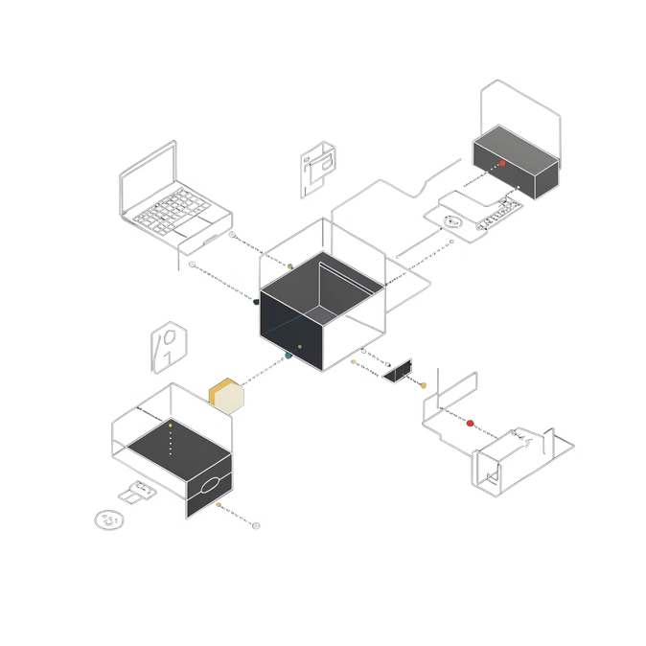
LESSON #7
Over-Privileged Functions: Excessive IAM Permissions
Issue
Impact
Lambda functions have more permissions than needed
Attacker gains access to additional AWS resources
Root Cause
Fix
Violates the principle of least privilege
Restrict IAM roles to only the minimum required permissions
Key Lesson: Least privilege is critical in cloud environments
Notes:
8

Slide 9
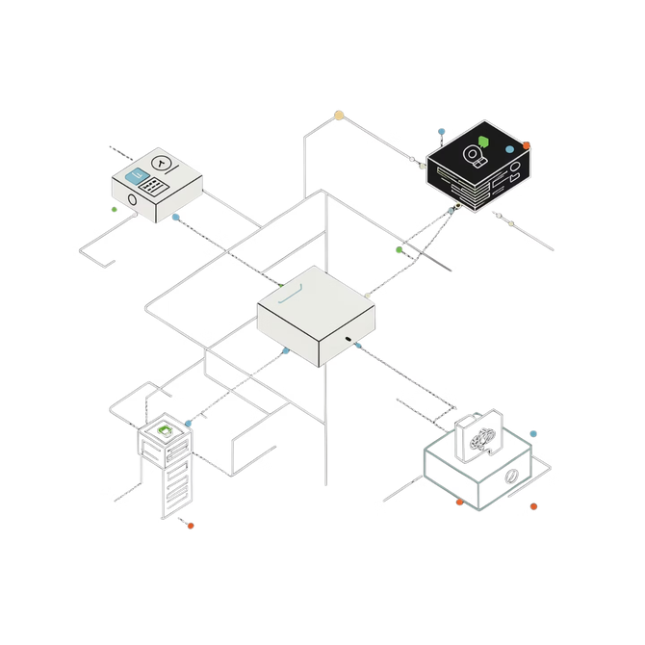
LESSON #8
Logic Vulnerabilities: Race Condition
Issue
Impact
Order updated before payment completes
Fraudulent transactions processed without valid payment
Root Cause
Fix
Poor workflow sequencing in the order process
Enforce strict process flow; use locking and validation
Key Lesson: Business logic flaws can bypass traditional security controls
Notes:
9

Slide 10

LESSON #9
Vulnerable Dependencies
Issue
Impact
Use of vulnerable packages (e.g., node-serialize)
Hidden attack entry points
Root Cause
Fix
Outdated / unsafe dependencies
Update and audit dependencies
Key Lesson: Supply chain security matters
Notes:
10

Slide 11
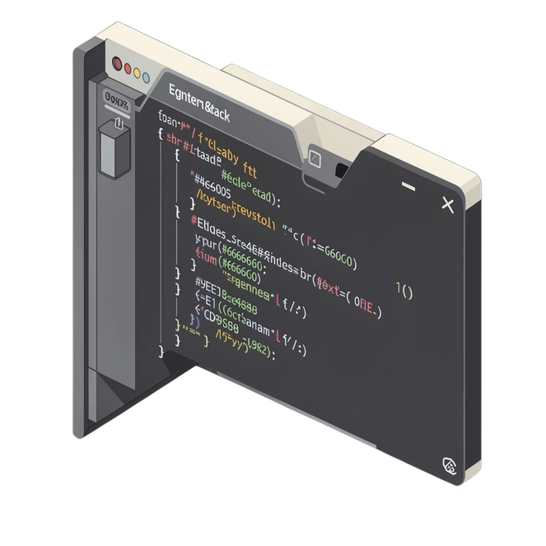
LESSON #10
Unhandled Exceptions
Issue
Impact
Errors expose internal details
Leak stack traces, system info
Root Cause
Fix
Poor error handling
Generic error responses & proper exception handling
Key Lesson: Errors should not reveal system internals
Notes:
11

Slide 12
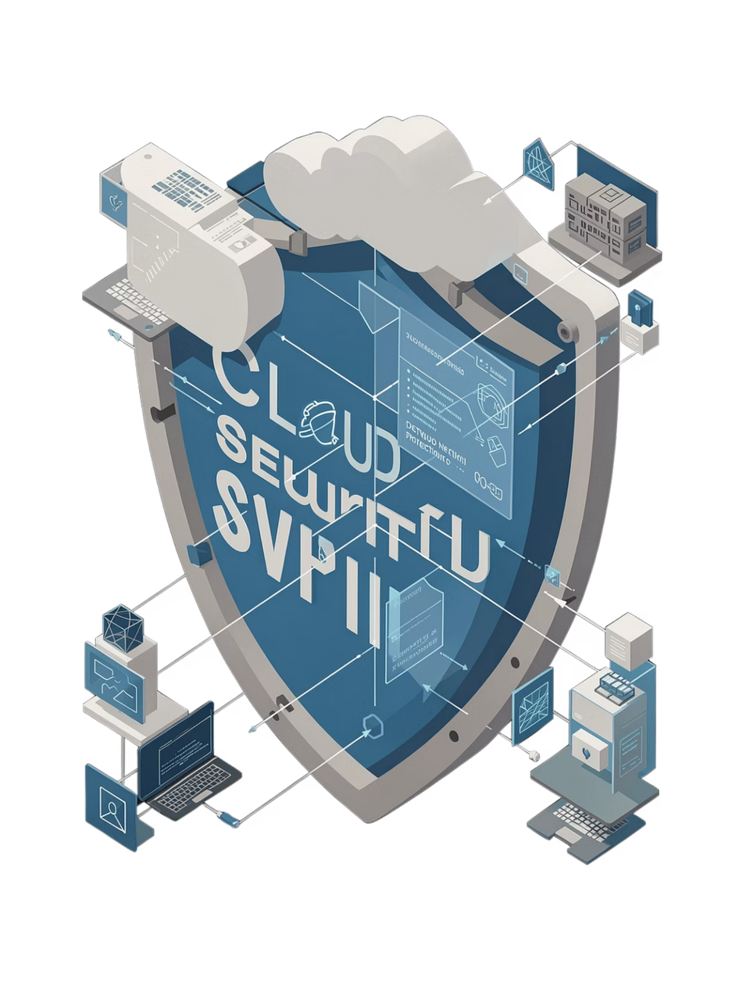
Key Takeaways
Serverless apps have distributed attack surfaces
Common Risks
Security Principles Applied
Input handling
Authentication
IAM permissions
Misconfigurations
Input validation
Least privilege
Defense in depth
Important Insight
Small bugs → major cloud impact
Notes:
12

Slide 13
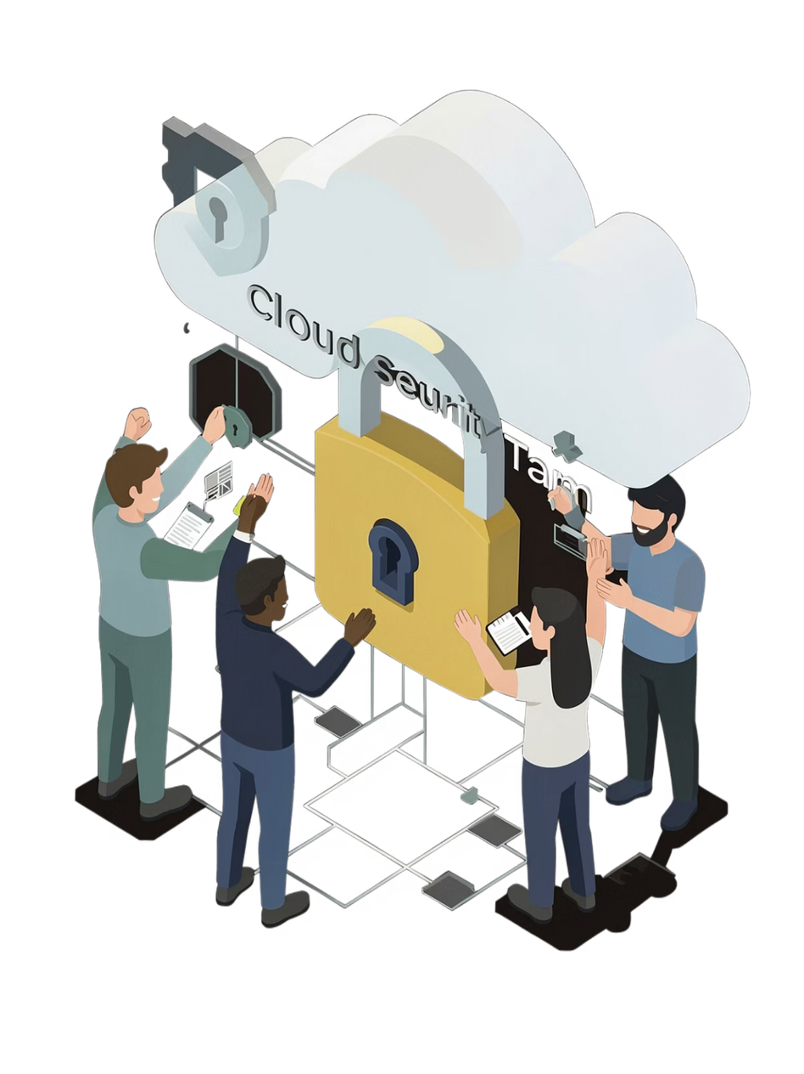
Conclusion
Successfully Identified & Exploited Vulnerabilities
Implemented Fixes
Verified Remediation
Learned:
Real-world cloud security risks
Offensive + defensive techniques
Final Thought: Secure design is essential in modern cloud systems
Notes:
13

