Slide 1
Creature DIVERSITY in TV
Creature DIVERSITY in MOVIES
Diversity Level 1
Diversity Level 2
Diversity Level 3
Diversity Level 1
Diversity Level 2
Diversity Level 3
Notes:
The Influence of Creatural Diversity on Supernatural Success
Shows Collected:
Angel Being Human UK Bitten Buffy the Vampire Slayer Charmed Dark Shadows Dead Like Me Dr Who Ghost Whisperer Grimm Hemlock Grove Hercules Humans iZombie Lost Girl Medium Merlin Moonlight Once Upon a Time Penny Dreadful Roswell Salem Sanctuary Shadowhunters Star Trek Voyager Supernatural Teen Wolf The Originals The Secret Circle The Vampire Diaries The Walking Dead Torchwood True Blood V Witches of East End Xena
Movies Collected:
Beetlejuice Ella Enchanted Enchanted ET Fright Night Ghost Halloweentown Harry Potter and the Sorcerer's Stone Hocus Pocus Interview with the Vampire Pirates of the Carribbean The Curse of the Black Pearl The Chronicles of Narnia The Lion the Witch and the Wardrobe The Hobbit An Unexpected Journey The Lost Boys Twilight
Conclusion:

Slide 2
Notes:
Ranking Page
has_undead has_others has_witch has_hybrid has_animalistic has_ghost has_werewolf has_god has_immortal has_vampire has_demon has_dragon has_alien has_shapeshifter has_fairy has_artificial has_enhance

Slide 3

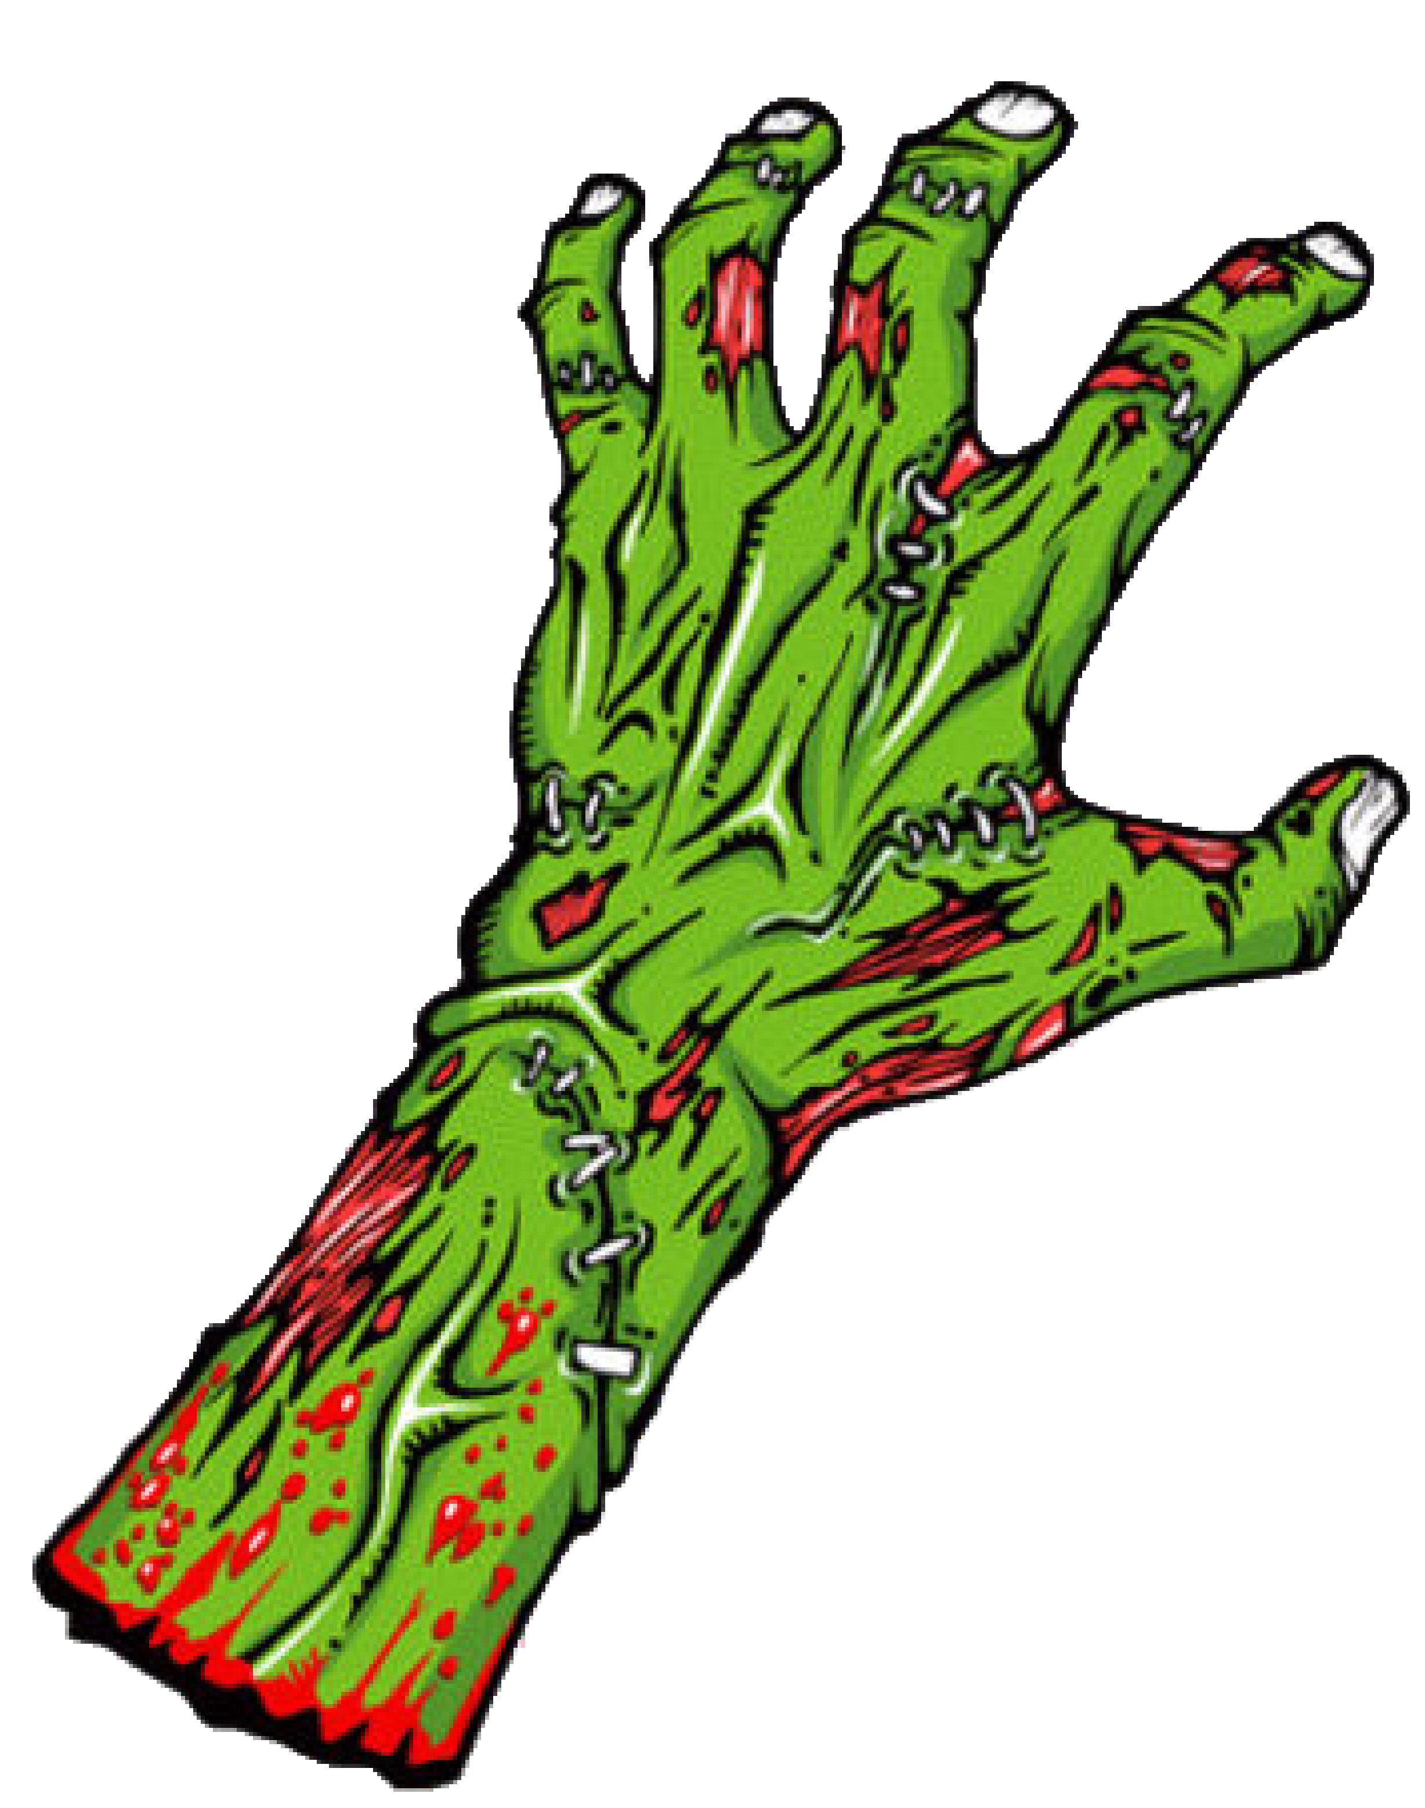

Undead creatures in TV
Undead creatures in Movies
Shows without the undead
Movies without the undead
Shows with the undead
Movies with the undead
Notes:
The Influence of the Undead on Supernatural Success
Shows Collected:
Angel
Buffy the Vampire Slayer
Dark Shadows
iZombie
Once Upon a Time
Penny Dreadful
Supernatural
The Walking Dead
Witches of East End
Movies Collected:
Beetlejuice
Hocus Pocus
Pirates of the Carribbean The Curse of the Black Pearl
Conclusion:
Both shows and movies with undead creatures were shown to have higher ratings than those without

Slide 4
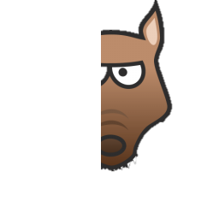
Werewolves in TV
Werewolves in Movies
Movies with werewolves
Shows with werewolves
Movies without werewolves
Shows without werewolves
Notes:
The Influence of Werewolves on Supernatural Success
Shows Collected:
Being Human UK
Bitten
Buffy the Vampire Slayer
Dark Shadows
Hemlock Grove
Once Upon a Time
Penny Dreadful
Sanctuary
Shadowhunters
Supernatural
Teen Wolf
The Originals
The Vampire Diaries
True Blood
Movies Collected:
Twilight
Conclusion:
Shows with werewolves were shown to have higher ratings than those without. Werewolves do not appear to have a significant effect on the success of movies.

Slide 5
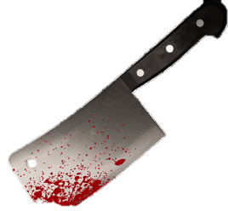

Immortals in TV
Immortals in Movies
None of the movies collected had any explicitly defined immortals
Shows with immortals
Shows without immortals
Notes:
The Influence of Immortals on Supernatural Success
Shows Collected:
Angel
Buffy the Vampire Slayer
Charmed
Dark Shadows
Dr Who
Hemlock Grove
Merlin
Supernatural
The Originals
The Vampire Diaries
Torchwood
Witches of East End
Movies Collected:
Conclusion:
Shows with immortals were shown to have higher ratings than those without

Slide 6

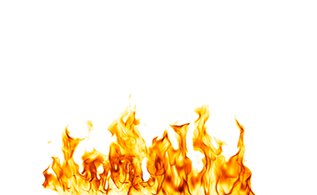
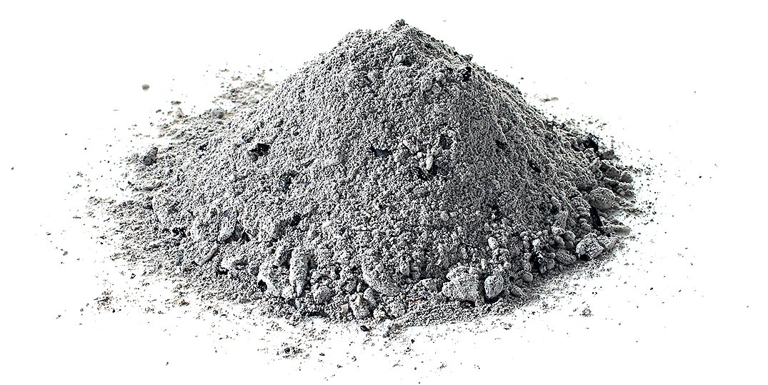
Animalistic Beings in TV
Animalistic beings in Movies
Shows with animalistic beings
Shows without animalistic beings
Movies with animalistic beings
Movies without animalistic beings
Notes:
The Influence of Animalistic Beings on Supernatural Success
Shows Collected:
Buffy the Vampire Slayer
Charmed
Lost Girl
Merlin
Once Upon a Time
Salem
Sanctuary
Supernatural
Movies Collected:
Narnia
Enchanted
Ella Enchanted
Harry Potter and the Sorcerer's Stone
Twilight
Conclusion:
Both shows with animalistic creatures were shown to have slightly higher ratings than those without. The opposite was found in movies.

Slide 7
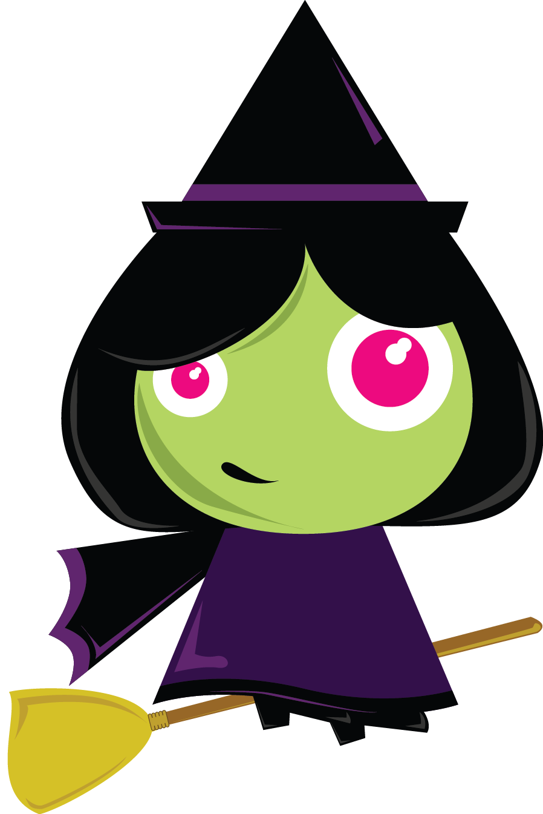
Witches/wizards/warlocks in TV
Witches/wizards/warlocks in Movies
Shows with magic users
Shows without magic users
Movies with magic users
Movies without magic users
Notes:
The Influence of Witches, Warlocks & Wizards on Supernatural Success
Shows Collected:
Angel
Buffy the Vampire Slayer
Charmed
Dark Shadows
Grimm
Hemlock Grove
Merlin
Salem
Supernatural
The Originals
The Secret Circle
The Vampire Diaries
True Blood
Witches of East End
Movies Collected:
Enchanted
Harry Potter and the Sorcerer's Stone
Hocus Pocus
The Chronicles of Narnia The Lion the Witch and the Wardrobe
The Hobbit An Unexpected Journey
Conclusion:
Both shows and movies with undead creatures were shown to have higher ratings than those without

Slide 8

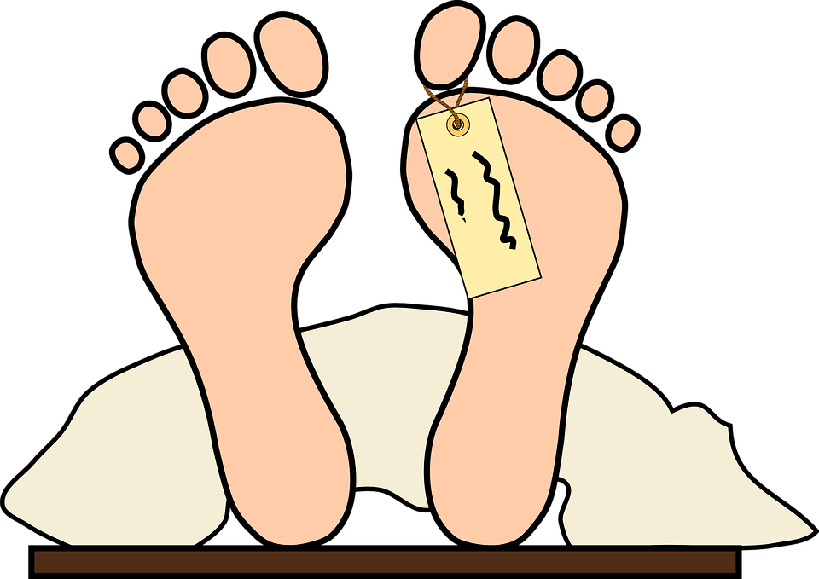
Ghosts in TV
Ghosts in Movies
Shows with ghosts
Shows without ghosts
Movies with ghosts
Movies without ghosts
Notes:
The Influence of Ghosts on Supernatural Success
Shows Collected:
Angel
Being Human UK
Buffy the Vampire Slayer
Charmed
Dark Shadows
Dead Like Me
Ghost Whisperer
Medium
Once Upon a Time
Salem
Shadowhunters
Supernatural
The Originals
The Vampire Diaries
True Blood
Movies Collected:
Beetlejuice
Ghost
Harry Potter and the Sorcerer's Stone
Conclusion:
Both shows and movies with undead creatures were shown to have higher ratings than those without

Slide 9

Vampires in TV
Vampires in Movies
Shows with vampires
Shows without vampires
Movies with vampires
Movies without vampires
Notes:
The Influence of Vampires on Supernatural Success
Shows Collected:
Being Human UK
Buffy the Vampire Slayer
Charmed
Dark Shadows
Lost Girl
Moonlight
Penny Dreadful
Sanctuary
Shadowhunters
Supernatural
The Originals
The Vampire Diaries
True Blood
Movies Collected:
Fright Night
Interview with the Vampire
The Lost Boys
Twilight Angel
Conclusion:
Shows with vampires were shown to have higher ratings than those without. The opposite was found with movies.

Slide 10


Gods & higher beings in TV
Gods & higher beings in Movies
None of the movies collected had any explicitly defined gods or higher beings
Shows with gods & higher beings
Shows without gods & higher beings
Notes:
The Influence of Gods & Higher Beings on Supernatural Success
Shows Collected:
Buffy the Vampire Slayer
Charmed
Hercules
Penny Dreadful
Once Upon a Time
Salem
Supernatural
Xena
Movies Collected:
Conclusion:
Shows with gods and higher beings were shown to have only slightly higher ratings than those without

Slide 11


Dragons in TV
Dragons in Movies
Shows with dragons
Movies with dragons
Shows without dragons
Movies without dragons
Notes:
The Influence of Dragons on Supernatural Success
Shows Collected:
Lost Girl
Merlin
Once Upon a Time
Movies Collected:
Enchanted
Conclusion:
The inclusion of dragons appear to have no affect on the success of shows. Movies without dragons however faired better than those with.

Slide 12
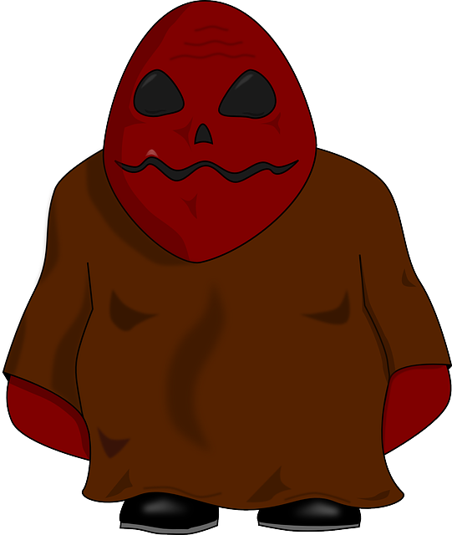
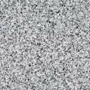
Demons in TV
Demons in Movies
Shows with demons
Shows without demons
Movies with demons
Movies without demons
Notes:
The Influence of Demons on Supernatural Success
Shows Collected:
Angel
Buffy the Vampire Slayer
Charmed
Penny Dreadful
Salem
Shadowhunters
Supernatural
Xena
Movies Collected:
Beetlejuice
Conclusion:
The inclusion of demons appear to have no affect on the success of shows. Movies without demons however faired better than those with.

Slide 13


Fairies in TV
Fairies in Movies
Shows with fairies
Movies with fairies
Shows without fairies
Movies without fairies
Notes:
The Influence of Fairies on Supernatural Success
Shows Collected:
Charmed
Lost Girl
Merlin
Once Upon a Time
Sanctuary
Shadowhunters
True Blood
Movies Collected:
Ella Enchanted
Conclusion:
The inclusion of fairies appear to have no affect on the success of shows. Movies without dragons however faired far better than those with.

Slide 14


Shapeshifters in TV
Shapeshifters in Movies
None of the movies collected had any explicitly defined shapeshifters
Shows with shapeshifters
Shows without shapeshifters
Notes:
The Influence of Shapeshifters on Supernatural Success
Shows Collected:
Charmed
Lost Girl
True Blood
Witches of East End
Movies Collected:
Conclusion:
Shows without shapeshifters appear to fair better than those with.

Slide 15
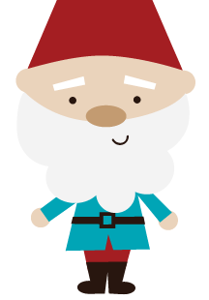
Other mystical beings in TV
Other mystical beings in Movies
Shows with other mysticals
Shows without other mysticals
Movies with other mysticals
Movies without other mysticals
Notes:
The Influence of Other Mystical Beings on Supernatural Success
Shows Collected:
Charmed
Once Upon a Time
Lost Girl
Xena
Movies Collected:
Ella Enchanted
The Hobbit An Unexpected Journey
The Chronicles of Narnia The Lion the Witch and the Wardrobe
Harry Potter and the Sorcerer's Stone
Conclusion:
Shows without mystical beings are rated on average slightly higher than those with. Movies with other mystical beings however were more successful than those without.

Slide 16

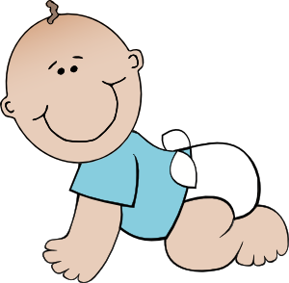
Hybrids in TV
Hybrids In Movies
Shows with hybrids
Shows without hybrids
Movies with hybrids
Movies without hybrids
Notes:
The Influence of Hybrids on Supernatural Success
Shows Collected:
Dark Shadows
Grimm Hemlock
Grove Hercules
Lost Girl
Once Upon a Time
Sanctuary
Shadowhunters
Teen Wolf
The Originals
The Vampire Diaries
Xena
Movies Collected:
Harry Potter and the Sorcerer's Stone
Pirates of the Carribbean The Curse of the Black Pearl
Conclusion:
Shows without hybrids are on average rated higher than those with. Movies with hybrids are rated significantly higher than those without.

Slide 17


Artificial beings in TV
Artificial beings in Movies
None of the movies collected had any explicitly defined artificial beings
Shows with artificial beings
Shows without artificial beings
Notes:
The Influence of Artificial Beings on Supernatural Success
Shows Collected:
Buffy the Vampire Slayer
Humans
Movies Collected:
Conclusion:
Shows without artificial beings are rated on average higher than those with.

Slide 18
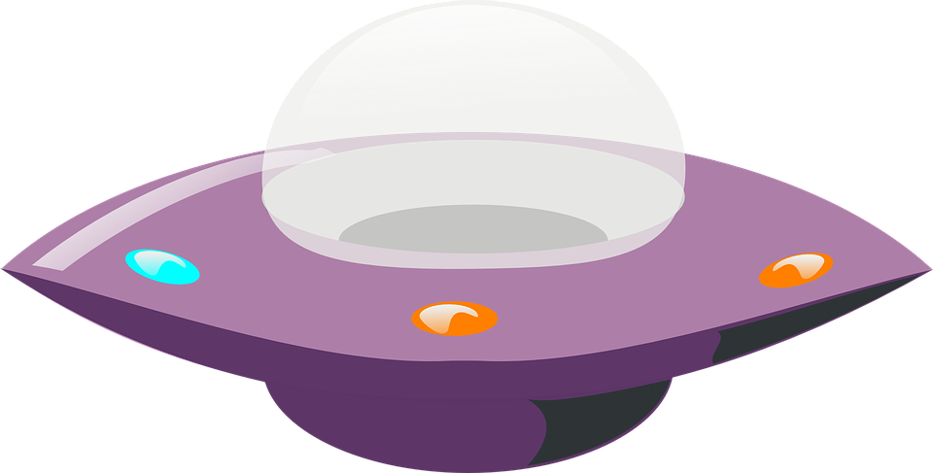
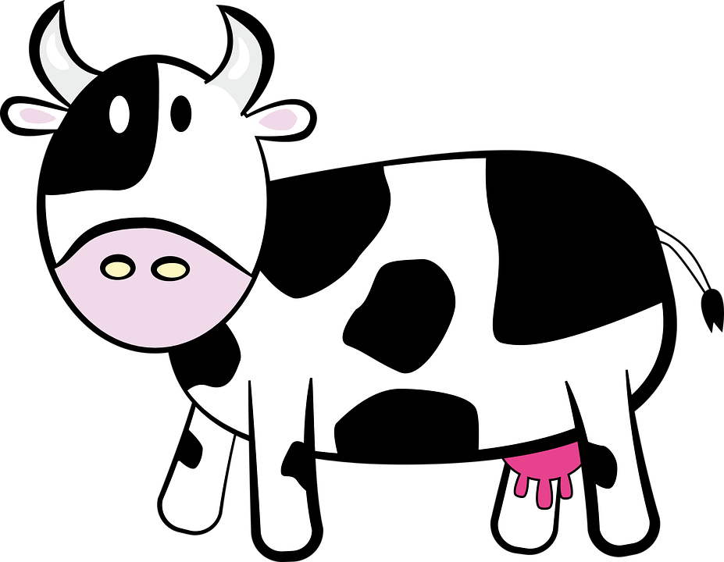
Movies with aliens
Movies without aliens
Shows with aliens
Shows without aliens
Movies without aliens
Shows with aliens
Shows without aliens
Movies with aliens
Aliens in TV
Aliens in Movies
Notes:
The Influence of Aliens on Supernatural Success
Shows Collected:
Dr Who
Roswell
Star Trek Voyager
Torchwood
V
Movies Collected:
ET
Conclusion:
Shows without aliens are rated higher than those with. The opposite is true of movies.

Slide 19


Enhanced humans in TV
Enhanced humans in Movies
None of the movies collected had any explicitly defined enhanced humans
Shows without enhanced humans
Shows with enhanced humans
Notes:
The Influence of Enhanced Humans on Supernatural Success
Shows Collected:
Angel
Buffy the Vampire Slayer
Charmed
Dead Like Me
Hemlock Grove
Movies Collected:
Conclusion:
Shows without enhanced humans are rated on average higher than those with.

