Slide 1
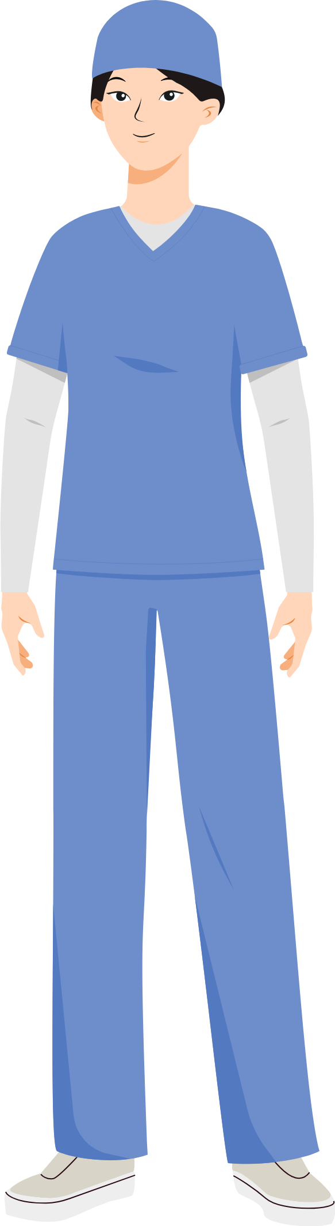
Power Walk Activity
You Character
Midwife at PHC
Welcome to the Power Walk! You'll be stepping into the shoes of different people from diverse backgrounds.
Each step you take represents a shift in power.
As you answer questions about their lives, your character will move forward or backward.
This game is a journey to understand the uneven distribution of power in our world.
Remember, there are no right or wrong answers, just different perspectives.
Let's explore together how privilege and disadvantage shape our lives.
Start Game

Slide 2



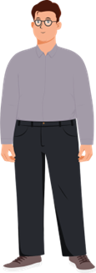

Question: 1
If you have attended secondary school, move one step forward
Correct Answer
Incorrect Answer
UP
DOWN
Next Question
Try again

Slide 3

Question: 2
If you cannot do all your daily tasks alone, move one step backward
Correct Answer
Incorrect Answer
UP
DOWN
Next Question
Try again

Slide 4
Question: 3
If you cannot travel, move one step backward
Correct Answer
Incorrect Answer
UP
DOWN
Next Question
Try again

Slide 5
Question: 4
If you cannot move around the streets of Lebanon easily, move one step backward
Correct Answer
Incorrect Answer
UP
DOWN
Next Question
Try again

Slide 6
Question: 5
If you can choose when to have a child, move one step forward
Correct Answer
Incorrect Answer
UP
DOWN
Next Question
Try again

Slide 7
Question: 6
If you can easily go to a doctor when you are sick, move one step forward
Correct Answer
Incorrect Answer
UP
DOWN
Next Question
Try again

Slide 8

Question: 7
If you can make a crowd of people follow your lead, move one step forward
Correct Answer
Incorrect Answer
UP
DOWN
Next Question
Try again

Slide 9

Question: 8
If you can make a crowd of people follow your lead, move one step forward
Correct Answer
Incorrect Answer
UP
DOWN
Next Question
Try again

Slide 10
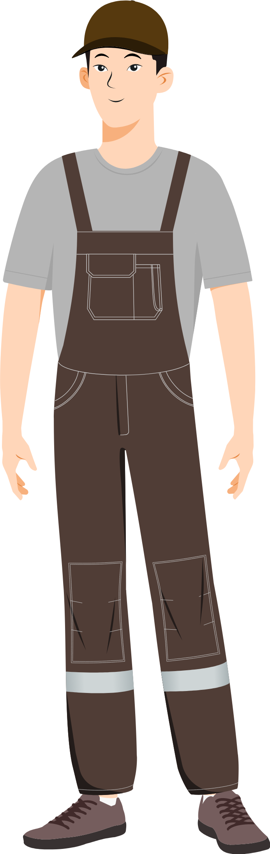
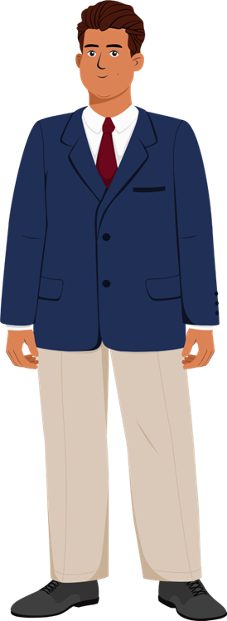
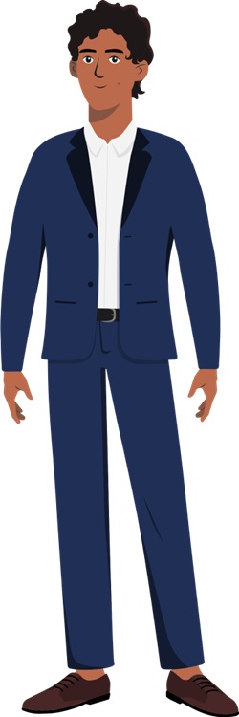
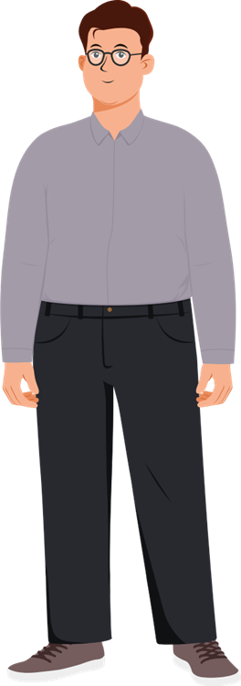
Result
Migrant worker without legal documentation
Religious leader
A middle-class man with visual impairment
Midwife
at PHC
Male field worker at local organization
Continue

Slide 11
Is power positive or negative?
Continue

Slide 12

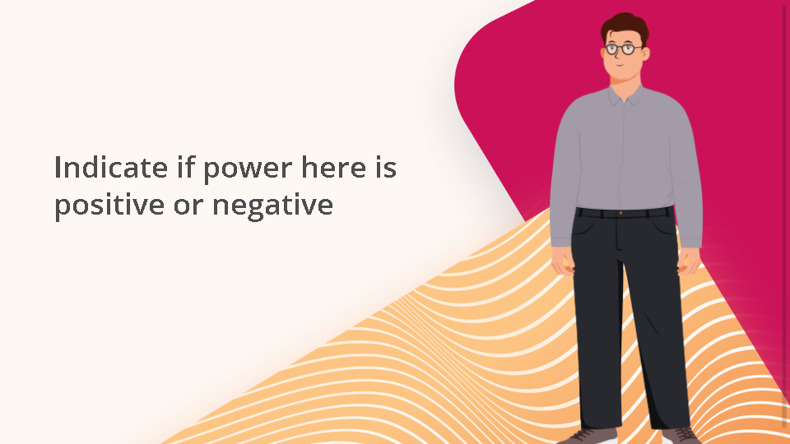
Quiz
Click the Quiz button to edit this object

Slide 13


Next Lessons

