Slide 1

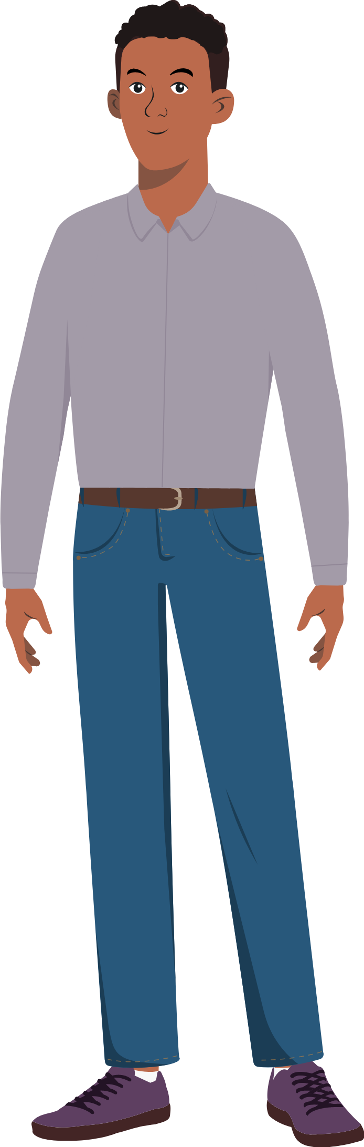
Hi! I’m Antoine. I’m here to help you get started.
Welcome to Safeguarding Course!

Slide 2
Objectives
In this course you will learn:
What is safeguarding and why does it exist?
What are the major concepts that you need to know about safeguarding?
What is the impact of misconducts?
How to receive and report misconduct?

Slide 3
Does it really exist?
You will now watch a video. Be ready to listen and apply the instructions that will be given to you.

Slide 4

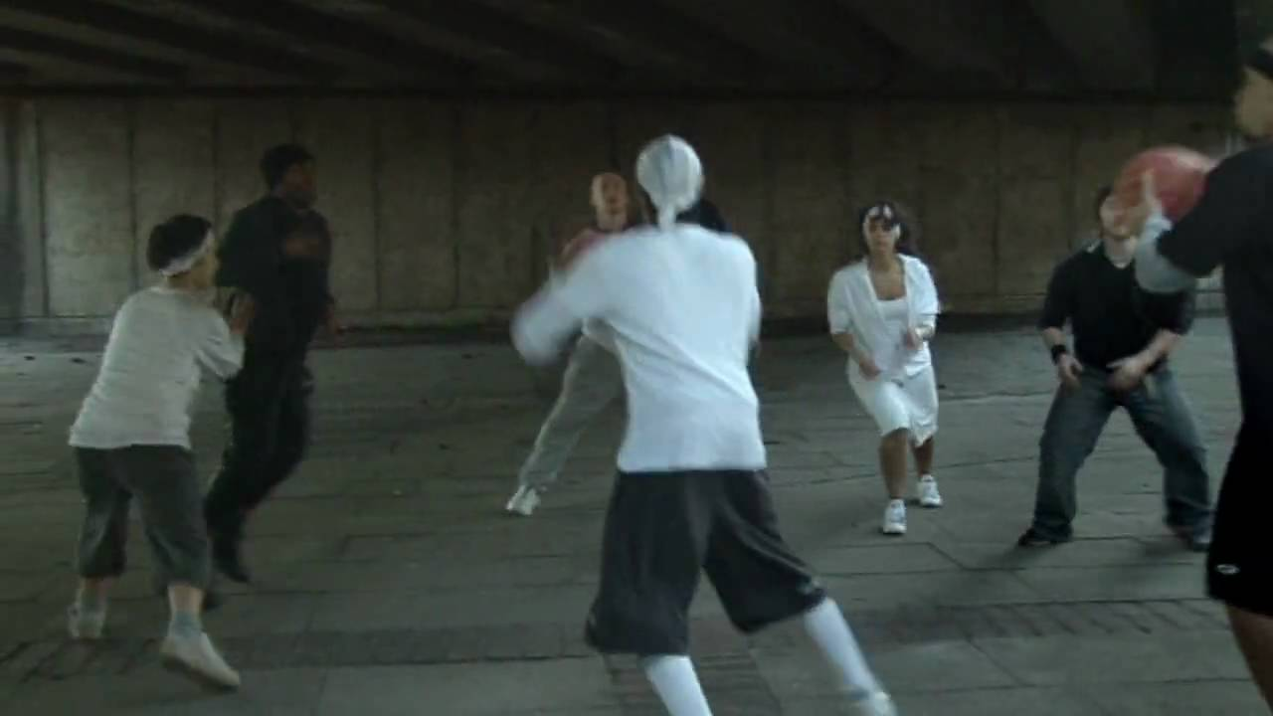

Slide 5
It is important to recognize that abuse can occur around us, often without our awareness, as we rarely anticipate it within the humanitarian field. Organizations are meant to serve as safe spaces for beneficiaries, project participants, and staff, in alignment with their mission to help, support, and protect these individuals.
It is important to recognize that abuse can occur around us, often without our awareness, as we rarely anticipate it within the humanitarian field. Organizations are meant to serve as safe spaces for beneficiaries, project participants, and staff, in alignment with their mission to help, support, and protect these individuals.

Slide 6
However, there may occasionally be individuals within an organization who exhibit abusive behaviors. This is why it is crucial for each of us to remain attentive and aware of potential harm within the organization, in order to intervene and prevent it. The presence of such behavior can have serious negative consequences. This highlights the vital importance of safeguarding policies.
It is important to recognize that abuse can occur around us, often without our awareness, as we rarely anticipate it within the humanitarian field. Organizations are meant to serve as safe spaces for beneficiaries, project participants, and staff, in alignment with their mission to help, support, and protect these individuals.

Slide 7
Next Lesson

