Slide 1


Numbers
Prevalence of misconducts in the humanitarian field

Slide 2

Go to link:
https://www.un.org/preventing-sexual-exploitation-and-abuse/content/data-allegations-un-system-wide
And find the following numbers:
Start Game

Slide 3

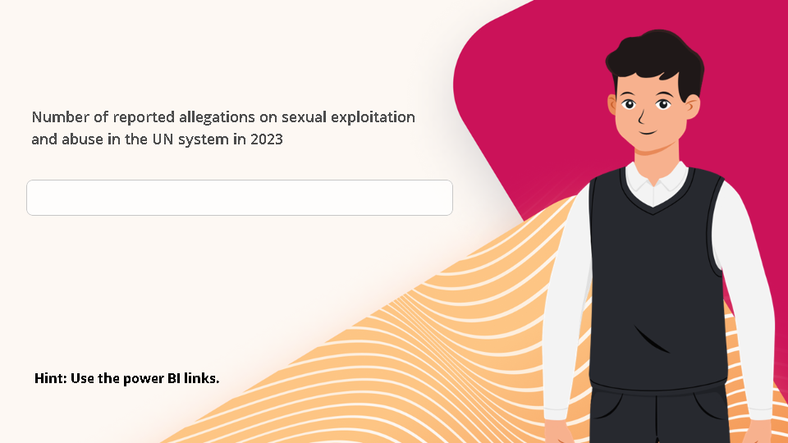
Quiz
Click the Quiz button to edit this object

Slide 4
Final Result
Number of reported allegations on sexual exploitation and abuse in the UN system in 2023 (298)
Number of reported allegations on sexual exploitation and abuse in partner organizations in 2023 (382)

Slide 5
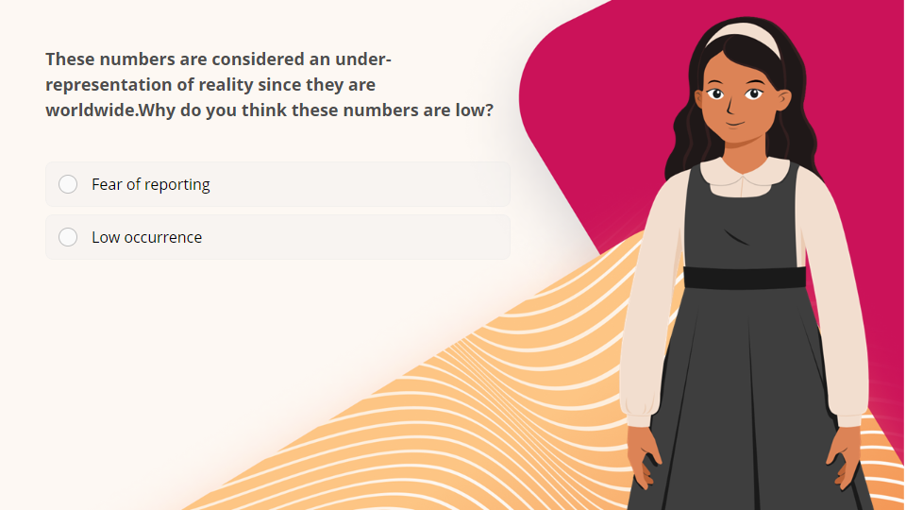
Quiz
Click the Quiz button to edit this object

Slide 6

Next Lesson

