Slide 1


Definitions
Safeguarding from types of abuse for children and adults

Slide 2

When we say sexual misconduct, it can have many forms, these include:
Verbal (with words)
Non-Verbal (with looks)
Physical (with touches)
Cyber (online)
All of these are unacceptable.

Slide 3
Now talking about the types of sexual misconducts, we will talk about 4 main ones:
Sexual Exploitation
Sexual Abuse
Sexual Harassment
Sexual Gender Based Violence

Slide 4
How do you know which is which?
Although all of these terms have been used
interchangeably sometimes, the latest policies at the humanitarian level have made the distinction between them very clear.

Slide 5
How do you know which is which?
Sexual Exploitation and Sexual Abuse (SEA) happen from aid worker to beneficiary. The only difference Between SE and SA, is that SE includes something in return to the beneficiary.

Slide 6
How ?
Sexual exploitation: Any actual or attempted
abuse of a position of vulnerability, differential
power, or trust, for sexual purposes, including,
but not limited to, profiting monetarily, socially
or politically from the sexual exploitation of another.

Slide 7
How ?
Sexual Abuse: Any actual or threatened physical intrusion of a sexual nature, whether by force or under unequal or coercive conditions.

Slide 8
How ?
So, in both SE and SA, sexual misconduct can be verbal, non-verbal, physical, or cyber. Both can be a look, a text message, a touch, a kiss, or a sexual intercourse.

Slide 9
Ready to do that through examples?
Mix & Match
Start Game

Slide 10

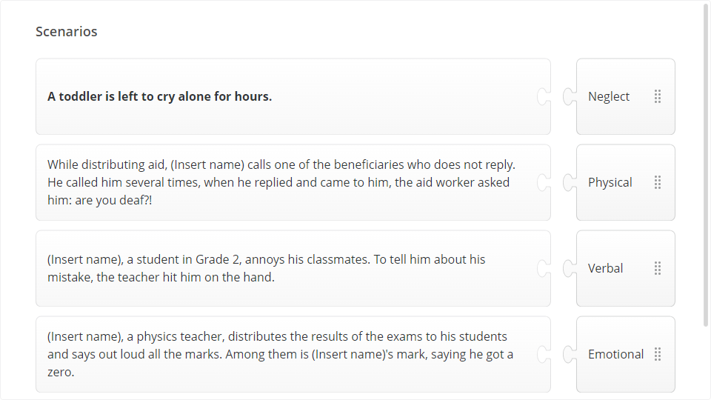
Quiz
Click the Quiz button to edit this object

Slide 11
Sexual Harassment happens from aid worker to aid worker. Any sexual misconduct happening between
two members from the organization, is called sexual
harassment. It can take the form of a look, a text message, a touch, a kiss, or sexual intercourse.

Slide 12
Sexual Gender Based Violence happens from member of the community to member of the community (beneficiaries). Also here it can take the form of a look, a text message, a touch, a kiss, or a sexual intercourse.

Slide 13
So to decide what type of sexual misconduct it is, we do not focus on the action but rather on who the perpetrator and victim are.

Slide 14
Who are the two parties?
If the perpetrator is an aid worker and the victim is a
beneficiary. This is either SE or SA. To decide, you ask
yourself another question: is there anything in return? If yes, it’s SE, if not it’s SA.

Slide 15
Who are the two parties?
If the perpetrator is an aid worker and the victim is an aid worker. This is sexual harassment (SH). Although it might sound that there is exploitation of power here, it is

Slide 16
Who are the two parties?
true, we still call it SH to distinguish the various types. If the perpetrator is a beneficiary and
the victim is a beneficiary. This is SGBV. This will not be our area of intervention in this course but we put it here for you to know all the differences.

Slide 17
Who are the two parties?
If the perpetrator is an aid worker and the victim is a beneficiary. This is either SE or SA. To decide, you ask yourself another question: is there anything in return? If yes, it’s SE, if not it’s SA.

Slide 18
Who are the two parties?
If the perpetrator is an aid worker and the victim is an aid worker. This is sexual harassment (SH). Although it might sound that there is exploitation of power here, it is

Slide 19
Who are the two parties?
true, we still call it SH to distinguish the various types. If the perpetrator is a beneficiary and the victim is a beneficiary. This is SGBV. This will not be our area of intervention in this course but we put it here for you to know all the differences.

Slide 20
Next Lesson

