Slide 1


Key Guiding Principles
What are the Key Guiding Principles?

Slide 2

There are key guiding principles that we all need to follow. Read them well before we continue our activities.
Discuss the main guiding principles

Slide 3
1. Survivor-Centered Approach
The rights, needs, and wishes of the survivor are prioritized. The survivor has the right to be treated with dignity and respect, choose the process in dealing with any action related to them.

Slide 4
2. Safety and Wellbeing
It is essential to conduct a risk assessment for each survivor, and to develop a safety/protection plan if necessary, based on individualized needs to prevent any additional harm.

Slide 5
3. Confidentiality
All information will be kept confidential, identities will be protected, and the personal information of survivors shall be collected and shared only with the informed consent of the person concerned. Disclosure of information will be on a strict need-to-know basis.

Slide 6
4. Mandatory Reporting
If the misconduct is done by an aid worker, it should be reported even if the survivor does not want that. However, to reconcile the potential conflict with the survivor centered approach and confidentiality, you are due to report without sharing the identity of the individual.

Slide 7
5. Accessibility
Multiple channels should be made for complainants/survivors and other persons to raise allegations and concerns regarding potential harm. These channels must be accessible by all people.

Slide 8
6. Transparency
Members of the affected community will be educated on how to raise complaints and report allegations, may offer input to improve how such complaints and allegations may be raised and handled, and will be kept informed and receive feedback on the outcome of a complaint or allegation raised, once available.

Slide 9
7. Accountability
Complainants/survivors will be kept informed about next steps related to their case, including investigation and referral to services.

Slide 10
8. Do No Harm
Ensuring that all actions and interventions designed to support the survivor do not expose them to further harm.

Slide 11
9. Non-discrimination
All actors are bound to treat all complaints without discrimination, based on age, economic or social situation, race, status, disability, nationality, belief or political opinion, gender, sexual orientation or reputation. Special support should be provided if needed.

Slide 12
10. Best Interest of the Child
The child has the right to be protected from all forms of violence, abuse, neglect and exploitation.

Slide 13
Can you guess which key guiding principle is responsible for this example?
Start Game

Slide 14

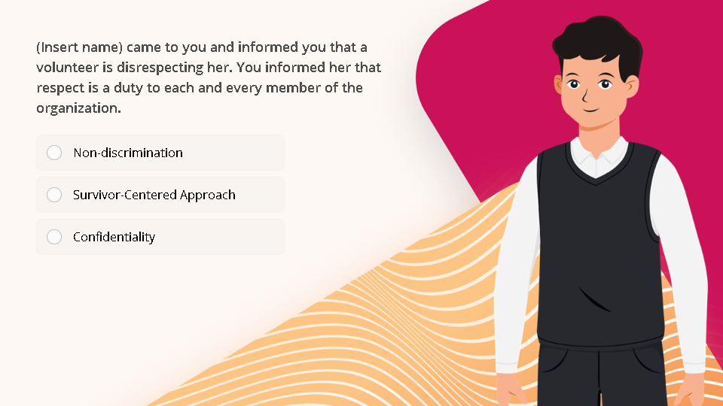
Quiz
Click the Quiz button to edit this object

Slide 15
Next Lesson

