Slide 1

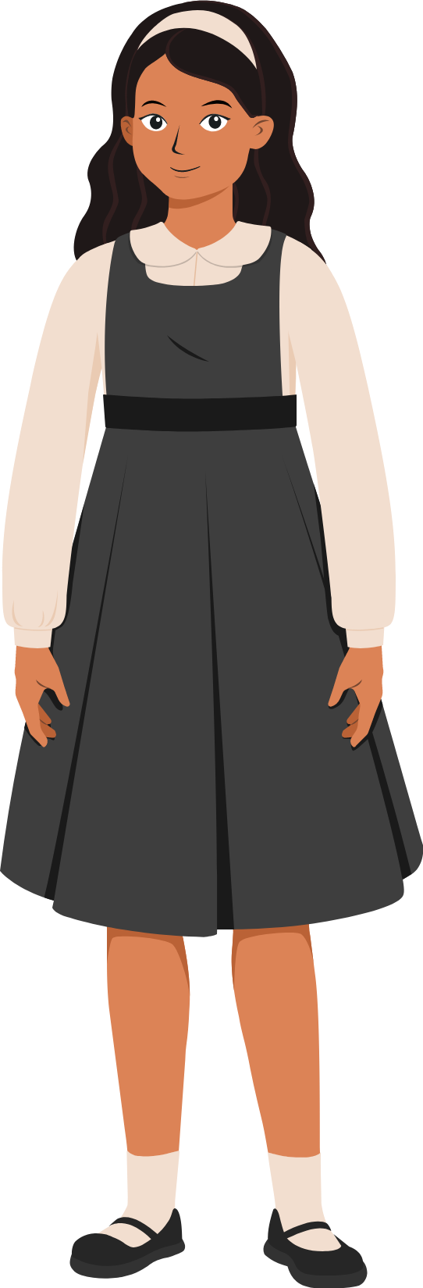
Definitions
Safeguarding from types of abuse for children and adults

Slide 2

What is Safeguarding?
Safeguarding is preventing harm to people – and the environment – in the delivery of humanitarian assistance of any form.
Now, let’s learn together the different types of harm and ways to protect the community from these.

Slide 3
Ready to do that through examples?
Mix & Match
Start Game

Slide 4

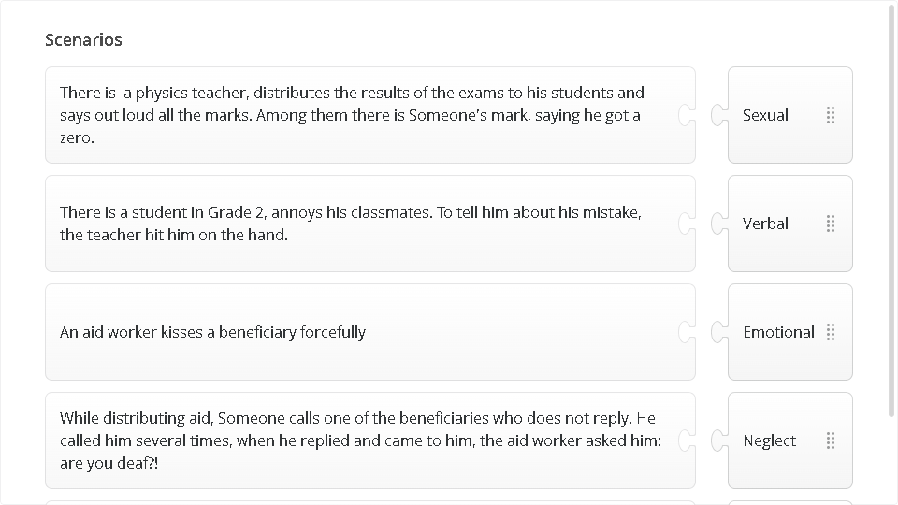
Quiz
Click the Quiz button to edit this object

Slide 5

Next Lesson

