Slide 1


Informed Consent
What is informed consent?

Slide 2

The informed consent is the voluntary agreement of an individual that is aged 18 years and older based upon a clear appreciation and understanding of the facts and implications of an action, with no threat, coercion or false promises.

Slide 3
Whereas, the informed assent is the agreement used with children. The assent alone is not enough to take actions related to children. It should be obtained with the permission of a trusted adult.

Slide 4
Age Group | Child | Caregiver | If no caregiver or not in child’s best interest
0-5 | - | Written Informed Consent | Other trusted adult’s or case worker’s informed consent
6-11 | Oral Informed Assent | Written Informed Consent | Other trusted adult’s or case worker’s informed consent
12-14 | Written Informed Assent | Written Informed Consent | Other trusted adult’s or child’s informed assent. Sufficient level of maturity (of the child) can take due weight.
15-18 | Written Informed Consent | Obtain informed consent with child’s permission | Child’s informed consent and sufficient level of maturity take due weight.

Slide 5

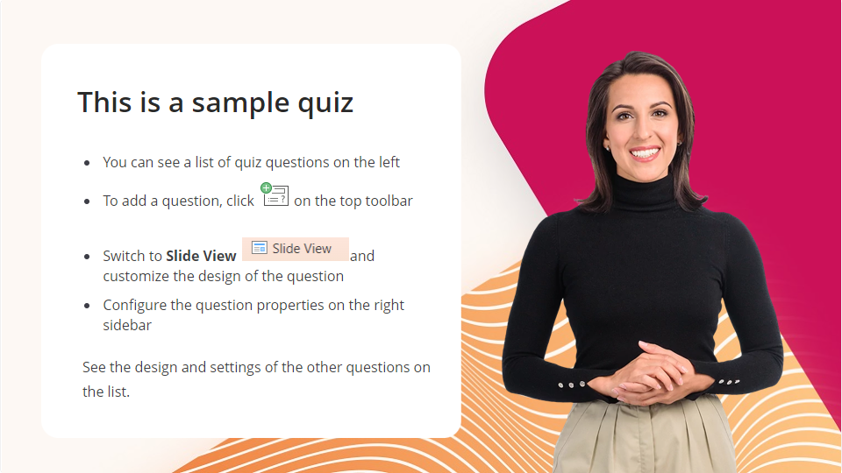
Quiz
Click the Quiz button to edit this object
Next Lesson

