Slide 1


Reporting Mechanism
How to report?

Slide 2

Reporting mechanisms at NABAD:
1- For staff:
A. Focal points:
- Mohamad Hawi reachable at @mohamad.hawi@nabadassociation.org
- Hussein Shouman reachable at @hussein.shouman@nabadassociation.org
- Naji Rifai reachable at @naji.rifai@nabadassociation.org
B. Anonymous reporting mechanism:
https://ee-eu.kobotoolbox.org/x/aidAFQvS

Slide 3
For beneficiaries:
Helpline: Takallam:
+961 79 111 538

Slide 4
Let’s not try to understand the difference between reporting and referral.
When there is a misconduct by a staff and you inform the organization, this is called reporting. If the person who survived the misconduct requires support, we refer him/her to the services. Let’s see together what that means!

Slide 5

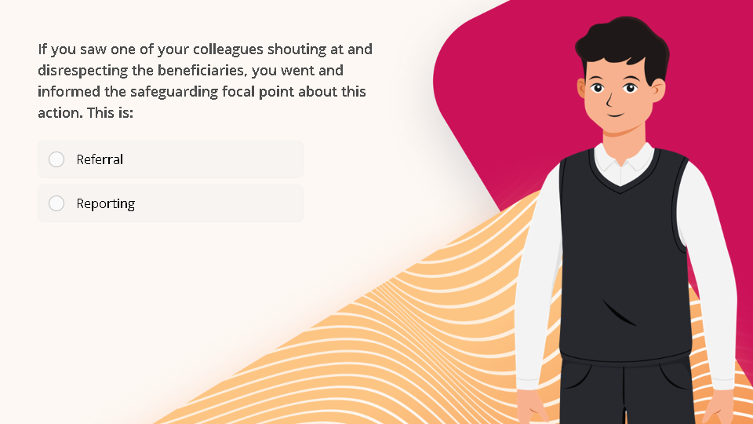
Quiz
Click the Quiz button to edit this object

Slide 6
On another side, every survivor has the right to receive services of:
Safety and protection,
Medical care,
Psychosocial support,
Education,
Legal services, and/or
Support for children born as a result of sexual exploitation and abuse.

Slide 7
These are not provided with every complaint. The provision of services is based on the needs of every person even before the outcome of the investigation.

Slide 8
Example: if a woman comes forward to inform you she was raped. You cannot wait for the outcome of the investigation before referring her to post-rape care. However, if she does not need education, you do not provide it. You only refer her to the care needed.

Slide 9
Next Lesson

